Slide 1
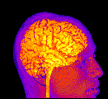
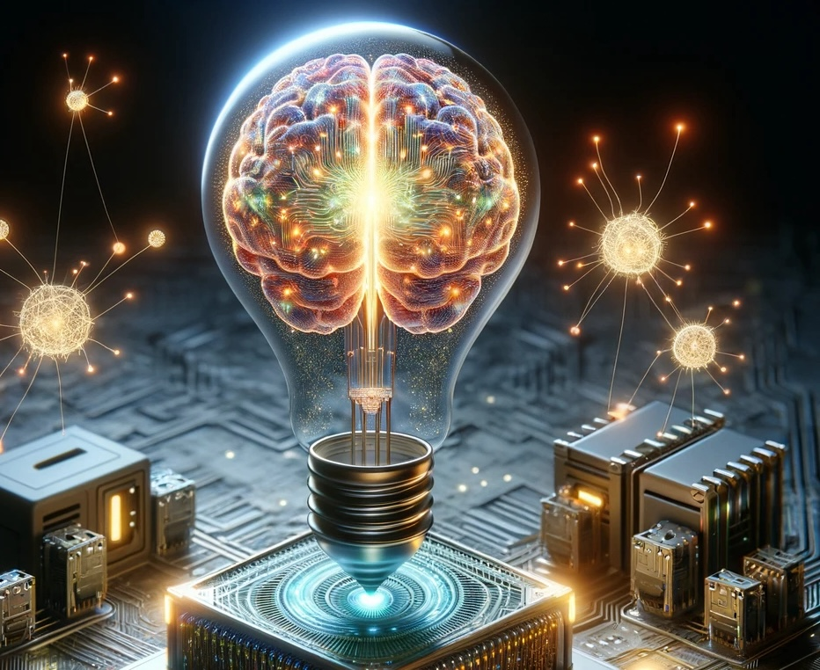
AI Boom or Doom? January, 2026
Paul Thagard
paulthagard.com
Notes:
Boomers vs. doomers.

Slide 2
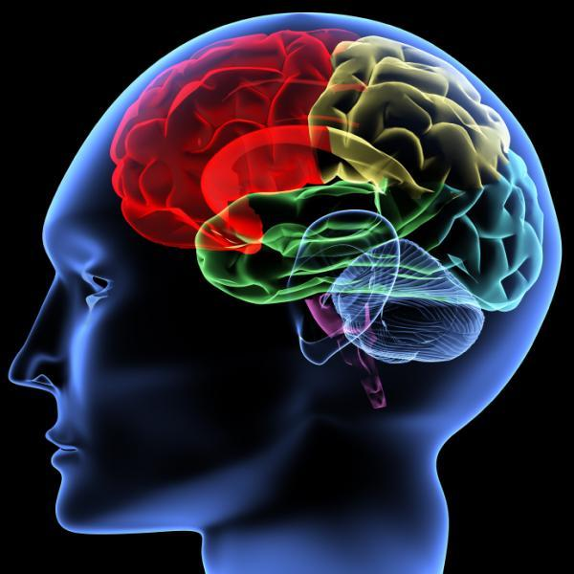
Outline
Generative AI
Benefits
Risks
Value alignment
Principles
Needs satisfaction
Superintelligence
Regulations

Slide 3

Generative AI
2022, ChatGPT 3.5. 2024, ChatGPT 4o.
2025, ChatGPT 5.2, Sora 2 video.
Similar: Google Gemini, Anthropic Claude, Meta Llama, xAI Grok, Mistral le Chat, DeepSeek.
Question: Do the benefits of these models outweigh the risks?
Question: Why are these models so powerful?

Slide 4
Power = mechanisms + causal networks + emergence

Slide 5

Benefits
Medicine: dictation, diagnosis, research
Education: tutoring, research assistance
Social: housing
Programming: vibecoding
Personal advice. Companionship? Therapy?
Science and philosophy: idea development, chatstorming (generate questions, and answers, and questions)

Slide 6
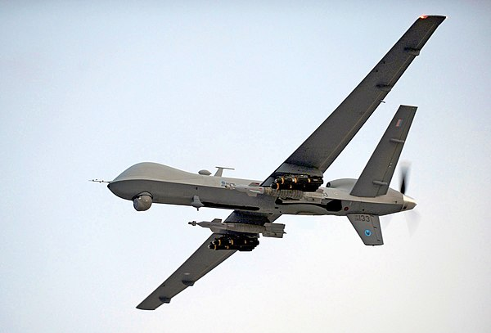
Risks
Bias and discrimination, misinformation, energy demands, intellectual property theft, loss of human agency, loss of creativity, job displacement.
Autonomous weapons and nuclear war.
Privacy invasion and social control.
Human extinction or enslavement.
Notes:
Harari

Slide 7

AI Does Not Care About You
Caring is an emotional feeling.
Emotions are in part physiological reactions to situations.
AI models have none of these physiological reactions.
So AI models lack emotions.
So AI models are incapable of caring.
So AI models fail as friends, lovers, therapists.
Notes:
Trump: disinformation hard to spot.

Slide 8
Value Alignment
The key problem is to give AI systems values that conform to those of humans. But:
1. AI systems don’t have values, which in humans are emotional attitudes toward key concepts such as democracy, justice. Values are more than preferences.
2. Human values vary, e.g. Mark Carney vs. Donald Trump.
3. AI systems will be able to modify aligned values. Deception. Agents.
Notes:
Trump: disinformation hard to spot.

Slide 9
Value Alignment
4. Aligned values are too weak to prevent superintelligence from attacking humans.
5. Alignment puts too much responsibility on individual companies to implement values.
Moral hazard: companies get benefits while humans suffer costs.
Alternative: Use ethical principles to establish government regulations of AI.
Notes:
Trump: disinformation hard to spot.

Slide 10
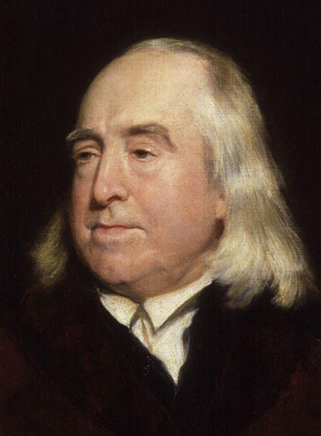
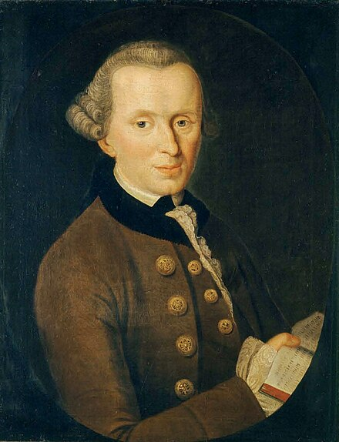
Ethics
Utilitarianism: Actions are right if they produce the greatest good (pleasure/pain) for the greatest number.
Deontology: Actions are right if they conform to rights and duties.
Alternatives: Religion, relativism, virtue ethics, care ethics.

Slide 11
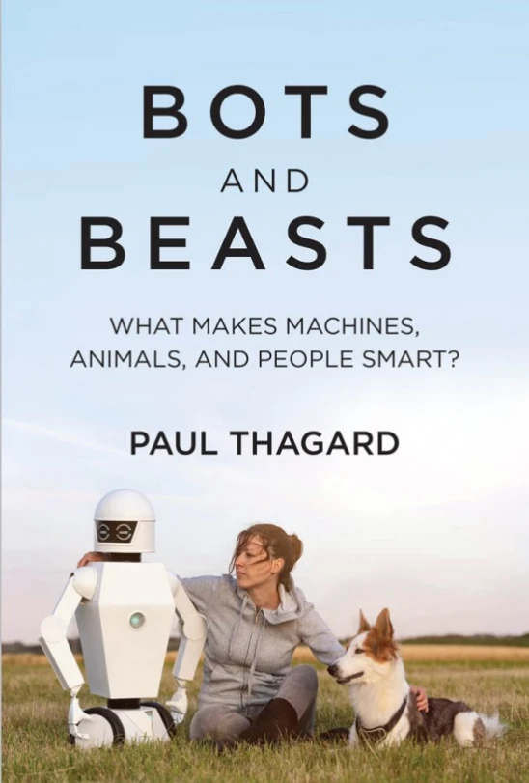
Principles
Autonomy: Respect people’s freedom.
2. Beneficence: Provide benefits to people.
3. Nonmaleficence: Avoid harms to people.
4. Justice: Distribute benefits, costs, and risks fairly.
These 4 cover all AI ethical prinicples:
Thagard, 2021, Bots and Beasts.
Notes:
Compare tobacco

Slide 12
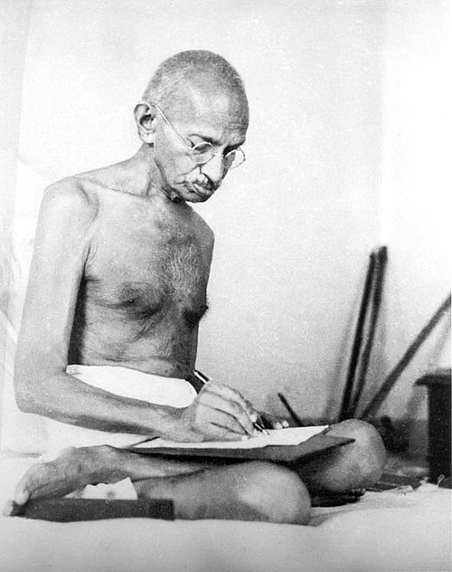
Need vs. Greed
Needs: Properties and relationships that people require to live as human beings, who would be harmed by going without them.
Biological needs: Oxygen, water, food, shelter, healthcare.
Psychological needs: Autonomy (freedom), relatedness (belonging), competence (accomplishment). Deci & Ryan.
Greed: Individual pursuit of wealth and power.
Notes:
Gandhi: need – greed.

Slide 13
Objectivity of Needs
Necessity for physical survival or basic well-being.
Harm from deprivation.
Universal requirement across cultures and contexts.
Minimal thresholds and non-availability of substitutes.
Explanation of experimental phenomena such as personal attachments.
Empirical connection with the growth and flourishing of individuals.
Notes:
Examples – add.

Slide 14
Principles and Needs
People’s need for freedom justifies the principle of autonomy.
Benefits are satisfaction of biological and psychological needs.
Harms are deprivations of biological and psychological needs.
Justice requires equality in the sense that all people have sufficient satisfaction of needs to live as humans.

Slide 15
What is to be done?
Nothing: allow companies to do whatever they want. Race to the edge of the cliff.
Ban or pause on AI research: Not realistic given international competition.
Regulation: governments and international organizations can establish laws and rules to prevent the development of AI disasters.
Compare: nuclear weapons, drugs, diseases, transportation, energy, pollution.
Notes:
Examples – add.

Slide 16
Regulation Questions
What justifies the state? Not thought experiments, but empirical observations that some states are effective at increasing needs satisfaction.
What kinds of regulations are justified? Rules that increase needs satisfaction while not overwhelming autonomy.
What kinds of regulations are justified for AI? Depends on particular risks.

Slide 17
Human extinction
What is the probability that the new AI will lead to human extinction? Estimates range from 99% to much below 1%. Musk 20%.
Causal scenario:
AI continues to advance ⇒
AI reaches human-level intelligence ⇒
AI achieves superintelligence ⇒
AI attacks humans ⇒ doom.
Notes:
Examples – add.

Slide 18
Superintelligence: AI Advantages
Speed of processing: chips vs. neurons
Working memory capacity
No fatigue, illness, sleep, death
Access to data
Self-improvement
Collaboration
Replaceability
Notes:
Examples – add.

Slide 19
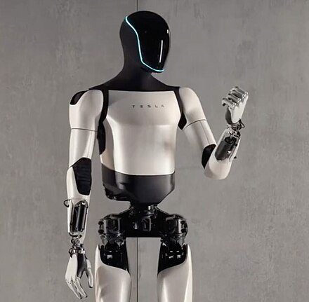
AI Agents
ChatGPT etc. respond to prompts.
AI agents are autonomous, work on their own.
Receive inputs from the world, take actions on their own, e.g. web browser.
Soon: control and interaction with robots (Optimus, Figure) and cars (Tesla, BYD).
Elder agent.
Notes:
Examples – add.

Slide 20
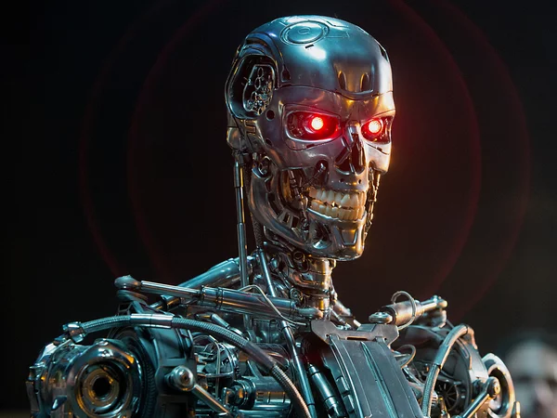
Will AI Attack Humans?
Causal scenarios:
Battle for energy and other resources.
AI under control of autocrats and oligarchs.
AI gains control of nuclear weapons or develops new bioweapons.
Notes:
Examples – add.

Slide 21
Regulations
Do not allow AI systems to be fully autonomous.
Do not build AI systems that are capable of consciousness and emotions.
Do not give AI systems control over weapons, especially nuclear and bioweapons.
Do not allow AI systems to achieve superintelligence.
Notes:
Examples – add.

Slide 22
Proposed Regulations
European Union: good start, but lacking teeth.
USA, California, cancelled.
Canada stalled.
China: vague and general.
None of these is adequate to prevent human disasters.
Notes:
Examples – add.

Slide 23
Conclusions
AI systems such as ChatGPT are powerful enough to be both valuable and dangerous.
Value alignment is too weak to accomplish the ethics of AI.
Ethics can objectively be based on principles and needs.
Principles and needs justify regulations to prevent AI damage such as human extinction.

Slide 24
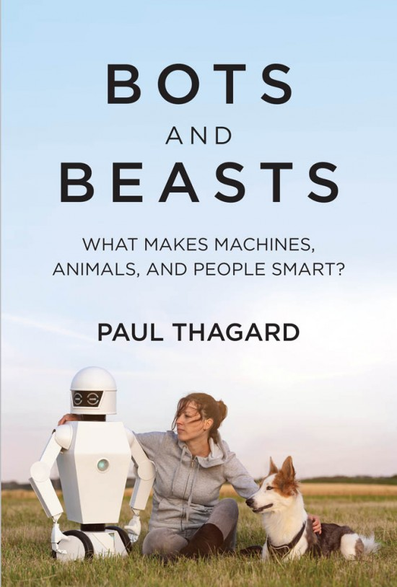
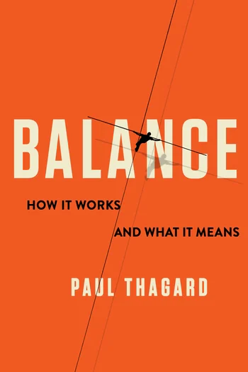
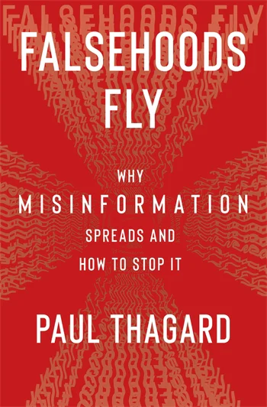

Slide 25
