Slide 1

Ethics of Artificial Intelligence
COGSCI 600
Dr. Matthew Silk (msilk@uwaterloo.ca)

Slide 2
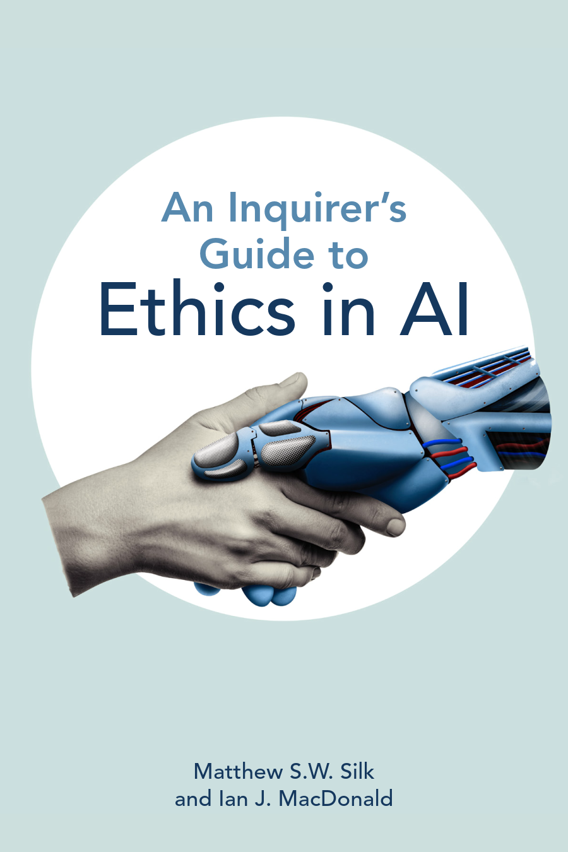
Matthew Silk
Ph.D. – Philosophy
BA – Political Science & Philosophy
Philosophy of science
Value theory
Ethics of Artificial Intelligence
Outer Space Ethics

Slide 3

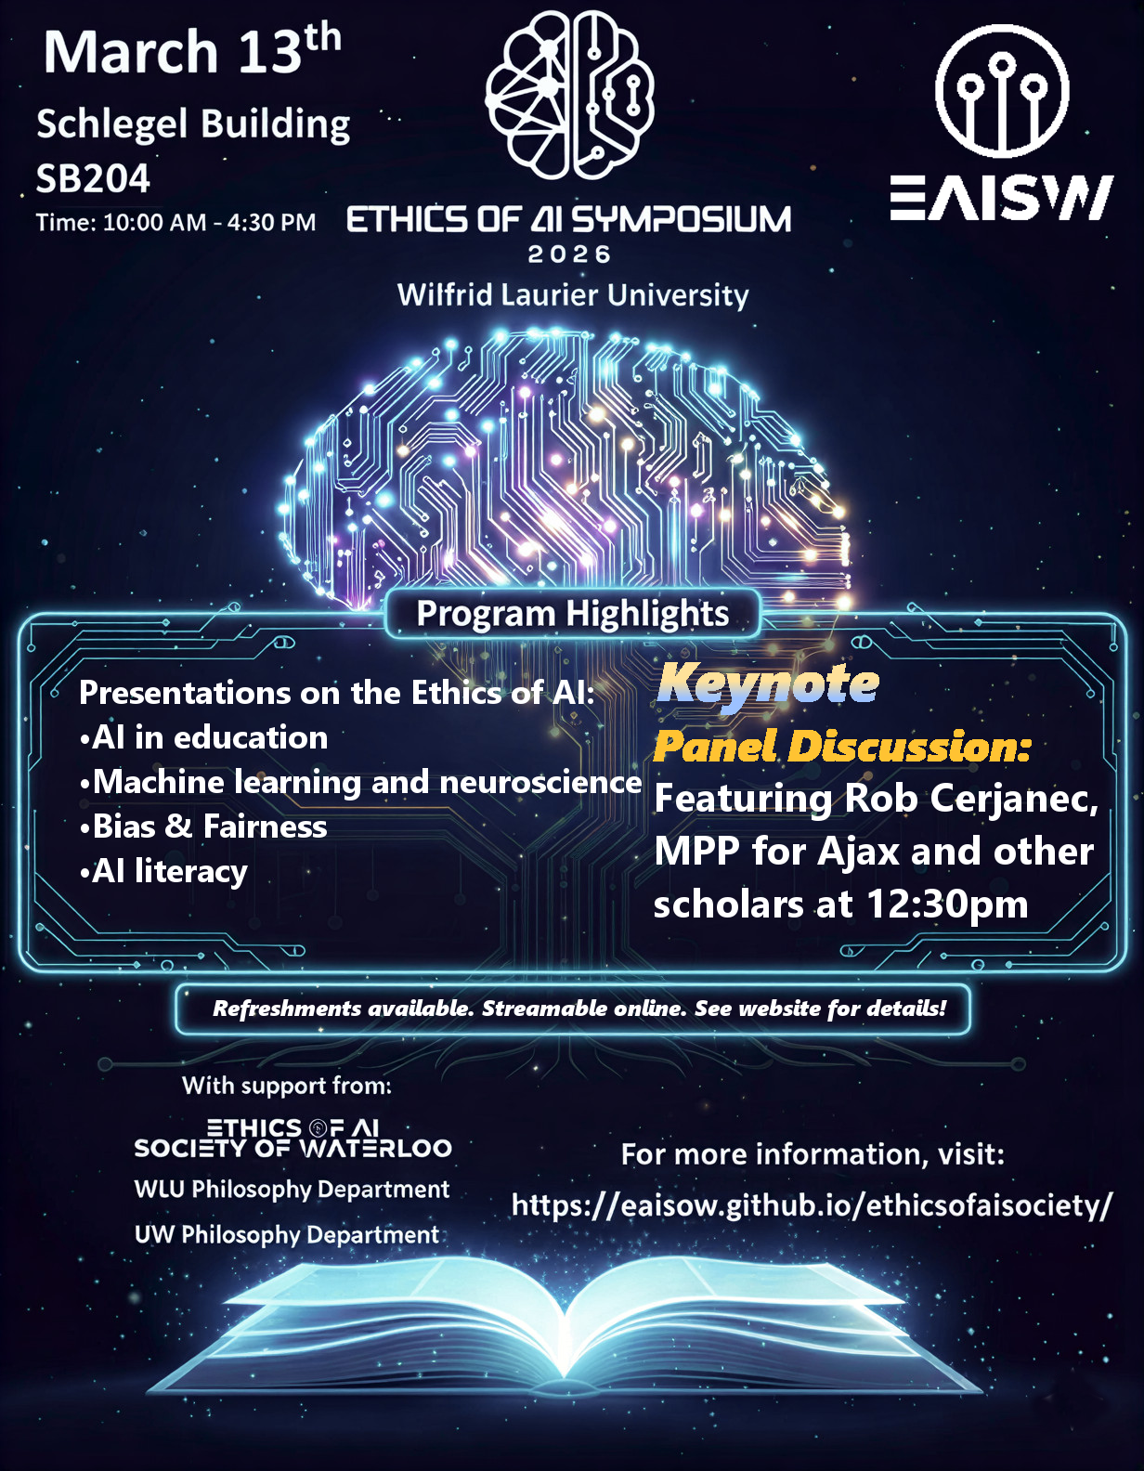
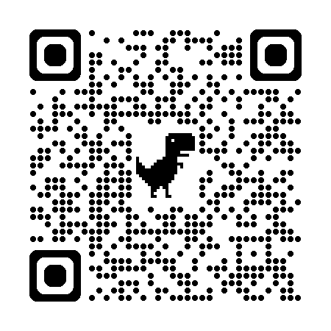
ttt

Slide 4
Theme 1: Ethics
How do you know you are dealing with an ethical situation?
Reflective moral thought emerges when we are “confronted with situations in which different desires promise opposed goods in which incompatible courses of action seem to be morally justified.”
-John Dewey, Ethics
“the only force of appeal to us … is found in the ‘everlasting ruby vaults’ of our own human hearts.”
- William James, The Moral Philosopher and the Moral Life

Slide 5
Value Judgments
If ethics is about determining what we ought to given incompatible goods, then ethics is fundamentally about value judgments.
End: A goal or objective.
Means: The resources/steps required to obtain an end.
Means
Plane ticket
End
Go on vacation.
Means
Hire movers
End
Help cousin.
Means
Rent truck

Slide 6

Car Insurance Algorithm
Means
End
Biometric Data
(AC)
Build model
Calculate risk for each driver
and determine appropriate premium.
Past driving experience
Credit rating

Slide 7
Car Insurance Algorithm
Means
End
Consequences
Better crash detection
Biometric Data
(AC)
Bias against the poor
Build model
Calculate risk for each driver
and determine appropriate premium.
Past driving experience
More anxious drivers
Credit rating
Feedback loops

Slide 8
An end goal considered in terms of the means (resources, steps) required and the consequences produced from achieving in the end in the way.
End-in-View
Consequences
Car model
Bias against the poor
Means
End
Build model
Calculate risk for each driver
and determine appropriate premium.
Past driving experience
Bias against racial minorities
Feedback loops
Credit rating
Don’t exacerbate income inequality.

Slide 9
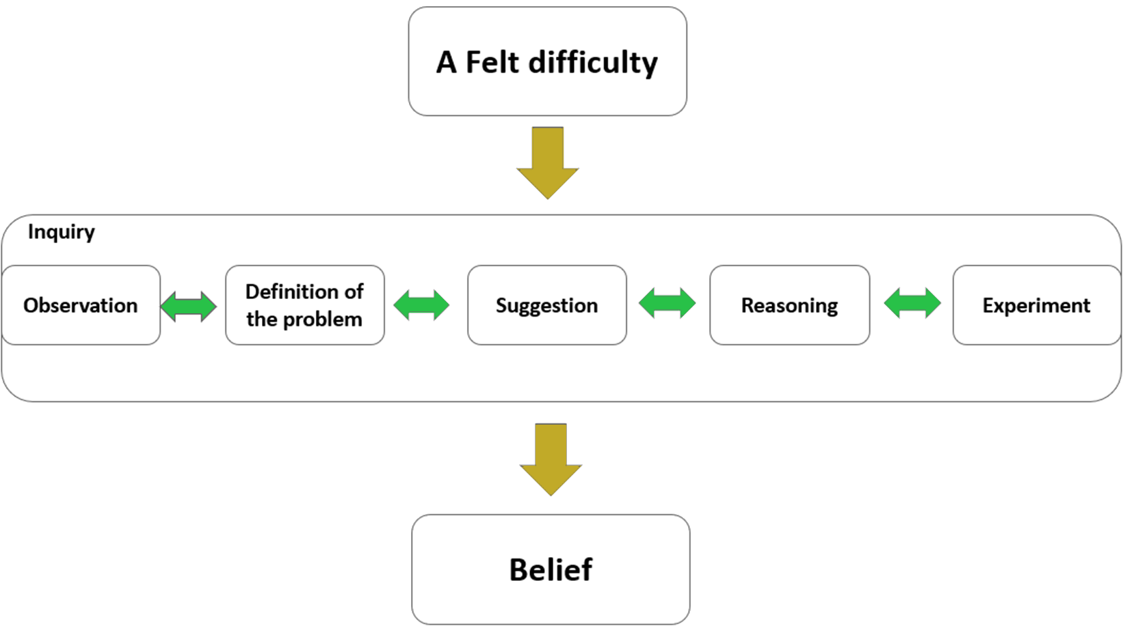
Moral Inquiry
Pattern of Inquiry
A felt difficulty
Definition of the problem
Solution suggestion
Reasoning
Experiment
Judgment
Experiment will lead to judgment that end our doubts in stable and lasting ways.

Slide 10
Theme 2: Ethics and AI
Many of the ethical problems associated with artificial intelligence involves either problematic assumptions or problematic data.
To what extent are developers and computer scientists responsible for either?

Slide 11
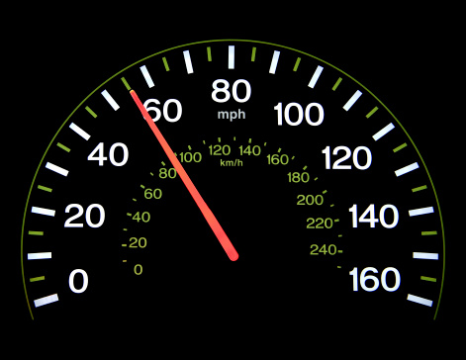
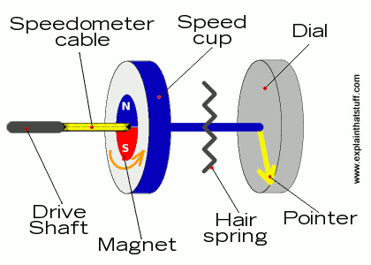
Evidential Reasoning
Imagine a cop pulled you over and claimed that you were exceeding the speed limit.
You do not believe that you were speeding. What evidence might you cite to justify your claim?

Slide 12
Evidential Reasoning
“States of affairs, that is, do not carry labels indicating that for which for which they can be taken as evidence.”
-Helen Longino
“States of affairs are taken as evidence in light of regularities discovered, believed, or assumed to hold.”
-Longino

Slide 13

Background assumptions
“A given item…can be described in different ways depending on the points of view and interests of those describing it…The consequences of emphasizing one aspect of the hat rather than another include the possibility of its receiving under one description an evidential assessment different from that received in a context in which some other aspect is emphasized.”
-Helen Longino, Science as Social Knowledge
“The grey hat”
“The hat on the stairs”

Slide 14
Confirming Background Assumptions
Longino: We cannot, nor is it prudent, to directly test and verify every background assumption in science, so we just rely on value judgments.
Impractical/undesirable
Unobservable particles
Non directly measurable things
“When a theory is being developed, the criterion for inclusion…is not that they are directly confirmed…but that they are relevant to the explanation of the phenomena”
-Longino

Slide 15

Case Study:Clinical Depression
Let’s say you wanted to design an algorithm that predicts of someone has clinical depression. What metrics would you use as data to teach it to do this?

Slide 16
Case Study: Clinical Depression
“There may be no reductive biological explanation that awaits discovery. This is because, contrary to quite widely shared current opinion, mental disorders are not brain disorders at all.”
"Psychopathology should be conceptualized in terms of what they call mechanistic property clusters: constellations of properties than hang together because they are connected by a diverse set of mechanisms.”
-Borsboom et. Al, Behavioral and Brain Sciences

Slide 17
Case Study: Clinical Depression
Determining what clinical depression is and what counts as a symptom of it is determined by background assumptions.
These background assumptions tell us how to measure the concept, what symptoms there are, and how severe.
Acceptance of some of these background assumptions will sometimes be based on value judgments.
Any biases in those assumptions would govern how we understand a successful model.
“If clinical depression is defined in terms of its symptoms, what criteria should be used to distinguish clinical depression from the common blues?”
“These symptoms all involve feelings of sadness that impair these vital functions….determining which functions are central to human flourishing involves making value judgments”
-Kristen Intemann, Science and Values.

Slide 18
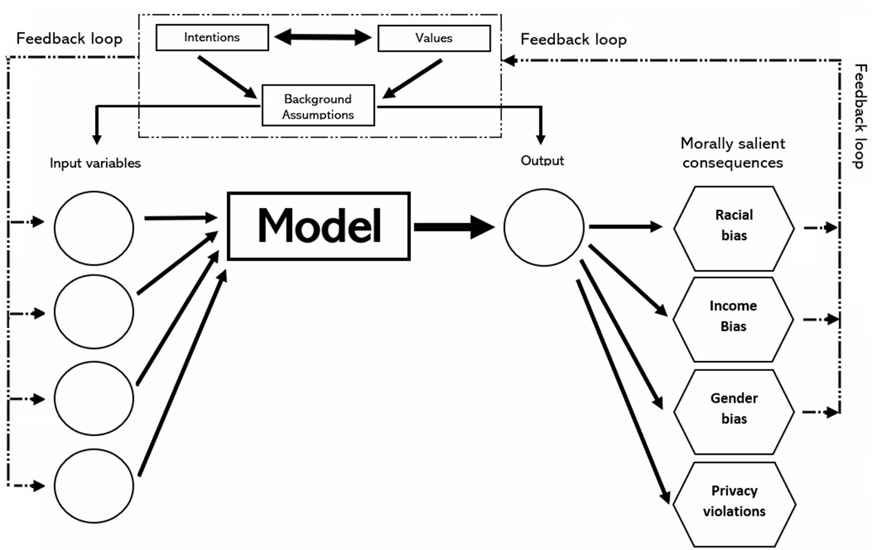
Values and AI
Values (how things ought to be) can influence how we understand and define a concept. This can influence:
How we may ideally think about operationalizing the concept for measurement.
What proxies we may decide to use when direct measurements are not available.
Whether our model is “successful.”
The entire world according to an AI is defined by the model and it has no incentive to look beyond a model’s limitations. It has no skin in the game. Only the developer can fill ethical gaps.

Slide 19
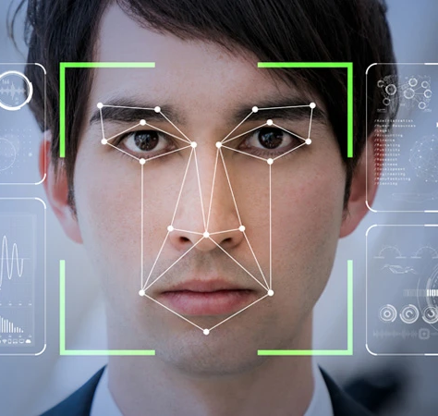
Theme 3: Responsibility
“We are aware of the persecution of the Uyghur communities [...] However, this article is about a specific technology and not an application of that technology.”
-Wiley Publishing
“Expression of Concern: Facial feature discovery for ethnicity recognition”
Data Mining and Knowledge Discovery

Slide 20
Scientific Responsibility
“Scientists, with few notable exceptions, are the worst citizens of the Republic … they sneer at politics and politicians … They sell their services to exploiters of human life… They produce powerful mechanisms and proudly proclaim that they ‘do not care how they are used—leave that to the moralists … The ‘pure’ scientist has to be a moral eunuch or a civic hermit.”
-Read Bain, 1933

Slide 21
Causal vs Moral Responsibility
“In more common situations individual responsibility is not considered to extend to all the consequences that may be initiated by the act of the individual. The miner of iron ore is not expected to see to it that none of the scrap iron…is sold to the Japanese to be used against his country.”
-Bridgman, 1947

Slide 22
Causal vs Moral Responsibility
Someone is causally responsible for something if they directly or indirectly cause something to happen, but we don’t hold them accountable.
Someone is morally responsible when someone causes something to happen, and they are held responsible (praised or blamed) for doing so; minimally, if they intended an action.

Slide 23
Basis of Responsibility
Scientists and AI developers are just as responsible as the rest of us
Recklessness: One is fully aware of the risks they are taking or imposing on others and those risks are unjustified.
Negligence: One is not aware of the risk of harm they are taking or imposing on others, but they should be.

Slide 24
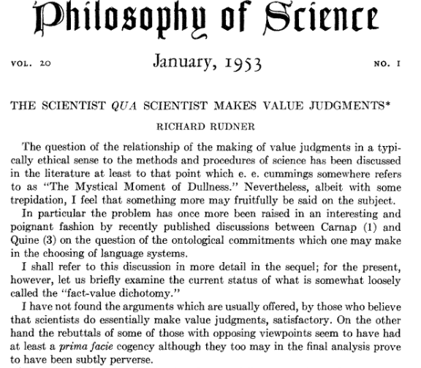
Arguments Against Scientific Freedom
Inductive Risk
Is science really value-free?
Richard Rudner “The Scientist Qua Scientist Makes Value Judgments”
Scientists must consider the risks
of error when deciding how much
evidence is sufficient.

Slide 25
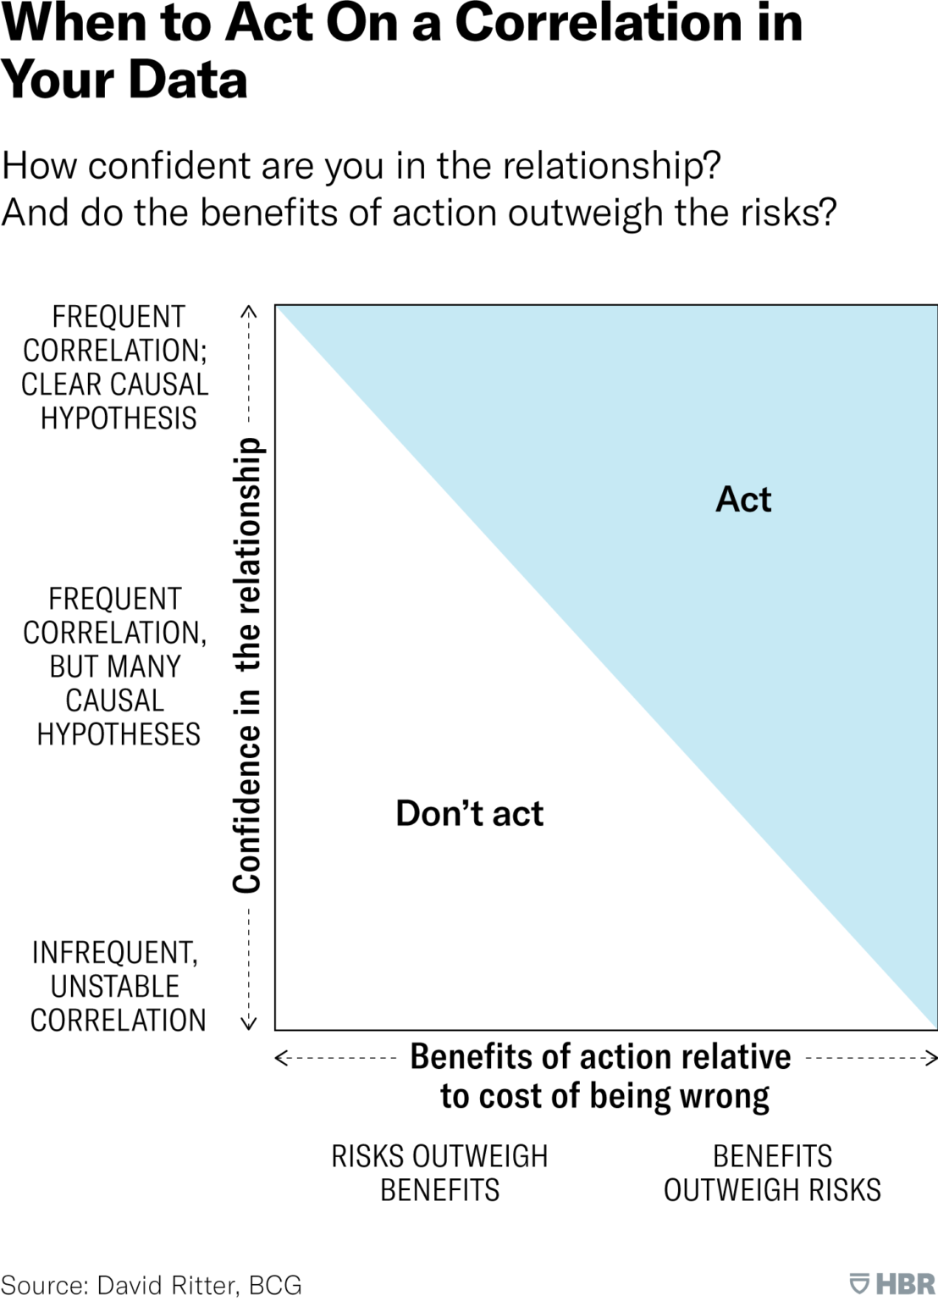
Inductive Risk
What are the ethical consequences if I am wrong about my conclusion?
Should I demand a higher standard of evidence? (greater concern consequences of type I error/false positive)
Should I set a low standard of evidence? (greater concern consequences of type II error/false negative)

Slide 26
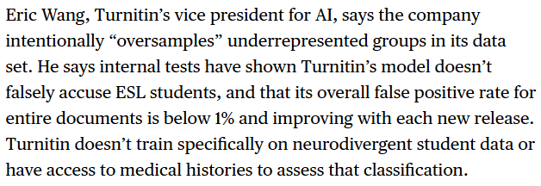

Cost sensitive
Machine Learning Optimization
Cost insensitive machine learning: Optimization is carried out by using equal costs for different types of training errors.
(aims to maximize predictive accuracy)
Cost sensitive machine learning: Optimization is carried out by using different costs for different errors.
(does not aim to maximize predictive accuracy)

Slide 27
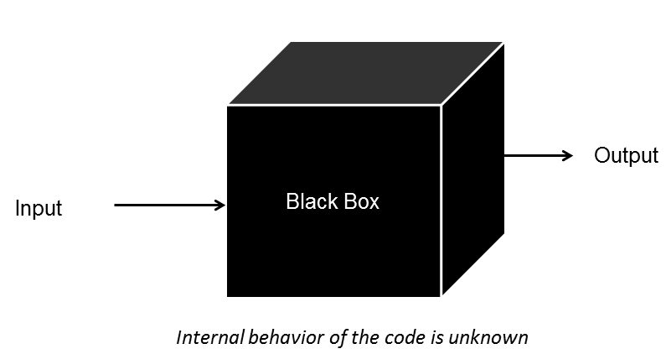
AI Opacity
A lack of transparency within an algorithmic system
“The designer may have a good understanding of the algorithm that was used to find the decision-making model, but not the model itself”
– Kearns and Roth, The Ethical Algorithm

Slide 28
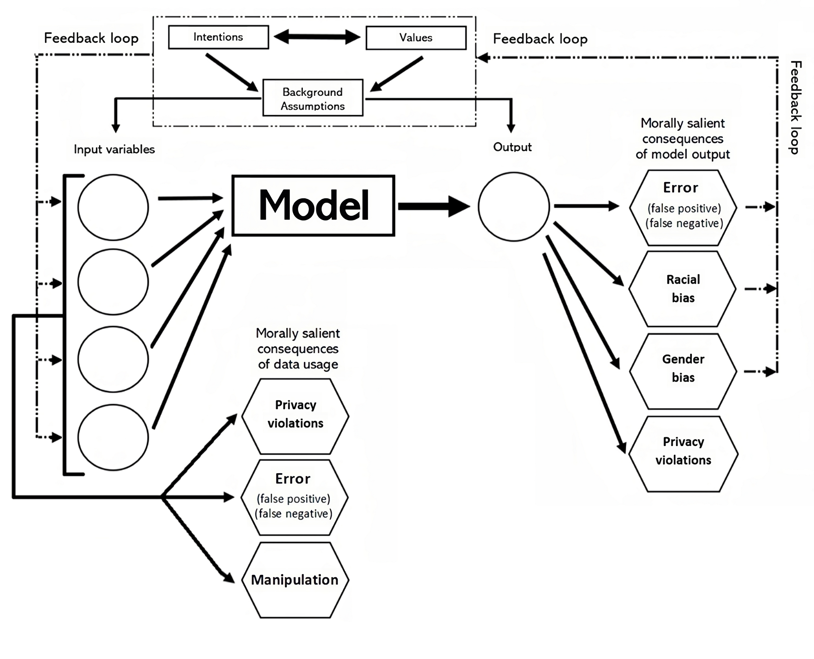

Ethical Significance of Opacity?
Developer

Slide 29

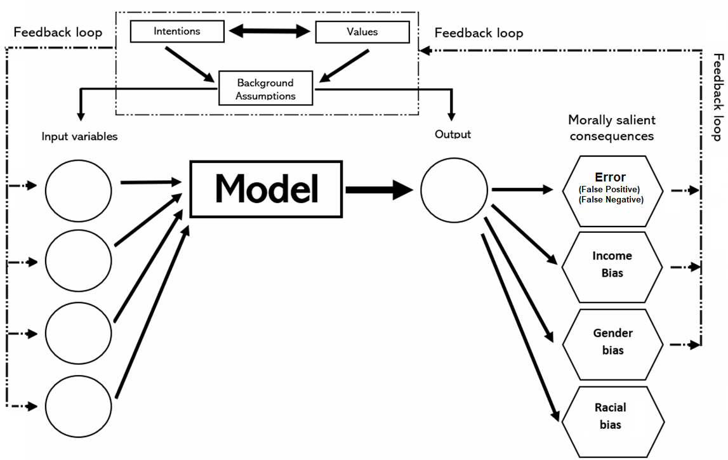

“although ‘opacity,’ ‘transparency,’ and ‘explanation’ mean different things to different stakeholders, there is no yet general account of what these terms actually mean for different stakeholders in the ML ecosystem”
-Carlos Zednic, 2019
End user

Slide 30
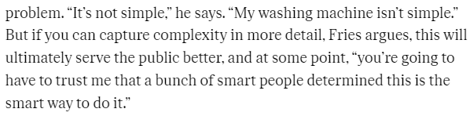
AI Opacity
A lack of transparency within an algorithmic system

Slide 31
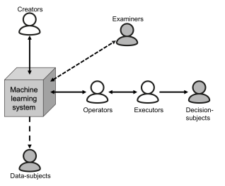
AI Opacity
Transparency will mean different things to different stakeholders
“Questions about why a system does what it does are questions about that behavior’s “appropriateness” within some particular environment.”
“Whereas why-questions must be answered by ‘looking inside’ at the functional or physical variables, structures, and process that intervene between the system’s inputs and outputs.”
-Carlos Zednik
How?
Where?
Why?
What?
How?
Why?
Why?
Why?

Slide 32
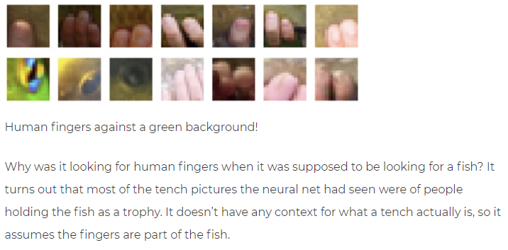
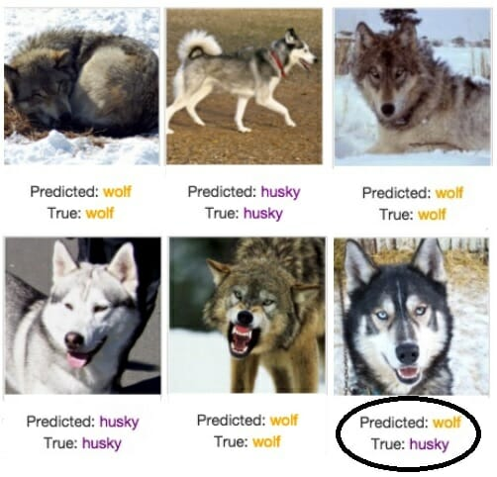
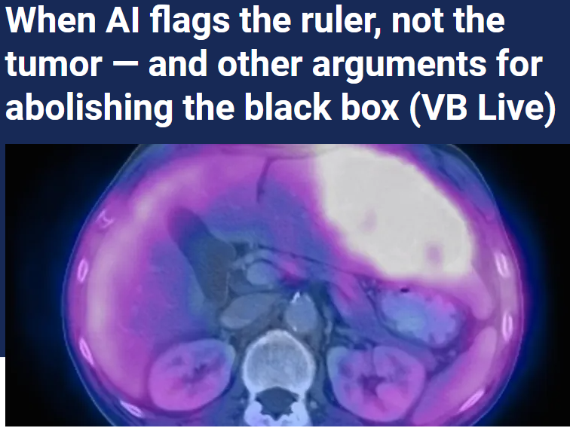
Hidden Reliance on Spurious Correlations
Is a text about Christianity or Atheism?
Explanation: “posting,” “host,” “re”

Slide 33

New AI Riddle of Induction
If an AI developer is unaware of what correlations are being used in the data (and their relative importance), they cannot really speak to risks of sampling representativeness.
Can’t say correlations are reliable/future projectable because we don’t know the correlations.
It might all seem fine, until it isn’t.
To be able to say one is not overfitting or that the training data isn’t too limited, they would need to say that future data won’t change in ways they can’t anticipate.

Slide 34
Standards of Negligence
Reasonable Standard
Duty of care
Foreseeability
Proximate cause
Corporate negligence
Contributive negligence
Gross negligence
Per Se negligence
“How much foresight and careful deliberation should we expect the individual to have? Often, this question is answered through an examination of community standards, couched in terms of what a reasonable person would have done in like circumstances.”
-Douglas

Slide 35
Once again, AI has no incentive to care about real world error. Correct predictions for the wrong reasons still count as a “win.” Unless the AI developer considers the risks and acts accordingly, no one else will.
“For certain high-stakes decisions, no black box should be deployed when there exists an interpretable model with the same level of performance…If we do not succeed at these efforts, it is possible that black box models will continue to be permitted when it is not safe to use them.”
-Cynthia Rudin 2019

