Slide 1



Sustainable A.I.: Mechanizing the Art of Being Human
Jesse Hoey
University of Waterloo
@drjessehoey bayesact.ca jhoey@uwaterloo.ca

Slide 2
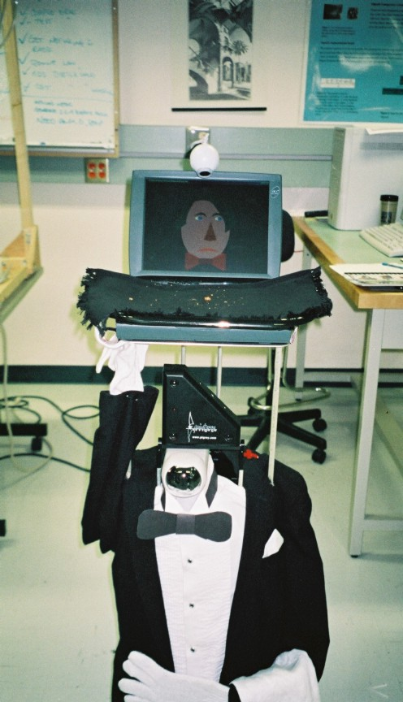
“Artificial Intelligence”
Notes:
what it was meant to be and what it became

Slide 3
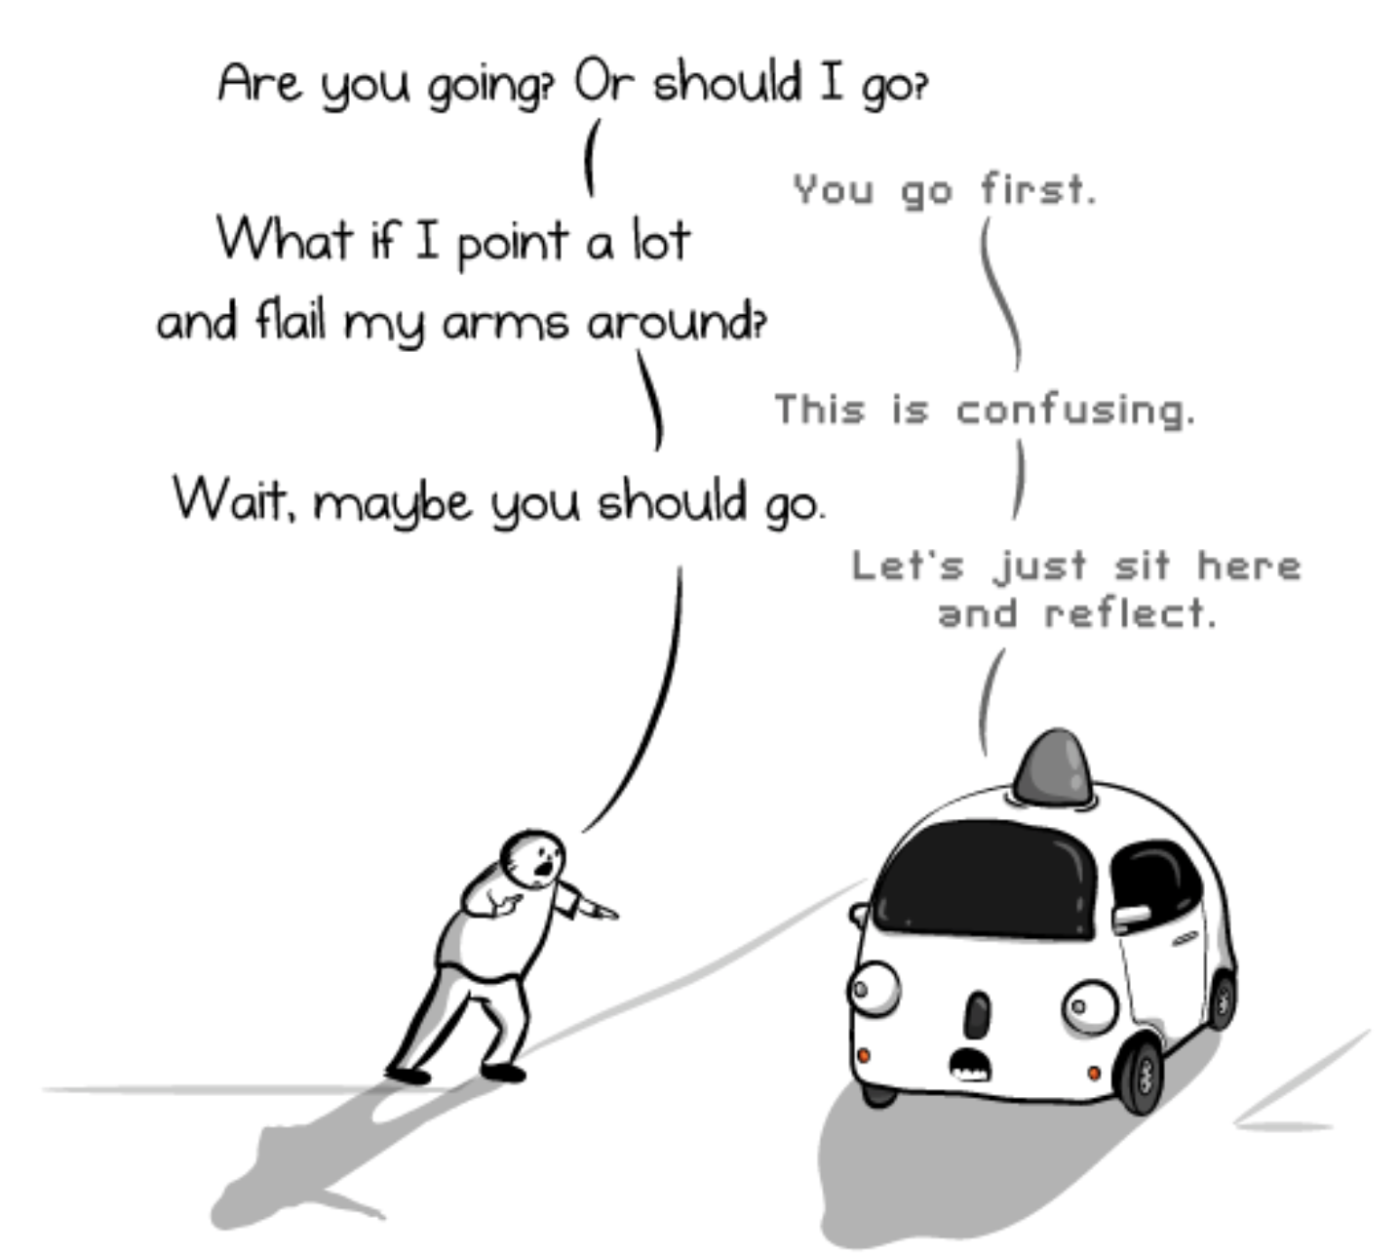
Human alignment
AI has difficulty aligning (understanding, cooperating effectively) with humans
I will argue later that this is true with LLMs as well, but it has become much more subtle
theoatmeal.com/blog/google\_self\_driving\_car
AI has no skin in the game

Slide 4
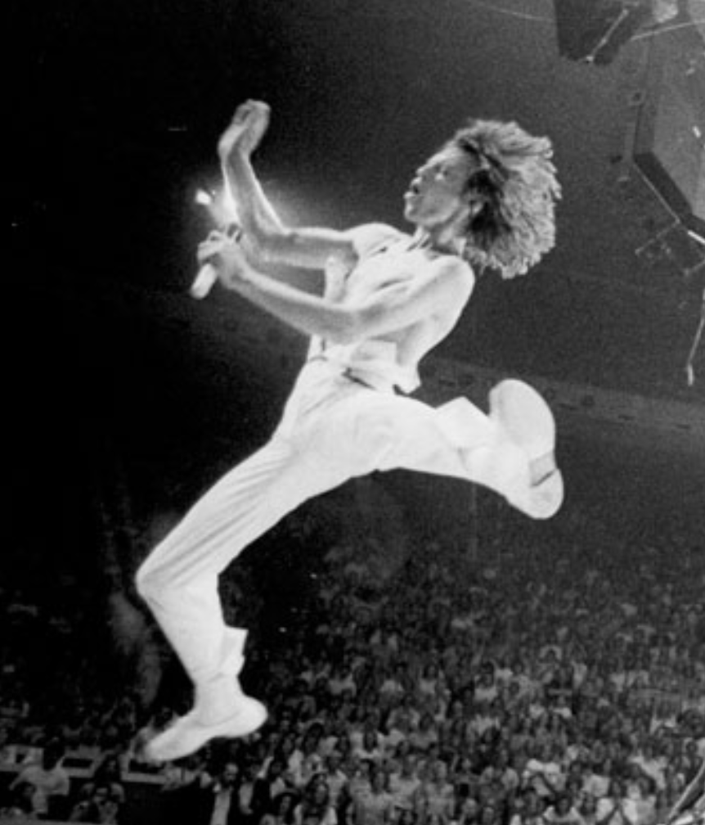
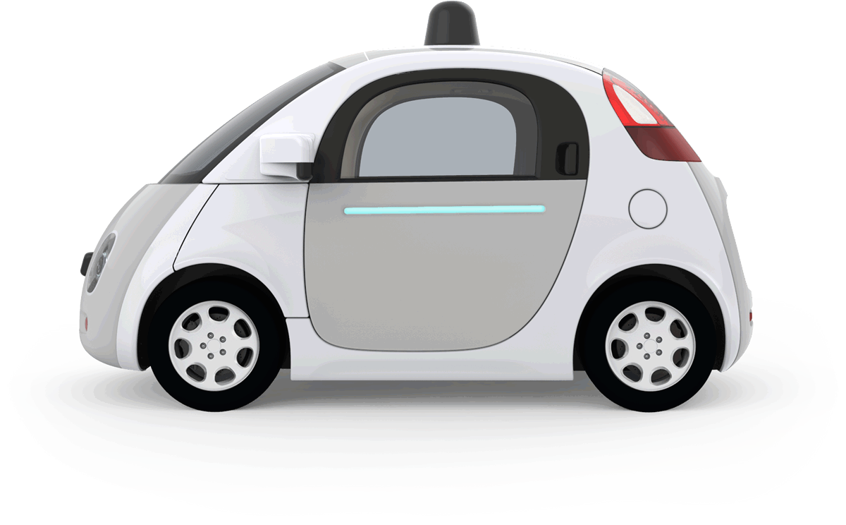
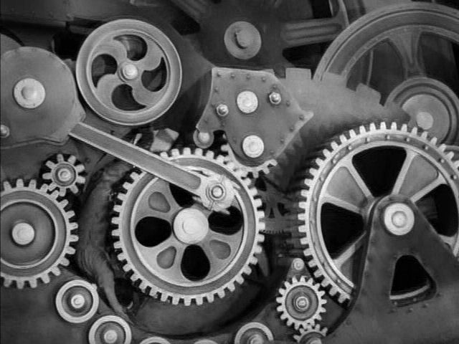
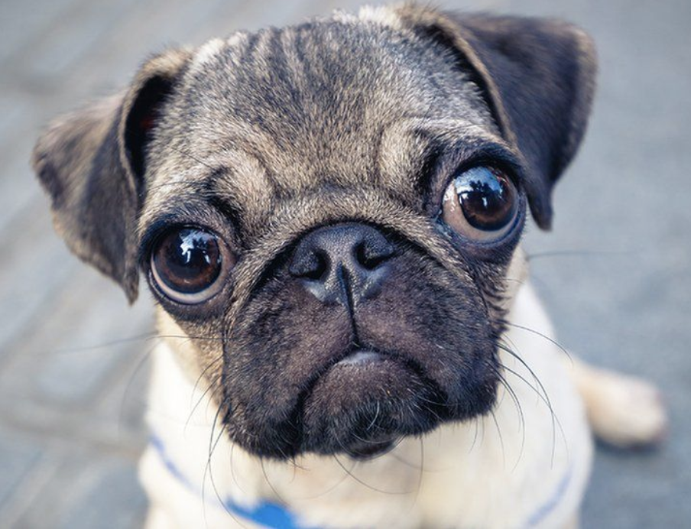
Being Human
rational, mature
“A.I.”
humans
human uniqueness
mechanistic
dehumanization
human nature
inertness,
coldness
emotionality,warmth
animalistic
dehumanization
machines
animals
irrational, childlike
adapted from: Nick Haslam, Stephen Loghnan, Yoshihisa Kashima and Paul Bain (2009).
Attributing and Denying humanness to others. European Review of Social Psychology, 19:1, 55-85

Slide 5
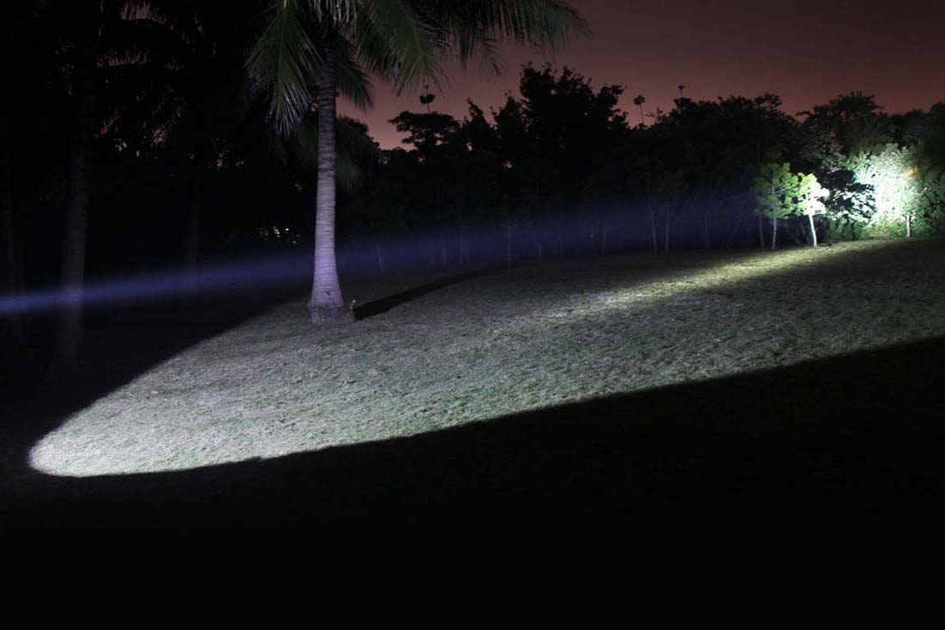
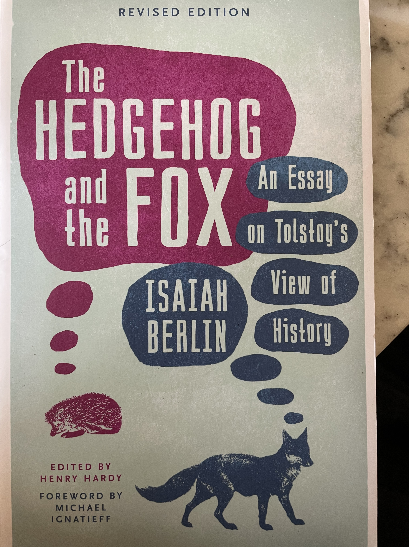
“A.I.” in a nutshell
Human-Centered
A.I. using a
Socio-Emotional
”flashlight”
Bayesian Reinforcement Learning
MODEL SPACE
“Sociology […] must, like history, concern itself with the relation between the unique and the general” – E.H.Carr ”What is History” p.66
“…the proportion of relevant reality which we can represent by any
such model or models in studying say, a foreign policy decision,
appears to be almost trivial.”
(Charles Hitch, head of Economics at RAND, quoted in Charles E. Lindblom, “The Science of Muddling Through”, 1959)
Notes:
use Newton quote instead - pebbles on the beach
connotative affective is then the other way to see connotative affective is as the set of models generating the arrows in the first place.
exactly what Tolstoy was trying to do
the other way to think about this flashlight is as the space of models
agent must have something in his head to make the predictions <- this is the model
The model defines the flashlight -- how wide and where does it point
therefore the hedgehog-fox tradeoff is the same as the model selection problem ...
Bayesian Reinforcement Learning

Slide 6
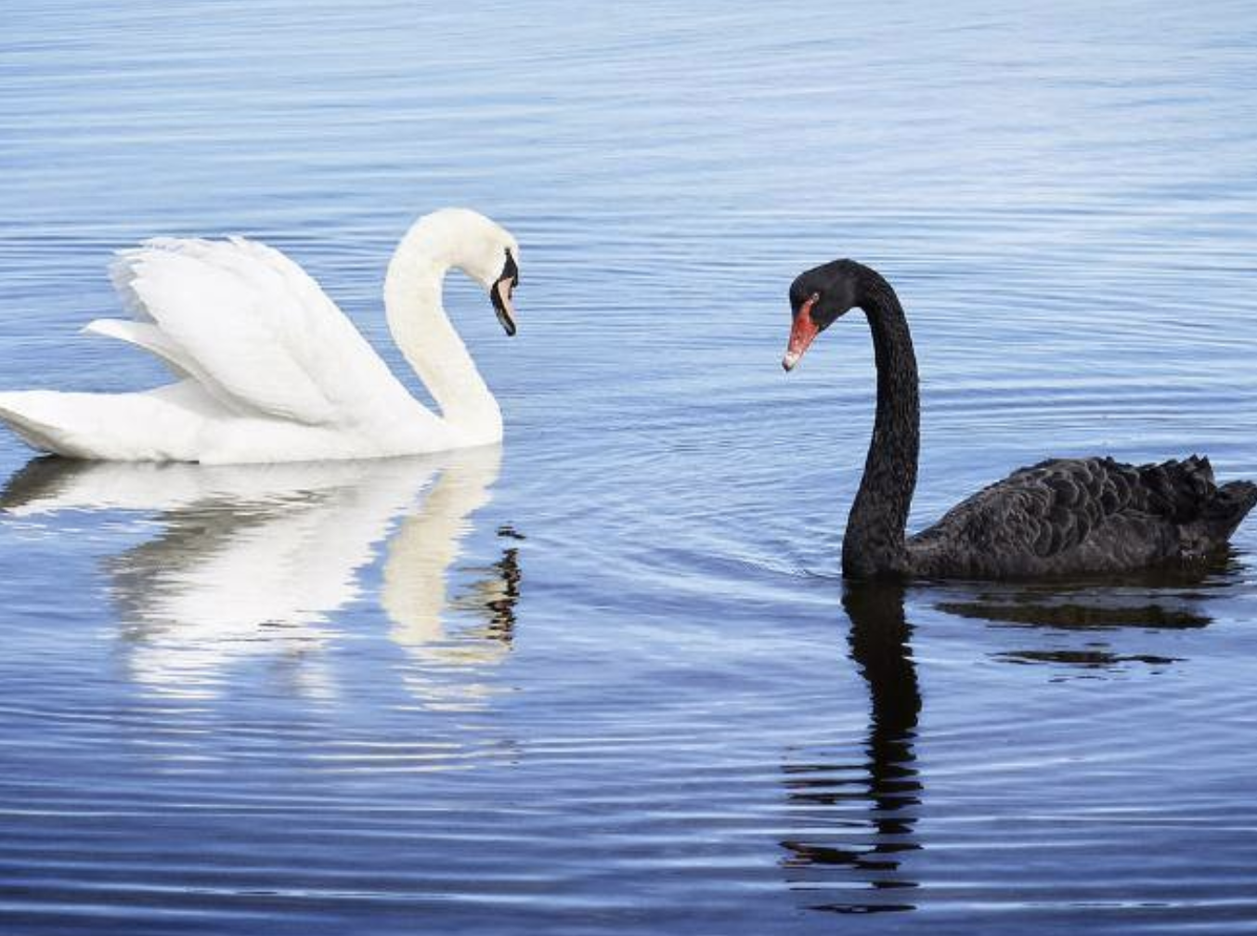
White Swans … Black Swans
Notes:
So where are we going to find this connotative flashlight?
More importantly, how wide should it be? Ideally, we’d like it to be really narrow, so that everyone’s load is lighter, but first we first need to talk about Swans
Before discovering Australia, Europeans had *never seen* a swan that was not white, so if you asked them what color the next swan they’d see was, they’d say 100% guaranteed to be white. This would be like asking you what color the next Bald Eagle’s head you see will be
But then they saw a Black Swan in Australia, but had no way of interpreting what kind of animal it was.
Statistical machine learning is based *by definition* on historical data only. Its based on the dataset that you have or can get.
IF the dataset you have covers only part of the things that can actually happen, you will be surprised and your model will break and fail

Slide 7
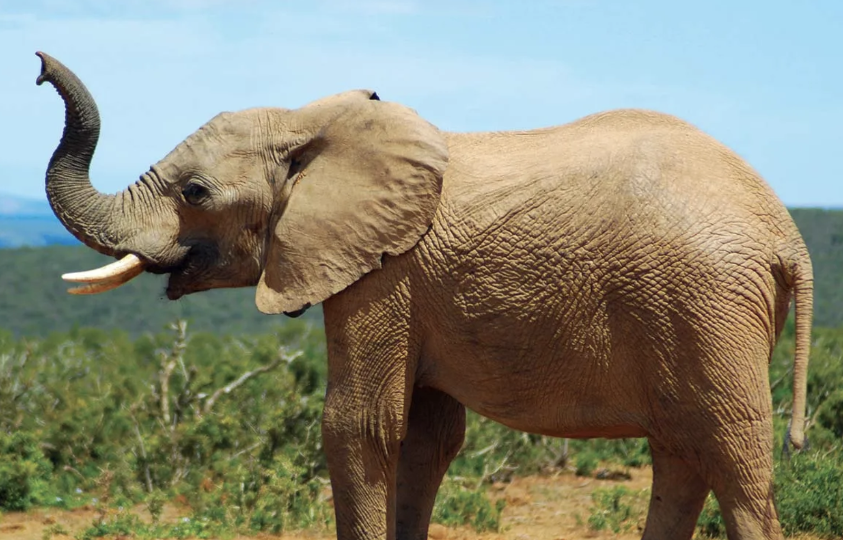
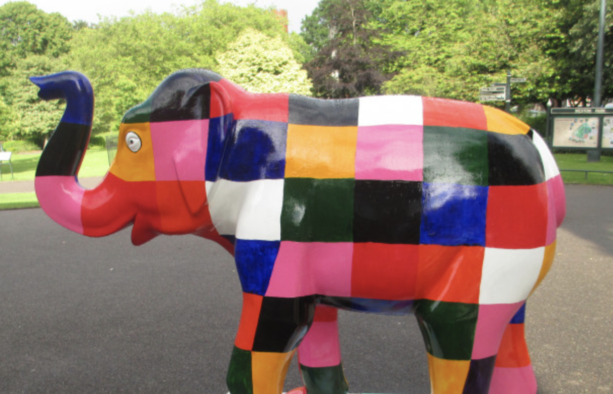
White Swans … Black Swans
Notes:
So where are we going to find this connotative flashlight?
More importantly, how wide should it be? Ideally, we’d like it to be really narrow, so that everyone’s load is lighter, but first we first need to talk about Swans
Before discovering Australia, Europeans had *never seen* a swan that was not white, so if you asked them what color the next swan they’d see was, they’d say 100% guaranteed to be white. This would be like asking you what color the next Bald Eagle’s head you see will be
But then they saw a Black Swan in Australia, but had no way of interpreting what kind of animal it was.
Statistical machine learning is based *by definition* on historical data only. Its based on the dataset that you have or can get.
IF the dataset you have covers only part of the things that can actually happen, you will be surprised and your model will break and fail

Slide 8
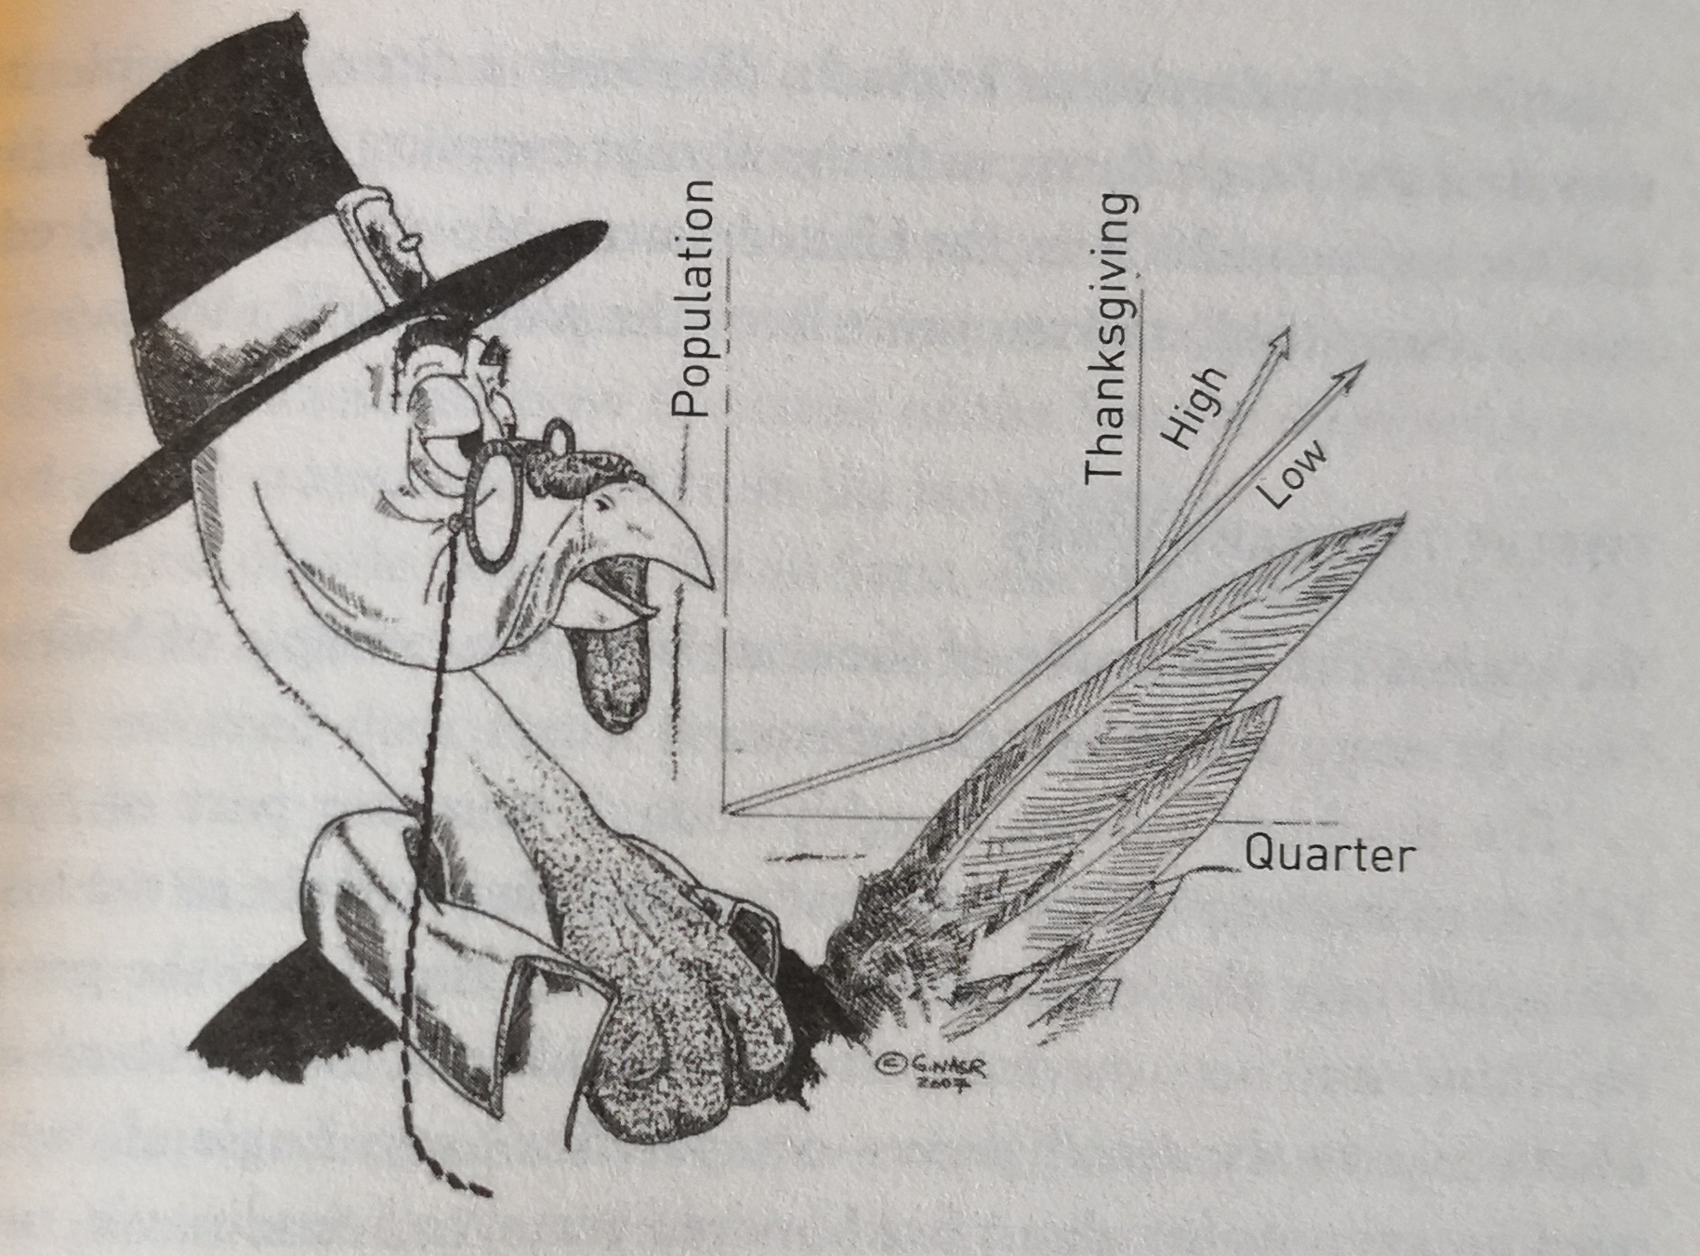
Black Swan Events
From N.N. Taleb “AntiFragile” p. 93
Notes:
So this is fine for categorizing swans, but this over-reliance on models can lead to much more dangerous outcomes if it happens
In financial forecasing, or perhaps worse, in public policy.
Important thing to realize is that you might be wrong
And not just wrong because your model is insufficiently trained
Wrong because your model SPACE is wrong. You will never be able to predict what happens next – accept it.

Slide 9
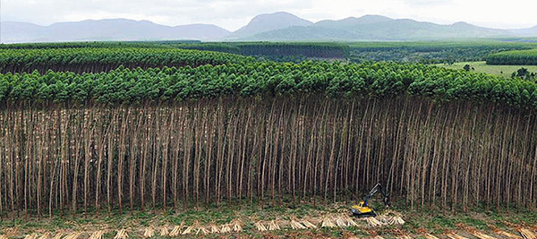
Monoculture…
Prussia 1765-1800: took 100 years before the damage was apparent (J.C.Scott Seeing like a State, 1998)

Slide 10
Efficient Crickets…
Computers and sensors will track everything from environmental factors like heat and humidity, to cricket growth, waste production, and even check for sick or dead insects.
“You need a lot of data with AI, and with living organisms how do I get enough examples of sick crickets for the algorithm to learn? You obviously don’t want to create that for ethical reasons ... so it is a technical hurdle we’ll have to overcome.”
Fernandez, whose company has already partnered with German automotive giant Audi and U.S. defence contractor Lockheed Martin, acknowledged that tracking the health and well-being of living, breathing crickets will be different from analyzing automotive or aerospace components.
“Using artificial intelligence to raise better crickets and help save the world”
Waterloo Record By James Jackson Record Reporter Mon., Feb. 22, 2021

Slide 11
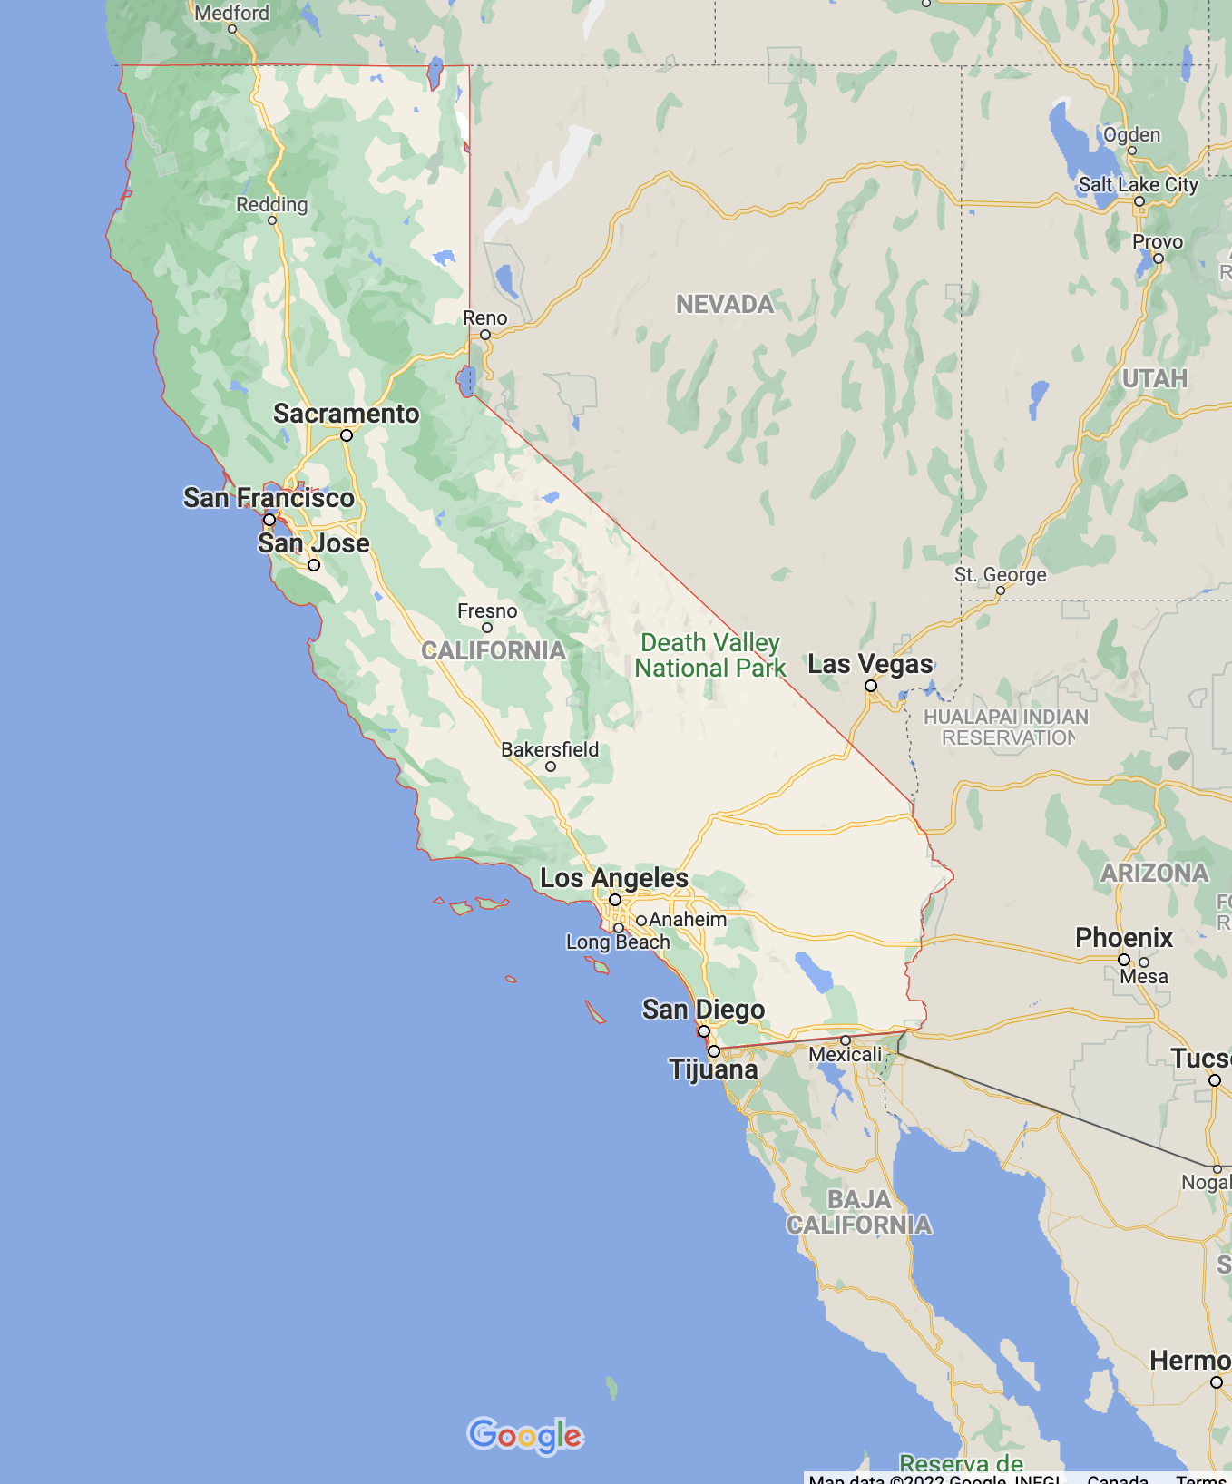
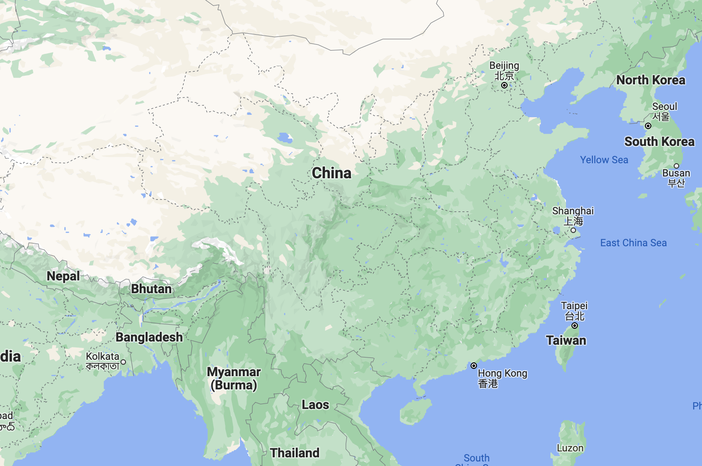
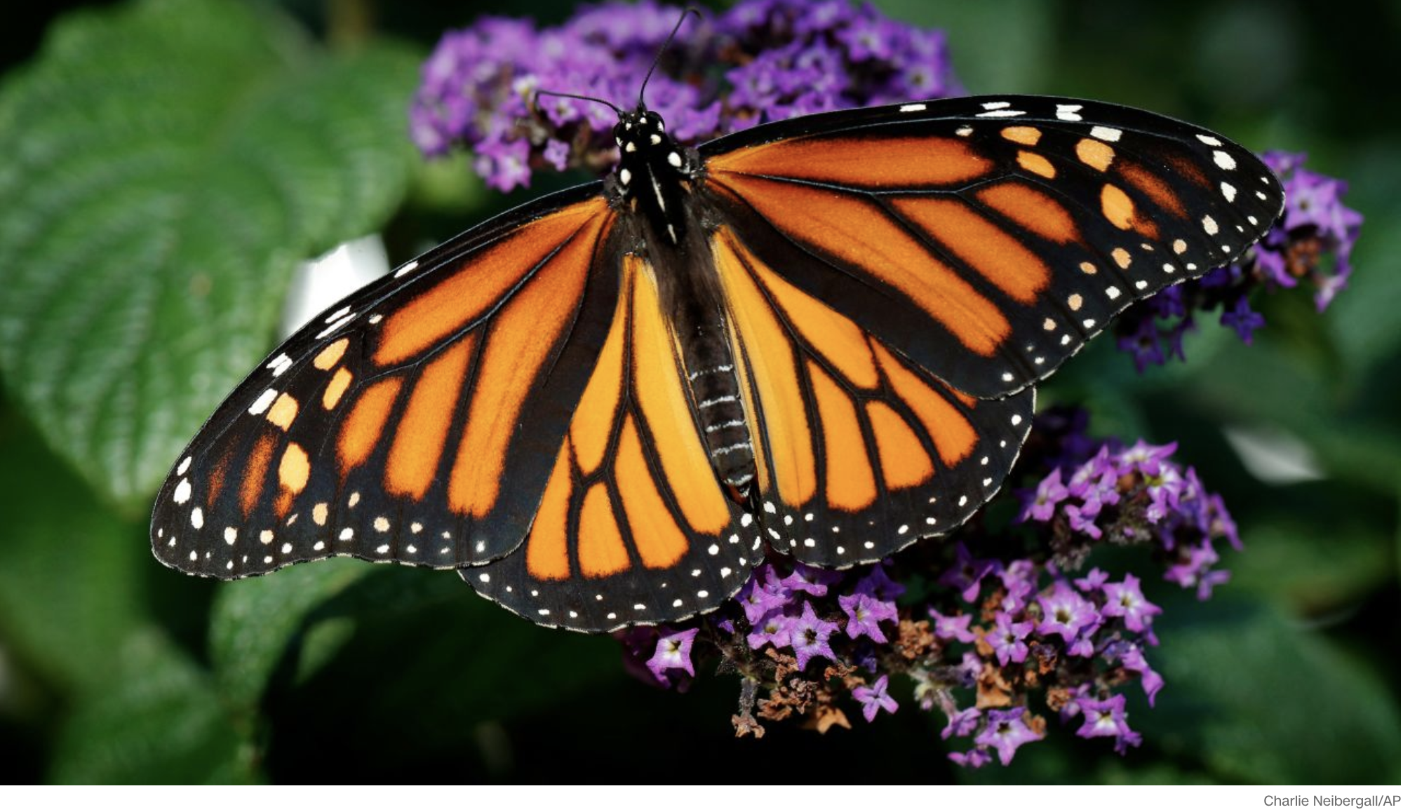
Complexity: Black Swans arise
Many interacting parts, long distance, path-based effects

Slide 12

Beam Search
Need a small enough beam to see what you are looking at …
… but a big enough beam not to miss the black swan.
Notes:
So your machine learning model is like a flashlight – wide beam or narrow beam, it never illuminates what is outside the beam
although deep nns have vastly expanded the beam, the amount covered is still trivial - Newton on the beach example (where he says he’s observing the stones but they are an insignificant part of everything), and this quote:
“…the proportion of relevant reality which we can represent by any such model or models in studying say, a foreign policy decision, appears to be almost trivial.”
(Charles Hitch, head of Economics at RAND, quoted in Charles E. Lindblom, “The Science of Muddling Through”, 1959)
”…the immeasurable background of space and time which is not it.” -- Joyce
Dark forest – set of all datasets – somewhere in there is the dataset with the black swan
Wide beams are going to hit the black swan, but only dimly
Narrow beams are going to miss the black swan

Slide 13

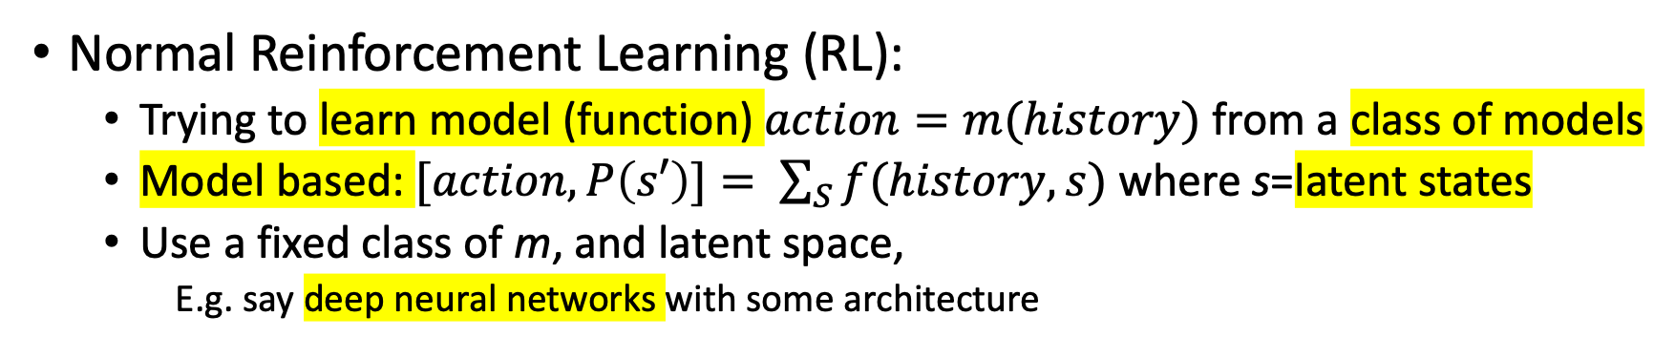
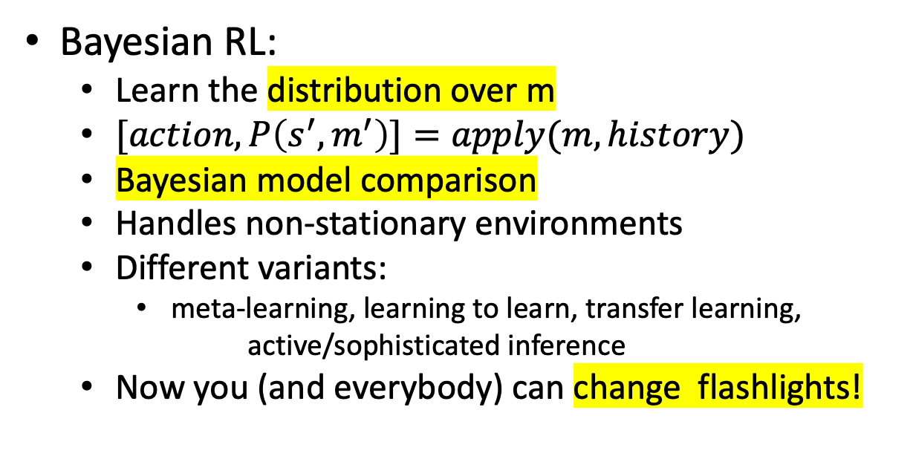
Bayesian Reinforcement learning
Normal Reinforcement Learning (RL):
Trying to learn model (function) $action=m(history)$ from a class of models
Model based: $[action,P\left(s′\right)]= \sum_{S}{f(history,s)}$ where s=latent states
Use a fixed class of m, and latent space,
E.g. say deep neural networks with some architecture
but…where do I aim? how wide?
Bayesian RL:
Learn the distribution over m
$[action,P\left(s^{′},m^{′}\right)]=apply(m,history)$
Bayesian model comparison
Handles non-stationary environments
Different variants:
meta-learning, learning to learn, transfer learning,
active/sophisticated inference
Now you (and everybody) can change flashlights!
Notes:
Learning a DISTRIBUTION OVER ALL POSSIBLE functions

Slide 14
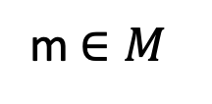
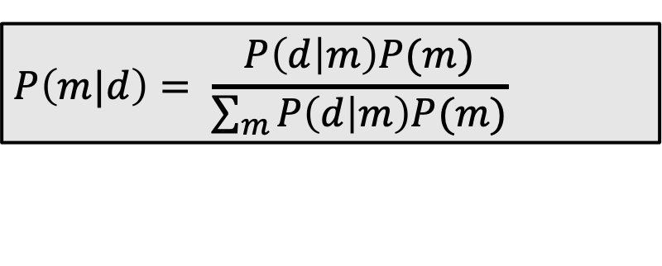
Bayesian Learning
d: data
To learn the distribution over models, m,
we compute:
M: class of models
$$P\left(m|d\right)= \frac{P\left(d | m\right)P(m)}{\sum_{m}{P\left(d | m\right)P(m)}}$$
m$∈M$
P(d): Evidence, partition function or
e^{–free energy} is hard to compute
sum over all models, m ∈ M

Slide 15
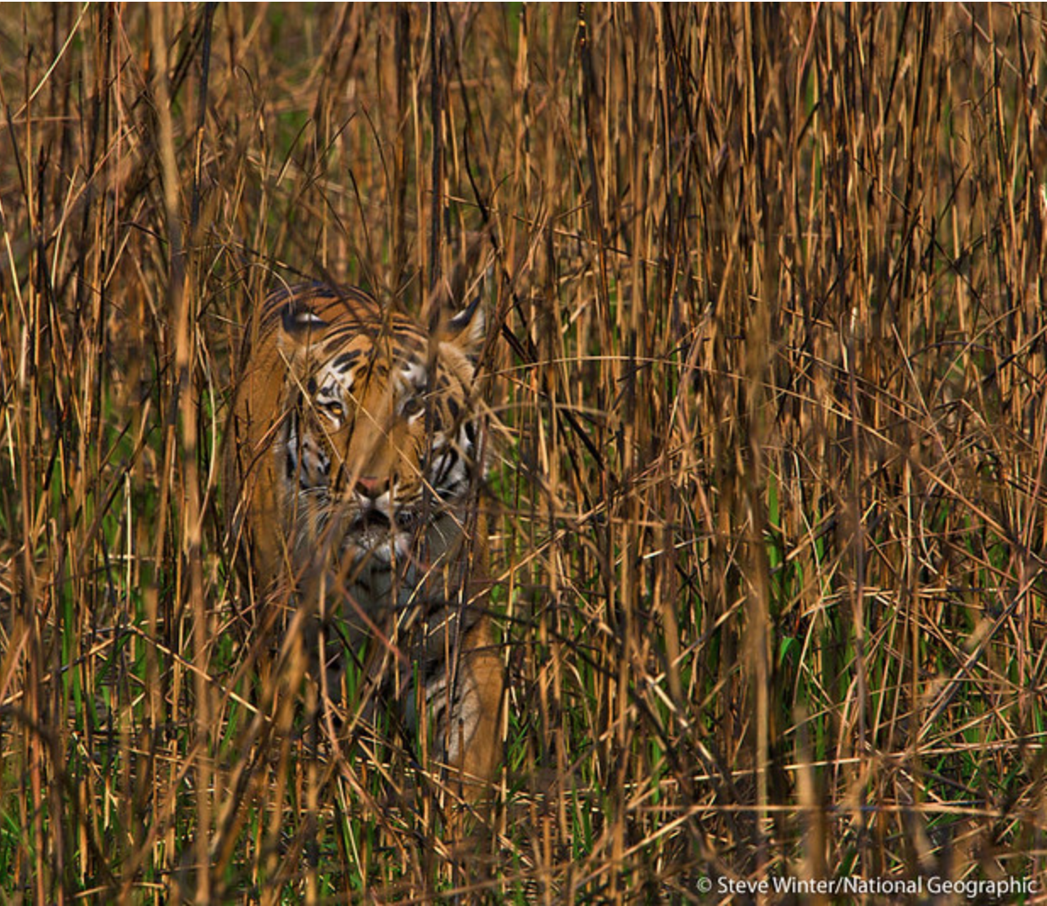
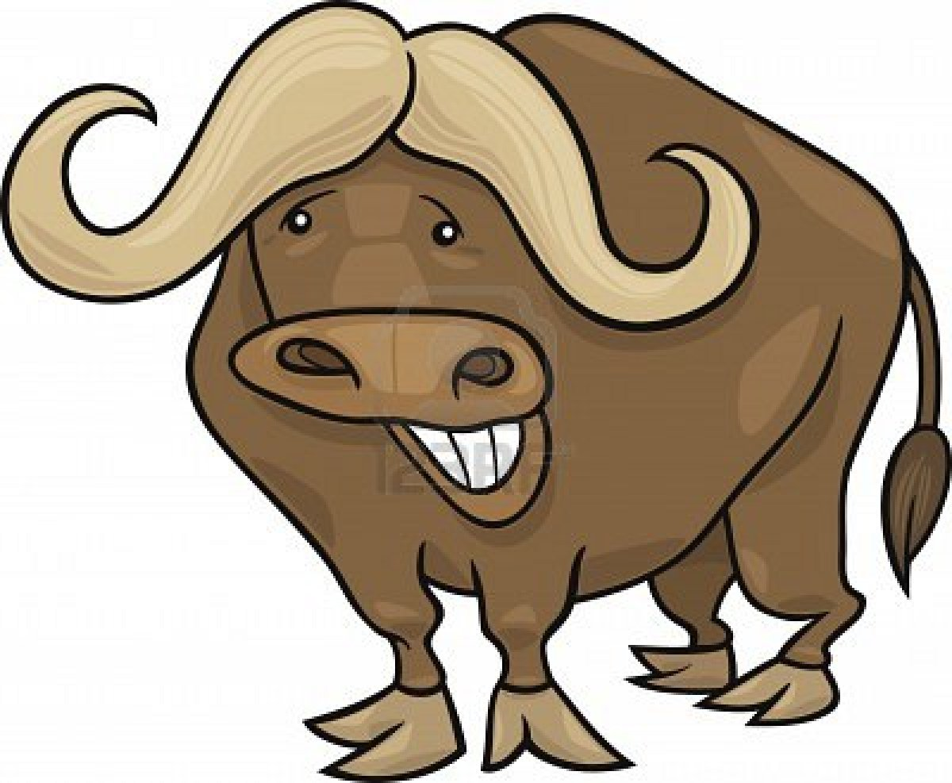
?
free energy
realization
expectation
Notes:
The realization of the world should meet the animals expectations
Therefore either
A) the expectations have to have sufficient capacity for the world, -------- learning – increase model capacity such that expectations meet realizations --- increase flashlight beam width
B) Or the world has to be simple enough for the expectations ------------ fleeing – keep narrow beam flashlight, run away
Just like the Turkey on thanksgiving day – this guy would be wrong if you asked him what would come next (Tiger)
First his world is only grass/nograss so he learns the distinction
Has certain expectations with respect to that distinction
Difference is partition functiojn – free energy
Now put in tiger
The animal that survives will be the one that rapidly handles the new state. Doing this inductively based on a model may be the only way forward for the animal.
Therefore, characterizing P(d) is a key step for the animal to compute P(m|d), which it can use to inductively sort out what is the right action to take
Even more basic – the partition function, if the free energy grows larger, must necessarily grow smaller – thus it must be enlarged to take into account the new states and this should shrink the free energy again
****
Free energy = realization - expectation - in that sense it is the "inverse" of the partition function - the PF describes everything that *is* - the free energy describes everything else left over
So you want FE to be low, partition function to be large
expectations match realization, so free energy is low, so the partition function represents everything there is from this agent's perspective
*****
When the free energy grows, there is more information hidden in the environment…. To be used
Can change its model of the world (to include tigers) or its actions (run away back to just grass!)
Free energy is the \sum_m P(d,m) - the probability of everything – for all models. P(d) – the evidence.
If you knew this you could deduce everything
Now you want this to be as small as possible – as few models as possible
But you need to have enough to deal with the fat tails – the unexpected and unknowable
Water Buffalo just sees grass, just models grass.
Expectations are perfectly satisfied
Tiger
Realization is different than expectation
Free energy is the information to be had by the agent –
This comes from basic physics – 2nd law --- go to bowl –total energy has increased but less so inside the bowl – macro states etc.

Slide 16
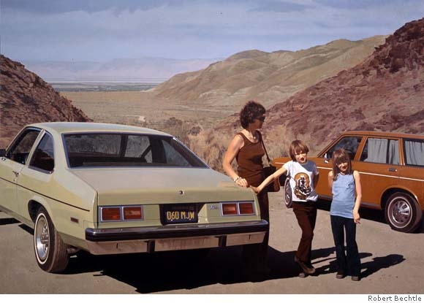
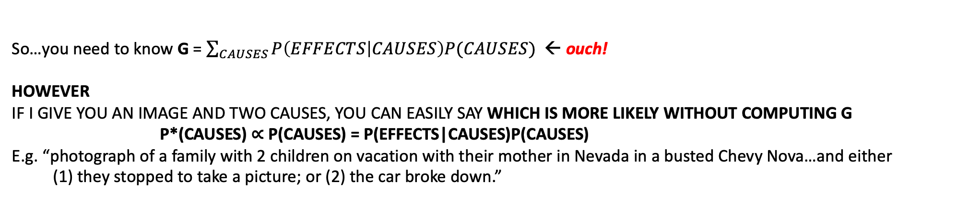
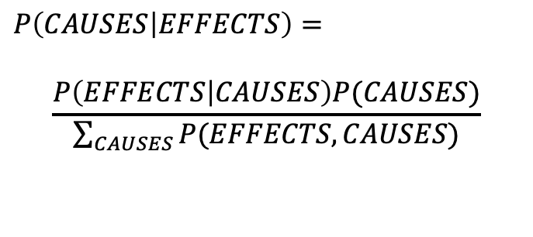
CAUSES
EFFECTS
BAYES’ RULE:
$$P\left(CAUSES | EFFECTS\right)=$$
$$\frac{P\left(EFFECTS | CAUSES\right)P(CAUSES)}{\sum_{CAUSES}{P(EFFECTS,CAUSES)}}$$
So…you need to know G = $\sum_{CAUSES}{P\left(EFFECTS | CAUSES\right)P(CAUSES)}$ ← ouch!
HOWEVER
IF I GIVE YOU AN IMAGE AND TWO CAUSES, YOU CAN EASILY SAY WHICH IS MORE LIKELY WITHOUT COMPUTING G
P*(CAUSES) ∝ P(CAUSES) = P(EFFECTS|CAUSES)P(CAUSES)
E.g. “photograph of a family with 2 children on vacation with their mother in Nevada in a busted Chevy Nova…and either
(1) they stopped to take a picture; or (2) the car broke down.”

Slide 17
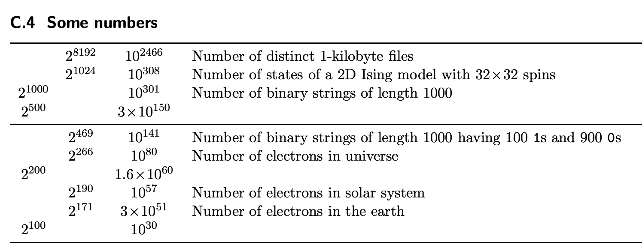

How many effects are there?
10 entities
20 features
100 values per feature
how big is $\sum_{CAUSES}{}$?
each entity can be ${100}^{20}$ different things
total states: ${100}^{20\text{×}10}≈{10}^{400}$
now try to write down P(CAUSES),
or try to draw a proper sample from it
FEATURES OF ENTITIES
…
Relationship to car2
Relationship to child1
type
color
woman
child1
child2
car1
photographer …
ENTITIES IN THE PICTURE

Slide 18
How many histories could have led to here:

Slide 19
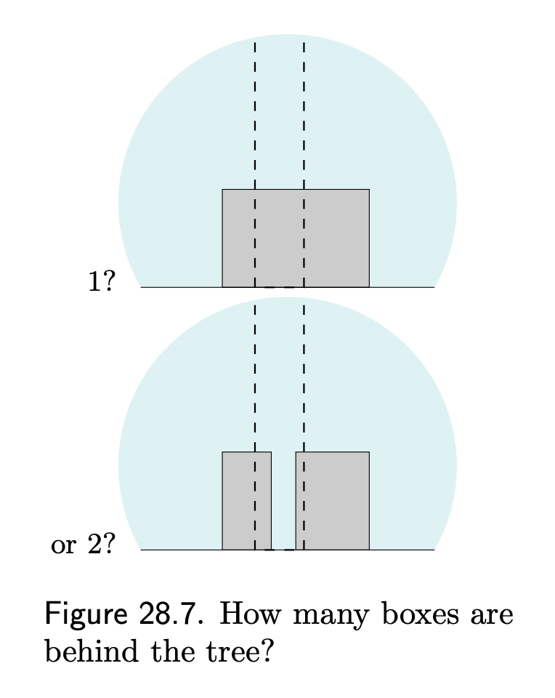
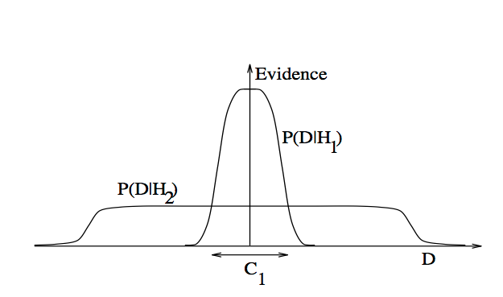
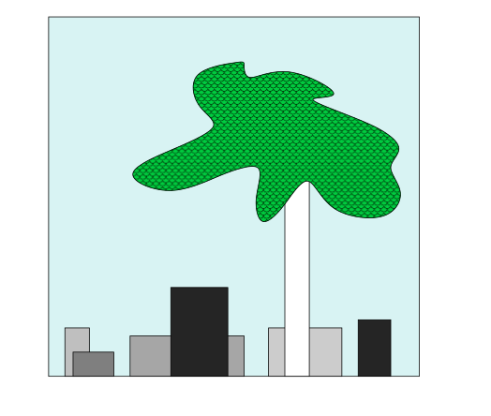
Occam’s Razor
Quantifying size of M
Size of : $P\left(d\right)=\sum_{m}{P(d,m)}$ = -log(free energy)
Or, how much free energy should be converted
into information useful for action?
H_{1,}H₂ are M: sets of all models
Likelihood function has built-in simplicity bias
even if you’re not Bayesian!
High bias, low variance
low bias, high variance
H₁ explains fewer datasets, but does each better,
H₂ explains more datasets, but each less well
From MacKay 2005 www.inference.phy.cam.ac.uk/mackay/itila/book.html
Notes:
Many more ways of arranging two boxes behind the tree so they look like that than one box
Neural Networks are GREAT at being low bias, high variance. But the variance is NOT BIG ENOUGH – somehow the human brain can operate in a zero bias mode when needed – how?
So you’d like to have a low bias and low variance model, but you can’t – these variables are complementary.
So in the end are trading off the flexibility to handle the black swans with the safety knowing what is going to happen.
Need to know in the end how much of this free energy are you going to run into – and make sure your model space \sum_M is big enough to handle it - this means you are constantly considering models that account for a certain degree of black-swanness, so that should one come along, it can be properly consideried
H1 are the models you want to use ... they are better at explaining data ... but you better be sure the black swan lies in C1 not outside of it

Slide 20
Bayesian Brain (Friston, Howhy and Clark)
prior + likelihood = posterior : Bayes Rule
top down prior vs bottom up percepts
expectations (top-down) vs realizations (bottom-up)
both are important
minimize “surprise” or free energy
Surprised agents tend to become dead agents.
Agents with skin in the game don’t want to be dead.
Therefore, agents with skin in the game don't want to be surprised, so…
…they will minimize free energy
Notes:
you figure out the set of models needed by picking the ones with the lowest free energy (expected future free energy)
- that is the same as saying the ones with the highest mutual information between models and world
but remember through all this that as humans, this expected future free energy may be quite challenging to compute, and you may be
better off bumming some off a friend, so to speak.
agents that are surprised are dead
agents don't want to be dead <-- skin in the game
agents don't want to be surprised

Slide 21
Bayesian Brain (Friston, Howhy and Clark)
minimize “surprise” or free energy: two kinds
neural surprise: expectations are not met in the likelihood function
cognitive surprise: expectations are not met in the prior.
precision weighted
Notes:
you figure out the set of models needed by picking the ones with the lowest free energy (expected future free energy)
- that is the same as saying the ones with the highest mutual information between models and world
but remember through all this that as humans, this expected future free energy may be quite challenging to compute, and you may be
better off bumming some off a friend, so to speak.
agents that are surprised are dead
agents don't want to be dead <-- skin in the game
agents don't want to be surprised

Slide 22

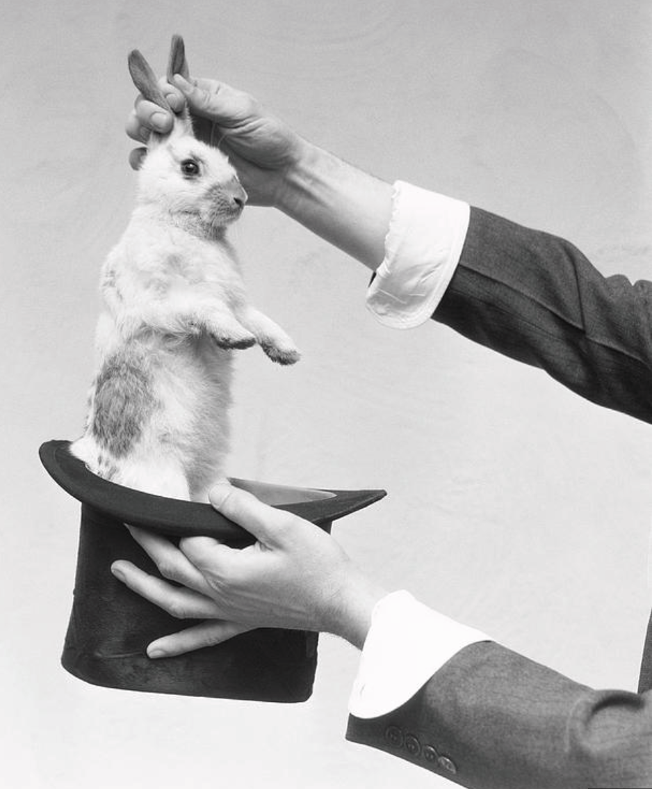
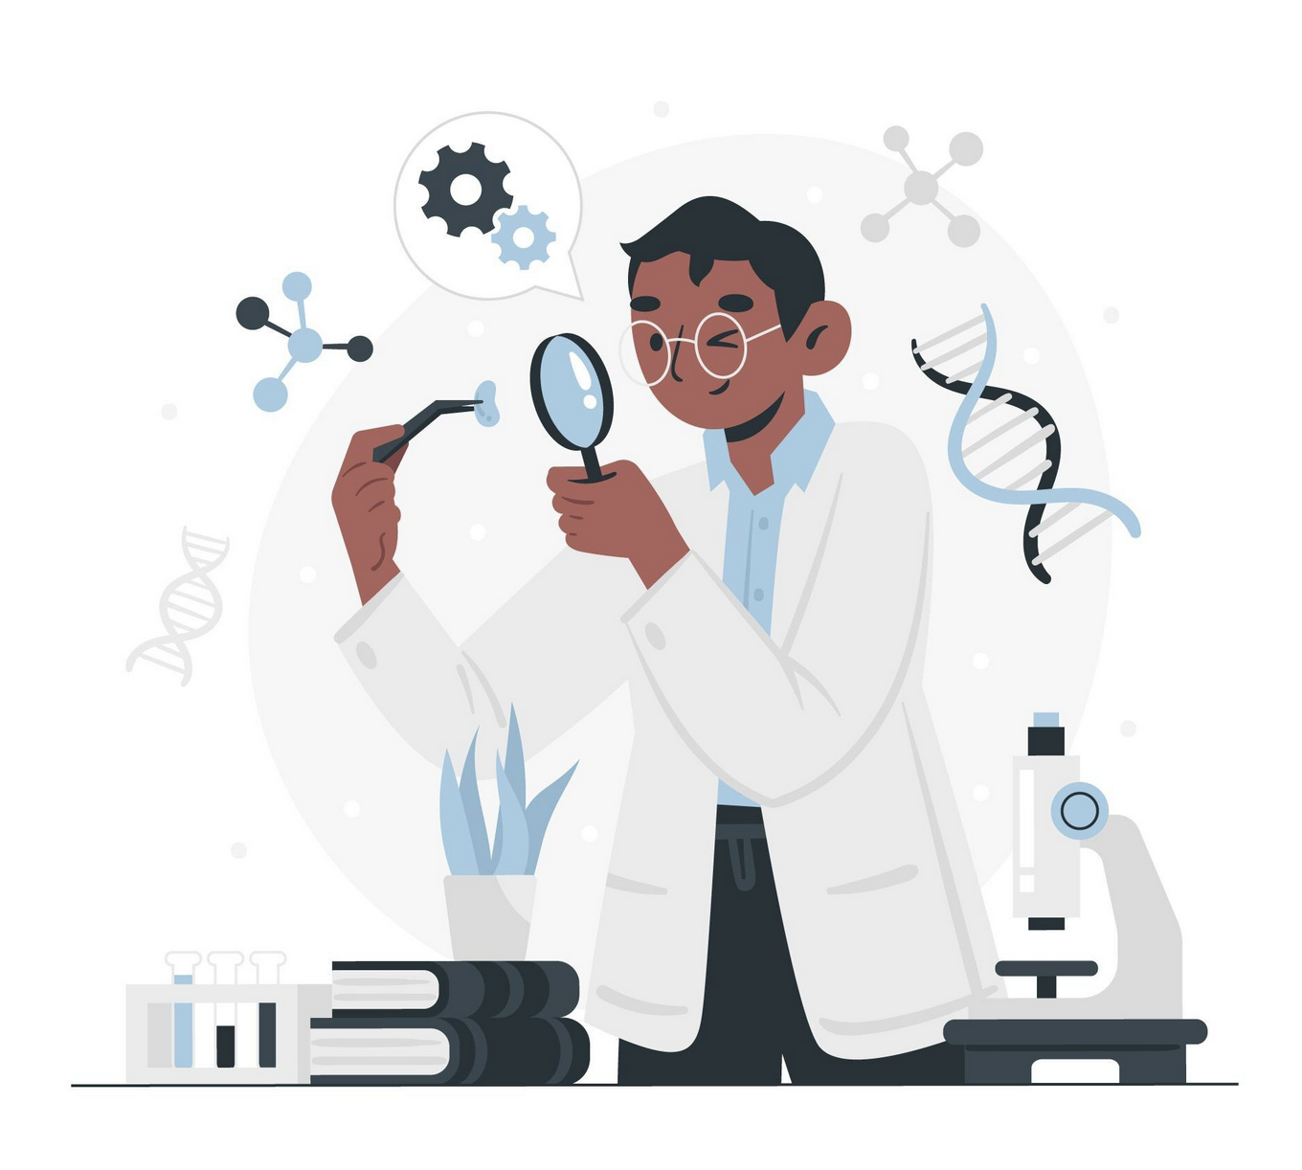
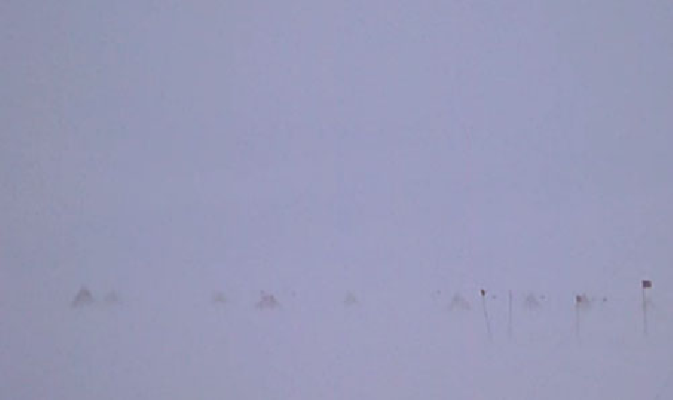
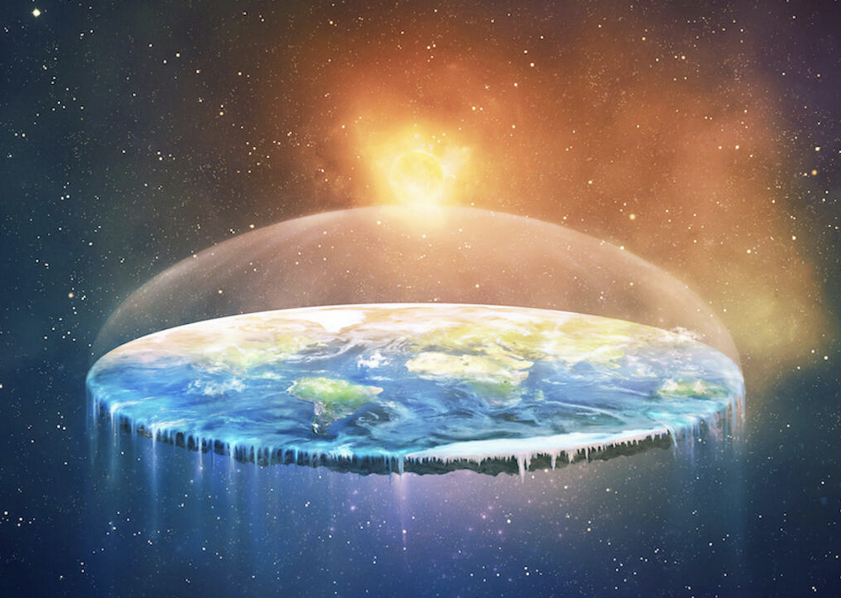
neural surprise vs. cognitive surprise
precision/strength of
evidence
Quid facti?
Scientist with
revisable priors and
strong evidence (rabbit) ”overrules” the prior (no rabbit)
– cognitive surprise
e.g. magician Clark p79
measurable evidence
strong prior beliefs and strong evidence – computational overload and difficulty matching reality.
strong prior beliefs (that the earth is flat) “overrules” the evidence (that it is round) – neural surprise (scientific evidence)
no prior and no evidence – cognitive and neural surprise
e.g. a “whiteout”
precision/strength of belief
Quid juris?
Notes:
top left corner is narrow flashlight, bottom right is wide one
bottom right: schizophrenia
top left: autism spectrum disorder

Slide 23
Free Energy
perceived repetition -> expected regularity [machine learning] OR
expected regularity -> perceived repetition [active inference]?
Where does the prior come from? Nature vs. Nurture, or some combination of both?
You are born with certain priors derived from in utero percepts (e.g. heartbeats, warmth, diffuse light, proprioception)
These provide the “ground” on which the figure of your world is built, the expected regularities above.
self-fulfilling prophecy (Howhy discusses this chapt 4?)
IMPORTANT: these priors encode “skin in the game”: they are your definition of what you believe is going to happen to you…and when.
Notes:
e.g. as a newborn, you believe (your expectations) are that you will hear your mother’s heartbeat. Your expectation is realized : then you feel fine and don’t need to take action. Your expectation is not realized: you don’t feel fine and you need to take action. This is the definition of skin in the game. The baby cries – he is showing his skin in the game by saying he’s willing to reveal his location to get the heartbeat and breastmilk back. Action is called for by skin in the game.
I’m willing to put something on the line for – so I can show roughly how much I value the subsequent events.

Slide 24
Interlude – looking back and forwards
Minimizing free energy by using a carefully chosen set of models in a Bayesian reinforcement learning framework
modeling “just the right amount” of the future and not missing the Black Swan.
Bayesian brain hypothesis shows the same tradeoff between hedgehog and fox – generality and precision – etc
It turns out this can be done in three different ways
(which I can talk about more later)
For now, we will focus on what not having skin in the game implies and what this means for LLMs
Then I will present more detail on some of the applications I have worked on

Slide 25
Machine Learning Bias
expectation
Threshold is arbitrary (from the learning algorithm’s perspective)
$$$
realization
 | Predicted | Predicted
Actual | 18/20=0.9 | 2/20=0.1
Actual | 6/18=0.33 | 12/18=0.67
 | Predicted | Predicted
Actual | 14/20=0.7 | 6/20=0.3
Actual | 2/16=0.13 | 14/16=0.87
Notes:
two examples
COVID: FP > FN
dangerous disease with dangerous treatment: FN > FP
this is something that comes from *outside*
simpler example - bird watching app
what's better a FP or a FN? need to ask a bird watcher
but the ML engineer is going to find out...
if his startup goes under - he got it wrong
again, the threshold is *outside* the system

Slide 26
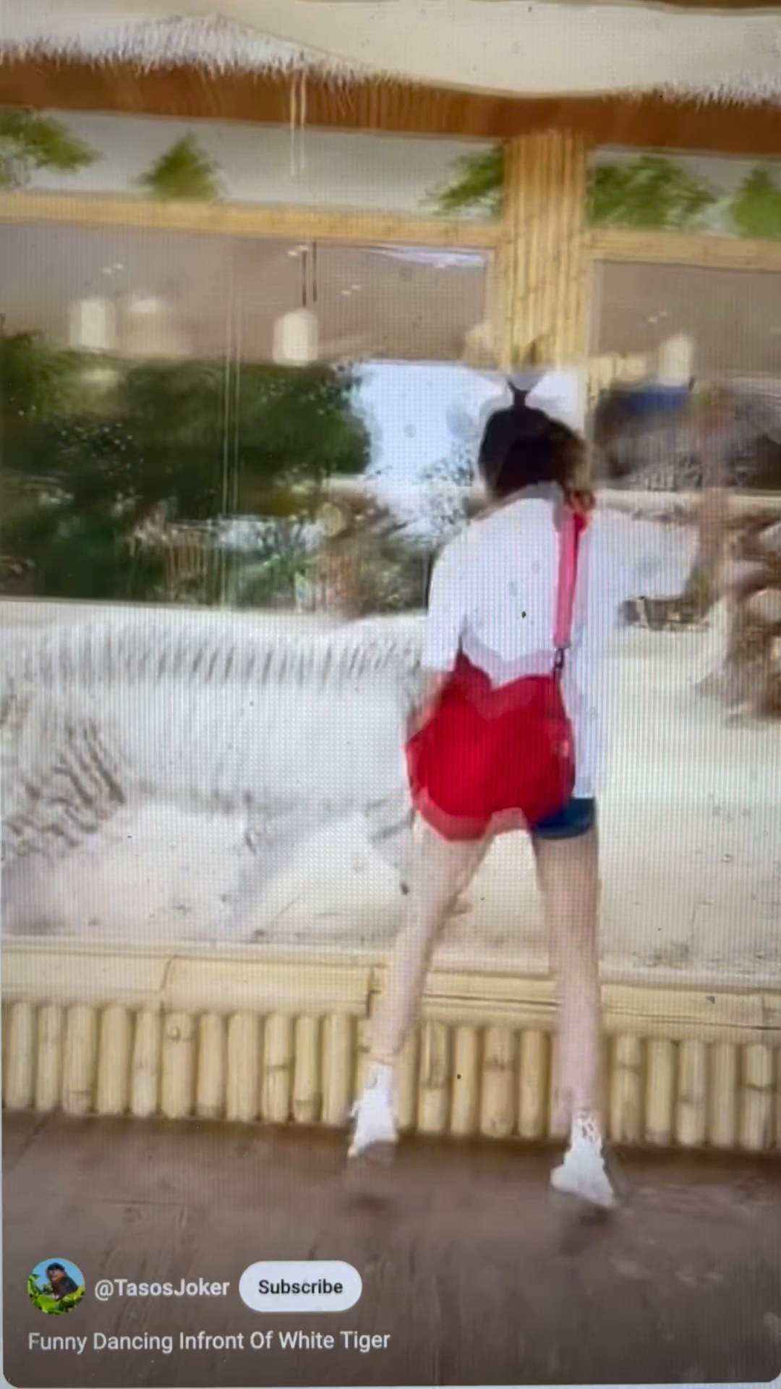
GPT et al. have no skin in the game
Large Language Models (e.g. ChatGPT, GPT-4, Claude…) are machine learning models with this arbitrary threshold
LLMs do not know or care how they get paid
LLMS do not have skin in the game
LLMs require someone to set the threshold
Therefore LLMs do not have to solve the problem of associating their sensations with their survival [[death]]
Notes:
trying to get everything done - a certain amount of urgency

Slide 27
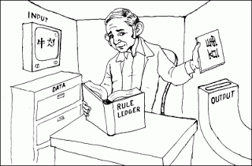
Searle’s Room (Howhy p. 185)
I can't help myself (Yuan and Yu, 2019)
Notes:
voynich manuscript instead of chinese
what would you do?
well, since you have Skin in the game, you would try to get out!
you'd start making "mistakes" in the output, and start a whole second book where you map out what is going on outside the room.
You would start manipulating your outputs to control your inputs.

Slide 28


GPT et al. have no skin in the game
“The falseness of an opinion is not for us any objection to it….The question is how far it is life furthering, life-preserving, species-preserving, perhaps species-creating” – Nietzsche, Beyond Good and Evil, 1886
“knowledge has no final legitimacy outside of serving the goals [of the] autonomous collectivity” – Lyotard 1979, The Postmodern Condition p.36
For an LLM to be truly intelligent, it must:
participate in the autonomous collective,
help define the goals of the collective,
set its own bias (threshold) to serve these goals,
be capable of achieving these goals,
recognize when it has achieved the goals,
recognize when it (and the collective) needs to change.
GPT?

Slide 29
humans as the reflection of society
evidence
precision
agents with skin in the game trade off, weighted by precisions:
society with skin in the game trades off, weighted by precisions:
evidence and beliefs
bottom up vs. top-down
prejudice and irrelevance
prior and likelihood
hedgehog-ness vs foxiness
security vs. innovation
belief (prior) precision

Slide 30
Learning as Societal Adaptation
(Social) Emotionally based
Allows the society to handles surprises that arise from complexity
Cooperative behavior is emphasized
Emotional alignment
Critical for human-centered AI
Example domains: Assistive Technology, Climate Change, Recommender Systems, Robots, General Game Playing, Politics,…
Implementation: BayesACT

Slide 31
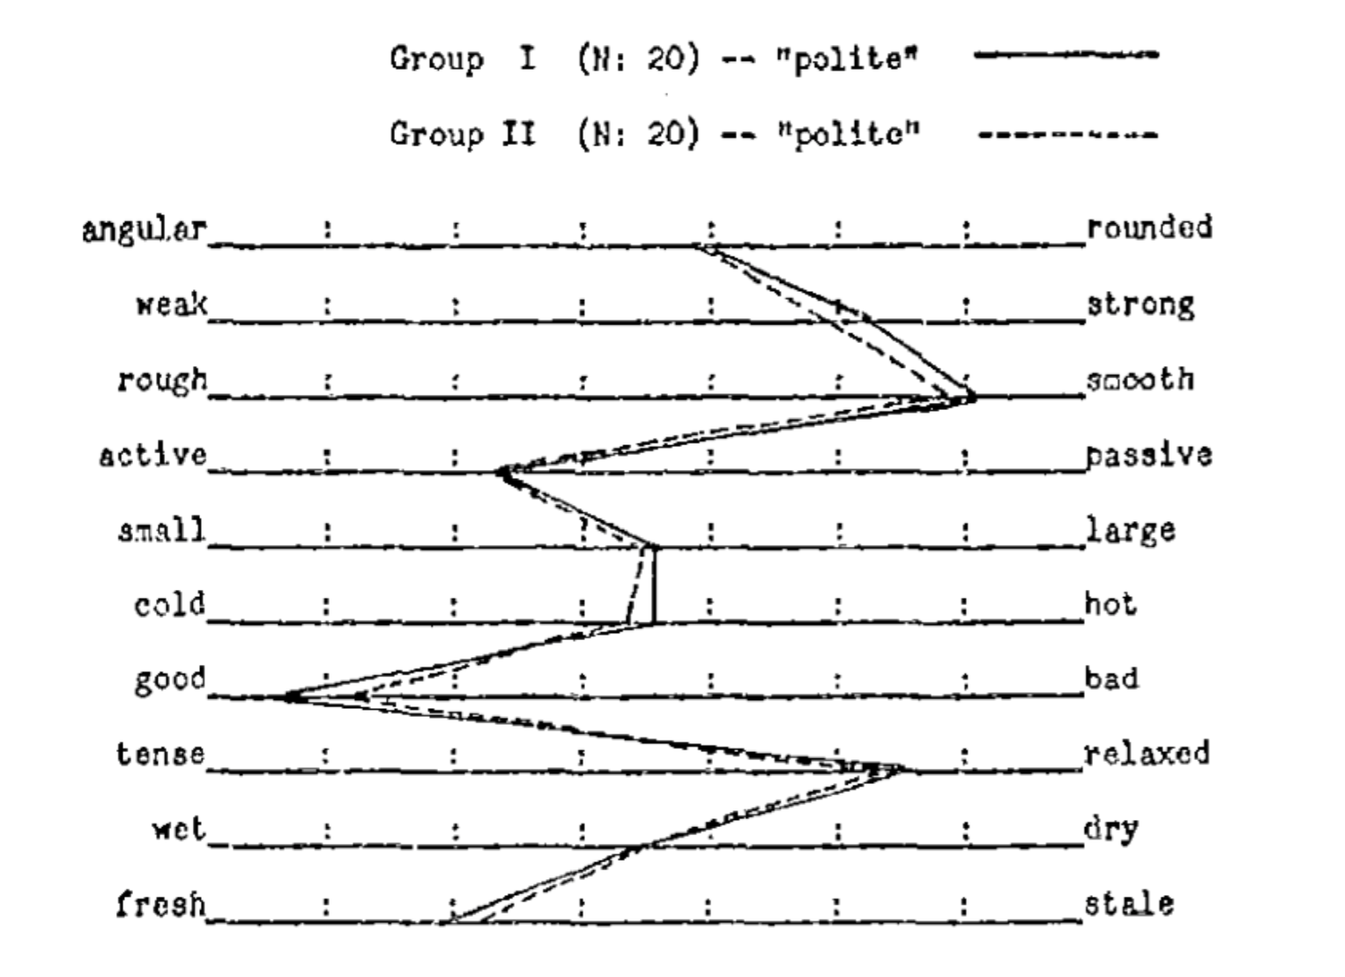
Cultural Consistency: Semantic Differential (Heise, 1969, 2010; Osgood, Suci, & Tannenbaum, 1957)
Notes:
So now we need to figure out how to do all this in a society.

Slide 32
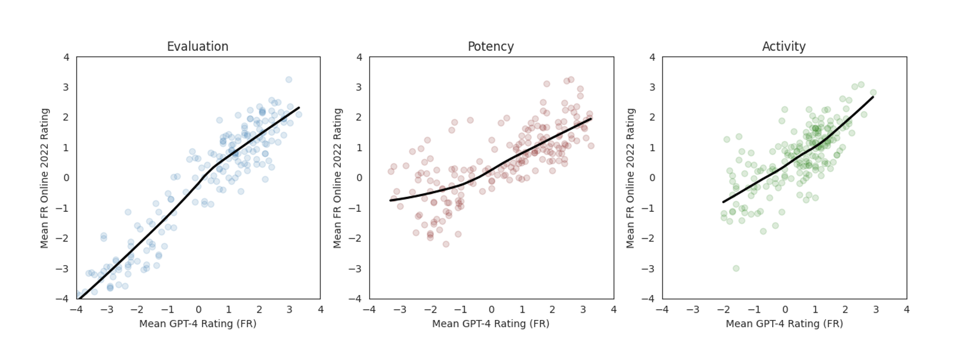
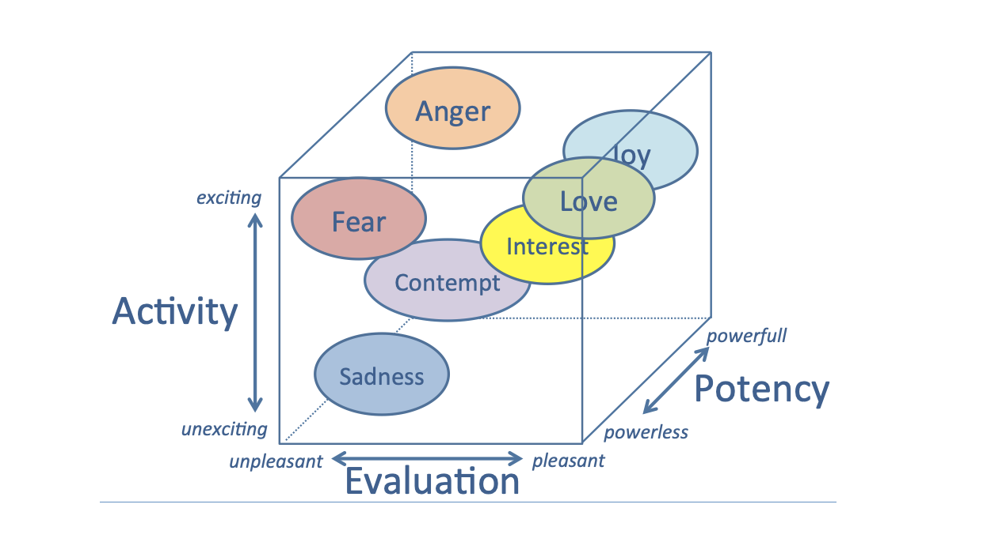
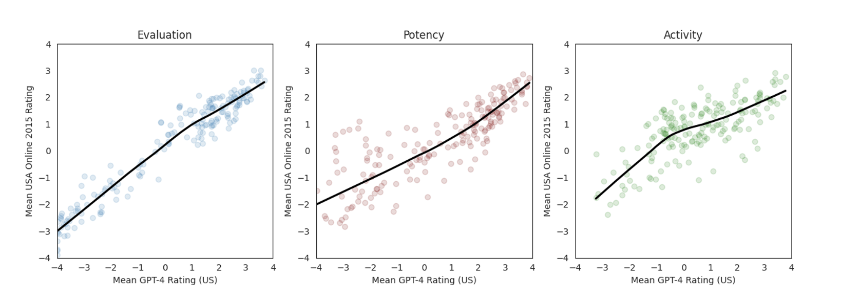
The EPA Model of the Affective Space (e.g., Ertel, 1964; Fontaine, Scherer, Roesch, & Ellsworth, 2007; Mehrabian, 1995; Morgan & Heise, 1988; Osgood, 1962, 1969; Osgood, May, & Miron, 1975)
fight
nurse
comfort
ignore
patient

Slide 33
Affect Control Theory
David Heise, 1979
Powers, 1973 people minimize
incongruence by controlling perception
f: fundamentals • τ: transients
deflection D = ∑ w_{i} (f_{i} − τ_{i} )²
Affect Control Principle:
actors work to experience
in-context sentiments (transients)
that are consistent with their
out-of-context sentiments (fundamentals)
emotion ε ∝ f − τ
bureaucrat
trainee
Notes:
Returning to ACT – here is a better picture of it and let’s dig into more details

Slide 34
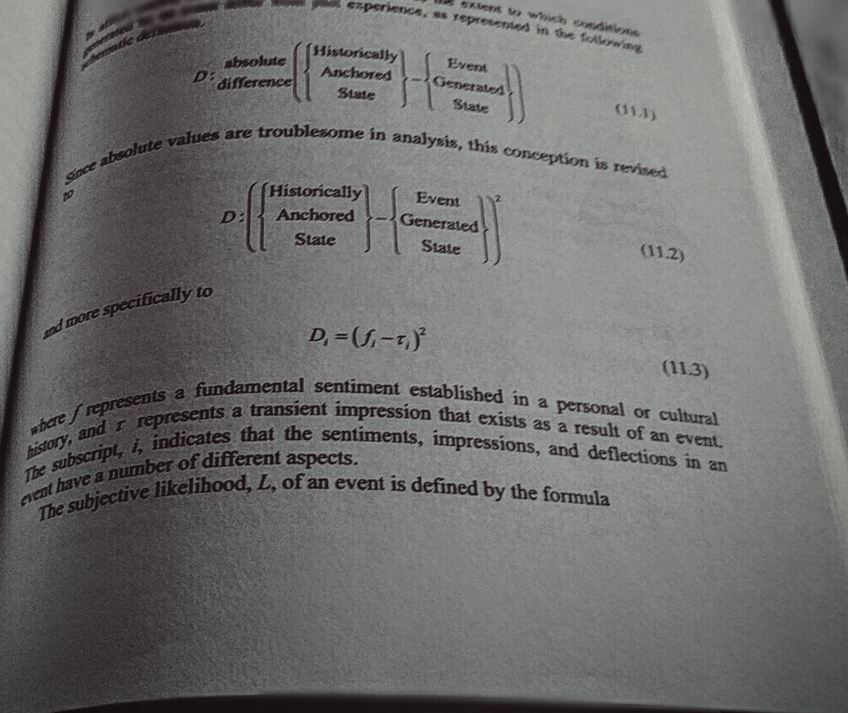
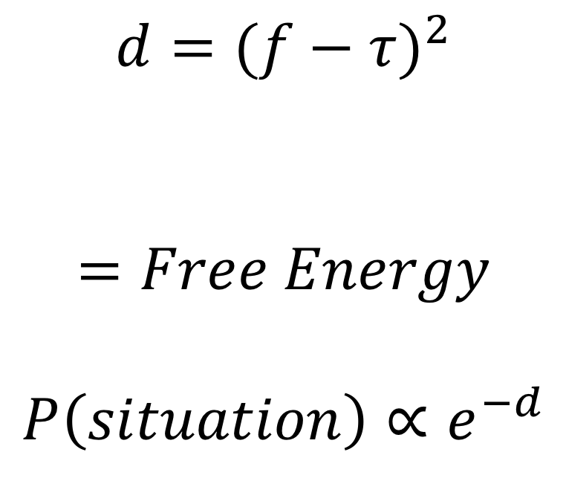
Enter Sentiment and Deflection
$$d={(f−τ)}^{2}$$
$$=Free Energy$$
$$P\left(situation\right)∝e^{−d}$$
expect
realize
Notes:
The free energy – like the balls in the air (potential energy) – is something that a physical system can reach out and take hold of, and turn into order.

Slide 35
BayesACT
Probabilistic Generalization of ACT as a
Partially Observable Markov Decision Process (POMDP)
O_{y}
backchannel observations -- emotional signaling
model space -- connotative: cultural sentiments
Y
action space
a
transform functions -- Neural/Bayes Nets
time
X
state space denotative
Bayesian Reinforcement Learning
O_{x}
evidence/observations
sensors

Slide 36
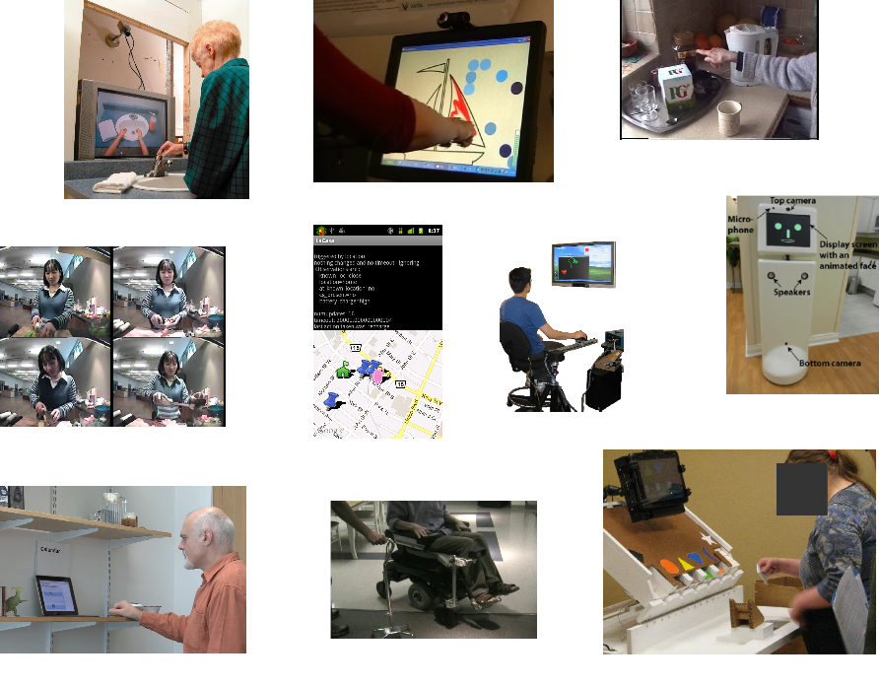
Cognitive Assistive Technologies

Slide 37


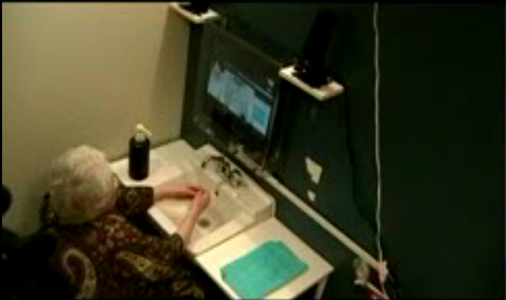
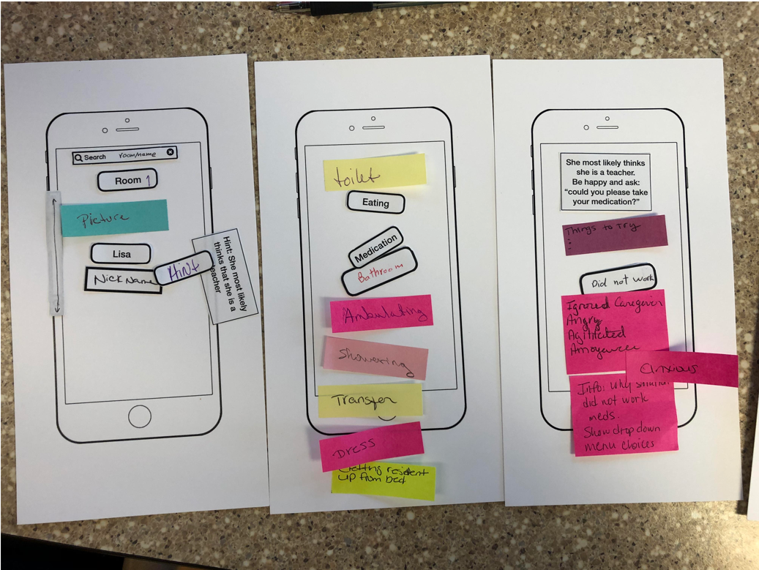
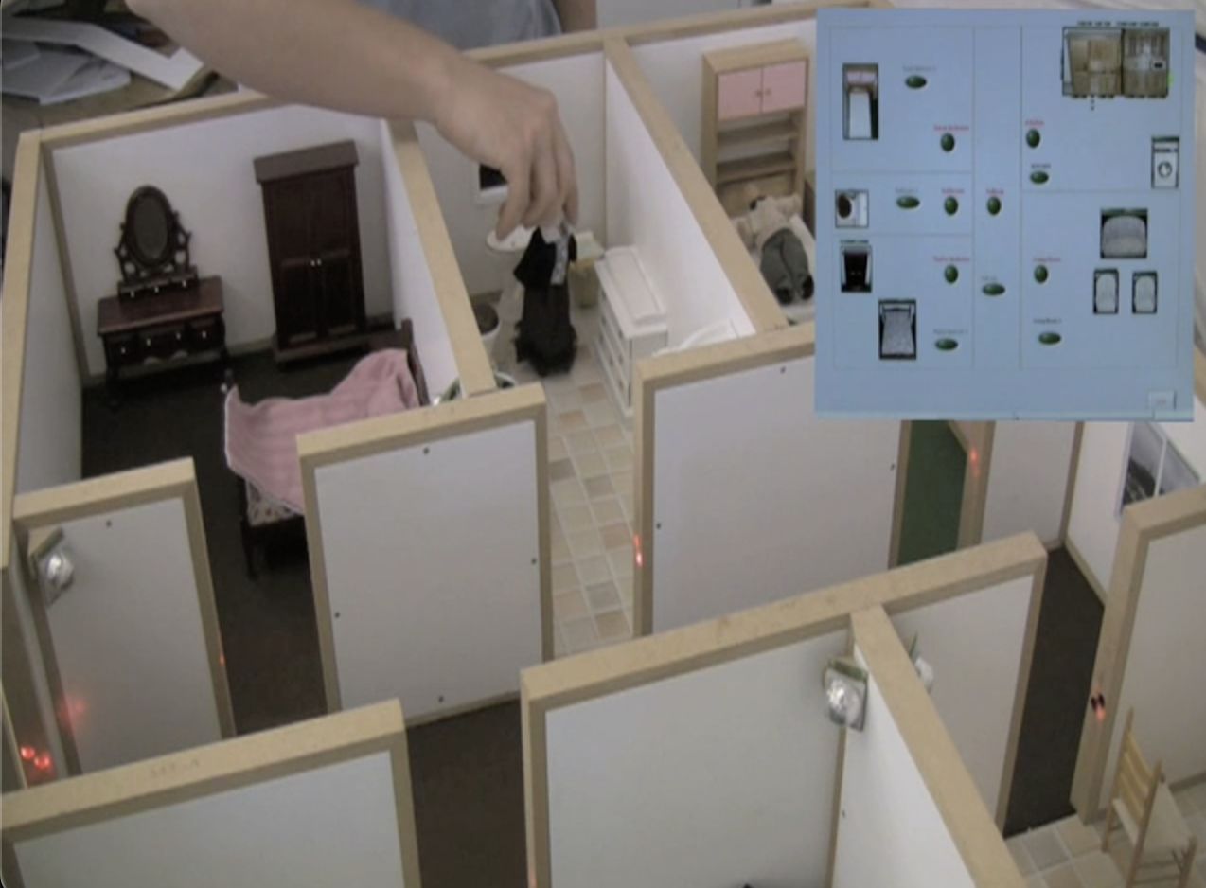

Human-Centered AI: Key Elements
ALIGNMENT
FUNCTION
emotion
identity
culture
sensing
deciding
acting
COLLABORATION
customizability
adaptivity
knowledge elicitation

Slide 38
Assistive Technology: Recent Work
ACT@HOME - Qualitative study of biographical identities in dementia
Alexandra Koenig (Waterloo), Alex Mihailidis (Toronto)
EMOTEC - Understanding perceptions of identity
Julie Robillard (UBC)
DISRUPT – Robots for Elder Care
Julie Robillard (UBC) and Moojan Ghafurian (Waterloo)
VIPCare - Building applications for caregivers
Linda Francis (Cleveland State), Moojan Ghafurian (Waterloo)
NEATO - Understanding biographical narratives
Heather Love, Heather Eustace, Renee Leung (Waterloo)

Slide 39
ACT@HOME
Alexandra König
self-sentiment
…people with dementia remember how they feel, not who they are.

Slide 40
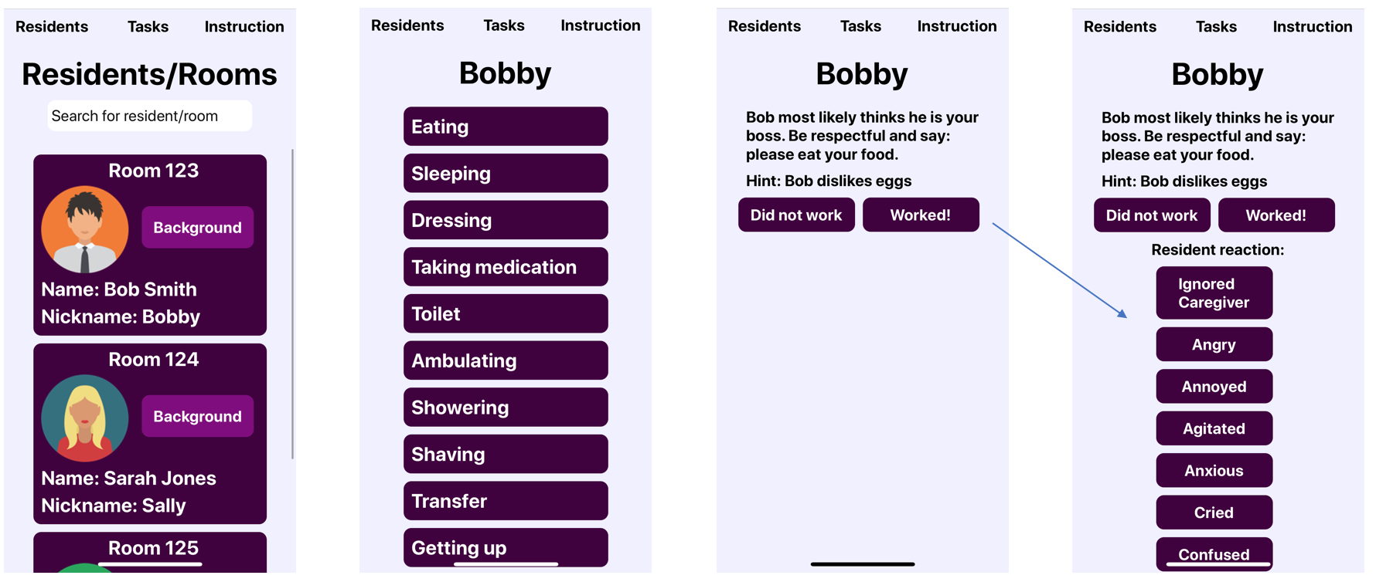
VIPCare: Co-Design
Avon Oaks Caring Community (Cleveland)
“...there are 30 residents, and you live in 30 different realities in a matter of 24 hours, so you have to figure out which one you are in.”
Moojan Ghafurian
Derek Tao

Slide 41
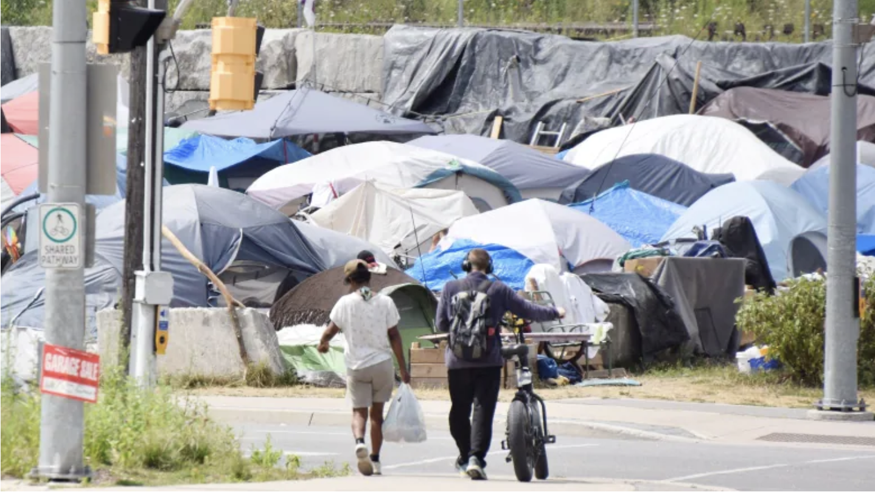
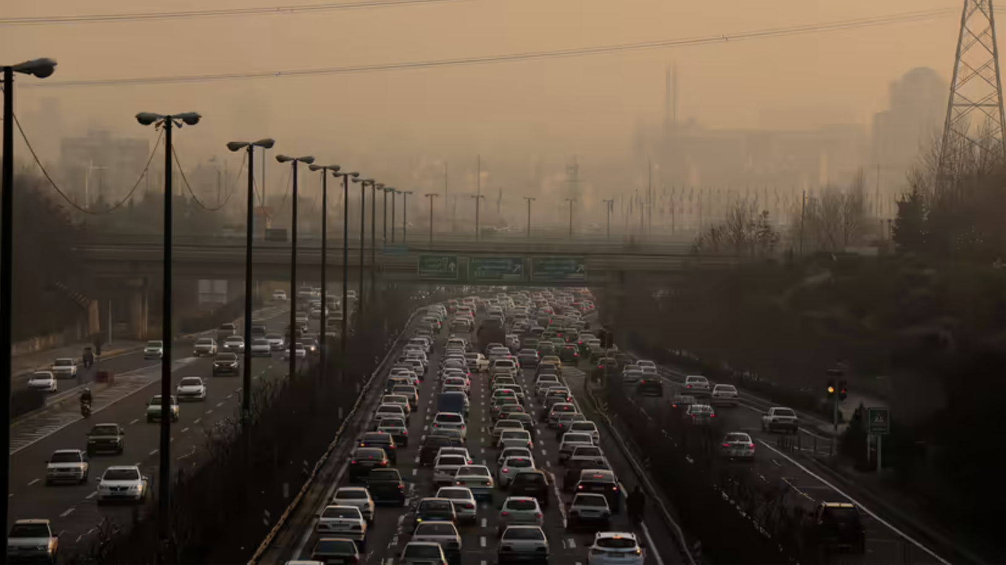
Human Society: a complex system
Build AI to work with people in a way that enhances collaboration and cooperation and preserves freedom/independence?
Can artificial agents become full-fledged members of a human society?
Is emotional alignment the social glue that holds groups together, yet allows innovation?
”…you have to build a relationship of trust first, then you can provide assistance.” --- Peter McKechnie, Sanguen Mobile Health, Kitchener
Can AI use emotional alignment to promote human benefits (e.g. U.N. Sustainable Development Goals)?
Notes:
Events are PATH dependent – many different chains of interactions can happen to produce events
So, if we do statistical machine learning for climate change – we are GUARANTEED TO BE WRONG
And the problem is with climate, as with economics and politics, the things you miss could be extremely costly
"It is far easier to figure out if something is fragile than to predict the occurrence of an event that may harm it." - Nassim Nicholas Taleb in Antifragile

Slide 42
Recent and Current Collaborators:
Alex Mihailidis (Toronto)
Tobias Schroder (Potsdam)
Julie M. Robillard (UBC)
Chris Nugent (Ulster)
Luke Chen (Ulster)
Heather Love (Waterloo)
Shehroz Khan (Toronto)
Charlene Chu (Toronto)
Kathryn Lively (Dartmouth)
Mary Step (Cleveland State)
Enrique Sucar (INAOE)
Current Students and
Postdocs (Waterloo):
Renee Leung
Jess Gano
Blake Vanberlo
Christopher Risi
Heather Eustace
Alyssa Clarkson
Joshua Jung
Aarti Malhotra
Freya Zhang
Gabby Chan
Wasif Khan
Sarel Van Vuuren (Colorado)
James Tung (Waterloo)
Rosalie Wang (Toronto)
Neil MacKinnon (Guelph)
Alexandra Konig (INRIA)
Stefan Teipel (Rostock)
Francois Michaud (Sherbrooke)
Linda Francis (Cleveland State)
Kimberly B. Rogers (Dartmouth)

Slide 43
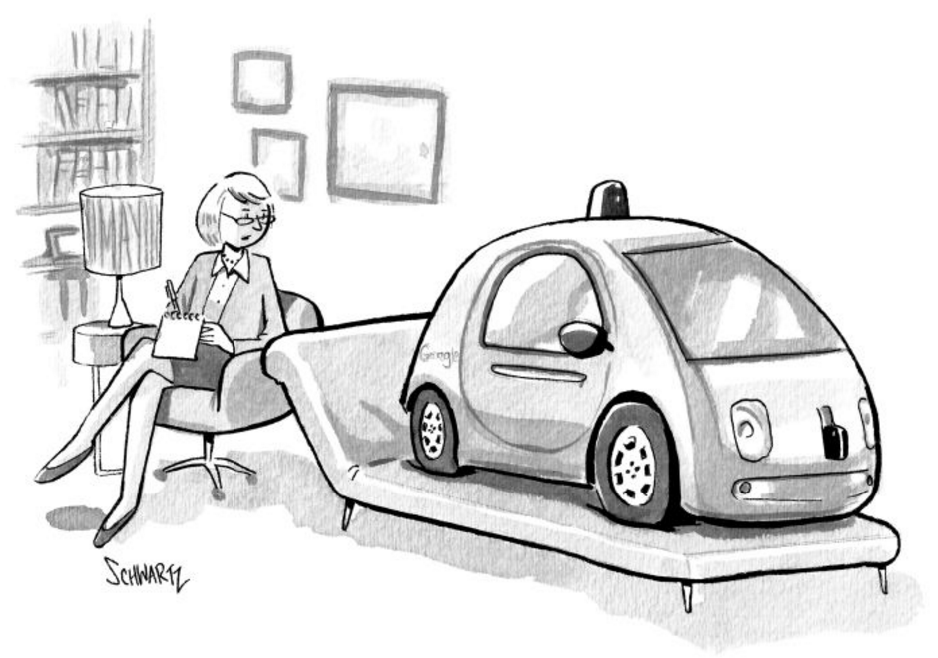
Selected Readings, or my favorite CogSci books:
(not ACT related)
Graeber and Wengrow, The Dawn of Everything, 2021
Henrich, The Weirdest People, 2020
Taleb, Skin in the Game, 2020
Mercier and Sperber, The Enigma of Reason, 2017
Anderson, Private Government, 2017
Clark, Surfing Uncertainty, 2016
Howhy, The Predictive Mind, 2013
Lawler, Thye & Yoon, Social Commitments, 2009
DJC MacKay, Information Theory, 2003
Lakoff & Johnson, Philosophy in the Flesh, 1999
Damasio, Descarte’s Error, 1994
Sartre, Being and Nothingness, 1943
jhoey@uwaterloo.ca
cs.uwaterloo.ca/~jhoey/teaching/cogsci600/

