Slide 1
The Delayed Choice
Quantum Eraser Experiment
Presented by Ian Davis
A validated experiment that raises questions about our notion of time
Class Presentation: QIC890

Slide 2

The ancients on time
Aristotle
  Time emergent property of change
  Time is natures way of stopping everything from happening all at once
St Augustine
  Time had a beginning
  Stopping clocks does not stop time
  Time is an objective reality

Slide 3
Time is a consequence of consciousness
  The past is no longer, it was.
  The future is not yet, but it will be.
  The present is, but cannot last because if the present would last, then it would be eternity and not the present.
  The present’s being as time depends on its perpetual flowing or passing away.
  The present lacks dimension; therefore it cannot be.
  Thus time depends on its non-existence.
  Past, present and future can be found only in the mind
Conclusion: Time is subjective and has no reality
www.ijhssnet.com/journals/Vol_6_No_6_June_2016/4.pdf

Slide 4
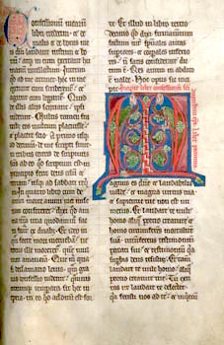
The dilemma - ~AD 350
“What, then, is time? If no one asks me, I know; if I wish to explain to him who asks, I know not.
Yet I say with confidence, that I know that if nothing passed away, there would not be past time; and if nothing were coming, there would not be future time; and if nothing were, there would not be present time.”
The Confessions - Book XI

Slide 5
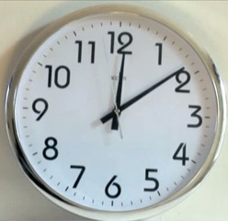
1600 Years Later – Zero progress
The block universe (Eternalism)
  Time is a real illusion because we experience it
  There is symmetry between the one past and the one future
  Another's past is my future so there is no “now”
The modified block universe (Eternalism + Presentism)
  The past is fixed but the future open (expanding outwards)
  Past and future are foundationally asymmetric
  They are divided by the vanishingly brief present
The vanishingly thin universe (Presentism)
  Only the present moment exists
  We remember a past which no longer exists
  We anticipate a future that does not yet exist
  en.wikipedia.org/wiki/Eternalism_(philosophy_of_time)

Slide 6

Jenann Ismael
  The block universe is not a changing picture. It’s a picture of change. For those who wanted to read more? I recommend Aristotle.
  www.quantamagazine.org/a-debate-over-the-physics-of-time-20160719/
  www.jenanni.com

Slide 7
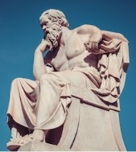
My philosophy
I don’t believe there is some special “now”
  There is no special “here”
  With relativity different observers can disagree on what the “now” is
  For someone in the Andromeda Galaxy I have no special “now”
    When they walk towards me I’ve already presented this talk
    When they walk away from me I haven’t yet started preparing it
  Why should I presume my “now” any more real than the “now” of others
Symmetric between past and future is the simpler proposition
  How does an asymmetric future become part of the symmetric past
  The present is not a dimensionless point in which nothing can happen
  It is a blurred grey area between past and future in which things do happen
  It is easier to erase notion of past and future than explain the interface between them
I reject presentism
  It renders our entire universe (and more important us) utterly pointless
  It absolves past crimes and refutes moral frameworks
  If the past didn’t exist, then I’d have to invent it
  CBC: Living on Oxford Time

Slide 8

What about free will
  We have freedom to choose our future
    Any of us could choose to not do a presentation
  We have no ability to change what our future will be
    There is only one future
    Only this one future can possibly be arrived at
  Both statements are equally valid
  There is no contradiction here
  But there is a the expectation that past determines future
  “There’s a long history of discussion about the truth-values of future contingent statements — and it really has nothing to do with the experience of time.”
  – Jennan Ismael

Slide 9
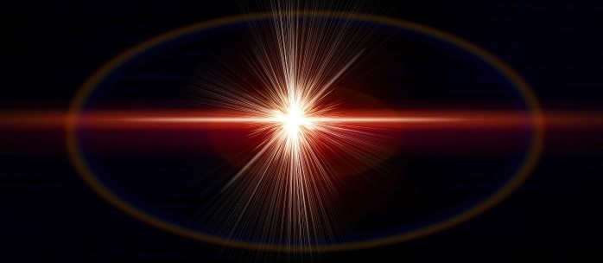
A Historic Question: What is a photon?
Is it a wave or a particle?
How does it travel across the universe?
How does it change between states?
How does it relate to measurement?
How can we make any sense of observed experimental results ?

Slide 10
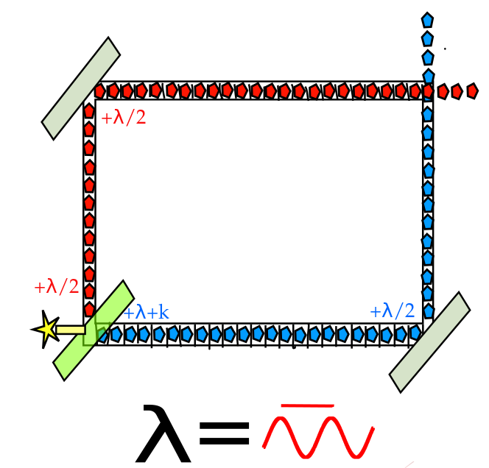
Wheeler’s Delayed Choice Experiment

Slide 11
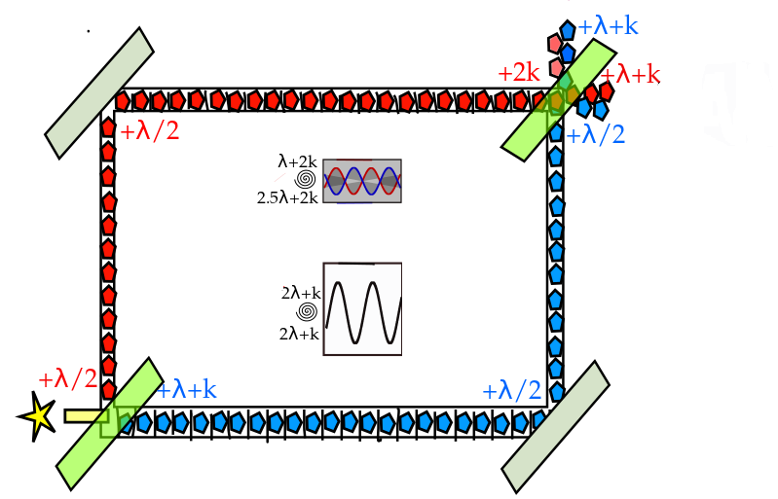
Wheeler’s Delayed Choice Experiment
https://en.wikipedia.org/wiki/Wheeler%27s_delayed-choice_experiment

Slide 12
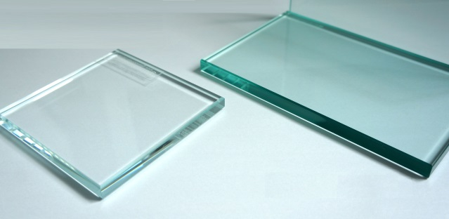
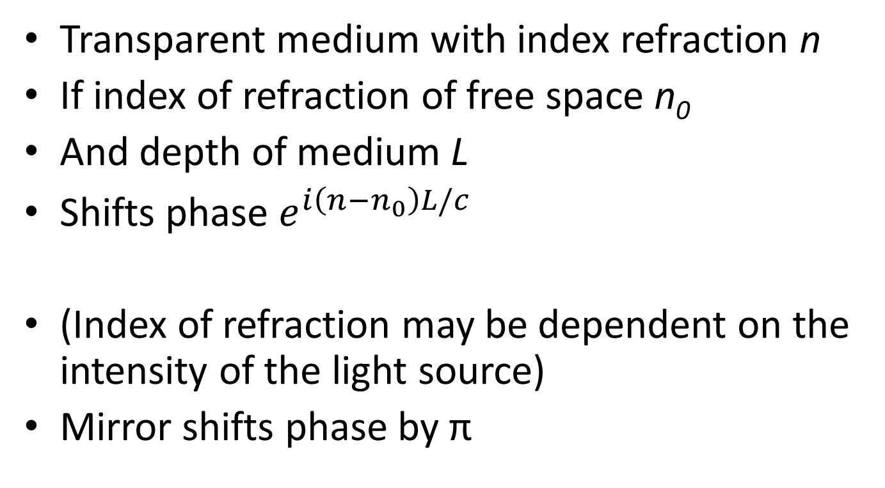
Phase shifter
Transparent medium with index refraction n
If index of refraction of free space n₀
And depth of medium L
Shifts phase $e^{i\left(n−n_{0}\right)L/c}$
(Index of refraction may be dependent on the intensity of the light source)
Mirror shifts phase by π

Slide 13
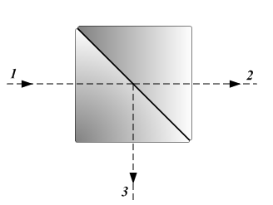
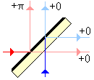
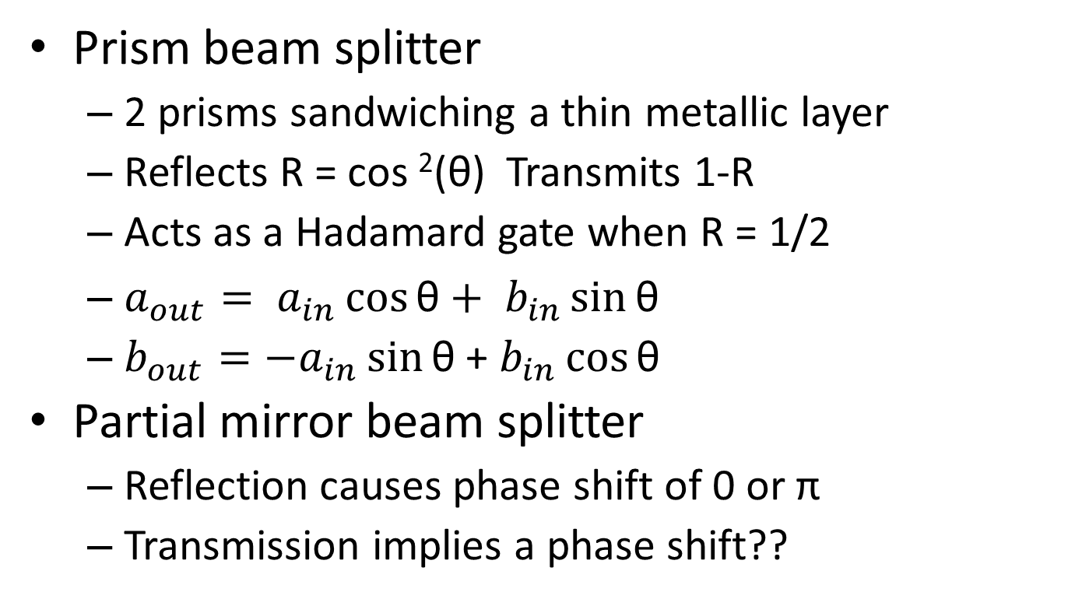
Beam Splitter
Prism beam splitter
  2 prisms sandwiching a thin metallic layer
  Reflects R = cos ²(θ) Transmits 1-R
  Acts as a Hadamard gate when R = 1/2
  $a_{out}= a_{in}\cos{\text{θ}+ b_{in}\sin{\text{θ}}}$
  $b_{out}=−a_{in}\sin{\text{θ}}$ + $b_{in}\cos{\text{θ}}$
Partial mirror beam splitter
  Reflection causes phase shift of 0 or π
  Transmission implies a phase shift??
+k?
+2k?
+k?

Slide 14
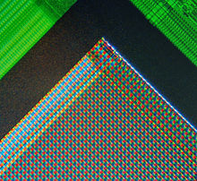
The detector
Historically:
  A photon detector scanning the x axis
  Could miss photons?
Now:
  A camera imaging sensor.
  Connected to computer software
  AI to identify presence of interference pattern

Slide 15
The experimental conclusion
Only an observed phenomenon is a phenomenon
No a-priori decision to be wave or particle
Presumption that it must be one or other false
The experimental setup determines behaviour
The mathematics determines the outcome
Math is predicated on what actually occurs
The photon is destroyed when measured

Slide 16
Extending the idea
What if the photon wasn’t destroyed?
What if it had an entangled twin photon?
How would measurement be correlated?
“Delayed Choice Quantum Eraser Experiment”
  Marian O. Scully and Kai Druhl Quantum eraser: A proposed photon correlation experiment concerning observation and "delayed choice" in quantum mechanics
  Physics Review A Vol 25 4 April 1982

Slide 17
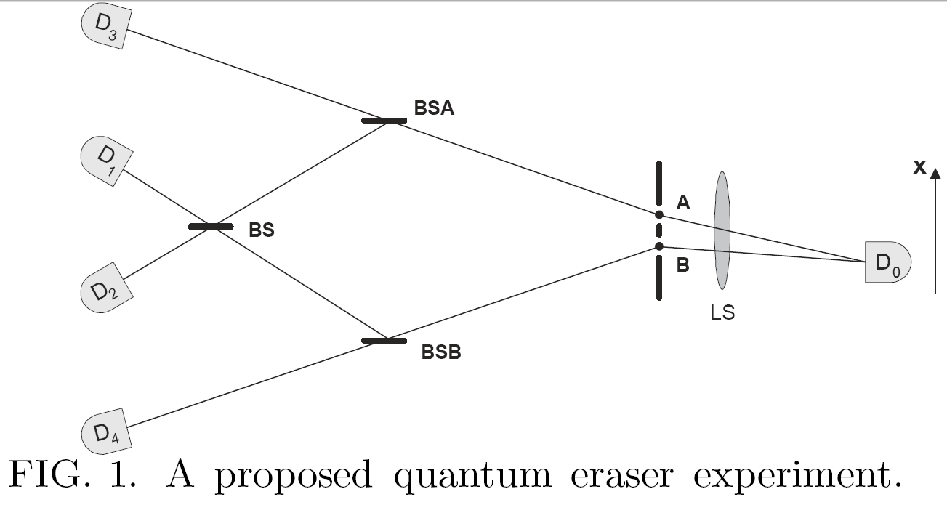
The proposed setup
“Quantum Eraser: A proposed photon correlation experiment concerning observation and “delayed choice” in quantum mechanics”

Slide 18
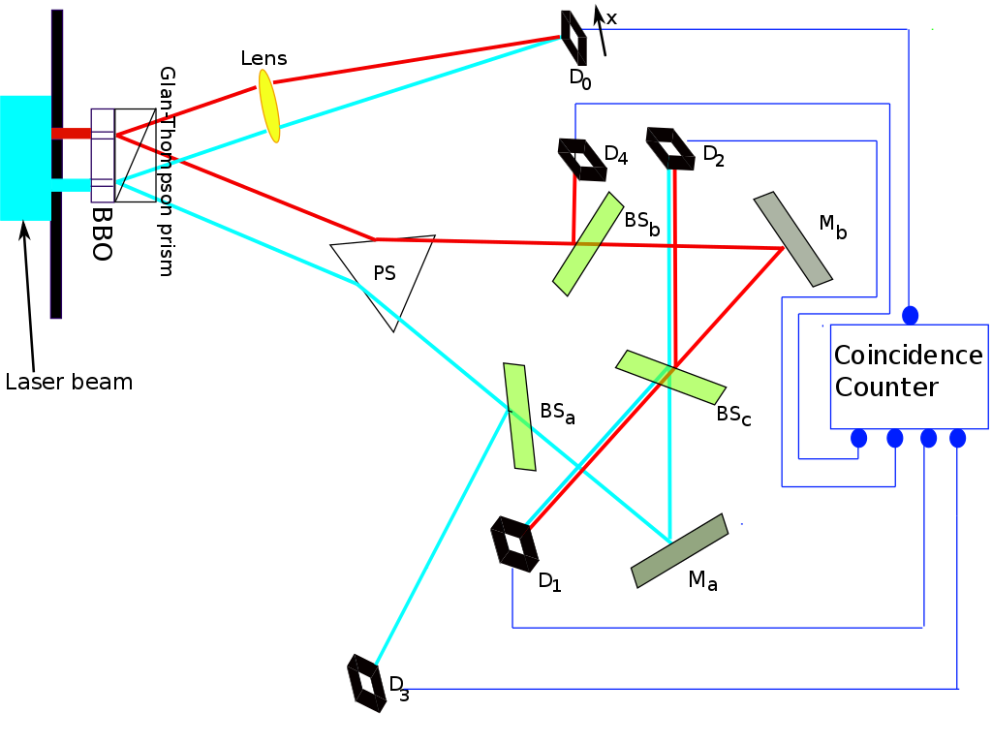
The implementation
Y-H Kim, R. Yu, S.P. Kulik, Y.H. Shih, M.O. Scully A Delayed Choice Quantum Eraser https://arxiv.org/abs/quant-ph/9903047

Slide 19
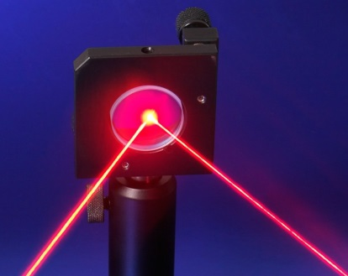
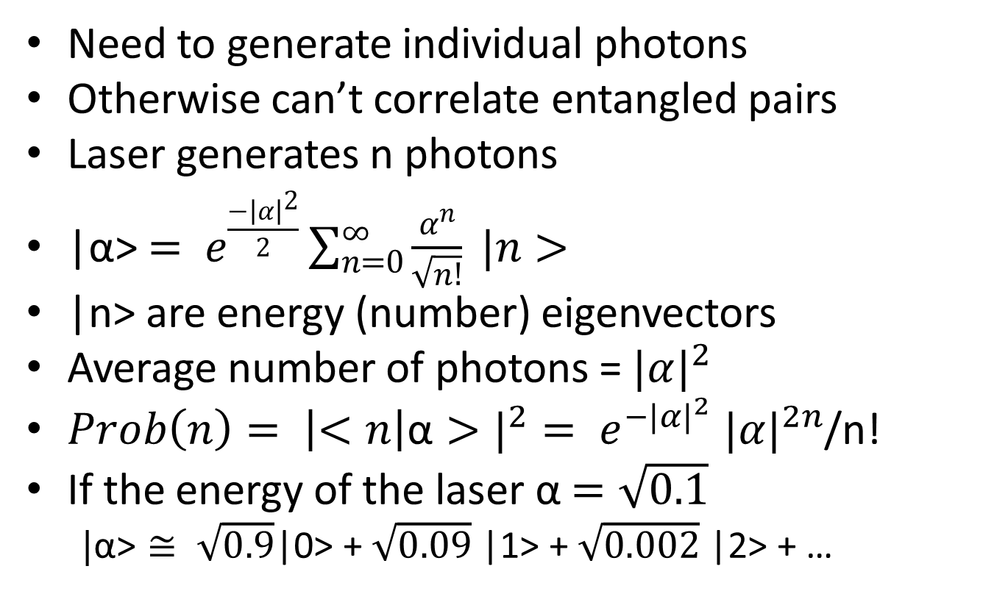
Attenuating the laser
Need to generate individual photons
Otherwise can’t correlate entangled pairs
Laser generates n photons
|α>$= e^{\frac{{−\left|α\right|}^{2}}{2}}\sum_{n=0}^{∞}{\frac{α^{n}}{\sqrt{n!}}} |n>$
|n> are energy (number) eigenvectors
Average number of photons = ${|α|}^{2}$
$Prob\left(n\right)= {\left|<n\right|\text{α}>|}^{2}= e^{{−|α|}^{2}} {|α|}^{2n}$/n!
If the energy of the laser α $=\sqrt{0.1}$
  $|\text{α}\text{>}≅ \sqrt{0.9}$|0> + $\sqrt{0.09}$ |1> + $\sqrt{0.002}$ |2> + …

Slide 20
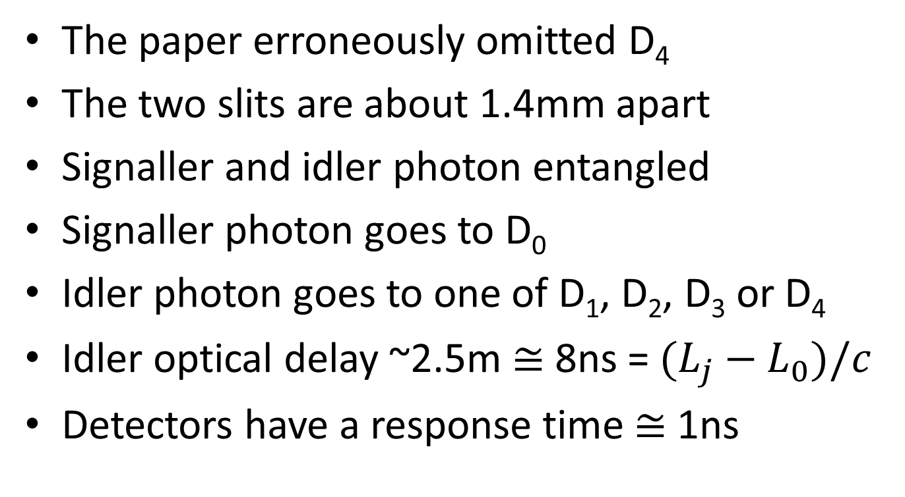
Some comments
The paper erroneously omitted D₄
The two slits are about 1.4mm apart
Signaller and idler photon entangled
Signaller photon goes to D₀
Idler photon goes to one of D₁, D₂, D₃ or D₄
Idler optical delay ~2.5m $≅$ 8ns = $(L_{j}−L_{0})/c$
Detectors have a response time $≅$ 1ns

Slide 21
The results
No interference pattern is initially seen at D₀
However when photons are correlated by time of arrival (accounting for the lag):
  Interference at D₀ when idler detected at D₁ or D₂
  No interference when idler detected at D₃ or D₄
  Combining D₁ and D₂ masks the interference
    The bright bands are out of phase by π
https://en.wikipedia.org/wiki/Delayed-choice_quantum_eraser

Slide 22
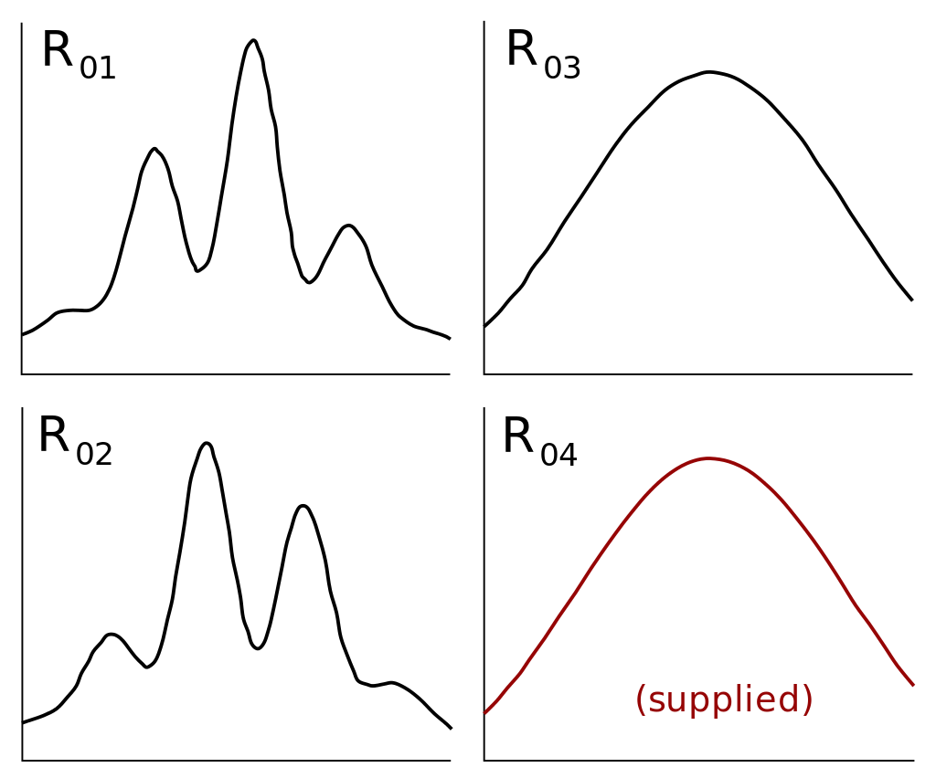

Slide 23
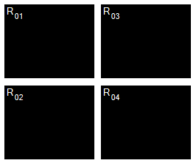

Slide 24
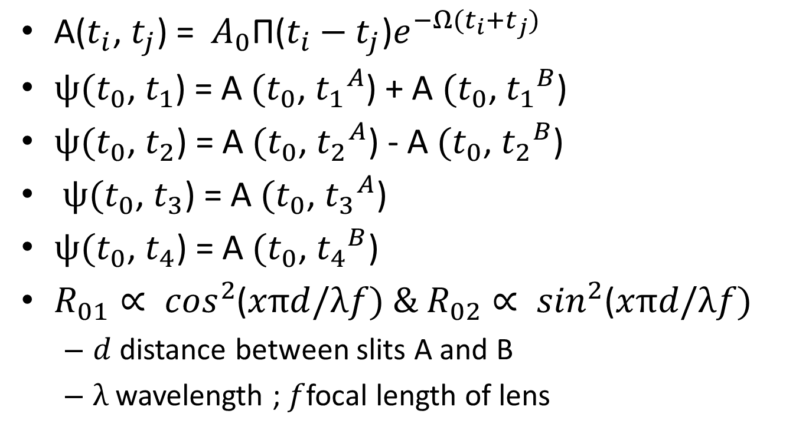
The math in the paper
$\text{A}\text{(}t_{i}\text{, }t_{j}\text{) = }A_{0}\text{Π}\text{(}t_{i}−t_{j}\text{)}e^{−Ω(t_{i}+t_{j})}$
$ψ(t_{0}$, $t_{1}$) = A $(t_{0}$, ${t_{1}}^{A}$) + A $(t_{0}$, ${t_{1}}^{B}$)
$ψ(t_{0}$, $t_{2}$) = A $(t_{0}$, ${t_{2}}^{A}$) - A $(t_{0}$, ${t_{2}}^{B}$)
$ψ(t_{0}$, $t_{3}$) = A $(t_{0}$, ${t_{3}}^{A}$)
$ψ(t_{0}$, $t_{4}$) = A $(t_{0}$, ${t_{4}}^{B}$)
$R_{01}∝ \cos^{2}$($xπd/λf) \& R_{02}∝ \sin^{2}$($xπd/λf)$
  $d$ distance between slits A and B
  $λ$ wavelength ; $f$focal length of lens

Slide 25
The math explained
If measurements A and B commute result of both is independent of time and space
  D0 observable = B0 ⊗ I
  D1 observable = I ⊗ A1
  D2 observable = I ⊗ A2
  D3 observable = I ⊗ A3
  D4 observable = I ⊗ A4
Conditional probability raises the issue of time
  But hold for measurements past, present and future.

Slide 26
The Wave Function
|Photon>→(|L>+|R>)/√2 →
(|L_{S}>|L_{I} >+|R_{S}>|R_{I}>)/√2 →
|D0>(|L_{S}>|L_{I}>(|D1>/√8+|D2>/√8+|D4>/2) +
|R_{S}>|R_{I}>(|D1>/√8+|D2>/√8+|D3>/2))
Measurements:
|D0>(L_{S}>+|R_{S}>)√2 ⊗ (|L_{I}>+|R_{I}>)√2|D1>
|D0>(L_{S}>+|R_{S}>)√2 ⊗ (|L_{I}>+|R_{I}>)√2|D2>
|D0>|R_{S}> ⊗ |R_{I} > |D3>
|D0>|L_{S}> ⊗ |L_{I}> |D4>
Collapse of super-position of which slit is non-local
Because this super-position is itself entangled between signal & idler

Slide 27
Why is this remarkable
Once a photon is detected at D₀
  It’s position is fixed
  It’s relationship to other photons at D₀ is fixed
  But twin photon may not yet have arrived at D_{j>0}
  Many photons may arrive at D₀ before any at D_{j>0}
  YET patterns at D₀ are predicated on a future event
Does arrival at D₀ fix the path for the idler photon
  What about freedom of choice to change path
Does arrival at D_{j>0} result in retro-causality at D₀
  This opens up readily constructed paradoxes

Slide 28
Wheeler’s question revisited
What happens if we change the setup in flight
A thought experiment:
  Replace BS_{a} and BS_{b} by mirrors.
  Combine D₁ and D₂ to produce interference
  Emit a strong beam of entangled photons
  Spin an opaque barrier at fixed speed in path
    To create regular breaks in the beam
  Reflect two idler beams back to earth from Mars.
    25 minute delay (per relay) (Moon is 2.5 seconds)
    Any desired delay can be constructed

Slide 29
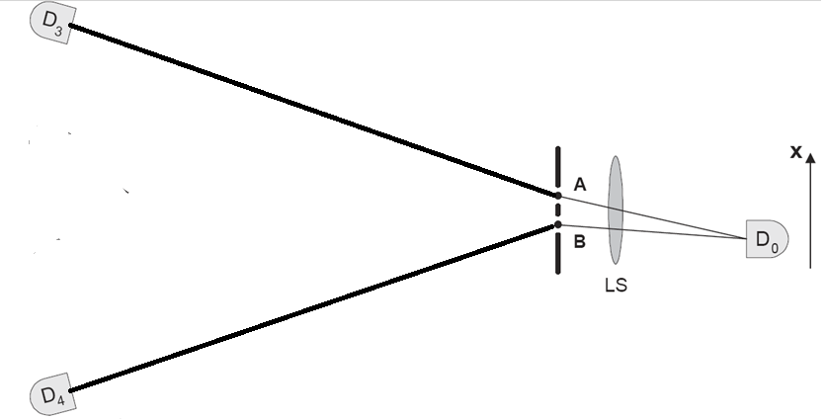

Slide 30
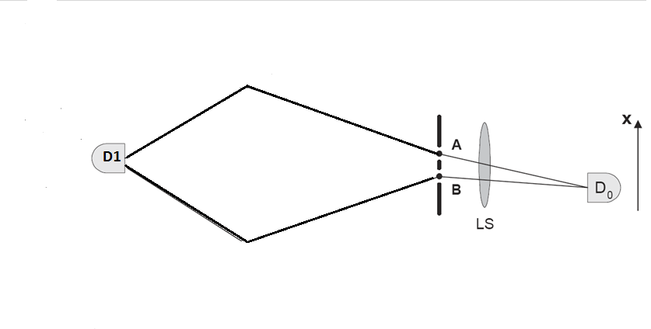


Slide 31
Retro-causal communication
In sync with the breaks in the beam
  Move mirrors BS_{a} and BS_{b} in/out of beam
With mirrors redirecting beam
  And one detector – not two
  Interference at D₀
With mirrors removed
  No interference at D₀
Treat each pulse between breaks as a bit
  Connect mirrors to a computer transmitting text
  Connect D₀ to a computer reading the bits
  Can a future self can communicate with a past self

Slide 32
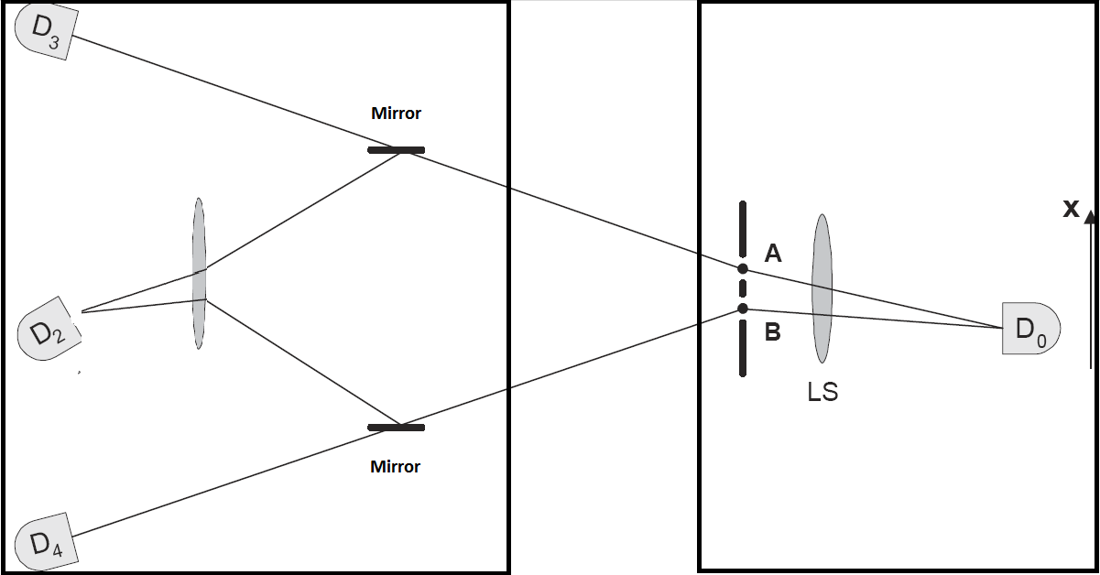
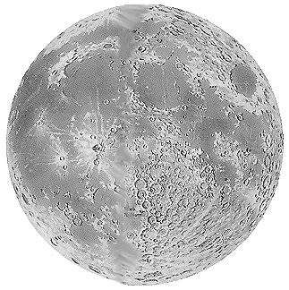
The modified setup
Phase shift
If needed

Slide 33
But such communication is absurd
What stops it from happening
Replacing BS_{a} and BS_{b} by mirrors ?
  But mirrors are already used in experiment
Removing BS_{a} and BS_{b} ?
  But this doesn’t remove the interference
Adding the mirrors
  How could that alter the experiment
Could a future event change past history?
  What happens if I see an interference pattern and then add the mirrors back in. Paradox!

Slide 34
A possible get out of jail card
R₀₁ and R₀₂ have a π phase shift
Even if signals arrive only at D₁ and D₂
  The interference will cancel hiding its presence
Perhaps mathematically the universe wins
  Maybe this phase difference cannot be removed
Maybe the two idler beams cannot be aligned
Seems like an interesting open? question

Slide 35
Is this a better idea?
Polarization
  Generate idler beams with opposite polarization
  Signalling is via a polarizing filter
  When filter blocks one beam
    which path known (see or don’t see a photon)
  Rotate filter π/4 both beams merged
    Which path not known
    Photon equally likely to have taken either path
    “Polarization entanglement by time-reversed Hong-Ou-Mandel interface”

Slide 36
What is entanglement ?
Some say that it is no more than correlation
  It can’t be used to communicate
Two laptops running the same random number generator on the same seed are correlated
  They can produce the same values at lagged times
  Entanglement is much more than this
Entanglement relates to tensor products
  Inability to separate state vector into tensor product
  The math determines the universe
  Not our perceived reality the math.

Slide 37
What about the nature of Time
Given one thought experiment suggesting communication with the past a theoretically possibility:
  This would suggest that past must still exist
  Also that the future has to already exist
  This would lend weight to eternalism
Even if the past is not reachable it would be comforting to know it was still there.
There are friends there and one day we’ll be there.

Slide 38
Thanks
I’ve been asking physicists about the “Delayed Choice Quantum Eraser” experiment for many years now and have yet to get a sensible answer

Slide 39
Time
  https://en.wikipedia.org/wiki/Eternalism_(philosophy_of_time)
  https://en.wikipedia.org/wiki/Philosophical_presentism
  Stanford University: Encyclopedia of Time Machines
  U. Coope “Time For Aristotle” Physics IV. 10-14
W.A. Hernandez “St. Augustine on Time” Int. Journal of Humanities and Social Science Vol 6.6 2016
D. Falk “A debate over the physics of time” Quanta Magazine www.quantamagazine.org/a-debate-over-the-physics-of-time-20160719
G.B. Lesovik et. al. “Arrow of time and its reversal on IBM quantum computer” arXiv:1712.10057v2
M. Proietti “Experimental rejection of observer-independence in the quantum world” arXiv:1902.05080v1
J. Conway, S. Kochen “The free will theorem” arXiv:quant-ph/0604079v1
  CBC: Living on Oxford Time

Slide 40
Wheeler’s experiment
C. Adami, N.J. Cerf “Quantum computation with linear optics” arXiv:quant-ph/9806048
R. Glauber “The quantum theory of optical coherence” Physical Review 130.6 1963
M. Bozic, L. Vuskovic, M. Davidovic, A.S Sanz “On Wheeler’s delayed-choice Gedankenexperiment and its laboratory realization” arXiv:1101.1511v4 2011
V. Jacques, E. Wu, F. Grosshans, F. Treussart, P. Grangier, A. Aspect. J.F. Roch “Experimental realization of Wheeler’s delayed-choice GedankenExperiment” Science, American Association for the Advancement of Science, 2007, 315 (5814)
R. Rhodes “Wheeler’s classic delayed choice experiment” http://www.bottomlayer.com/bottom/basic_delayed_choice.htm c:f can-someone-debunk-this

Slide 41
Delayed Choice
M.O. Scully, K. Druhl “Quantum Eraser: A proposed photon correlation experiment concerning observation and “delayed choice” in quantum mechanics” Physical Review A Vol 25.4 1982
Y.H. Kim, R. Yu, S.P. Kulik, Y.H. Shih “A delayed choice quantum eraser” arXiv:quant-ph/9903047v1
G. Scarcelli, Y. Zhou, Y. Shih “Random delayed-choice quantum eraser via two-photon imaging” arXiv:quant-ph/0512207v2
A.F. Kracklauer “Quantum complementarity, erasers and photons” arXiv:quant-ph/0612005v1
S.P. Walborn, M.O. Terra Cunha, S. Padua, C.H. Monken “A double-slit quantum eraser” arxiv.org:quant-ph/0106078
Y. Abranyos, M. Jakob, J. Bergou “Quantum eraser and the decoherence time of a local measurement process” Acta Physica Slovaca 48.3 1998
T. Qureshi, Z. Rahman “Quantum eraser using a modified stern-gerlach setup” Progress of Theoretical Physics 127.1 2012

Slide 42
H. Zwirn “Delayed choice, complementarity, entanglement and measurement”
D. Ellerman “Why delayed choice experiments do not imply retrocausality” Quamtum Studies: Math. Found 2 2015
C. Gidney “Deflating delayed choice quantum erasure” Algorithmic Assertions algassert.com/quantum/2016/01/07/Delayed-Choice-Quantum-Erasure.html
J.M. Ashby, P.D. Schwarz, M. Schlosshauer “Delayed-choice quantum eraser for the undergraduate laboratory” American Journal of Physics 84.95 2016 https://aapt.scitation.org/doi/10.1119/1.4938151
R. Rhodes “Excepts from: A delayed choice quantum eraser” www.bottomlayer.com/bottom/kim-scully/kim-scully-web.htm

Slide 43
T. Hellmuth, H. Walther, A. Zajonc, W. Schleich “Delayed-choice experiments in quantum interference” Physical Review A Vol 35.6 1987
R. Shoup “Understanding Retrocausality – Can a message be sent to the past?” In Daniel P. Sheehan (Ed) Quantum retrocausality: Theory and experiment. AIP Conf. Proc. 1408 2011 http://dx.doi.org/10.1063/1.3663728
Xantox “The quantum eraser experiment” 2007 strangepaths.com/the-quantum-eraser-experiment
Y. Chan et. Al. “Polarization entanglement by time-reversed Hong-Ou-Mandel interface” 2018 arXiv:1807.00383v1
B. Gaasbeek, Demystifying the Delayed Choice Experiments arXiv:1007.3977

