Slide 1
Standardized Administration Tools
Web Application
Presented by: Daniel Allen
drallen@uwaterloo.ca
CSCF (Computer Science)

Slide 2
In this talk
Why SAT?
App tour (What's SAT?)
Roadmap for the future
Notes:
This has three parts.

Slide 3
Why?
Rooms
Person
Accounts
Groups
In the School of Computer Science
Long-standing support need for
  integrated
  “people”-related
  administrative data
Notes:
Long-standing = We've been looking at this problem for over a decade. It took until 2018 to have the resources to commit.
Looking at this diagram, you'll see some of the people-related administrative data we are integrating.

Slide 4
Why? SAT Goals
Improve clients' experience of computing support
Improve onboarding and offboarding processes
Connect useful data from multiple sources

Slide 5
Why? Example one
Improving computing support in Computer Science
"What do we know about this person who just showed up at my door?"
  97 regular faculty; also 34 lecturers, 66 adjunct and cross-appointed professors
  Dozens of visiting scholars, post-docs, ...
  64 full-time support staff
  400 graduate students
  4000 undergraduate students

Slide 6
Why? Example two
Onboarding 100+ incoming grad students every Fall
  Requires an admin identifying free offices and desks to allocate
  CSCF staff coordinate their computing needs
    Laptops
    specialized computing environments according to supervisor / research group

Slide 7
Onboarding data flows
One CS person handles staff and faculty HR (in Workday database)
A Graduate office handles CS graduate onboarding (their own database)
One CS person handles assigning desks (in a separate spreadsheet)
A group (in CSCF) deploys computers onto desks (from emailed spreadsheet)
Notes:
Let's talk about onboarding for a bit. CS has an admin person responsible for HR and workday data, relating to all employees.
We have an office which handles graduate onboarding and data.
We have one admin person responsible for assigning offices and desks, including faculty, staff, and grad students.
And a group of technical staff deploys computers onto desks for all incoming people in CS.

Slide 8
Onboarding- All of these involve duplicate and possibly stale data :(
One CS person handles staff and faculty HR (in Workday database)
A Graduate office handles CS graduate onboarding (their own database)
One CS person handles assigning desks (in a separate spreadsheet)
A group (in CSCF) deploys computers onto desks (from emailed spreadsheet)

Slide 9
New onboarding process
One CS person handles staff and faculty HR (Workday is authoritative)
A Graduate office handles CS graduate onboarding (their database is authoritative)
One CS person handles assigning desks (into SAT database)
A group (in CSCF) deploys computers onto desks (from grad and SAT databases)
Notes:
Now that SAT is deployed, we have the authoritative information more easily accessed within a web application and reduced redundancy.

Slide 10
SAT database
Is driven by odyssey.uwaterloo.ca
SAT additions by Isaac Morland and Daniel Allen
Odyssey has access to Quest and WatIAM data, among other sources
Notes:
… SAT database is built upon odyssey.uwaterloo.ca, which is an ongoing project chiefly by my colleague Isaac. … We have added some data … and have connected the app to odyssey's Quest and WatIAM data feeds.

Slide 11
A note about grouper
We investigated grouper.private.uwaterloo.ca for access control and group definitions.
Many common features: data from HR, Quest class data, group memberships
Many disjoint requirements: data models for rooms and desks, our "sponsorships"
We didn't want to try and force this app into grouper
Happy to keep looking at grouper for possible future integration
Notes:
… … Disjoint requirements: courses need course instructors and coordinators; odyssey has both; we have discussed adding those to grouper
Unclear how rooms and desks would fit into grouper.
Unclear how we would fit our current definitions for "sponsorship" of account privileges.

Slide 12
App Tour
Built on React and Flask
Developed with a series of co-ops over the last five years
  10 or so work terms
User-centered development
  Three administrative areas within Computer Science plus discussions with admins in other areas outside CS
Notes:
… OK, let's look at the app, to discuss both of the examples I mentioned earlier.

Slide 13
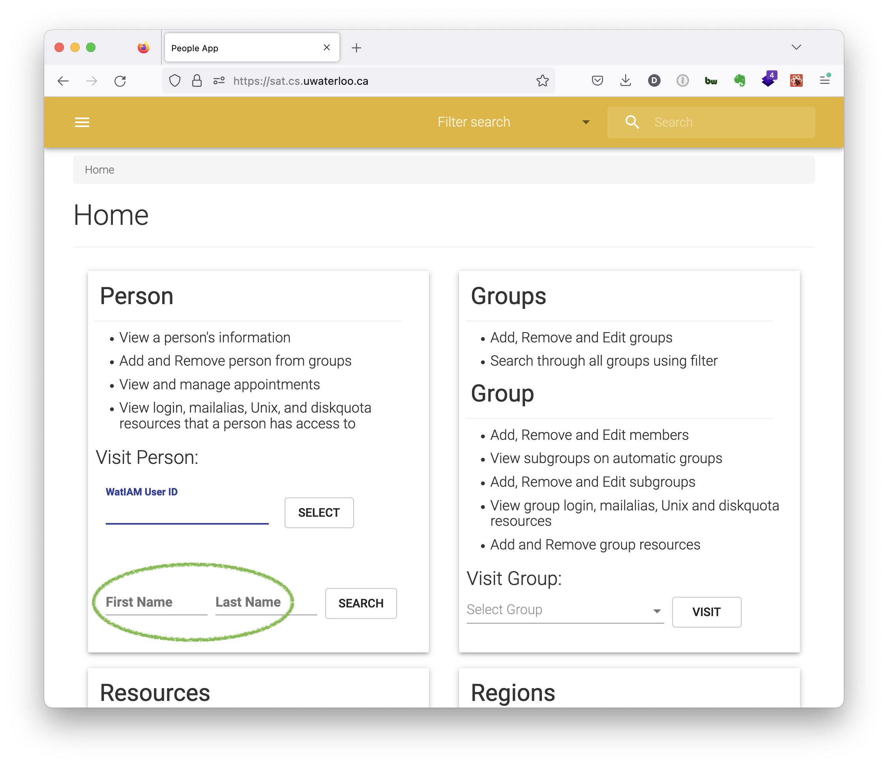
Notes:
This tour is not a live demo, for security and recording reasons
- front page wizard for the most frequently used areas
- let's look at the common use-case of "what can I learn about someone?"

Slide 14
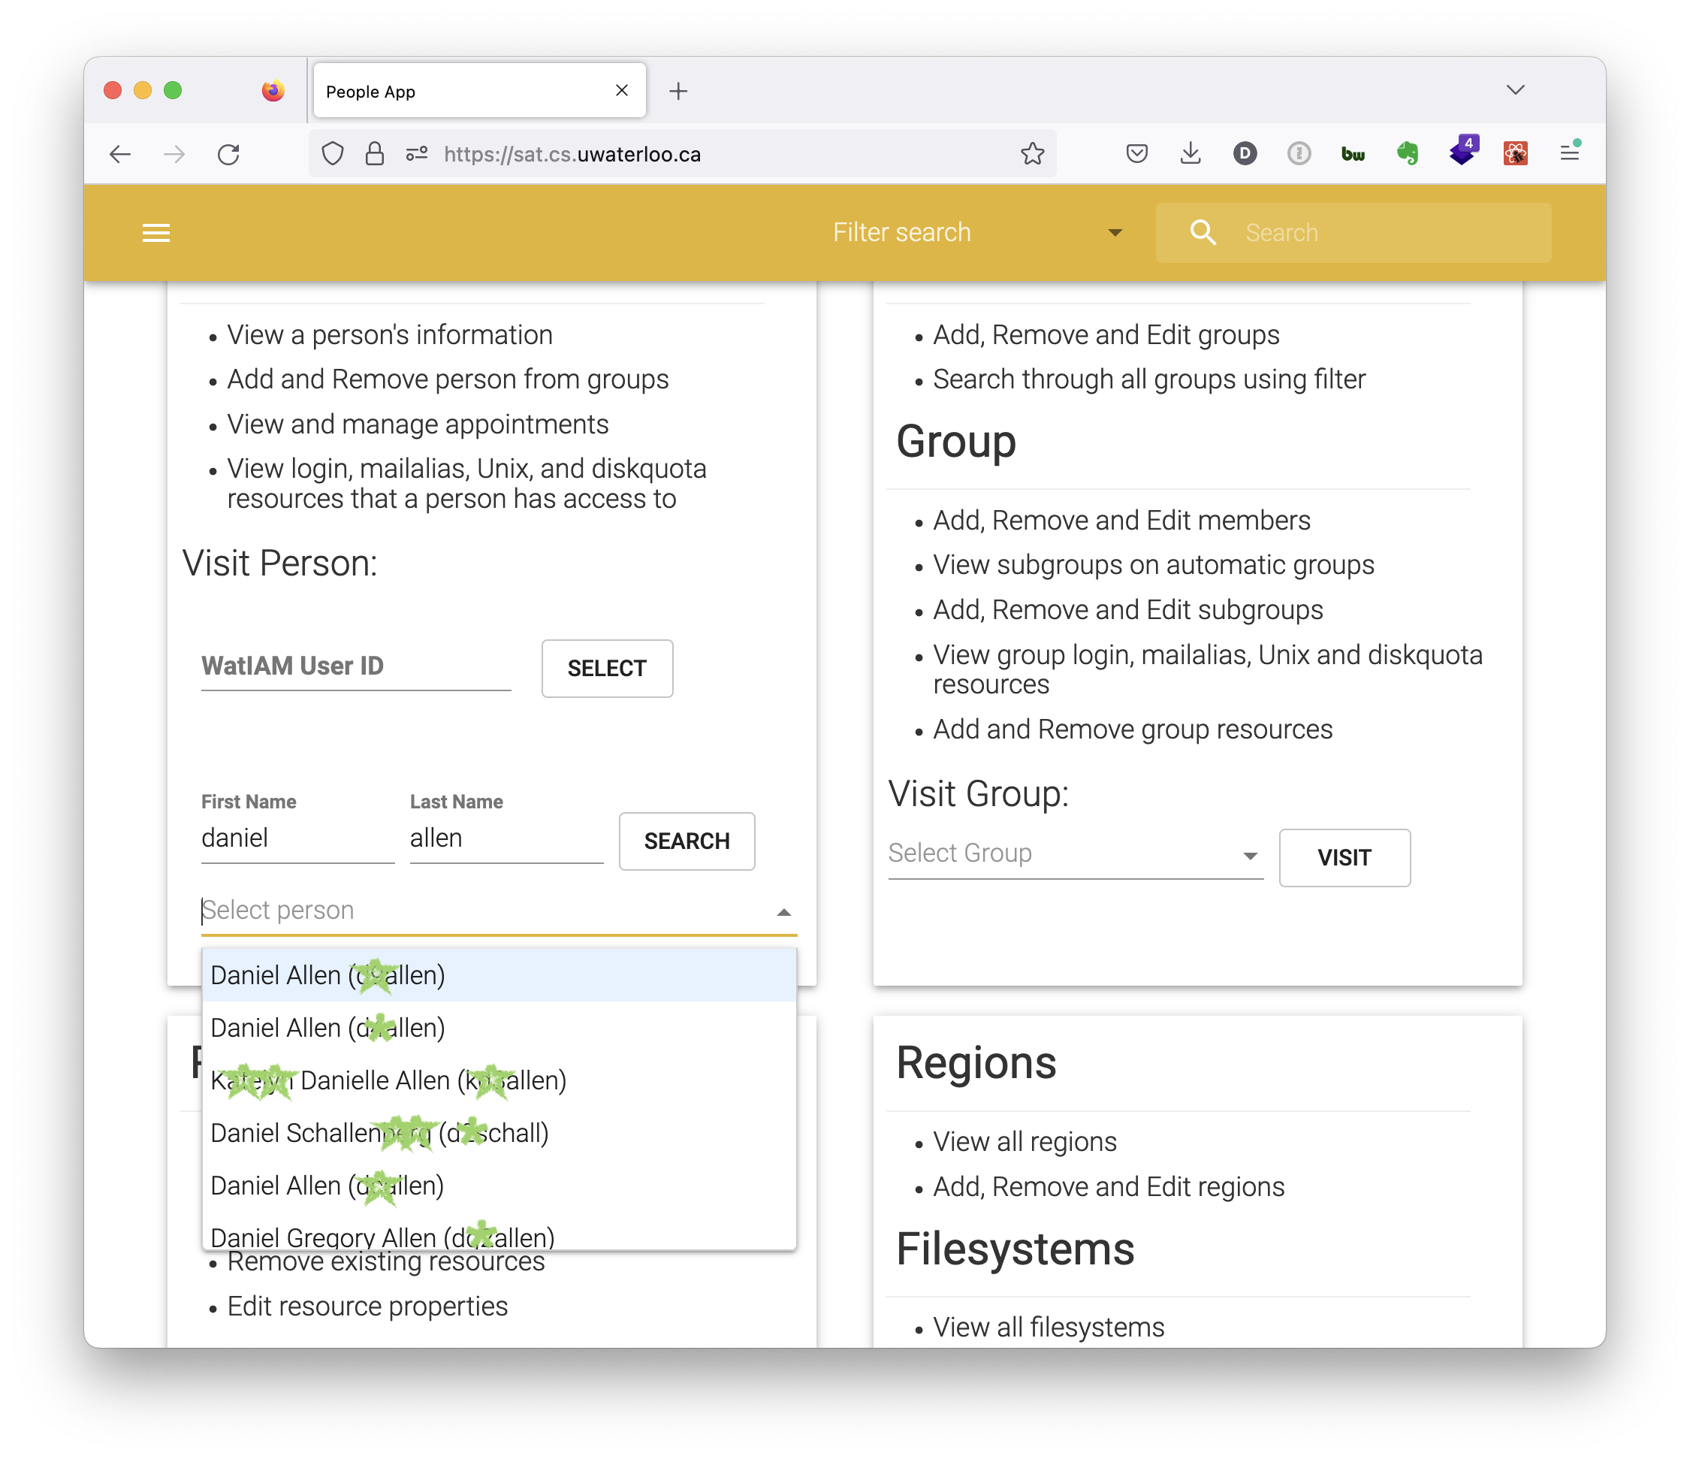
Notes:
I have typed in my own name. The search results include all current and past watiam identities, with wildcards.
I pick one and we then go to...

Slide 15
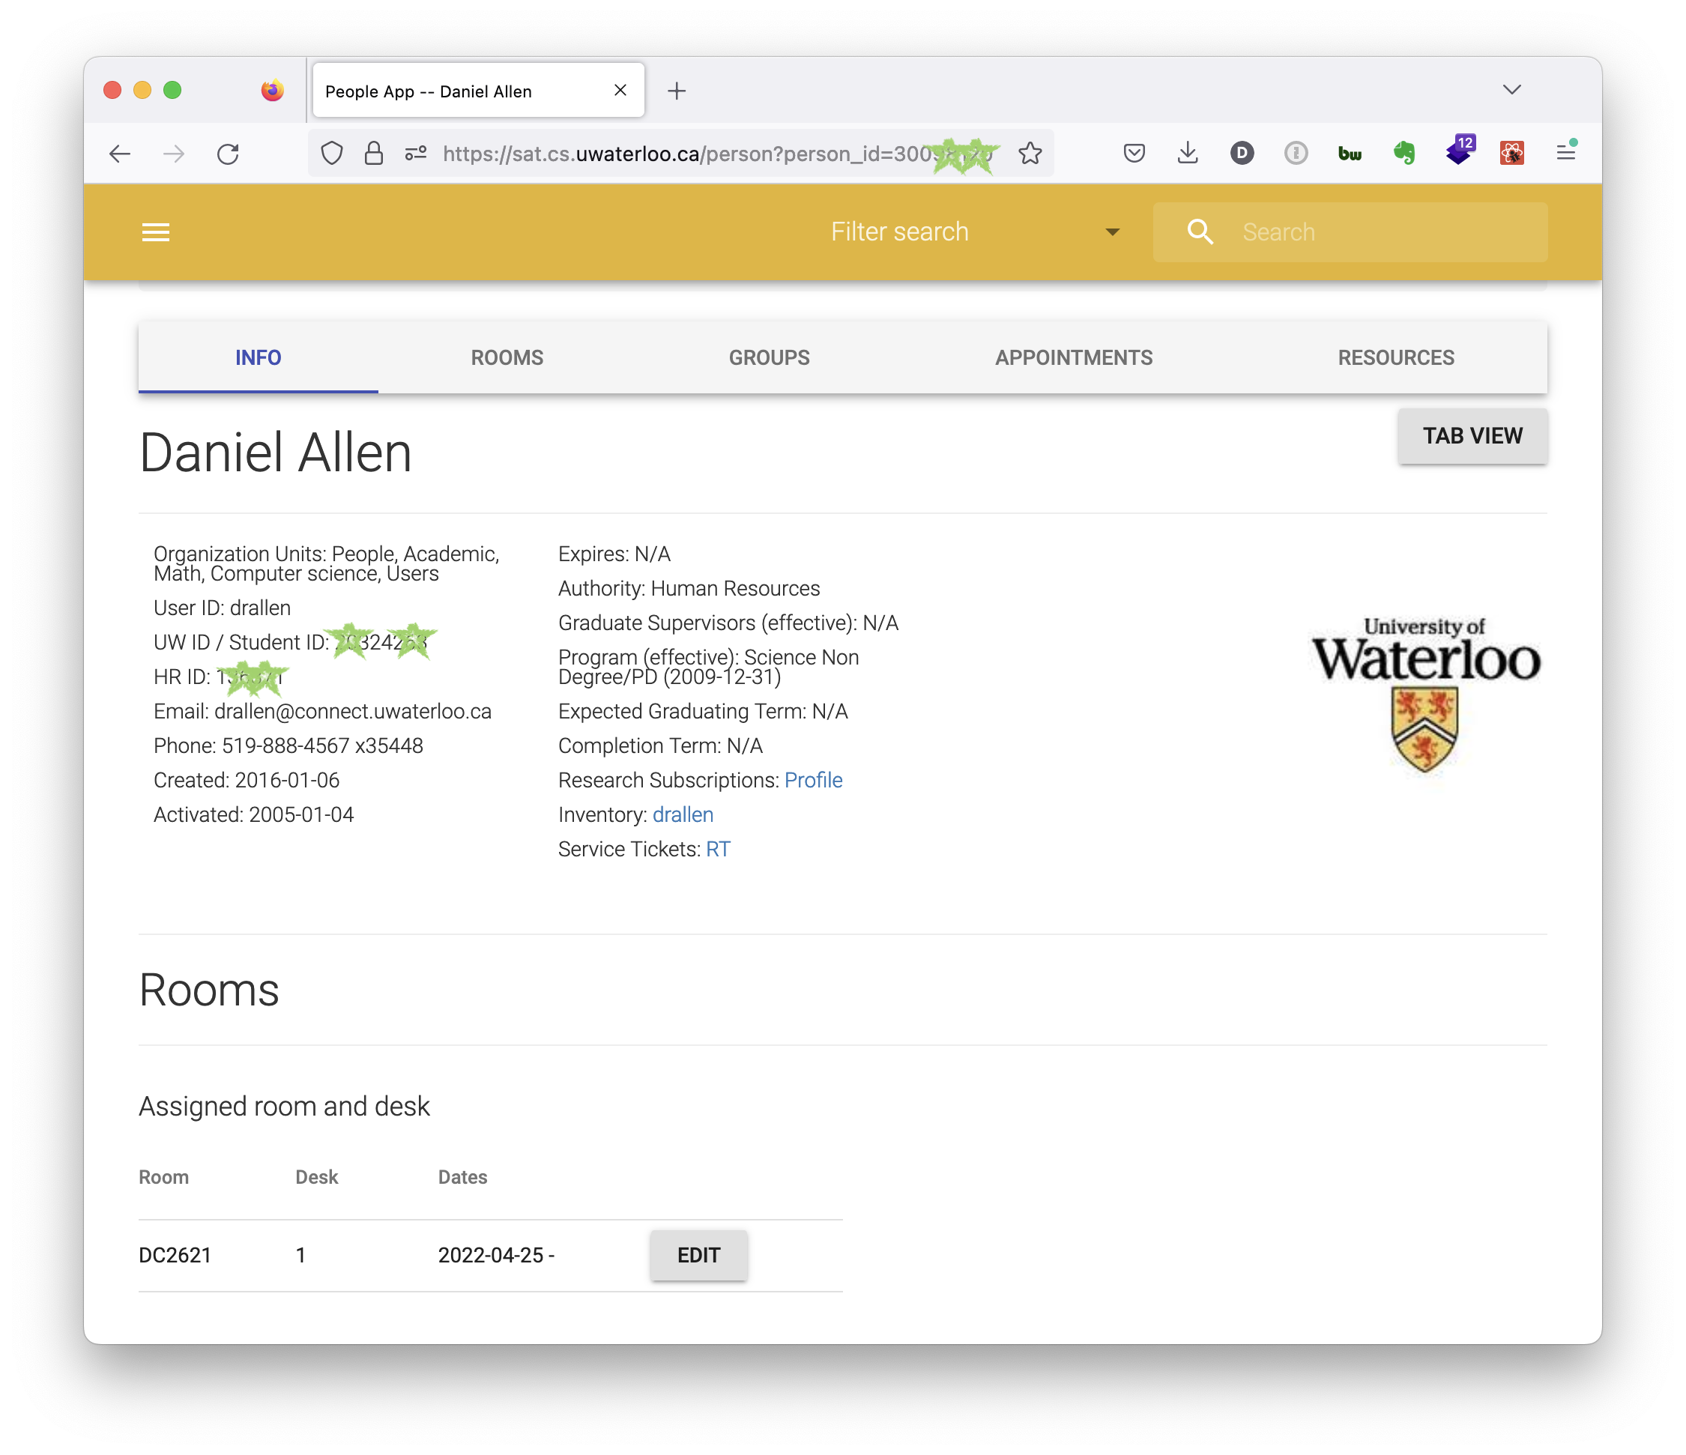
Notes:
The user view, which includes a variety of requested available data from watiam and quest. If I were a student, where the UW crest is, you'd see my watiam photo. If I were a grad student, it would have my supervisor history. If I had completed my degree, that would be visible. We can jump from this page to other systems looking up this person. … And lastly, rooms and desks are SAT data, which I'll describe on the next few slides.

Slide 16
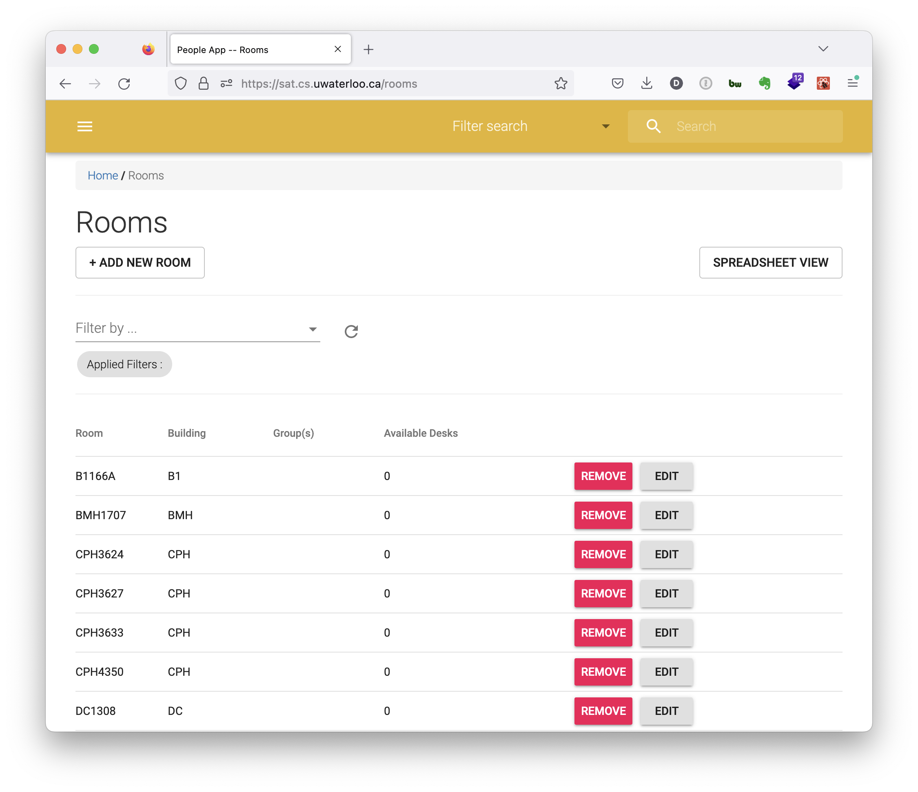
Notes:
We built the rooms pages to meet the needs of the admin staff person who handles all room and desk allocations across computer science.
Let's take the example of needing to find an available desk for a visiting post-doc who is coming next Fall.
Here we see some rooms, and if I click to re-sort by Available Desks...

Slide 17
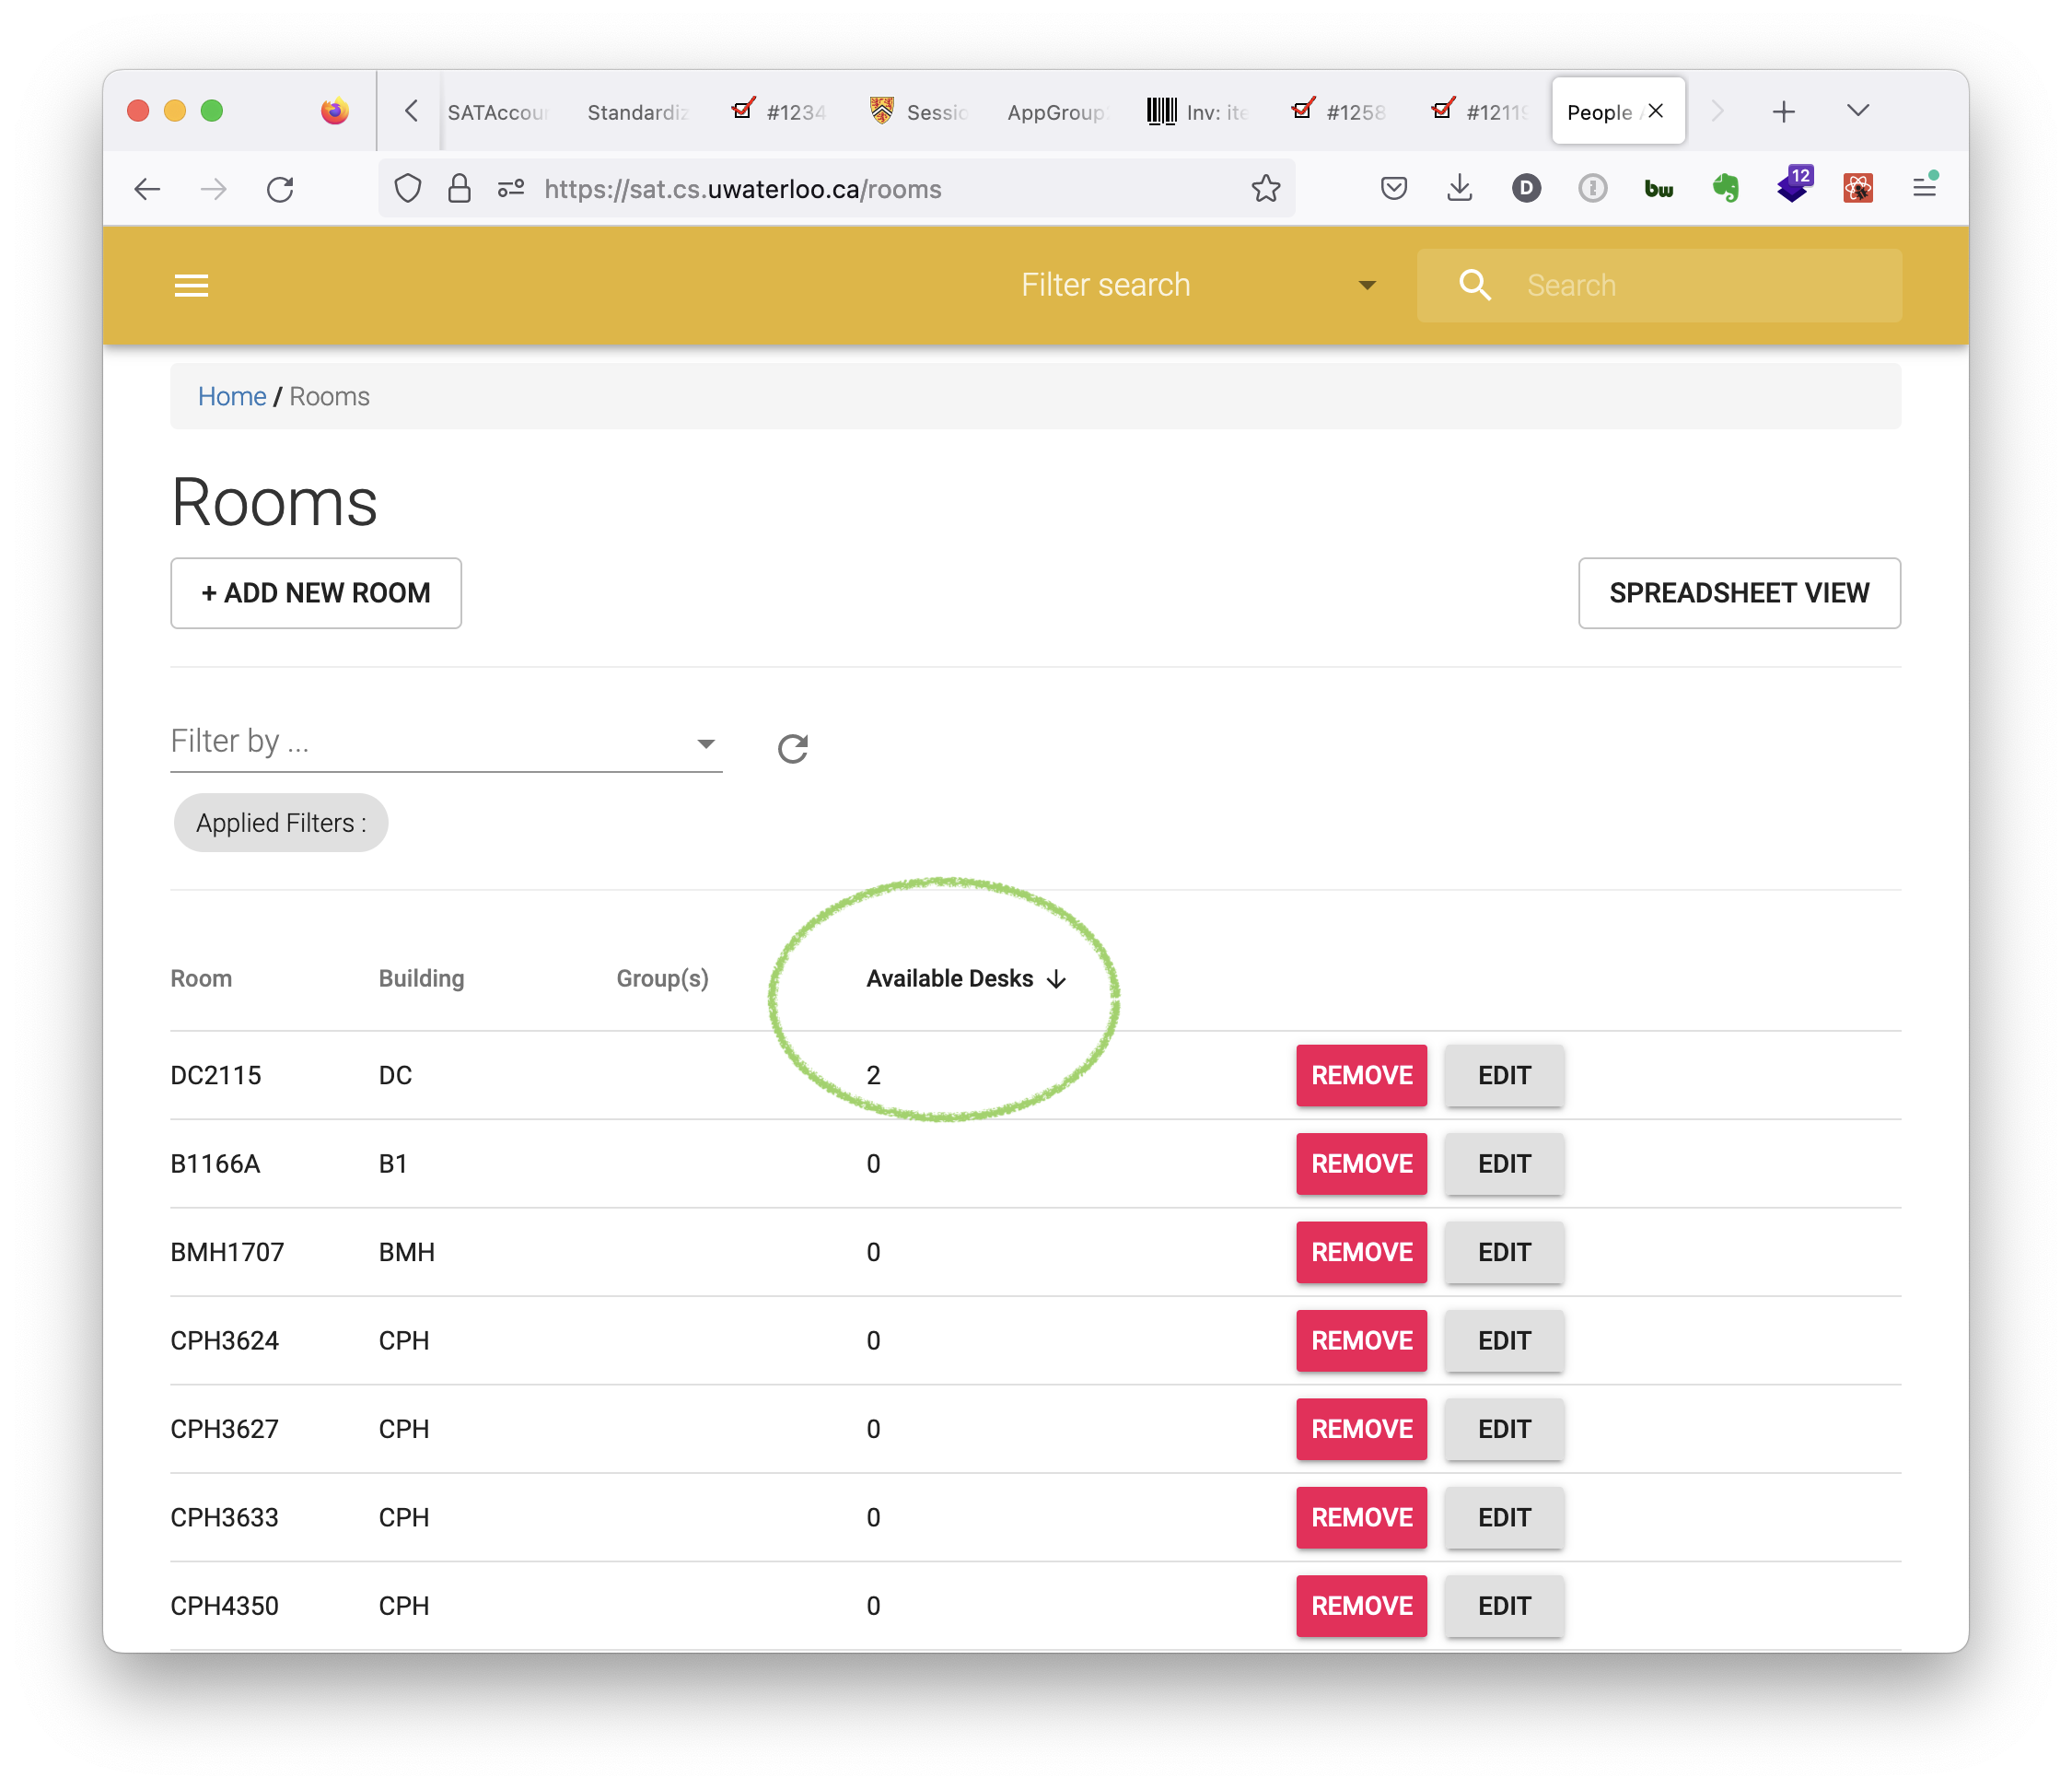
Notes:
You'll see the desks that are currently empty.
A useful feature is being able to filter at any particular date, such as next Fall, to plan for future availability.
When this is fully in operation, the "Groups" column can identify particular labs or researchers who should be clustered together, and you can search by those as well.
The "Spreadsheet View" gives additional information...

Slide 18
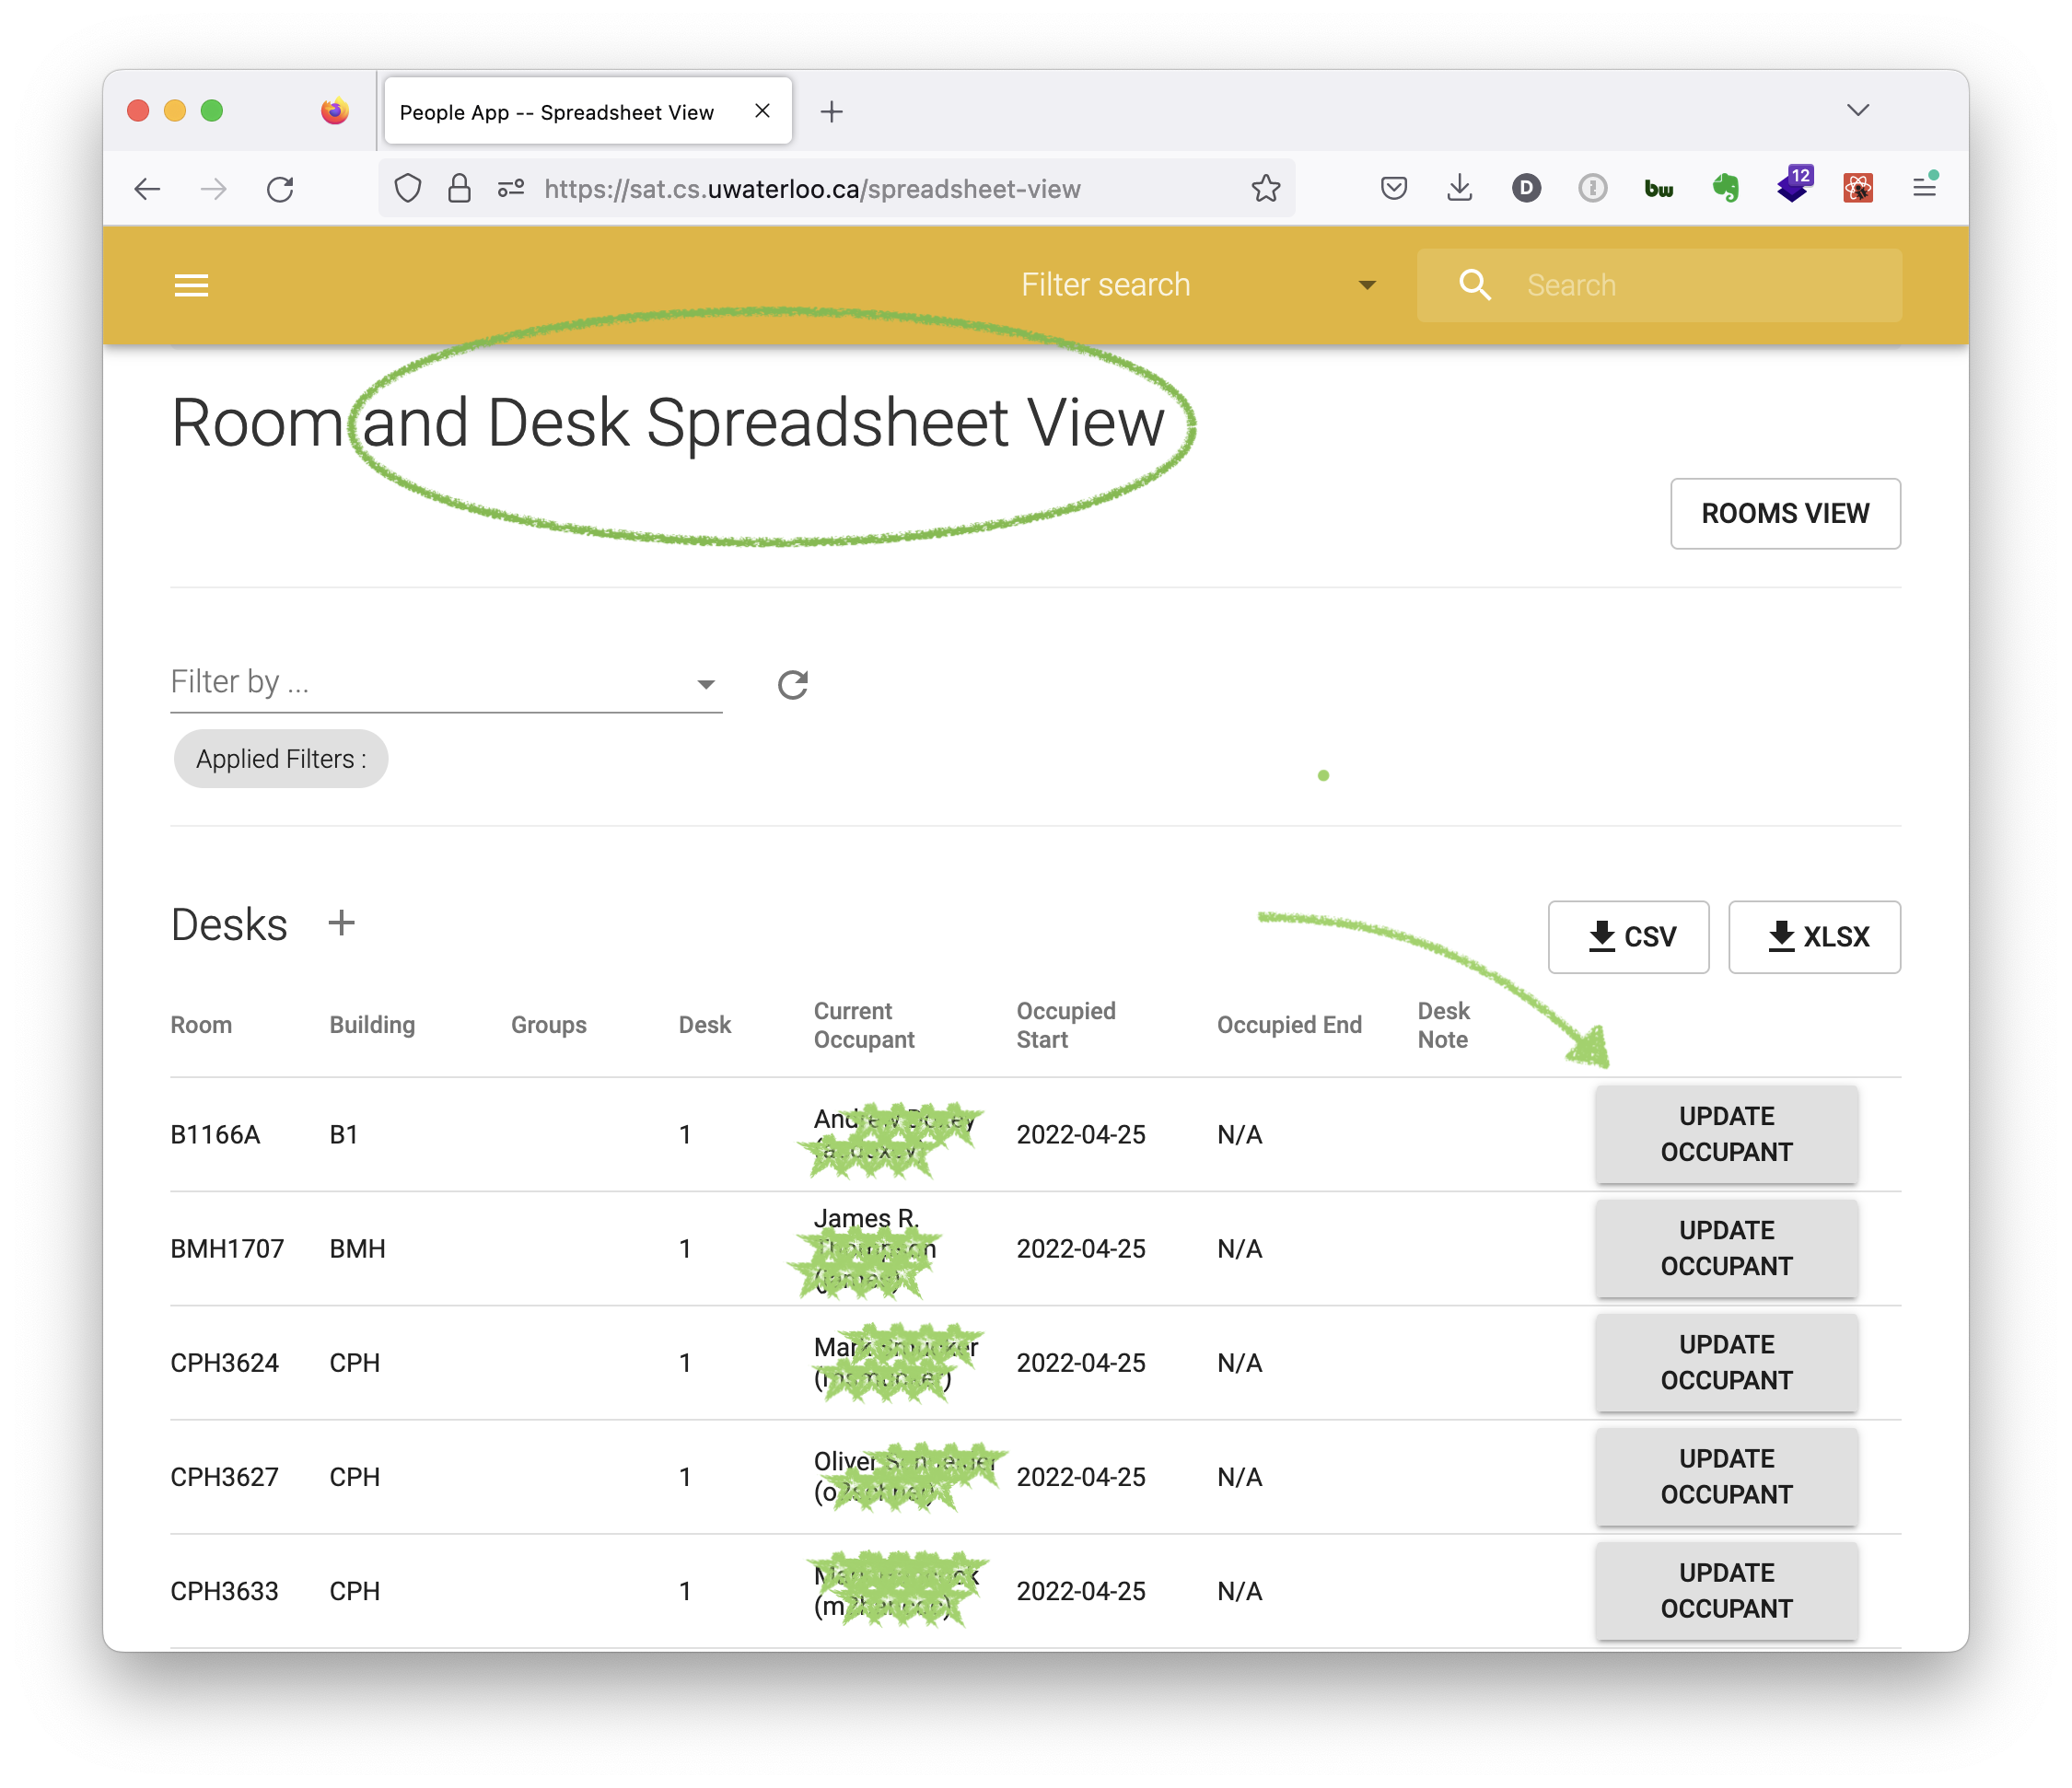
Notes:
To display all desks and their occupants if any. This view is designed to be helpful for batch onboarding. Let's try and update one desk, by clicking on Update Occupant...

Slide 19
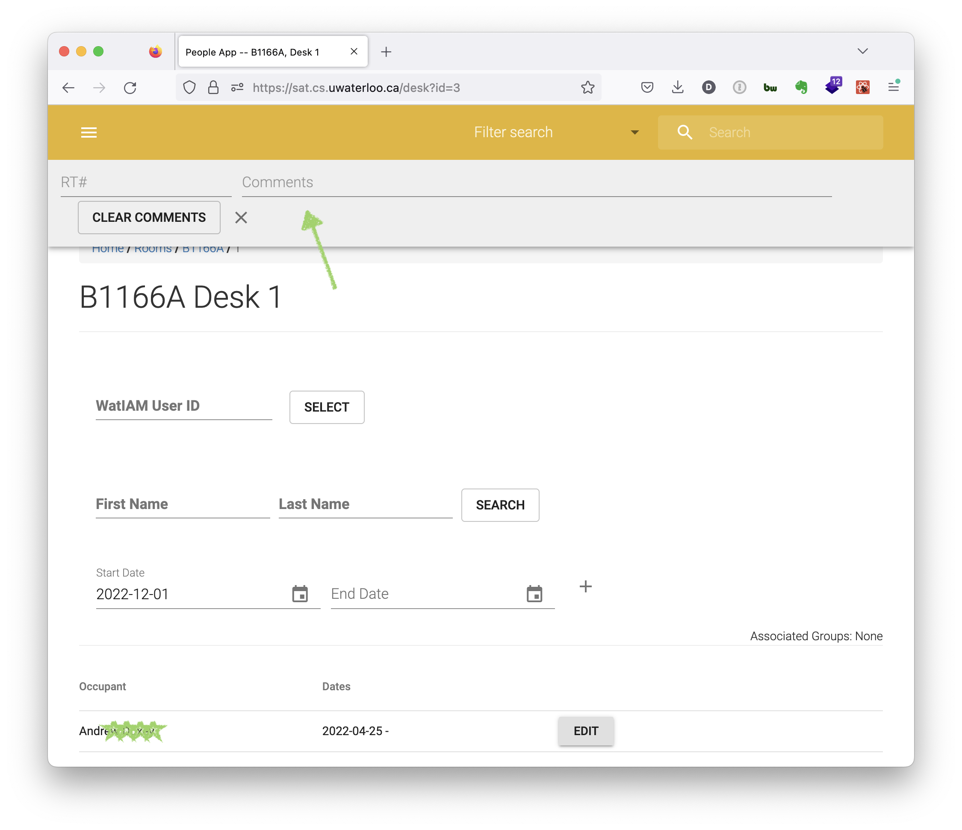
Notes:
And you can pick a new occupant for this desk, with a start date of now, or any date in the future such as Fall 2023.
The green arrow at the top points to a comment feature- any update to the system can have optional tickets and comments which are available and searchable within the app.
Noting the start and end dates, I'd like to show you another feature...

Slide 20
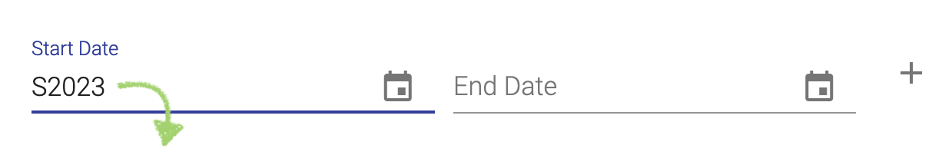
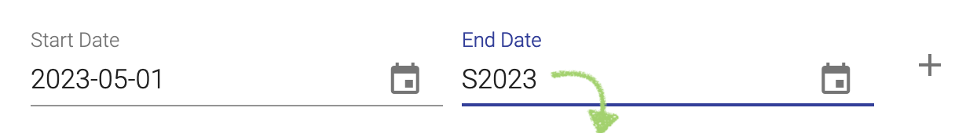
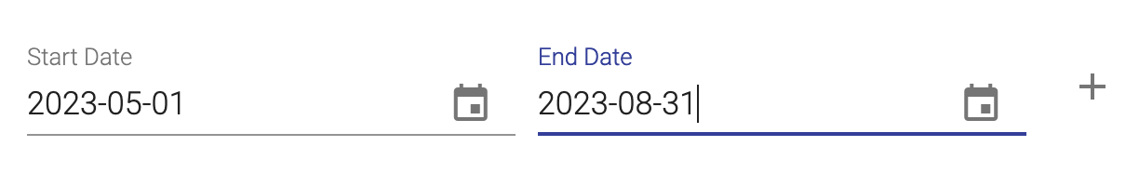
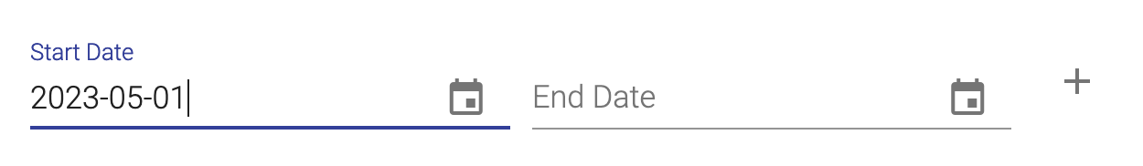
Date auto-completion
Notes:
Throughout the app, the date-pickers are UW Term aware. If you type "S2023" into the start-date and hit return, it returns the first day in the term, and if you type it into the end-date, it returns the last day in the term. It also works with UW term IDs like 1129.
This idea came out of discussion with one of our co-op employees, and it took a lot of effort to get it right.
OK. We've covered a lot of ground here, and I'd like to show you just one more thing.

Slide 21
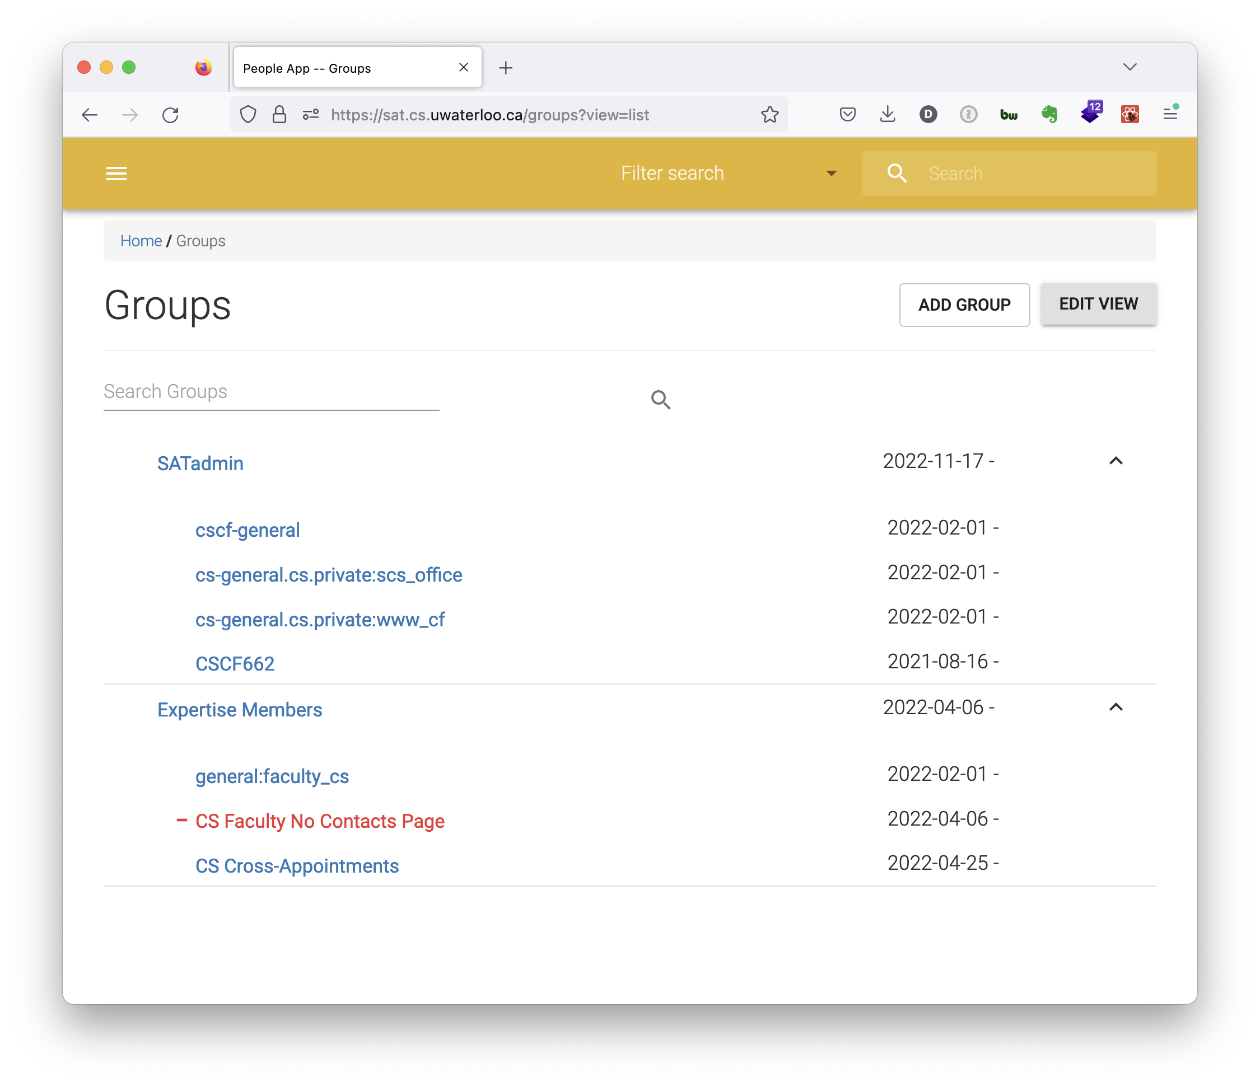
Notes:
Groups are very flexible, and similar to grouper if you are familiar.
Groups can be manually updated, or can be automatically updated and depend on other groups, as addition or subtraction.
Here we see a tree view of two sets of groups. The first set, SAT Admin, is composed of the groups who have access to the SAT application. The second set, Expertise Members, depend on the members of three groups, and one of them is subtracted. And groups can nest with many levels, and using active start and end dates, the group dependencies can automatically expire when no longer needed.

Slide 22
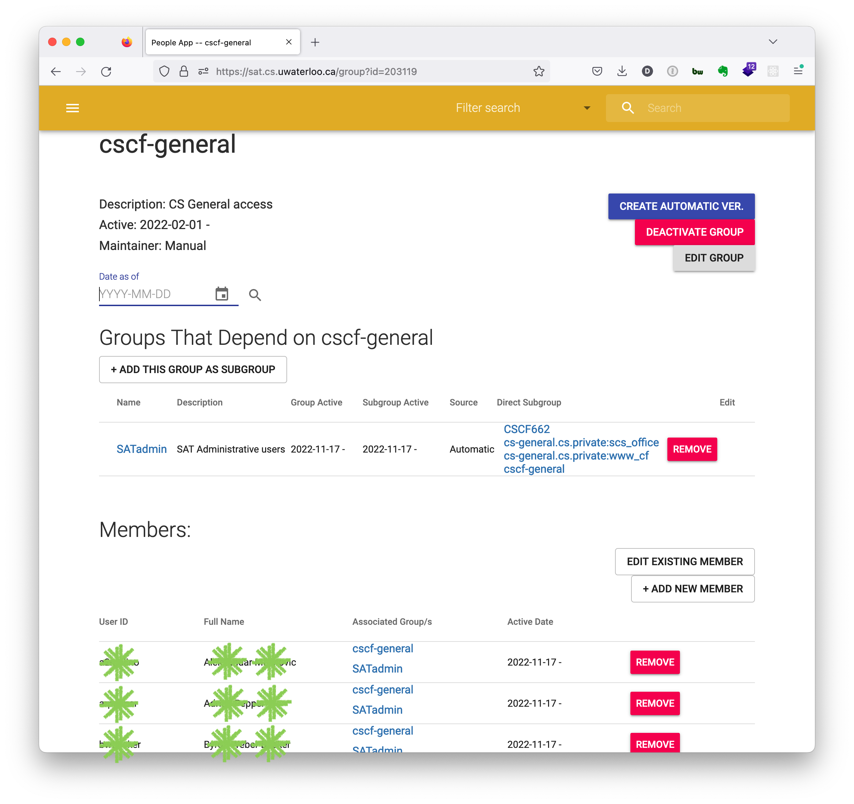
Notes:
Here we see the components of a group, laying out what depends on this group, what this group might depend on, members, and date ranges.
We think these will make our administrative work much more flexible and automated, as we figure out what we can control with these groups.
OK. That completes the tour of just some of the features that fulfil our user requirements.

Slide 23
Roadmap
Fall 2022:first deployment ✓
Winter 2023: testing, finish integration with CS “accounts sponsorship” system
  Hopefully including rest of Math Faculty's accounts sponsorship system
Spring 2023: refine automatically loaded groups
  Hopefully including automatically loaded Workday details to support automatic access rights
Spring 2023+: revise privileges models
  Currently, access controlled by group memberships
  Currently, one level of app privileges and access to all data.
  Goal: restricted per-department access, broaden number of departments
Notes:
… So, as of this term, we have deployed the app for initial use by selected CS Admin staff, and will be gathering feedback on the many required improvements.
… Next term will include finishing integration with our "accounts sponsorship" system, which is tricky to describe but a very annoying text-based privilege system we want to deprecate, and it's used in both CSCF and MFCF so perhaps we can solve it for the whole faculty of Math.
… The following term, we'd like to integrate groups contained in workday. And we want to revamp privileges. Currently...

Slide 24
Wrap-up
Various people-related data
  Including groups, accounts, rooms and desks – and other areas I didn't cover!
Built to meet administrative users' needs
  From user discussions within CSCF, admin groups in Computer Science and Math faculty, and other faculties
Future improvements include using Workday to support access restrictions
  To accommodate administrative use by different areas on campus
Notes:
To summarize what we've been though in this talk ... we have built this app to include various people-related data, … in a user-centered development environment to meet our user's needs, and also discussing with administrators in other faculties. … Lastly, we foresee this being more useful once we build in multiple levels of data access, and hope to accommodate use by different areas of campus.

Slide 25
Any questions?
Daniel Allen
drallen@uwaterloo.ca

