Slide 1
Perspectives on co-op employment and User-centered web-app development
Presented by: Daniel Allen
drallen@uwaterloo.ca
CSCF (Computer Science)

Slide 2
Road map for this presentation
Cooperative Education
User-centered design principles
School Administration Tools project
Notes:
This presentation will have three parts about software development in the School of Computer Science.
- The "Education" in Cooperative Education is an important part of our mission;
- User-centered design principles are foundational to our project success;
- Briefly discuss a current project to simplify administrative workflow.
- And then we’ll have lots of room for questions and comments about how this might be similar/different in other areas on campus.

Slide 3
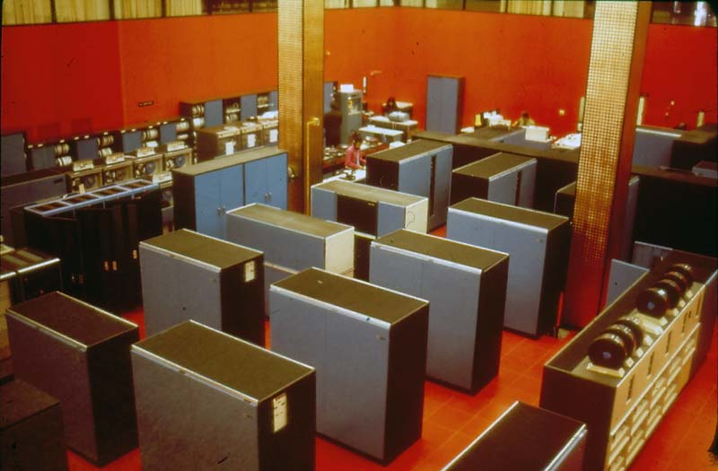
MC Red Room
University of Waterloo Library, Special Collections & Archives, University of Waterloo Archives
Notes:
Let’s go back. Red Room circa 1967. IBM 360/75.
- University of Waterloo has a history of supporting software development
- Many will recall last year's WatITis plenary by Professor Gregor Richards on WatCom software development in the 1980s
- Computer Science is in many ways different today, but innovation is still central.

Slide 4
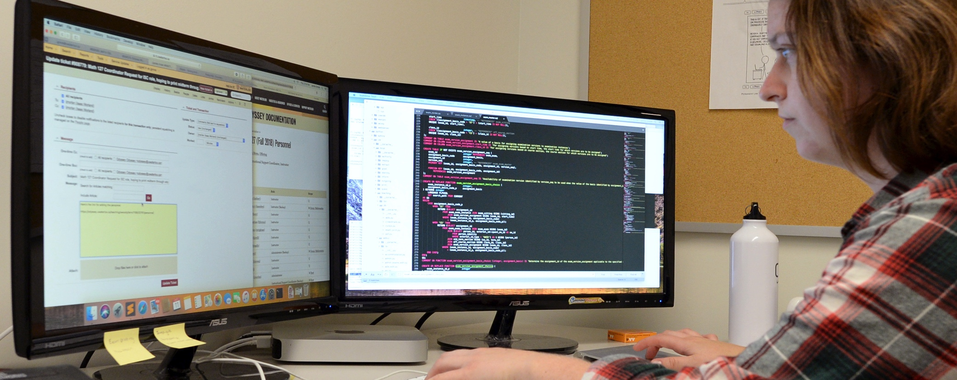
Co-op employment in CSCF
Notes:
Waterloo is of course famous for co-op education.
Here we have a representative picture of the modern co-op programmer experience.
Jamie worked for us on a co-op term, then came back for a summer term outside co-op, and she has returned for a one-year contract.
Probably can’t tell but that’s xkcd.com/1597/ comic on the cork-board
I’ll also note the mac mini which is over 1000 times as powerful as the supercomputer in the last photo
[ https://en.wikipedia.org/wiki/IBM_System/360 ]

Slide 5
Some CSCF Web Applications
Math Faculty Inventory / Asset Management
Faculty Recruiting
Supporting evaluate.uwaterloo.ca Course Evaluations
“School Administration Tool” under development
Notes:
For the last decade, I've been hiring and managing Waterloo students to assist with many web applications including but not limited to the following.
…
Notably, the first three are projects that started outside Computer Science that we adopted or contributed to. #1 originated in Math Faculty Computing
#2 started in Management Sciences, #3 was developed and is run out of Science Computing, and we shared a co-op with them to work on development.
We started #4 and hope it will become useful outside of CS.

Slide 6
My Job
2004: 75% IT support 25% programmer
2008: 40% IT support 50% programmer 10% assist with (HS) co-op project
2009: 10% IT support 50% programmer 40% one co-op project (1 co-op per year)
2018: 10% IT support 30% programmer 40% projects / 20% co-op (3 co-ops per year)
Notes:
This has been a progressive evolution in my job.
- 2004: I was hired as a linux sysadmin, automating tasks where I could.
- 2008: a high-school student doing volunteer work with us wrote a SQL database to help automate his work. My boss sent him to me.
- 2009: we had a high-profile project we wanted to devote extra resources to, and I proposed hiring a co-op, with my boss’s support.
For the next while, I hired a co-op when my schedule permitted.
- In 2018 more than half my job is a blend of project management, project work, and web-dev co-op management

Slide 7
Project Management
Waterloo Continuing Ed: Project Management Essentials
Critical part of CS work is long-term projects
We establish term goals, at start of term
Co-op scheduling means I usually have their projects identified +2 terms
Notes:
My job has grown into more formal project management. And CSCF has realized we need better project management overall.
-Recommended course
-Increasingly planning our projects better

Slide 8
Waterloo co-ops are excellent
I supervise one programmer per term
My colleague Isaac working on OAT/Odyssey does also
We have budget to pay the posted “going rate” for Math faculty and work term
Notes:
-I supervise one programmer per term
-My colleague Isaac Morland does also
- Co-op Education and Continuing Ed publishes averages reported by co-ops on work terms, broken down by faculty. We have the budget to pay the going rate for Math Faculty and their work term

Slide 9
What do we hire for?
Related academic program and experience
Independent worker
Writing ability
Bonus: creative interest in proposing new directions
Notes:
-
-
-Writing ability: good code comments will explain why they did what they did, not just explain what they did. We heavily use Request Tracker on our projects, and often look back for explanations of context and motivation. Being able to communicate in print turns out to be very helpful.
-As a bonus, showing creativity and proposing new solutions is great when we see it.

Slide 10
Things I’ve learned: 1/3
Co-operative Education
Look for aspects to stretch each co-op.
This is why we hire for soft skills
Hiring next term's co-ops!
Notes:
-The name co-operative education has two parts. Productivity is important but it's critical they are learning too, not just turning out code
- Each co-op has their own areas for growth. Everyone ends up trained in git, RT, interaction with clients, presentation to our peers.
-Many early-term co-ops don’t realize the importance of their soft-skills, and fitting into a work environment. We are happy to teach this. -For example, code check-in messages: start of term “fixed bug”. End of term: enough text to explain the motivation behind the code change, for me when I review it, and for the co-op who comes next.
- Many are involved in hiring next term’s co-ops, and discover it to be very educational.

Slide 11
Things I’ve learned: 2/3
Solid management and project management
Clear project guidelines
Correct issues early
Teach good documenting
Notes:
These are project management in general.
- Issue clear project guidelines- at the start, or take the time during the term to flesh them out.
- There have been terms where I didn't put the time into this in advance and the results were not great.
- Or where they didn't pay attention to the guidelines and I didn't correct them early enough.
- Reviewing code is important, especially at the start- what are our expectations.
If I succeed at getting them to document their work well, the next co-op to work on a project will have an easier time ramping up. I tell the co-ops this as a useful motivator.

Slide 12
Things I’ve learned: 3/3
Good successes with first term coops
Budget-friendly! $11k instead of $16k for 6th term in Math Faculty
Many already have relevant experience on their own projects
Build flexible time at start of schedule for them to ramp up

Slide 13
Things I’d like to learn
More agile development with co-ops
More end-user involvement
Notes:
More agile development: fail quicker
Involve the users more
Which leads us to…

Slide 14

Part Two: User centered design
Notes:
This is the bible of User Centered Design, which I read the first edition of when I was in University in the 90s.
Overall, software design has matured a lot since then, however the foundations are still true.

Slide 15
Simplify design so that a user’s possible actions at any moment are intuitive
Notes:
…At core, this is what we’re after.

Slide 16
Simplify design so that a user’s possible actions at any moment are intuitive

Slide 17
Make behaviour visible, including:
“Simplify design so that a user’s possible actions at any moment are intuitive”
Feedback to user
Conceptual model
Mapping between intended results and required actions
Notes:
Make a program’s behaviour visible.
Feedback to user: You just did this thing
Show the conceptual model for the system: when you did this thing, there were these impacts.
Give them a clear map to go from where they are, to where they want to go and what they want to accomplish.
This is abstract; maybe best illustrated with an example.

Slide 18
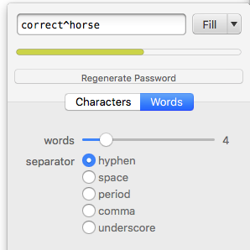
My favourite example of making behaviour visible
Screenshot from 1Password
Notes:
This may be familiar to you; it’s a password-strength meter. This is from 1password.
- You can type into the white box at the top; you can click “regenerate password” to randomly generate a new password
The green bar changes colour;
Other password-strength examples include more wording to explain the rules, but this is pretty intuitive.
You can see how it fulfills all of the advice: feedback to the user, the meter illustrates the conceptual model, and you have an easy idea of how to get a secure password simply.

Slide 19
Software that isn’t intuitive
Technical phrases with no explanation
Complex business processes with no explanation
Extra user steps in the app just for programmer convenience
Notes:
We can all identify software that isn’t intuitive. Can you think of some ways software fails by being unintuitive?
-
-
-
You can take any of these and imagine the opposite, if they had instead centered the design around what users needed.

Slide 20
Design Process
Work to have an explicit understanding of users, tasks, and environments
Involve users throughout design and development
Process is iterative (the specification is NOT set in stone at the start)
Notes:
So how do you get there? What’s the process for designing with users at the centre?
-Build an explicit understanding of all these things: who the users are, what are they trying to do, what’s the context for why they are doing it
-Do this by involving users throughout the development.
-This is iterative. You start with a spec, and then change it as you learn more about the users, and test things with them.

Slide 21
User centered design remarks
I have lots to learn about this.
It can contradict other goals
More end-user involvement
Notes:
Some remarks.- After over 20 years I’m still learning about user-centered design.
It can contradict other goals, like speed of dev. Changing the spec can be difficult in the middle of a project
- It can also make project management more difficult. Fortunately there are now established ways to do project management:
eg., agile programming. Instead of having a 4-month project cycle, have a series of 2-week cycles to iterate quickly.
On some projects, we’re doing a 1-month cycle, which is pretty good.
-And sometimes, I don’t have nearly enough end-user involvement, due to factors like lack of time.

Slide 22
Part Three: School Administration Tools
Long-standing support need for integrated "people" data
  84 regular faculty, 17 lecturers, 60 adjunct and cross-appointed professors;
  56 full-time staff;
  400 graduate students
Improving new clients experience of tech support
Improving onboarding (faculty, staff, students)
Notes:
So we’ve talked about the abstract; how about a bit about a current project.

Slide 23
Onboarding
One CS person handles staff and faculty HR; (soon, in Workday; but separate database)
A whole office handles CS graduate onboarding (their own database)
One CS person handles assigning desks (in a separate spreadsheet)
A group (in CSCF) deploys computers onto desks (from emailed spreadsheet)

Slide 24
All of these involve duplicate data :(
One CS person handles staff and faculty HR; (soon, in Workday; but separate database)
A whole office handles CS graduate onboarding (their own database)
One CS person handles assigning desks (in a separate spreadsheet)
A group (in CSCF) deploys computers onto desks (from emailed spreadsheet)

Slide 25
Process
Series of client meetings to record current work and data flows
Reviewed previous design documents
Paper demo to end-user; dev work
Demo to technical users; dev work
  Iterate, guided by client interviews
Notes:
We have attempted this sort of project before, but it repeatedly got pre-empted by high-priority work. This time we made it a priority because it meets a number of connected needs.
Some notes about our process.
-

Slide 26
Simplifying design to be intuitive – one case
Pull data from existing sources rather than manual input
Automatically know when grad students are due to arrive and due to finish
More efficiently “offboard” to reclaim desks and equipment
Notes:
- Where possible, pull data from existing database sources rather than manual input
-

Slide 27
Working with Co-ops in 2018
Database schema: iterated
Web UI: most of the co-ops’ development time to make it simple to use
User surveys
Roadmap for requested improvements
Notes:
My current co-op is the third to work on it in 2018; with good progress.
- we have a 2nd version database schema – requiring a lot of my time to make sure it fits with other systems
- we have a web UI– needing much more user-testing.
- we’ve done user surveys in a cross-section of campus - to some extent, this workflow is the same. So we’re designing this to be useful outside of CS.
- we have a roadmap for requested improvements

Slide 28
Roadmap
Winter 2019: Planning integration with CS “accounts sponsorship” system
Spring 2019: coding and testing
Fall 2019: the first deployment
Notes:
-
This may turn out to be the largest project I’ve managed from scratch. Certainly the longest before deploying version 1.
We won’t deploy version 1 until late spring or possibly Fall.

Slide 29
Conclusions
Hiring a co-op developer improves project efficiency
Enables separation between development and project management
Encourage treating them as a partner in design - along with the end-users
Furthering the mission of the University
Notes:
- Having a co-op developer more than doubles my coding effectiveness
- They can be working on details while I look at the bigger picture
- I encourage treating them as a partner in design - along with the end-users
- And in the process, we further the mission of the University.

Slide 30
Any questions?
Daniel Allen
drallen@uwaterloo.ca

Slide 31
Extra: How projects really work
http://www.projectcartoon.com

Slide 32
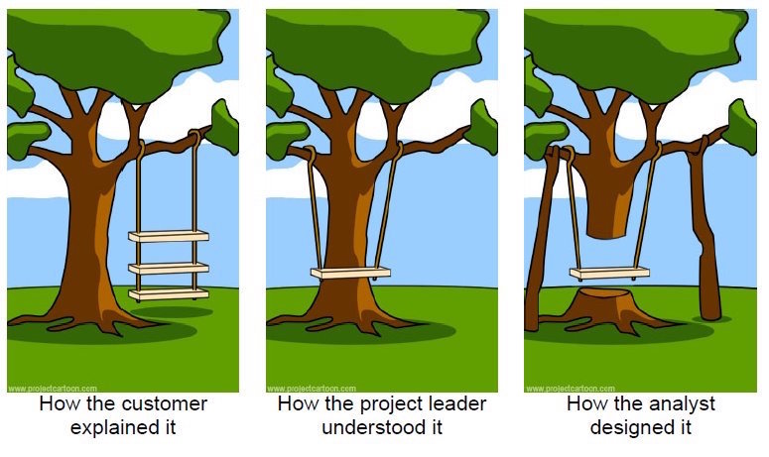
Extra: How projects really work

Slide 33
Extra: How projects really work

Slide 34
Extra: How projects really work

Slide 35
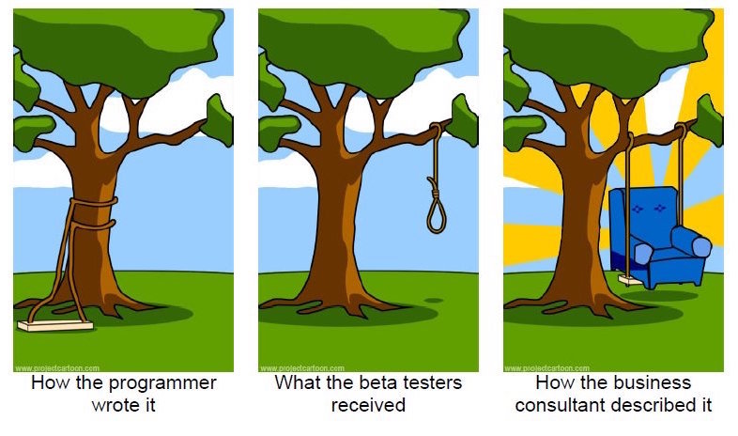
Extra: How projects really work

Slide 36
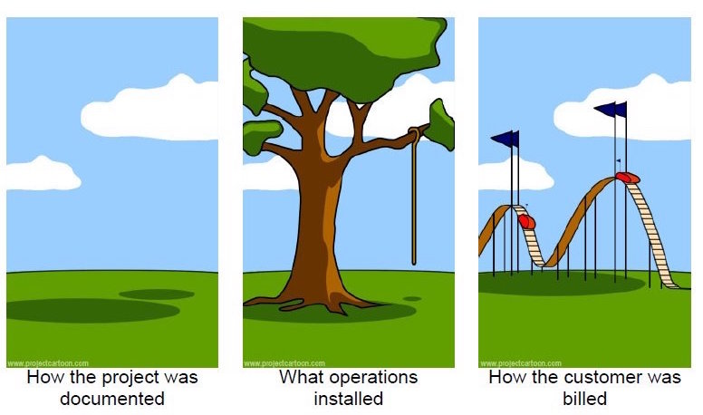
Extra: How projects really work

Slide 37
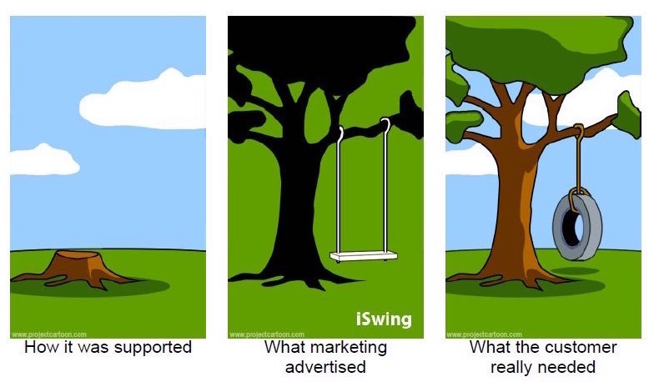
Extra: How projects really work

