Slide 1
The Computational Complexity of Chinese and Italian Noodle Making
Daniel M. Berry
University of Waterloo, Waterloo, ON, N2L 3G1 Canada
dberry@uwaterloo.ca
Luisa Mich
University of Trento, I-38122 Trento, Italy
luisa.mich@unitn.it

Slide 2
A Graphic Extended Abstract!
We will be looking at algorithms (a.k.a. recipes) for making noodles:
Chinese mian
Italian pasta
We will be giving complexities as a function of the number, n, of noodles made.

Slide 3
O(log n) Algorithm
First, a demonstration of an O(log n) algorithm for making Chinese mian:
https://youtu.be/PHoQN9vQwHE?start=330&end=352

Slide 4
4096 Mian in 41.34 Seconds
If you go to http://www.scientificpsychic.com/mind/noodles.html and search for "4,096", you find:

Slide 6
World’s Record!
If you play the video, you see:
https://youtu.be/auhHl5-6VdY?start=20&end=70
We bet that they did not count the strands get to 4096! :-) 4096 just happens to be equal to 2¹²! Wow! Wotta coincidence!!!!!

Slide 7
O(n) Algorithm
A demonstration of an O(n) algorithm for making Italian fettucine:
https://youtu.be/-lMmUf2nqYA?start=330&end=355

Slide 8
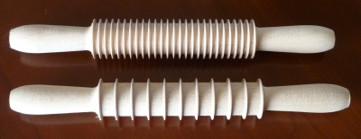
Constant-Time Algorithm
Now the instrument needed for a constant-time algorithm for making Italian pasta:

Slide 9
O(⎷n) Algorithm
Finally, a demonstration of sorts of an O(⎷n) algorithm for making short Italian pasta:
https://youtu.be/1teUhznIYeU?start=230&end=242

Slide 10
Conclusions
We wrote the paper to be an educational resource, to be used as an appetizing and motivating introduction to computational complexity, …
which normally scares the s--t out of students, to the extent that they avoid all courses in which it is taught.

Slide 11
Conclusions (cont’d)
We submitted the paper for publication at SIGBOVIK in the hopes of having a permanent place from which educators and students can download this educational resource. Also, it gives us an opportunity to visit Pittsburgh, to visit the Bagel Factory, to buy at Giant Eagle (Jaint Iggle) American products not available in Canada and Italy! Daniel used to work for the SEI!

Slide 12
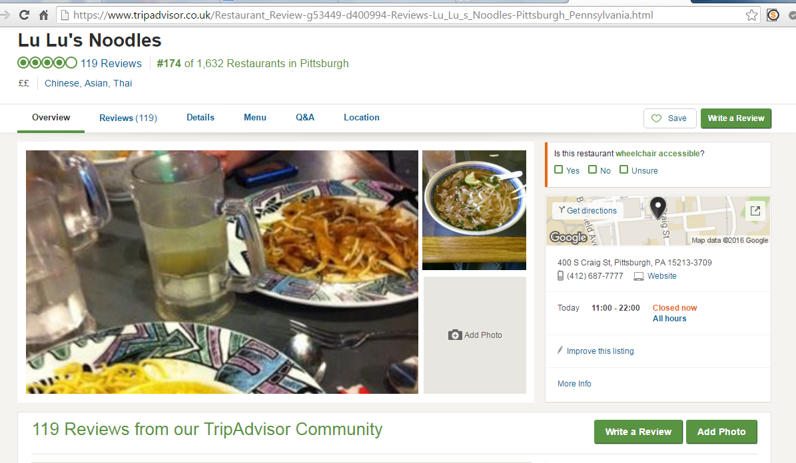
Noodle Dinner Tonight?
BTW, after the conference is over, we were thinking of going to eat dinner at Lu Lu's Noodles at 400 S Craig St. What do you think?

