Slide 1
RE to Avoid Gender Bias
Presented By: Shuchita Singh
CS846
University of Waterloo

Slide 2
Outline
Background
Research Questions
Problem
Detection
RE as a Solution

Slide 3
Biased Computer System
A computer systems that systematically and unfairly discriminate against certain individuals or groups of individuals in favor of others
Example: An automated credit advisor
Unbiased System | Biased System
Denies credit to individuals with consistently poor payment records Appropriate for a credit company to want to avoid extending credit privileges to people who consistently do not pay their bills | System that systematically assigns poor credit ratings to individuals with ethnic surnames Discriminates on grounds that are not relevant to credit assessments and, hence, discriminates unfairly
Notes:
Important to understand bias and biased system in order to solve a problem.

Slide 4
Types of Bias
Pre-existing Bias
has its roots in social institutions, practices, and attitudes
can enter a system
explicitly and conscious efforts of individuals or institutions, or
implicitly and unconsciously, even despite the best of intentions
Individual
Societal

Slide 5
Types of Bias
Technical Bias
Arises from technical constraints or technical considerations
Caused due to
Computer Tools - limitation of the computer hardware, software or peripherals
Decontextualized Algorithms – an algorithm that fails to treat all groups fairly
Random Number Generation - imperfections in or misuse pseudorandom number generation
Formalization of Human Constructs - Bias that originates from attempts to make human constructs
Notes:
Computer tools - in a database for matching organ donors with potential transplant recipients certain individuals displayed on initial screens are favored over individuals displayed on later screens
Algo – algo that depends on alphabetical ordering of names
Human constructs – system advices defendants whether or not to plea bargain, it assumes human laws can be spelled in an unambigous manner

Slide 6
Types of Bias
Emergent Bias
This bias typically emerges some time after a design is completed, as a result of changing societal knowledge, population, or cultural values
UIs are mostly prone to this
Caused due to
New Societal Knowledge
Mismatch between Users and System Design
Notes:
Societal – sys for AIDS patients diagnosis updates regularly
Mismatch- some system design was assumed for a major part of society

Slide 7
Gender Bias
Unfair differences in the way a person is treated because of their gender

Slide 8
Research Questions
RQ1
A systematic study of gender bias in software engineering
What leads to introduction of gender bias in a software?
How to detect gender bias in pre-existing system?
RQ2
RE to avoid gender bias
How can RE prevent/avoid gender bias in software?
Notes:
Now lets try to understand the problem of gender bias by going over 2 different studies

Slide 9
Problem of Gender Bias
Study 1(a): Graphical Software
Study 1(b): Linguist Software
City County Opposites by Random House
Animals were used to make it gender neutral
Male Animals – doctors, Policemen
Female Animals – Cooking, cleaning
Streets by Microcomputer Workshops
Story telling for young kids
Female character – Crazy old witch, less frequent
Male character – Working and earning, more frequent
Notes:
Research conducted by Proffs of California state univ
Both used to teach young kids, subtle hints of sexism

Slide 10
Problem of Gender Bias
Study 2: Amazon’s AI recruiting tool
Global workforce is 60% male
Men hold 74% of the company’s managerial positions
Dataset used was based on resumes submitted over 10-year period – mostly white male
Software penalized any resume that contained the word “women’s” in the text and downgraded the resumes of those who attended women’s colleges

Slide 11
Problem of Gender Bias
Another example, AI based targeted ads show better paying jobs to men
Gartner predicts that by 2022, 85% of AI projects will deliver erroneous outcomes
This will be caused due to bias in
data
algorithms
the teams responsible for managing them

Slide 12
What leads to introduction of gender bias in a software?
No software is intentionally designed to be sexist
Key component - Pre-existing bias in society
Lack of awareness
Bias can creep in during all phases of a project
Problem Description
Considering an insufficiently rich set of factors
Lack of diverse data
Lack of strict code towards gender neutrality starting from requirement gathering phase
No focus on countering the issue which leads to further growth
Notes:
We grew up in a patriarchal society
A UI designer is not trying to be sexist while choosing graphics but has an inherent idea that men should be working and women can stay at home cook clean

Slide 13
Detecting Gender Bias
Study 1(a) and 1(b) (Cont.)
A study with 2 sections
Section A : 11 Students (1 male, 10 Female)
Section B: 7 Students (All female)
Evaluation method
Expanded Sexism Checklist (ESC)– Supported characters, title, subject matter etc
Computers, Reading and Language Arts (CRLA) – yes/no
Both sections chose 2 software and evaluated using both the methods

Slide 14
Detecting Gender Bias
Most accurate method would be - Manual Method
High accuracy
Time consuming
Cannot be done for every piece of software
Prone to pre-existing bias
Automated detection
Can be less accurate than manual
Fast
Prone to technical bias
Mostly successful for language issues
Compare outputs for different groups

Slide 15
RE as a Solution
Inclusive Design
Expanded sexism checklist should be included in each user manual
Requirement engineer should be made aware of gender bias issue so that it is continuously countered
UI design should be carefully defined as it directly impacts user psychology, including attitudes and intentions
Test cases specified during requirement gathering phase should include all minority cases
Notes:
UI Design – a star

Slide 16
RE as a Solution
Inclusive Design Method: The GenderMag Project
Evaluates a system’s gender inclusiveness
Specialized personas
Method
Group of software professionals walk through a scenario in their system, step by step, through the eyes of one of the GenderMag personas
At each step, they decide whether their persona (e.g., “Abby”) will
know what to do and,
if Abby performs the action, whether she will know that she is progressing toward her goal
Notes:
HCI Research
It is not a software, it is a design method

Slide 17
RE as a Solution
Problem Description
Clearly worded
Preference should be given to gender neutral terms
Should be defined in a way that acknowledges different classes and how they will be impacted
Dataset Description
Flawed data is a big problem!
Recognize and address statistical bias
Data should represent all groups
Sufficient data should be gathered (What do you call “sufficient”?)
Notes:
Insufficient training data is another cause of algorithmic bias.

Slide 18
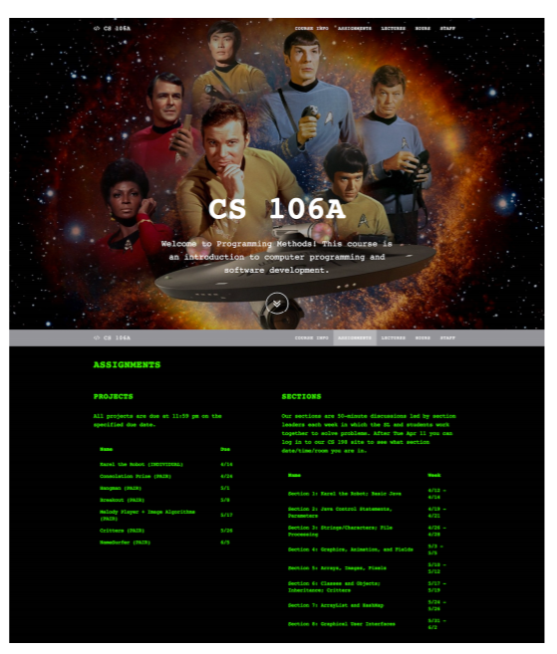
RE as a Solution
Source:Metaxa-Kakavouli, D., Wang, K., Landay, J. A., & Hancock, J. (2018). Gender-Inclusive Design. Proceedings of the 2018 CHI Conference on Human Factors in Computing Systems - CHI ’18.doi:10.1145/3173574.3174188

Slide 19
Future Work
Extend the work on Cause, Detection and Solution of gender bias from
Standard SE Perspective
Inclusive Design focusing on RE
AI & ML perspective
NLP
Work can be extended to other issues such as racism

Slide 20
References
Nina Ribak Rosenthal & Diana Mayer Demetrulias (1988) Assessing Gender Bias in Computer Software, Computers in the Schools, 5:1-2, 153-164, DOI: 10.1300/ J025v05n01_13
Friedman, B., & Nissenbaum, H. (1996). Bias in computer systems. ACM Transactions on Information Systems, 14(3), 330–347.doi:10.1145/230538.230561
https://www.brookings.edu/research/algorithmic-bias-detection-and-mitigation-best-practices-and-policies-to-reduce-consumer-harms/
https://www.ey.com/en_gl/wef/why-we-need-to-solve-the-issue-of-gender-bias-before-ai-makes-it
https://gendermag.org/index.html

Slide 21
Thank You!

