Slide 1
Requirements engineering in Cloud Computing
Presented by: Ritik Arora
CS846 : Advanced Topics in Requirements Engineering

Slide 2
Agenda
Cloud Computing
Motivation
Case Study
Traditional RE Approach
Goal based RE Approach
Conclusion

Slide 3
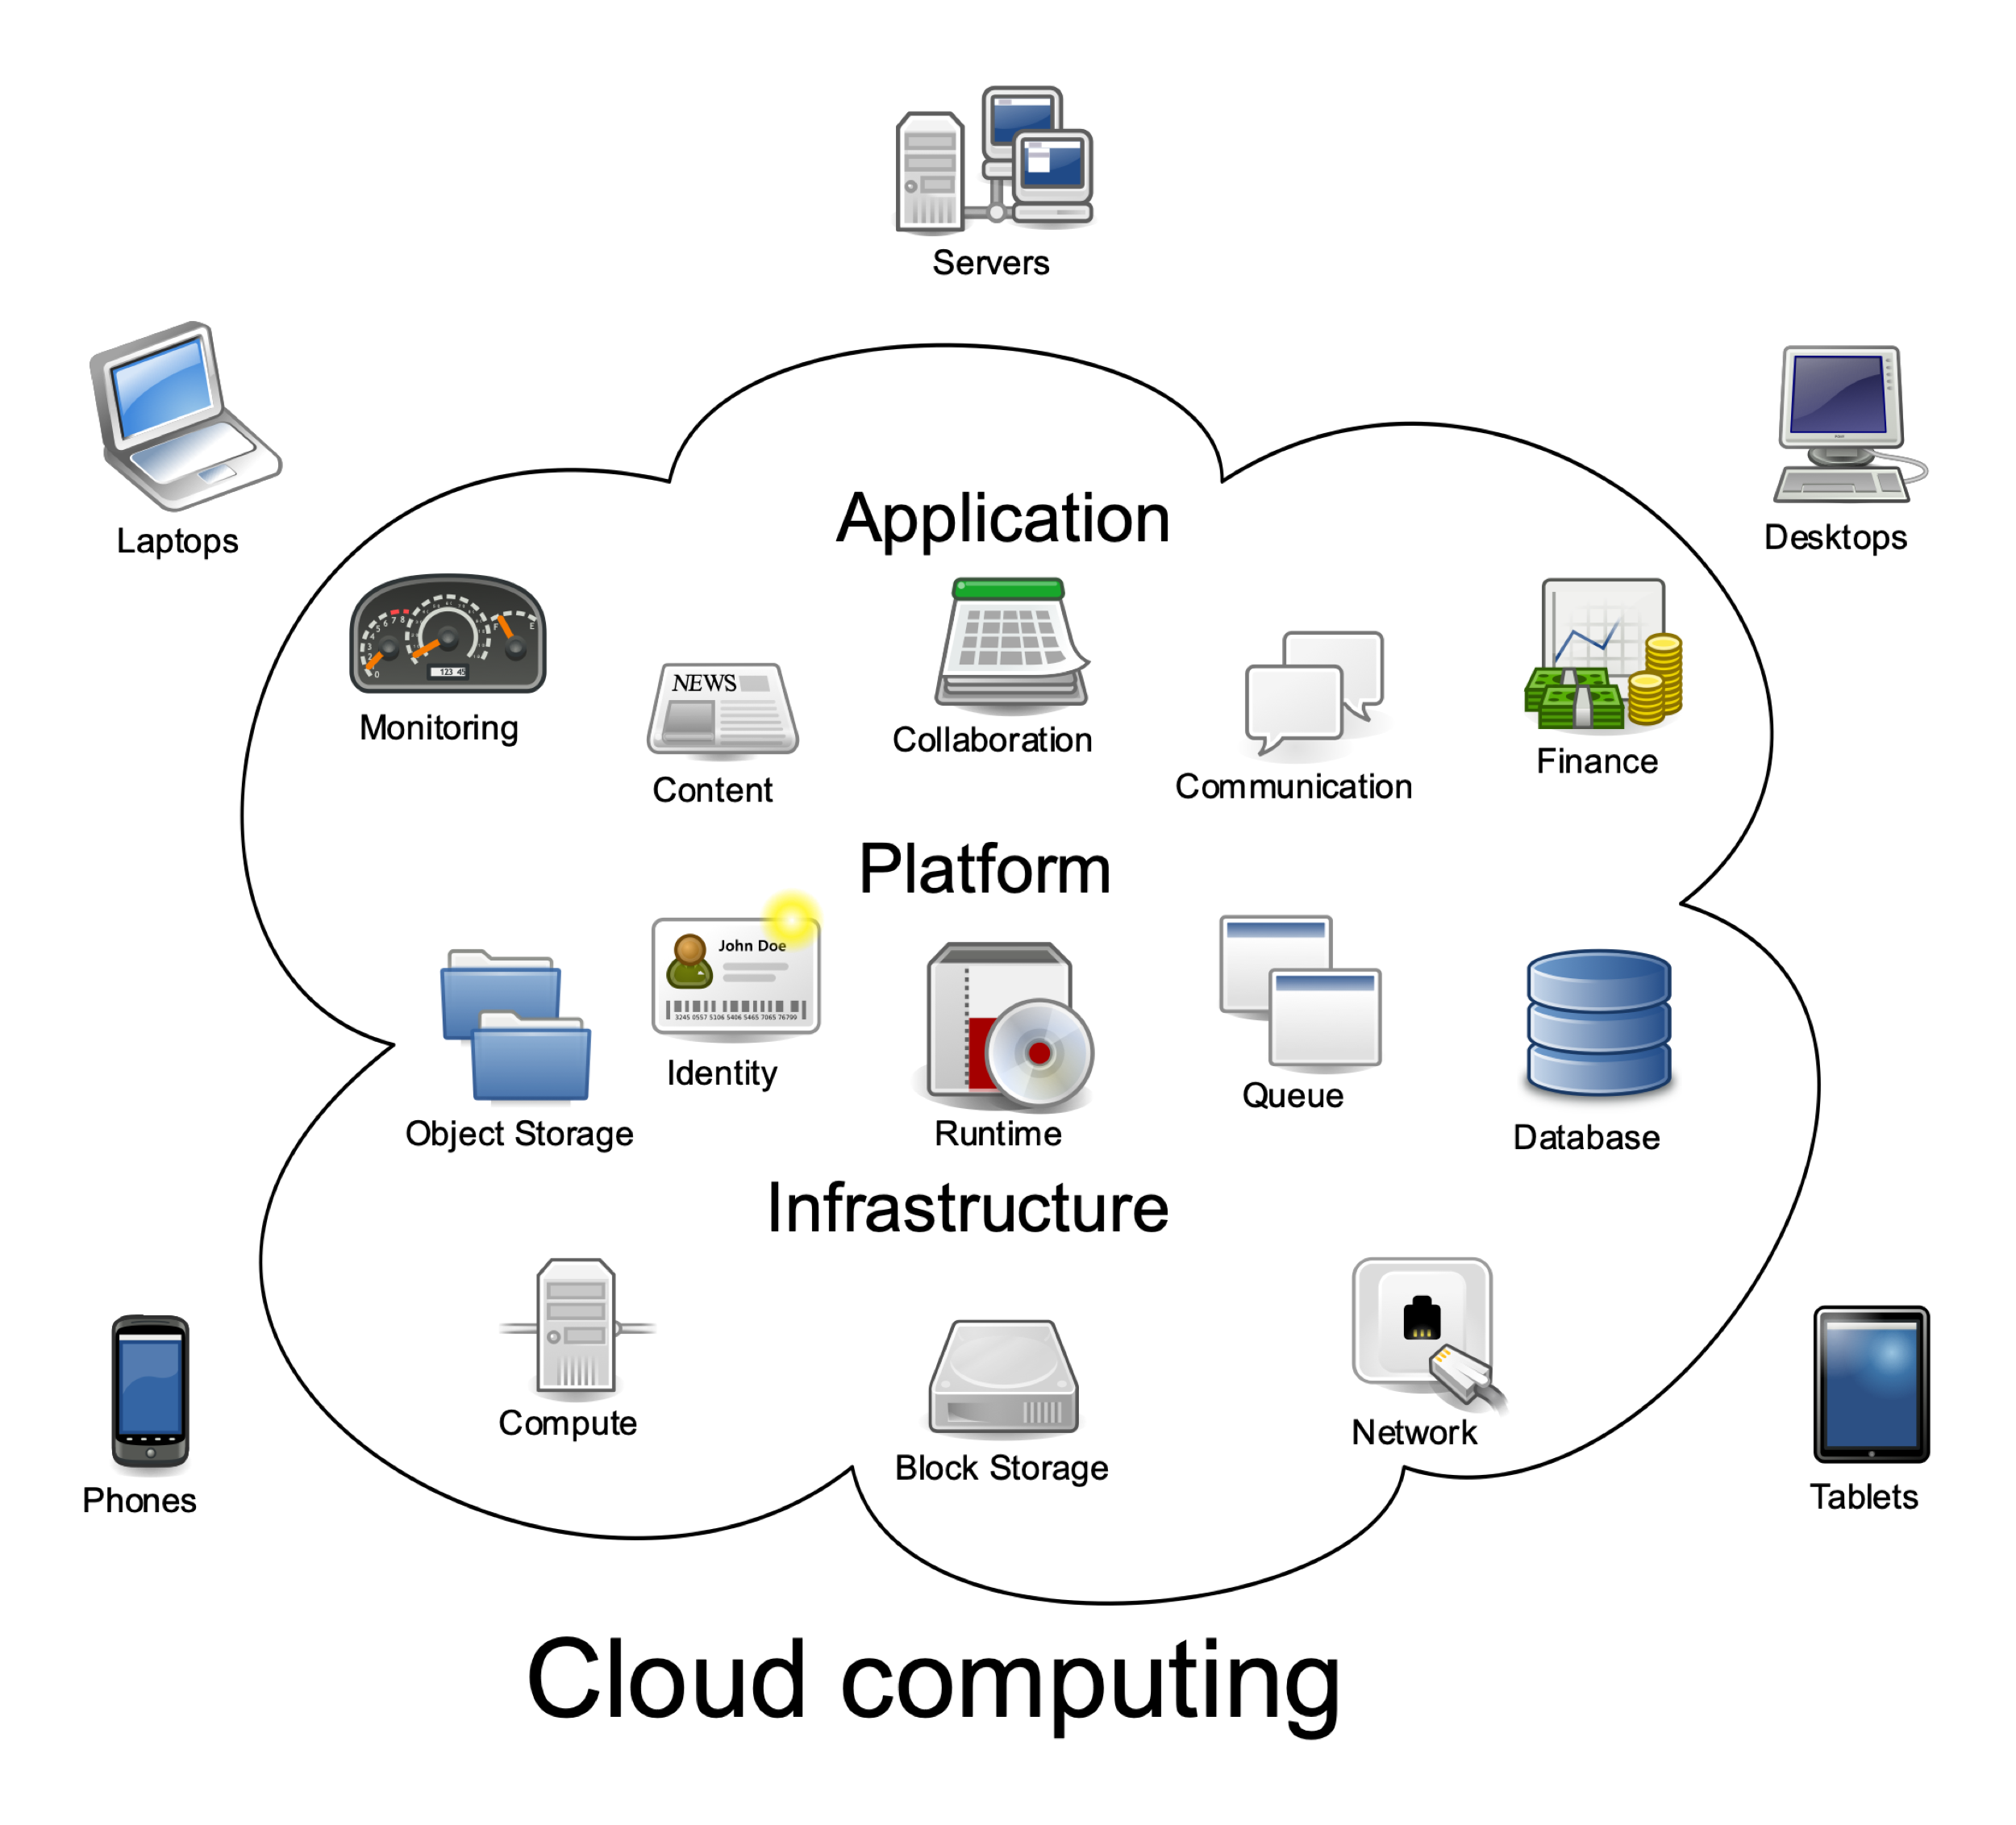
Cloud Computing

Slide 4
Advantages of Cloud Computing
Flexibility
Fault tolerance
Cost Reduction
Scalability
Security
Performance

Slide 6
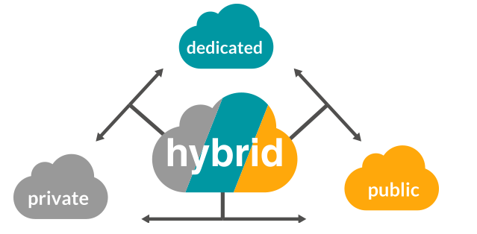
Motivation for requirements engineering
Best model, type and service
Business priorities changes

Slide 7
Motivation for requirements engineering
Product changes like adding new features or security policies
Market change – targeting new market or customers
New solutions and technical changes

Slide 8
Motivation for requirements engineering
Government policy changes like Data localization
Infrastructure costs

Slide 9
Case Study
Company X wants to move it’s Inventory Management application to cloud. Some of the key requirements –
Security requirements
Functional requirements
Non Functional requirements – Availability, Support, Response time
Future upgrades and maintenance
Adhere to country’s data regulations

Slide 10
Traditional RE Approach
Requirements Elicitation-
Initial stage of requirements
Gather core requirements
Search for cloud providers

Slide 11
Traditional RE Approach
Requirements Analysis and Negotiation-
Gather information related to cloud providers
Reassess the requirements based on finding
Prioritization and negotiation
Risk analysis of the tradeoffs

Slide 12
Traditional RE Approach
Requirements Evaluation-
Continuous process of evaluation
Short list candidates
Evaluate the end user goals

Slide 13
Traditional RE Approach
Requirements Documentation and Management-
Informal contract
Documentation of finalized requirements
Document changes required in existing process

Slide 14
Goals based RE Approach
Acquire and Specify Goals -
Strategic and business goals
Core goals
Operational goals
Define acceptance criteria for goals

Slide 15
Goals based RE Approach
Search for Cloud Service Provider -
Search based on the generic goals
Critical goals need to be meet
Provide confidence degree for each functionality
Trial period

Slide 16
Goals based RE Approach
Performance matching -
Gather information for operational goals
Evaluate score for each operational goal
Examine the global satisfactory score
Evaluate scores for multiple vendors
Also gather user reviews

Slide 17
Goals based RE Approach
Analyzing Mismatch and Risks -
Evaluate mismatch in goals and tradeoffs
Clearly define risk factors which are intolerable
Preventive risk management strategy
Risk Identification
Risk Analysis
Risk Mitigation

Slide 18
Goals based RE Approach
Finalize Cloud Provider -
Optimal cloud provider
Maximize satisfaction of goals and reduce risk
Factors to assess –
Cost
Value
Risk

Slide 19
Conclusion
What is cloud computing?
Challenges in RE for cloud computing
Case study
Traditional RE Approach
Goal based RE Approach

Slide 20
References
https://en.wikipedia.org/wiki/Cloud_computing
https://www.salesforce.com/uk/blog/2015/11/why-move-to-the-cloud-10-benefits-of-cloud-computing.html
https://www.educba.com/cloud-computing-issues-challenges/
https://www.researchgate.net/publication/315913697_Analyzing_Requirements_Engineering_for_Cloud_Computing
https://www.researchgate.net/publication/228578811_Cloud_adoption_A_goal-oriented_requirements_engineering_approach

Slide 21
Thank You!
Q & A

