Slide 1
Neo
Tomorrow’s Healthcare Today.
Presented by Prashanth T.K. ( Founder Network+)
Startup Info: www.networkplus.ca
Twitter: @networkplus
Facebook: @networkplusblockchain

Slide 2
Contents
Introduction
Problem
Solution
Contributions: Neo Product Features
Neo: User Guide
Results
Discussion and Future Work

Slide 3
Introduction
It is impossible to do Requirements Elicitation(REl) after victims have been “cyber-attacked”
Requirements Engineering(REng.) need to be introduced as the first step of development of a product
PIPEDA Def.: The Personal Information Protection and Electronic Documents Act
In simple terms , PIPEDA “requires” everyone to keep records of breaches

Slide 4
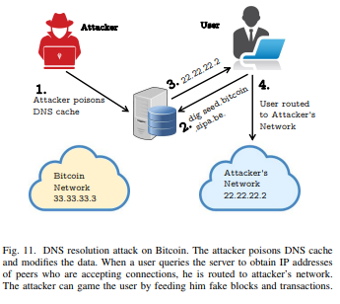
Requirements for DNS Protection

Slide 5
Problem Statement
Centralized storage < Decentralized Storage
2 databases is better than 1
Failure to comply with PIPEDA and other Compliance Requirements in general
Threats: Malware, ransomware, botnet attacks
Notes:
CarePartners software was not updated for 2 years. Data was unencrypted. Hackers made use of it.
MedStar was attacked by a virus.
Common keywords after an analysis of North Carolina State University’s antivirus requirements and regulation policy shows that exemption is a commonly occurring theme

Slide 6
Problem Statement
Ranking of Top 5 Requirements Elicitation Processes:
Observation : Rank 1
Brainstorming: Rank 2 ( lack of communication with client)
Interviews: Rank 3 ( Expensive and sample size constraints)
Req Workshops ( Expensive and lack of “direct” understanding and communication with client requirements)
Prototyping: ( Same as Rank 4)
Notes:
CarePartners software was not updated for 2 years. Data was unencrypted. Hackers made use of it.
MedStar was attacked by a virus.
Common keywords after an analysis of North Carolina State University’s antivirus requirements and regulation policy shows that exemption is a commonly occurring theme

Slide 7
Research Questions
What are the common requirements of the User of a Distributed Ledger based Electronic Medical Record system ?
What are the critical functional requirements of a blockchain based serverless storage solution ?
How to effectively migrate a centralized legacy EHR storage system to a decentralized storage solution?
Notes:
CarePartners software was not updated for 2 years. Data was unencrypted. Hackers made use of it.
MedStar was attacked by a virus.
Common keywords after an analysis of North Carolina State University’s antivirus requirements and regulation policy shows that exemption is a commonly occurring theme

Slide 8
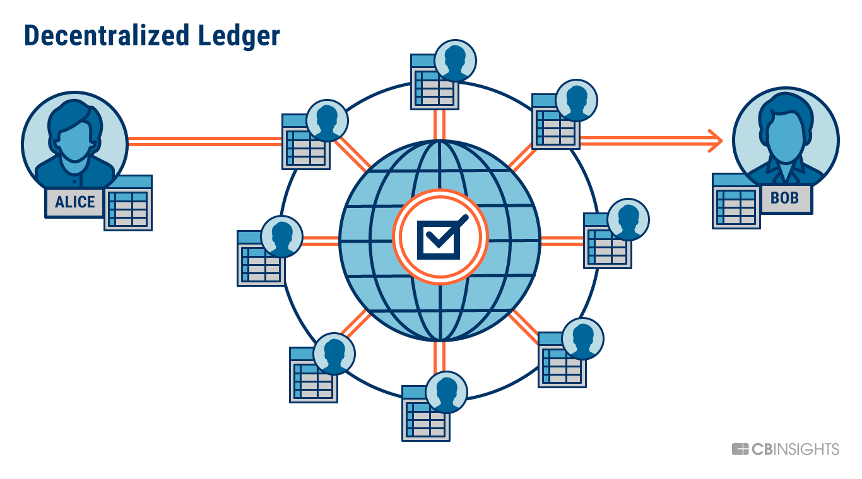
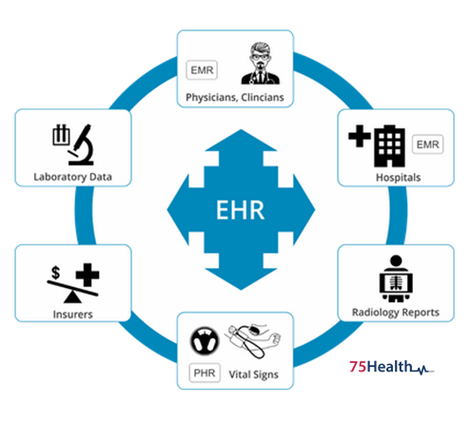
Solution: Neo Defense Model

Slide 9
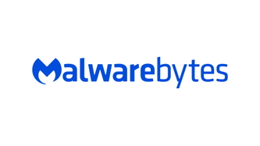
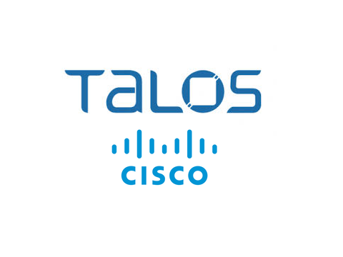
Requirements of a Secure EHR Storage System
Digital formatting enables information to be used and shared over secure networks
Track care (e.g. prescriptions) and outcomes (e.g. blood pressure)
Trigger warnings and reminders
Send and receive orders, reports, and results
Decrease billing processing time and create more accurate billing system

Slide 10
Results: Neo Product Features
Immutable Ledger
Cryptographically Verifiable
Scalable
Serverless
Easy to Use
Case study of popular DApp features
Product Usage Guide

Slide 11
Neo: Defense Model User Guide
Step 1: Encryption
Step 2: Electronic Health Record Ledger Storage (IPFS)
Step 3: Smart Contract Automation
Step 4: DApp Development
Step 5: DApp Release on Platform Neo

Slide 12
Discussion and Future Work
Post Requirements Gathering: Establishing Goals, Objectives and KPIs
Smart-Contract based Access Control
Leveraging PIPEDA Toolkit
Integration with common platforms such as SQL Server, mongoDB, docker, wordpress etc.

Slide 13
Thank you
Twitter: @networkplus
Facebook: @networkplusblockchain

