Slide 1
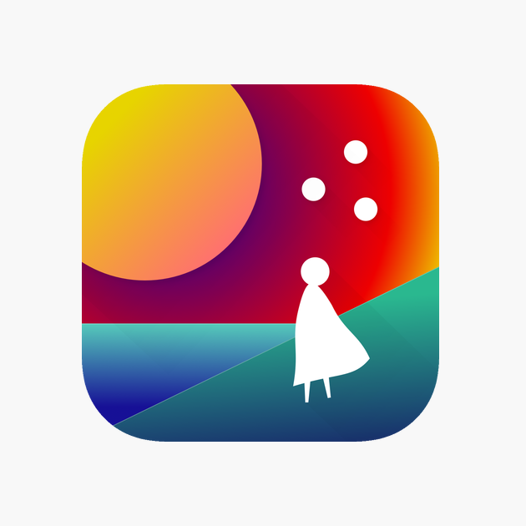
Requirements of Persuasive Systems : Case Study of a Habit Changing Application
Presented By : Noshin Nawar Sadat

Slide 2
Outline
Introduction
Fabulous : Self Care App
Persuasive Systems Design (PSD) Model
Analysis
Discussion
Conclusion

Slide 3
Introduction
Fabulous : Self Care Application
Aims to change people's habits, more specifically, their behaviors.
Developed in Duke's Behavioral Economics Lab
Claims to have been built based on principles of behavioral psychology
Rating is 4.6 in the App Store and Play Store
Over 297,000 monthly app downloads, with monthly growth at over 40% (May 30, 2019)
Apple Store - Best Apps 2018 in Self-Care, Best App Finalist in Google Play Awards and Material Design Award Winner.
Identify its persuasive features

Slide 4
Introduction
Why Fabulous: Self Care?
Successful
High rating and downloads
Award winners
Claims to have used behavioral science

Slide 5
Introduction
Goal of Study
Identify persuasive features in a successful habit changing application – Fabulous : Self Care
Leverage a most commonly used evaluation framework for persuasive systems - Persuasive Systems Design (PSD) model

Slide 6
Fabulous : Self Care Application
Fairy tale like visuals and soft sounds
Very easy to use and intuitive interface
Onboarding
A series of questions to determine gender, existing habits and confidence in changing behaviors
Based on the inputs, provide a personalized experience

Slide 7
Fabulous : Self Care Application
Journeys
Goals range from feeling energized and eating better to leading a purposeful and well-balanced life
Most journeys require purchase of the full version
Users can take up more than one journeys at a time (not recommended)

Slide 8
Fabulous : Self Care Application
Habits
Each journey has a set of compulsory habits
Except for the first habit, all other compulsory habits are locked
Journey involves a series of challenges of increasing difficulty
Next compulsory habit gets unlocked and is required to be performed along with the previously unlocked habits
Perform the habit(s) at least three days in a row
Also provides a list of optional habits
Users can take up at any time

Slide 9
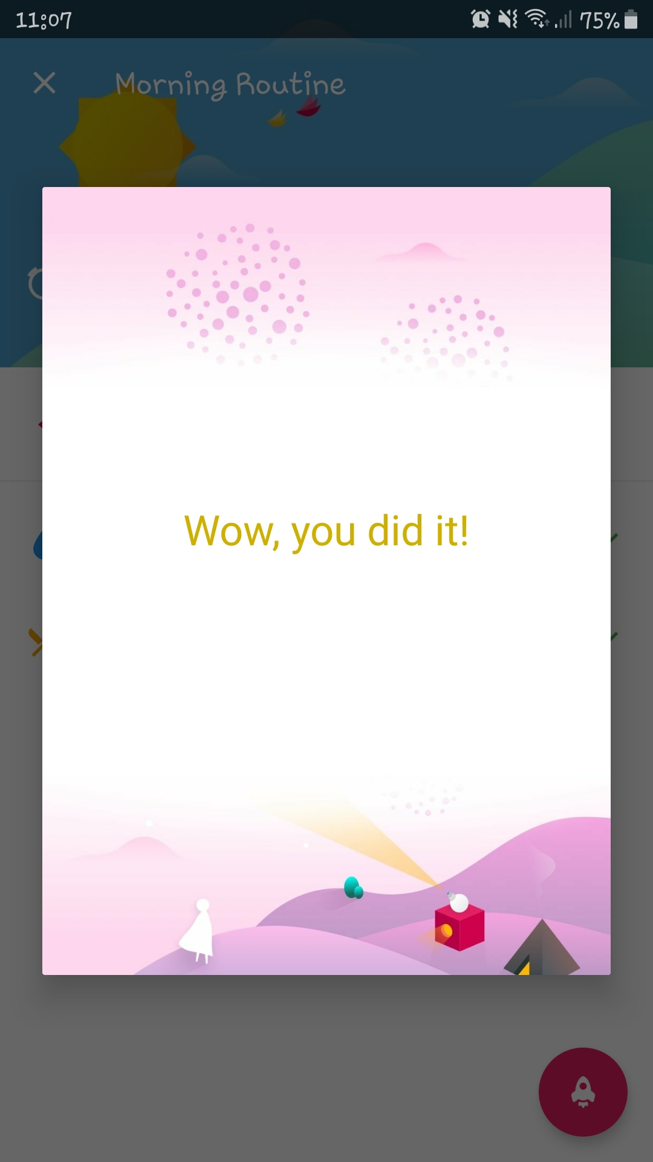
Fabulous : Self Care Application
Congratulatory messages and letters after completing each challenge that include
Why the habit they have worked towards is important to their ultimate goal
Information on the next habit/challenge
Importance of next habit
Suggestions to easily perform next habit

Slide 10
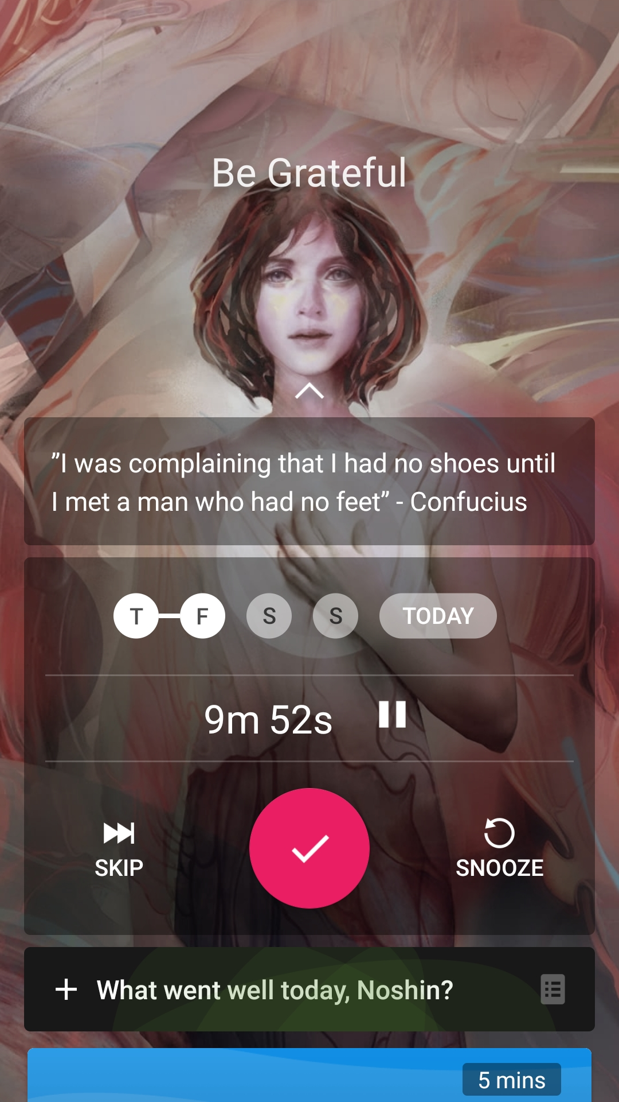
Fabulous : Self Care Application
Tracking habits
Through user inputs
Prompts user with a hovering notification
Snooze
Skip
Tick
If it is an activity that requires a set period of time (e.g. exercise for 8 minutes), it starts a timer
If it is a simple activity like drinking water, tapping the play option ticks off the habit immediately.

Slide 11
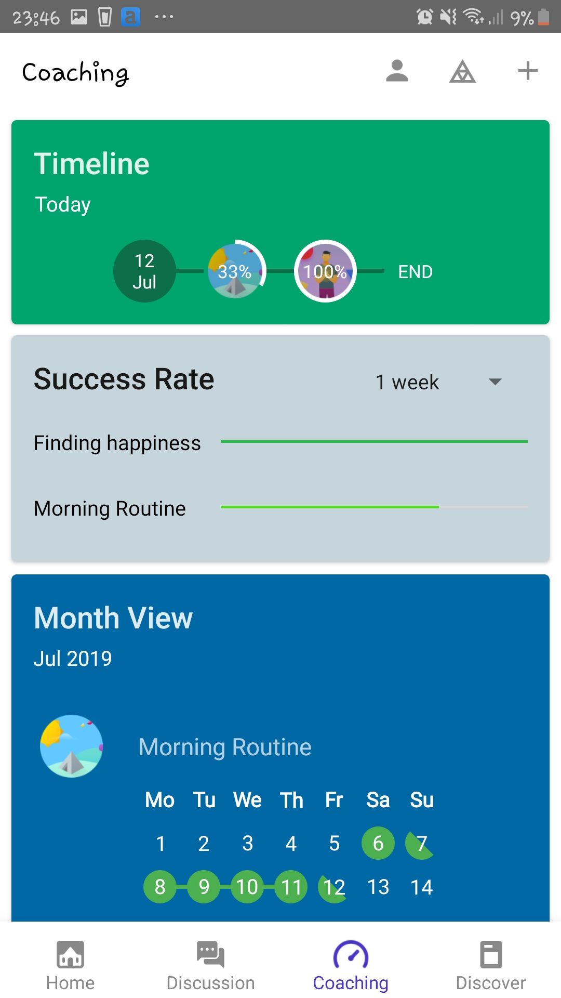
Fabulous : Self Care Application
Monitoring user progress
Percentage of journey completed
Weekly and monthly success rate
Monthly view of their performances in the daily routines
Daily timelines to see the list of habits to be performed

Slide 12
Fabulous : Self Care Application
Additional features
Contents for exercise, yoga, meditation and so on
Editorials and infographics on healthy living

Slide 13
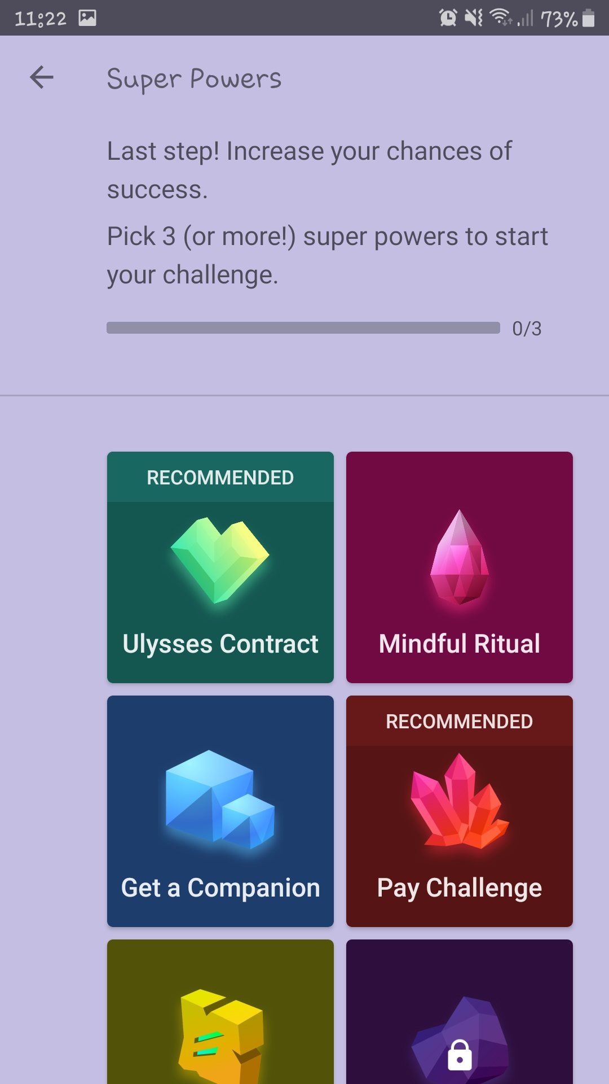
Fabulous : Self Care Application
Additional features
Users can take part in some individual and group challenges
Not related to the main journeys of the application
“Super powers” to ensure success
Individual super power - making the Ulysses contract (where the user has to think of a trick that would absolutely make it necessary for them to complete the challenge)
Social super power - getting a companion (to complete the job with or to monitor the user)

Slide 14
Persuasive System Design (PSD) Model
Proposed by Oinas-Kukkonen and Harjumaa
Framework for persuasive system design and evaluation
Derived from existing knowledge base of behavioral economics and captology
Most often used for analysis and evaluation of persuasion context and persuasive features

Slide 15
Persuasive System Design (PSD) Model
Persuasiveness is a non-functional requirement
Persuasive features
28 persuasive techniques
4 categories, each with 7 techniques
Primary Task Support
Facilitate user interaction with the system and assist in performing tasks
Dialogue Support
Improve user-system dialogues and guide user through the task
System Credibility Support
Make the system more credible to the eyes of the user
Social Support
Motivate user by leveraging social influence

Slide 16
Analysis : Persuasive Features
Primary Task Support
Reduction
Reduce user's efforts in performing the target behavior
Fabulous : Self Care
Reduction
One tap inputs
Small and incremental habits
Salient and convenient choices

Slide 17
Analysis : Persuasive Features
Primary Task Support
Tunneling
Guide the user towards their target behavior by providing means for action.
Fabulous : Self Care
Tunneling
Guides the user through several fixed habits in order to attain a goal (complete a journey).

Slide 18
Analysis : Persuasive Features
Primary Task Support
Tailoring
Provide tailored functionalities based on different user groups.
Fabulous : Self Care
Tailoring
No evidence of tailoring
Same journeys, letters and overall experience for extremely different inputs

Slide 19
Analysis : Persuasive Features
Primary Task Support
Personalization
Offer personalized content based on user input.
Fabulous : Self Care
Personalization
Allow users to
Take challenges they wanton challenges they want
Defer a challenge if they feel like they are not ready for it.
Set the dates and times according to their own convenience.

Slide 20
Analysis : Persuasive Features
Primary Task Support
Self-monitoring
Provide tracking and monitoring user performance and status.
Fabulous : Self Care
Self-monitoring
Presents the user's progress information

Slide 21
Analysis : Persuasive Features
Primary Task Support
Simulation
Provide means to view cause and effect relationship of target behavior.
Fabulous : Self Care
Simulation
No simulation techniques were observed in the application.

Slide 22
Analysis : Persuasive Features
Primary Task Support
Rehearsal
Provide means for rehearsing target behavior.
Fabulous : Self Care
Rehearsal
Helps users rehearse exercises, yoga and meditation by providing timed guides as well as audio tutorials

Slide 23
Analysis : Persuasive Features
Dialogue Support
Praise
Provide positive feedback using words, images, symbols or sounds.
Fabulous : Self Care
Praise
Users receive congratulatory messages as well as encouraging letters to boost their self-efficacy.

Slide 24
Analysis : Persuasive Features
Dialogue Support
Rewards
Give credit for performing target behavior.
Fabulous : Self Care
Rewards
No extrinsic rewards like badges or points.
Letters are the only form of rewards.

Slide 25
Analysis : Persuasive Features
Dialogue Support
Reminders
Remind users to perform target behavior.
Fabulous : Self Care
Reminders
Reminders according to user convenience

Slide 26
Analysis : Persuasive Features
Dialogue Support
Suggestion
Suggest methods to complete the target behavior.
Fabulous : Self Care
Suggestion
Provides suggestions to the users in order to help them perform the new habits and complete challenges

Slide 27
Analysis : Persuasive Features
Dialogue Support
Similarity
Imitate the user in some specific way.
Fabulous : Self Care
Similarity
Makes use of careful wording as well as tones of speaking in the audio, which makes it seem like it is sympathizing with the user and that both are on the same boat on this journey.

Slide 28
Analysis : Persuasive Features
Dialogue Support
Liking
Have an appealing look and feel.
Fabulous : Self Care
Liking
Clean and simple interface with beautifully designed graphics.

Slide 29
Analysis : Persuasive Features
Dialogue Support
Social Role
Adopt a social role.
Fabulous : Self Care
Social Role
Adopts the role of a life coach and guides the user in their journey.

Slide 30
Analysis : Persuasive Features
System Credibility Support
Trustworthiness
Provide truthful, unbiased and fair information.
Fabulous : Self Care
Trustworthiness
Allows users to be in complete control of their information.

Slide 31
Analysis : Persuasive Features
System Credibility Support
Expertise
Demonstrate knowledge, experience and competence.
Fabulous : Self Care
Expertise
Mentions that it was developed in the Duke's Behavioral Economics Lab under the guidance of behavior change scientist Dan Ariely

Slide 32
Analysis : Persuasive Features
System Credibility Support
Surface Credibility
Have a competent look and feel where visual design reflects the context.
Fabulous : Self Care
Surface Credibility
Interface is simple and intuitive, and the contexts are well represented by the graphics.
No grammatical or spelling error is observed.

Slide 33
Analysis : Persuasive Features
System Credibility Support
Real World Feel
Provide information of the organization and/or the people behind its contents and services.
Fabulous : Self Care
Real World Feel
Mentions about the organization (Duke's Behavioral Economics Lab) and the people (Dan Ariely) behind it.

Slide 34
Analysis : Persuasive Features
System Credibility Support
Authority
Refer to people in authority.
Fabulous : Self Care
Authority
Provides information about scientific evidences and their references to justify their methods.

Slide 35
Analysis : Persuasive Features
System Credibility Support
Third Party Endorsement
Provide endorsements from respected sources.
Fabulous : Self Care
Was incubated in a lab that studies behavior change.

Slide 36
Analysis : Persuasive Features
System Credibility Support
Verifiability
Provide means to verify accuracy of content.
Fabulous : Self Care
Verifiability
Provides names and references to stated facts so users can verify them if they want.

Slide 37
Analysis : Persuasive Features
Social Support
Social Learning
Allow observing of the progress of other users performing the target behavior.
Fabulous : Self Care
Social Learning
User can view how many people are attempting the challenge, have completed the challenge or are working towards it in real time.

Slide 38
Analysis : Persuasive Features
Social Support
Social Comparison
Show comparison of user performance with that of other users.
Fabulous : Self Care
Social Comparison
Users can compare their own progress against other users and see whether they belong to the group that has completed the challenge or not.
Users can also share the letters which they receive after completing each challenge.

Slide 39
Analysis : Persuasive Features
Social Support
Normative Influence
Gather people of same goals together to exchange information.
Fabulous : Self Care
Normative Influence
A discussion board where users can post and comment about their experiences while going through the journeys (interaction and networking).
A closed Facebook group for its users

Slide 40
Analysis : Persuasive Features
Social Support
Social Facilitation
Discern other users performing the target behavior
Fabulous : Self Care
Social Facilitation
Users can view how many people are at the same progress level as themselves in the individual or group challenges outside the main journey.
A discussion group which can give them an idea about the other users who are in the same journey.

Slide 41
Analysis : Persuasive Features
Social Support
Co-operation
Provide means for cooperation.
Fabulous : Self Care
Co-operation
A question/answer feature where users can anonymously ask each other for motivation as well as recommendations.

Slide 42
Analysis : Persuasive Features
Social Support
Competition
Provide means for competing with other users.
Fabulous : Self Care
Competition
Users can invite their friends and compete with each other in completing challenges.

Slide 43
Analysis : Persuasive Features
Social Support
Recognition
Publicly recognize people who have performed the target behavior.
Fabulous : Self Care
Recognition
No recognition technique was observed in Fabulous.

Slide 44
Discussion : Verdict on Fabulous : Self Care
Has all persuasive features except for
Tailoring (might be present in the paid version)
Simulation
Recognition
Unobtrusive
Considers user context
Cannot handle cheating

Slide 45
Discussion : Limitations of the Study
Effectiveness based on application ratings
Might have been subject to bias due to the application's availability, pricing, marketing as well as release date
Only one person was responsible for analyzing the application
Could be subject to several biases
A major challenge for e-health applications is their inability to engage users for the long term
Interest and engagement with a new technology are at their peaks immediately after the introduction of the new technology
Human behavior typically takes a very long time to change
A longitudinal study with a large number of participants and with the full (not free) version of the application is essential to truly determine the effectiveness of Fabulous in changing behaviors.

Slide 46
Conclusion
Used PSD model to identify persuasive features in Fabulous : Self Care application
Application met all requirements except for tailoring, simulation and recognition

Slide 47
Thank You!

