Slide 1
Requirement Engineering for Databases and Data Cleaning
Presented to: Prof. Dan Berry Presented by: Marian Boktor Course Code: CS846

Slide 2
Outline
Introduction
Databases and Data Quality
Data Cleaning
Requirements for a good Data Cleaning system
Summary

Slide 3
How to know if a database is any good?
Helps support and ensure the accuracy and integrity of information
Divides information into subject-based tables to reduce redundant data
Provides Access with the information it requires to join the information in the tables together as needed
Accommodates your data processing and reporting needs
It is easy to modify and maintain without affecting other fields or tables in the database
Information is easy to retrieve, and user applications are easy to develop and build

Slide 4
How to know if a database is any good?
The database is scalable, meaning that it can be expanded to meet the changing needs of an organization
Normalized, to minimize data redundancy, I/O redesign transaction sizes and to enforce referencing integrity
Semantically same data have same representations in heterogeneous sources
We have to have a single view and access to accurate and consistent data
Quality Design: data is stored in a single logical unit instead of multiple files, maintaining data integrity and security, and finally increase the performance of the database

Slide 5
How to know if database software is any good?
Easy to use
Customizable
Mobile-optimized
Real-time insights
Cloud-based
Tailored for any company
Multiple database formats
Define constraints to maintain data integrity
e.g. TeamDesk, Knack, Oracle Database Cloud Service, Microsoft Azure Cloud

Slide 6
Why we need a good database?
Centralized systems
Better management of human resource (HR) matters
Managing customer data and relationships
Efficient inventory tracking
Planning for growth

Slide 7
High Quality Data | Criteria
Validity e.g. Mandatory, Data-type, Range, Foreign-key and Unique constraints
Accuracy
Completeness
Consistency
Uniformity
Traceability
Timeliness

Slide 8
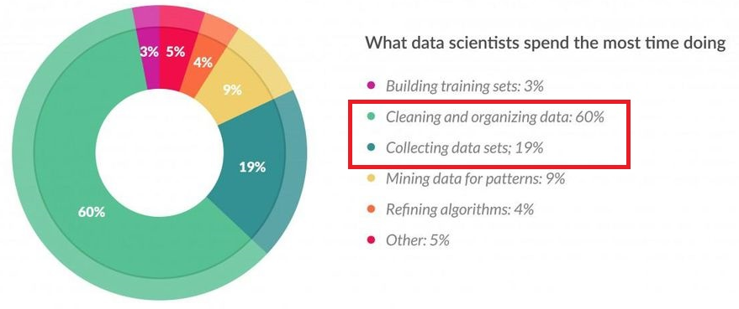
Data Cleaning
According to an article on Forbes, by the year 2020, about 1.7 megabytes of new information will be created every second for every human being on the planet. This means that different types and sources of data will be at play, and that could prove to be messy

Slide 9
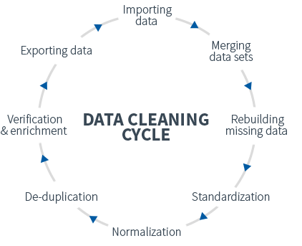
Data Cleaning CYCLE

Slide 10
Data Cleaning
What is Data Cleaning?
It is basically the act of identifying and correcting false, incomplete or irrelevant parts of data
Process of detecting and correcting (or removing) corrupt or inaccurate records from a record set, table, or database and refers to identifying incomplete, incorrect, inaccurate or irrelevant parts of the data and then replacing, modifying, or deleting the dirty or coarse data

Slide 11
Data Cleaning Example

Slide 12
Data Cleaning
Why is it important?
It will make everyone more efficient since they’ll be able to quickly get what they need from the data
Reduce operational and maintenance cost as a result of enhancing data quality
Marketing (Increased productivity), Sales (faster cycle), Compliance and Operations (better decisions)
Your project will live or die by the quality of your data; garbage in, garbage out!!!

Slide 13
Data Cleaning
Why is it important?
It’s kind of like getting ready for a vacation. You might not like the preparation part, but tightening down the details in advance can save you from one nightmare of a trip.
You just have to do it.. or you can’t start having fun.

Slide 14
Data Cleaning
What are the challenges?
Large-scale data, hard to detect and repair missing, erroneous and duplicate data
Expensive and time-consuming in terms of analyst effort Almost all data cleaning software requires some level of analyst supervision, on a spectrum from defining data quality rules to actually manually identifying and fixing errors.
Error correction and loss of information
Maintenance of cleansed data (require efficient data collection and management techniques)

Slide 15
Data Cleaning
What are the challenges? (cont’d)
Data cleansing in virtually integrated environments e.g. IBM, requires cleansing of data every time the data is accessed; lower efficiency
Data-cleansing framework is iterative; requires integration and maintenance stages)
As a result of human-in-the-loop cleaning systems; novel problems at the intersection of human factors and database research are presented
Therefore; we need to know how data analysts use data cleaning tools, and what changes must be made to make data cleaning faster and more reliable.

Slide 16
Data Cleaning Existing Systems Categories
Extract-Transform-Load (ETL) systems
Requirements:
manually written data cleaning rules
constraint-driven tools to define data quality rules
Drawbacks:
do not provide the opportunity for analyst iteration or user feedback– inhibiting the user’s ability to rapidly prototype different data cleaning solutions

Slide 17
Data Cleaning Existing Systems Categories
Interactive frameworks like Wrangler and OpenRefine
Requirements:
user direct manipulation of a data sample
Drawbacks
limited to specific cleaning tasks (extraction)

Slide 18
Things you should know about data cleaning task! According to a survey done by Amplab, UC Berkeley and Columbia University
Data Cleaning Methodology
Data cleaning is iterative*
It needs to be an interactive and iterative process. “It’s an iterative process, where I assess biggest problem, devise a fix, re-evaluate. It is dirty work.”
>> PROBLEM! Overfitting! <<
Needs to be performed not in isolation but together with schema-related data transformations based on comprehensive metadata
*analysts alternate between cleaning and analysis, and use the analysis to guide future cleaning results

Slide 19
Things you should know about data cleaning task! According to a survey done by Amplab, UC Berkeley and Columbia University
Data Cleaning Methodology (cont’d)
Evaluating data cleaning is ad-hoc
“Other than common sense we do not have a procedure to do this.”
“We usually do not do rigorous validation of data cleaning. We typically clean our data until the desired analytics works without error. This is not desirable but practical since in most cases data error is probably overshadowed by errors/inaccuracies in the models themselves.”
“We typically cross-reference data with other published materials to make sure it is in the right ballpark”
>> Data Cleaning community needs to have a better answer to this problem <<

Slide 20
Things you should know about data cleaning task! According to a survey done by Amplab, UC Berkeley and Columbia University
Analysts vs. Infrastructure
Infrastructure engineers and analysts address data quality problems differently
e.g. Analysts GUESS there is an error while looking at the models (highly analysis-dependent, and depends on who knows semantics of data)... While Infrastructure Engineers see dirty data as SYMPTOMATIC of an error in the processing pipeline (i.e., a software bug or incorrect schema)

Slide 21
Requirements
Interactive data cleaning and analysis process
Infrastructure engineers, data analysts and domain experts can design, evaluate, and modify (with automated support) any stage of the data cleaning workflow
Developing High-level Language for Domain Experts
Algorithms such as machine learning, clustering, or rule-based procedure too specialized for expert
Should describe the data cleaning goals at a logical level (e.g., providing de-duplication examples, descriptions of outliers), using a visual interface; guides implementation too

Slide 22
Requirements
Application-oriented Cleaning
Systems tailored to specialized use cases (individual aggregation queries and convex models), and support for other more complex operations as well as multi-stage sequences of analyses is needed
Human-Computer Symbiosis
Let experts do what they do best, while machines do the rest
e.g. active learning is used to optimize an operation such as deduplication; automatic hyper-parameter tuning for machine learning models

Slide 23
Requirements
Testing and Debugging
In order to develop automated optimization and tuning procedures, there must be a metric to optimize (not just compile and run)
For example, one might use performance on gold examples of known clean data to evaluate a cleaning operator
To accelerate data cleaning research, there is a need for a cleaning benchmark analogous to industry standard analytical data processing benchmarks
Provide tools to summarize and explain the intermediate results

Slide 24
Requirements
Combating Over-fitting
Potential to favor certain outcomes, into the analysis process
Design data cleaning tools that:
Allow analysts to communicate assumptions (e.g., which records have been removed) when presenting results,
Automatically determine when an assumption is risky (e.g., correlates with the tested hypothesis),
Manages a “paper trail” of data transformations.

Slide 25
Commercially Available Tools
Data quality functionality offered as a separate product, or integrated, or a suite of functions covering full spectrum of capabilities
data profiling,
data parsing/ correction,
data matching/ de-duplication,
enrichment,
integration,
data monitoring

Slide 26
Commercially Available tools
Features | Athanor 3.0 | IQ8 | WebSphere QualityStage
Vendor | Informatica | First Logic (Business Objects) | IBM
Data Profiling | Basic | Good | Very good
Data parsing/correction | Basic | Very good | Very good
Matching/de-duplicate | Good | Very good | Very good
Enrichment | - | Very good | -
Integration | Good | Good | -
Real time support | - | Good | Good
Database support | - | Very good | Good
User Interface | - | Intuitive | Easy to use

Slide 27
Commercially Available Tools
Target
Customer data
Product data
Financial data
Powerful Technologies
Fast access to and from relational databases like: Oracle, SQL Server, DB2, ...etc
Support Windows ODBC connectivity and traditional delimited files
Provide a scope for connectivity to databases, integration with enterprise systems like Enterprise Resource Planning (ERP) and data warehousing tools like Extract transform Load (ETL)
Support Unicode framework, Geocoding and SOA also Web Services standards like SOAP, XML, WSDL, UDDI and HTTP

Slide 28
Commercially Available Tools
How to know is a data cleaning tool is any good?
Handy for dealing with messy data, raw data ingestion; clean, match and transform data from one format to another at a fast pace e.g. OpenRefine, Google
Free or at affordable cost, interactive, with machine learning algorithms that helps in suggestion common transformations and aggregations e.g. Trifacta Wrangler

Slide 29
Commercially Available Tools
How to know is a data cleaning tool is any good?
Advanced data cleansing and fuzzy matching is included, also multi language edition available (e.g. Winpure)
Strong data profiling engine for analysing the quality of data to drive better business decisions, also lets you build your own cleansing rules (e.g. Data Cleaner)
Helps in delivering quality data for big data, business intelligence, data warehousing, master data management, ...etc. (e.g. IBM Infosphere Quality Stage)

Slide 30
Commercially Available Tools
More needs to be done
Support for control and monitoring data in real-time and streaming
Expected to cleanse data before it is saved onto a database or data repository, or used for triggering or actuating some action linked to the status of data
Tools should enhance their capabilities from syntactical (structure of the data) to semantic (meaning of data, metadata)
Tools based on metadata-driven design will enable enterprises to move beyond defect inspection to solving data defects through root-cause analysis

Slide 31
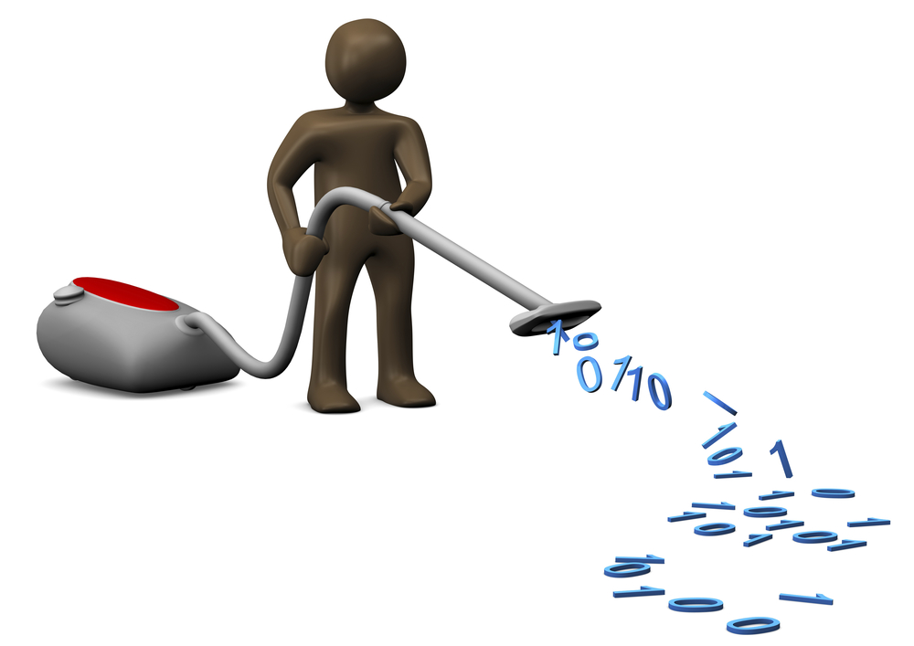
Thank You!

