Slide 1
Path Coverage Guided Fuzzing using Bounded Fuzzing and DAG-ification
Yunji Kim, Department of Mathematics

Slide 2
Index
Background -- Block / Branch Coverage
Method -- Path Coverage
Implementation
System Architecture
DAG-ification
Bounded Fuzzing
Conclusion
References

Slide 3
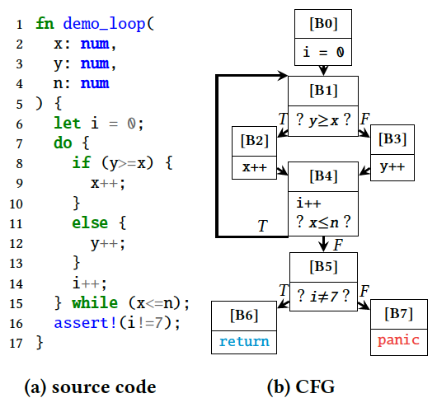
BACKGROUND
Evaluation of coverage
Test case | Test case | 𝑇1 : ⟨𝑥 = 1,𝑦 = 1, 𝑛 = 0⟩ | 𝑇2 : ⟨𝑥 = 0,𝑦 = 1, 𝑛 = 1⟩. | Seed Pool
metric | Input Output | 𝑃1 : 𝐵0 → 𝐵1 → 𝐵2 → 𝐵4 → 𝐵5 → 𝐵6 | 𝑃2 : 𝐵0 → 𝐵1 → 𝐵2 → 𝐵4 → 𝐵1 → 𝐵2 → 𝐵4 → 𝐵5 → 𝐵6 | Seed Pool
Block | Set of CFG nodes ($S^{n}$) | $S_{1}^{n}=$ {𝐵0, 𝐵1, 𝐵2, 𝐵4, 𝐵5, 𝐵6} | $S_{2}^{n}=${𝐵0, 𝐵1, 𝐵2, 𝐵4, 𝐵5, 𝐵6} | {𝑇1} | $S_{block}=$ {𝐵0, 𝐵1, 𝐵2, 𝐵4, 𝐵5, 𝐵6}
Branch | Set of CFG edges ($S^{e}$) | $S_{1}^{e}=${B0 → B1, 𝐵1 → 𝐵2, 𝐵2 → 𝐵4, 𝐵4 → 𝐵5, 𝐵5 → 𝐵6} | $S_{2}^{e}=${B0 → B1, 𝐵1 → 𝐵2, 𝐵2 → 𝐵4, 𝐵4 → 𝐵5, 𝐵4 → 𝐵1, 𝐵5 → 𝐵6} | {𝑇1, 𝑇2} | $S_{branch}=$ {𝐵1 → 𝐵2, 𝐵4 → 𝐵5, 𝐵4 → 𝐵1, 𝐵5 → 𝐵6}
Degree of abstraction
Loss of semantic
Optimality
Table 1. Output Comparison of CFG-Based Coverage Metrics
Figure 1. A Simple Loop Function
Control-Flow-Graph-based
Coverage-guided
Fuzzing
Decide which test cases to add to the seed pool
Automatically generate good seed pool
Test PUT more thoroughly and find more potential bugs

Slide 4
METHOD
Evaluation of coverage
Test case | Test case | 𝑇1 : ⟨𝑥 = 1,𝑦 = 1, 𝑛 = 0⟩ | 𝑇2 : ⟨𝑥 = 0,𝑦 = 1, 𝑛 = 1⟩. | Seed Pool
metric | Input Output | 𝑃1 : 𝐵0 → 𝐵1 → 𝐵2 → 𝐵4 → 𝐵5 → 𝐵6 | 𝑃2 : 𝐵0 → 𝐵1 → 𝐵2 → 𝐵4 → 𝐵1 → 𝐵2 → 𝐵4 → 𝐵5 → 𝐵6 | Seed Pool
Block | Set of CFG nodes ($S^{n}$) | $S_{1}^{n}=$ {𝐵0, 𝐵1, 𝐵2, 𝐵4, 𝐵5, 𝐵6} | $S_{2}^{n}=${𝐵0, 𝐵1, 𝐵2, 𝐵4, 𝐵5, 𝐵6} | {𝑇1} | $S_{block}=$ {𝐵0, 𝐵1, 𝐵2, 𝐵4, 𝐵5, 𝐵6}
Branch | Set of CFG edges ($S^{e}$) | $S_{1}^{e}=${B0 → B1, 𝐵1 → 𝐵2, 𝐵2 → 𝐵4, 𝐵4 → 𝐵5, 𝐵5 → 𝐵6} | $S_{2}^{e}=${B0 → B1, 𝐵1 → 𝐵2, 𝐵2 → 𝐵4, 𝐵4 → 𝐵5, 𝐵4 → 𝐵1, 𝐵5 → 𝐵6} | {𝑇1, 𝑇2} | $S_{branch}=$ {𝐵1 → 𝐵2, 𝐵4 → 𝐵5, 𝐵4 → 𝐵1, 𝐵5 → 𝐵6}
Path | Vector of CFG* nodes ($V^{n}$) | $V_{1}^{n}=$[𝐵0, 𝐵1, 𝐵2, 𝐵4, 𝐵5, 𝐵6] | $V_{2}^{n}=$[𝐵0, 𝐵1, 𝐵2, 𝐵4, 𝐵1, 𝐵2, 𝐵4, 𝐵5, 𝐵6] | {𝑇1, 𝑇2} | $S_{path}=$ {[𝐵0, 𝐵1, 𝐵2, 𝐵4, 𝐵5, 𝐵6], [𝐵0, 𝐵1, 𝐵2, 𝐵4, 𝐵1, 𝐵2, 𝐵4, 𝐵5, 𝐵6]}
Degree of abstraction
Loss of semantic
Table 1. Output Comparison of CFG-Based Coverage Metrics
Optimality
Figure 1. A Simple Loop Function
Control-Flow-Graph-based
Coverage-guided
Fuzzing
Decide which test cases to add to the seed pool
Automatically generate good seed pool
Test PUT more thoroughly and find more potential bugs

Slide 5
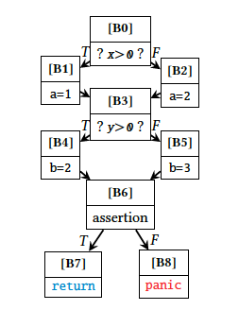
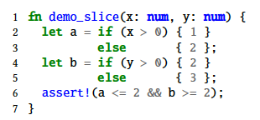
METHOD
Evaluation |  | E1 = Coverage of single test case |  | E2 = Aggregated cov of PUT | E1 | E2 | E3 = Quantification
Test case | Test case | 𝑇1 : ⟨𝑥 = 1, 𝑦 = 1⟩ | 𝑇2 : ⟨𝑥 = 0, 𝑦 = 0⟩ |  | 𝑇3 : ⟨𝑥 = 1, 𝑦 = 0⟩ |  | Quantification
metric | Input Output | 𝑃1 : 𝐵0 → 𝐵1 → 𝐵3 → 𝐵4 → 𝐵6 → 𝐵7 | 𝑃2 : 𝐵0 → 𝐵2 → 𝐵3 → 𝐵5→ 𝐵6 → 𝐵7 | $Seed Pool=${𝑇1, 𝑇2} | 𝑃3 : 𝐵0 → 𝐵1 → 𝐵3 → 𝐵5→ 𝐵6→ 𝐵7 | seed pool =
Block | Set of CFG nodes ($S^{n}$) | $S_{1}^{n}=$ {𝐵0, 𝐵1, 𝐵3, 𝐵4, 𝐵6, 𝐵7} | $S_{2}^{n}=${𝐵0, 𝐵2, 𝐵3, 𝐵5, 𝐵6, 𝐵7} | $S_{block}=$ {𝐵0, 𝐵1, 𝐵2, B3, 𝐵4, 𝐵5, 𝐵6, B7} | $S_{3}^{n}=${𝐵0, 𝐵1, 𝐵3, 𝐵5, 𝐵6, 𝐵7} | {𝑇1, 𝑇2} | 8/9 => 88.8%
Branch | Set of CFG edges ($S^{e}$) | $S_{1}^{e}=${B0 → B1, 𝐵1 → 𝐵3, 𝐵3 → 𝐵4, 𝐵4 → 𝐵6, 𝐵6 → 𝐵7} | $S_{2}^{e}=${𝐵0 → 𝐵2, 𝐵2 → 𝐵3, 𝐵3 → 𝐵5, 𝐵5 → 𝐵6, 𝐵6 → 𝐵7} | $S_{branch}=$ {B0 → B1, 𝐵0 → 𝐵2, 𝐵1 → 𝐵3, 𝐵2 → 𝐵3, 𝐵3 → 𝐵4, 𝐵3 → 𝐵5, 𝐵4 → 𝐵6, 𝐵5 → 𝐵6, 𝐵6 → 𝐵7} | $S_{3}^{e}=${B0 → B1, 𝐵1 → 𝐵3, 𝐵3 → 𝐵5, 𝐵5 → 𝐵6, 𝐵6 → 𝐵7} | {𝑇1, 𝑇2} | 9/10 => 90%
Path | Vector of CFG* nodes ($V^{n}$) | $V_{1}^{n}=$[𝐵0, 𝐵1, 𝐵3, 𝐵4, 𝐵6, 𝐵7] | $V_{2}^{n}=$[𝐵0, 𝐵2, 𝐵3, 𝐵5, 𝐵6, 𝐵7] | $S_{path}=$ {[𝐵0, 𝐵1, 𝐵2, 𝐵4, 𝐵5, 𝐵6], [𝐵0, 𝐵1, 𝐵2, 𝐵4, 𝐵1, 𝐵2, 𝐵4, 𝐵5, 𝐵6]} | $V_{3}^{n}=$[𝐵0, 𝐵2, 𝐵3, 𝐵5, 𝐵6, 𝐵7] | {𝑇1, 𝑇2, 𝑇3} | X
Table 2. Output Comparison of CFG-Based Coverage Metrics
Figure 2. (a) PUT (b) CFG
Figure 3. Github Code Coverage Badge

Slide 6
Implementaion
System Architecture
DAG-ification
Bounded Fuzzing

Slide 7
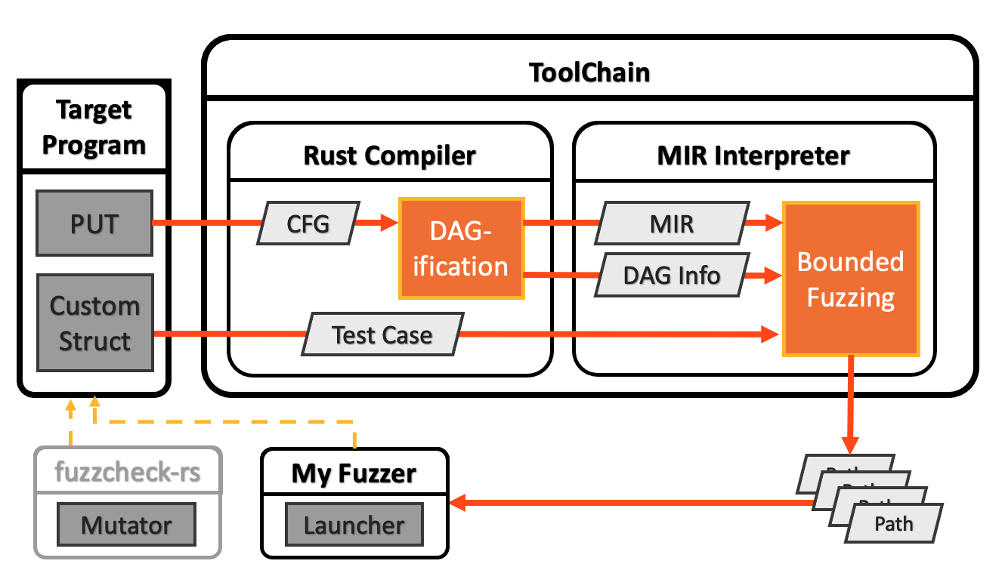
ARCHITECTURE
* DAG: Directed Acyclic Graph
* MIR: Middle-level IR
Figure 4. Static and Dynamic Implementation of Path Coverage in Rust

Slide 8
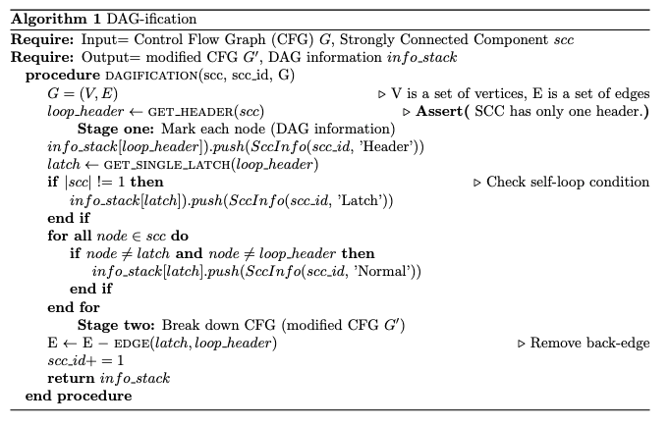
DAG-ification

Slide 9
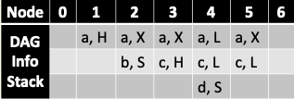
DAG-ification
0
0
0
a
1
1
1
c
d
5
b
5
5
2
3
4
6
2
3
4
6
2
3
4
6
Figure 3. Step-by-step SCC
* DAG-ification: Convert Directed Cyclic Graph to Directed Acyclic Graph
* SCC (Strongly Connected Component)
H: Loop header
L: Latch (node from which the back edge originates)
X: normal node
S: node with self-loop
Table 2. DAG Information

Slide 10
BOUNDED FUZZING
The basic block ID is not recorded once the number of loop iterations exceeds fixed depths (say 𝐾).
LIMIT = 2
𝑃1 : 𝐵0 → 𝐵1 → 𝐵2 → 𝐵4 → 𝐵5 → 𝐵6
Figure 1. A Simple Loop Function
𝑃2 : 𝐵0 → 𝐵1 → 𝐵2 → 𝐵4 → 𝐵1 → 𝐵2 → 𝐵4 → 𝐵5 → 𝐵6
𝑃3 : 𝐵0 → 𝐵1 → 𝐵2 → 𝐵4 → 𝐵1 → 𝐵2 → 𝐵4 → 𝐵1 → 𝐵2 → 𝐵4 → 𝐵1 → 𝐵2 → 𝐵4 → 𝐵1 → 𝐵2 → 𝐵4 → 𝐵5 → 𝐵6
𝑃3 : 𝐵0 → 𝐵1 → 𝐵2 → 𝐵4 → 𝐵1 → 𝐵2 → 𝐵4 → 𝐵1 → 𝐵2 → 𝐵4 → 𝐵1 → 𝐵2 → 𝐵4 → 𝐵1 → 𝐵2 → 𝐵4 → 𝐵5 → 𝐵6
V = 𝐵0, 𝐵1, 𝐵2, 𝐵4, 𝐵1, 𝐵2, 𝐵4, 𝐵1, 𝐵2, 𝐵4, 𝐵5, 𝐵6

Slide 11
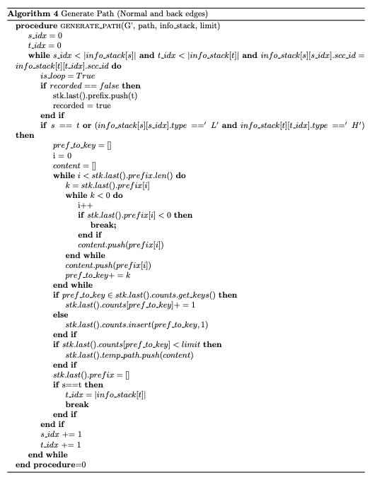
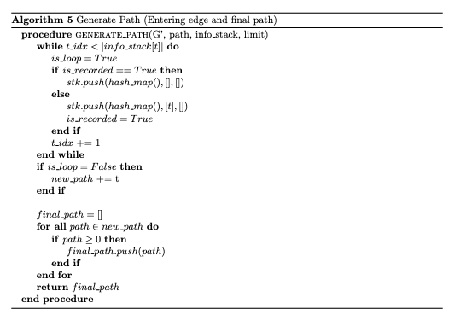
BOUNDED FUZZING

Slide 12
CONCLUSION
The problem of state-of-the-practical block and branch coverage:
The abstractions are brutal and incur non-trivial semantic losses.
E2 index does not properly reflect how thoroughly PUT is tested.
New abstraction methods to make path coverage practical:
We use Bounded Fuzzing and DAG-ification to reduce the semantic loss and get closer to the optimal implementation of the Fuzzer.
We prove the flaws of the existing E2 index and show that path coverage can increase the diversity of the seed pool.

Slide 13
THANK YOU

