Slide 1
Website Fingerprinting Attacks in Non-Traditional Network Environments
Prabhjot Singh
Supervisor : Diogo Barradas
David R. Cheriton School of Computer Science
University of Waterloo

Slide 2
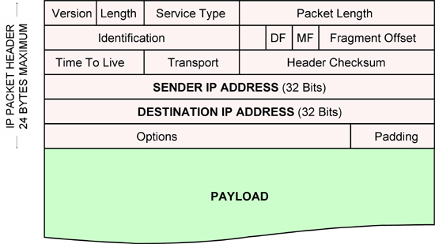
Can someone find what website are we visiting ?
Privacy is a myth!
Most traffic over internet is encrypted
TLS/SSL encryption
Leaks metadata like
Source and destination address

Slide 3
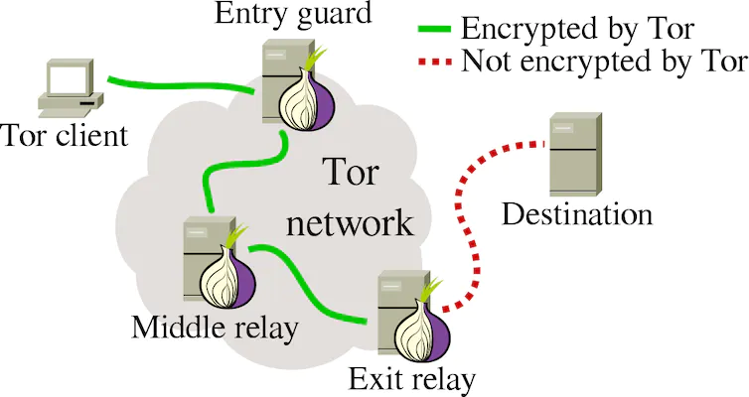
Can someone find what website are we visiting ?
Privacy is a myth!
Most traffic over internet is encrypted
TLS/SSL encryption
Leaks metadata like
Source and destination address
To prevent this information leakage
VPN tunneling and anonymity networks like Tor
Privacy can still be broken using website fingerprinting

Slide 4
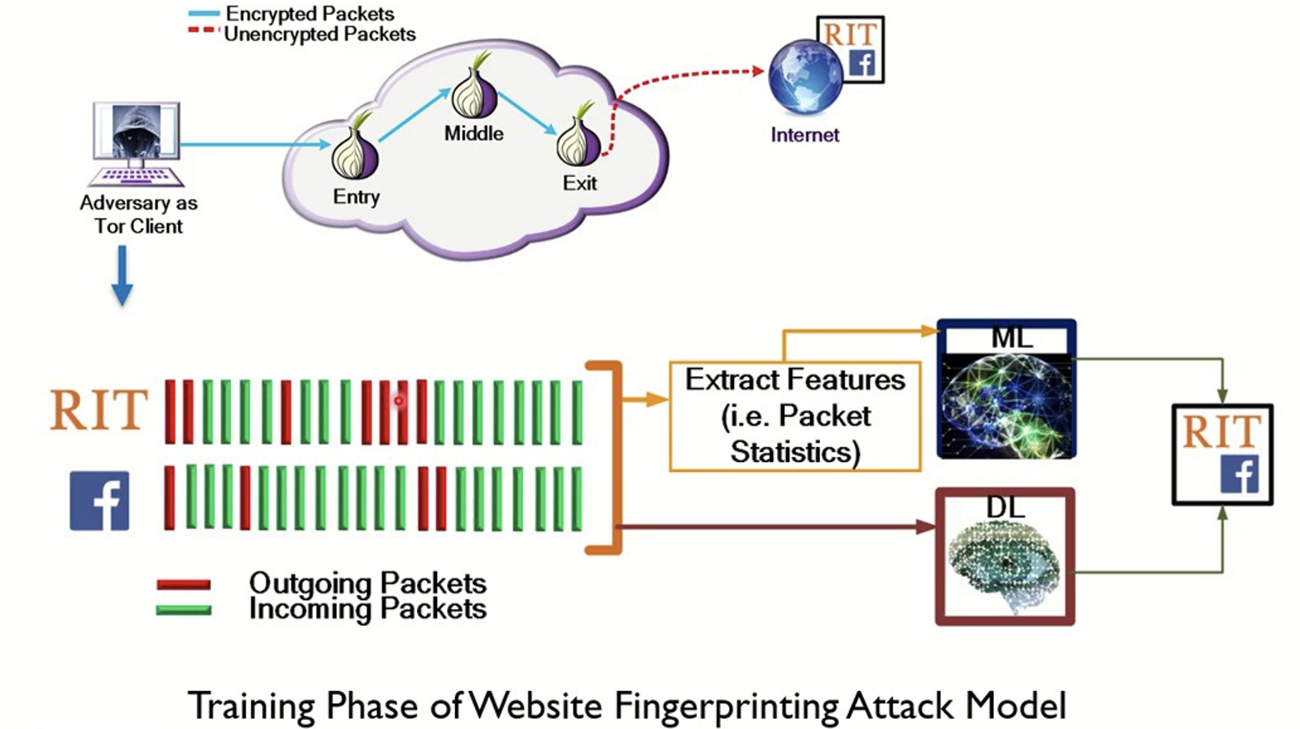
How does a Website Fingerprinting attack work?
Training phase

Slide 5
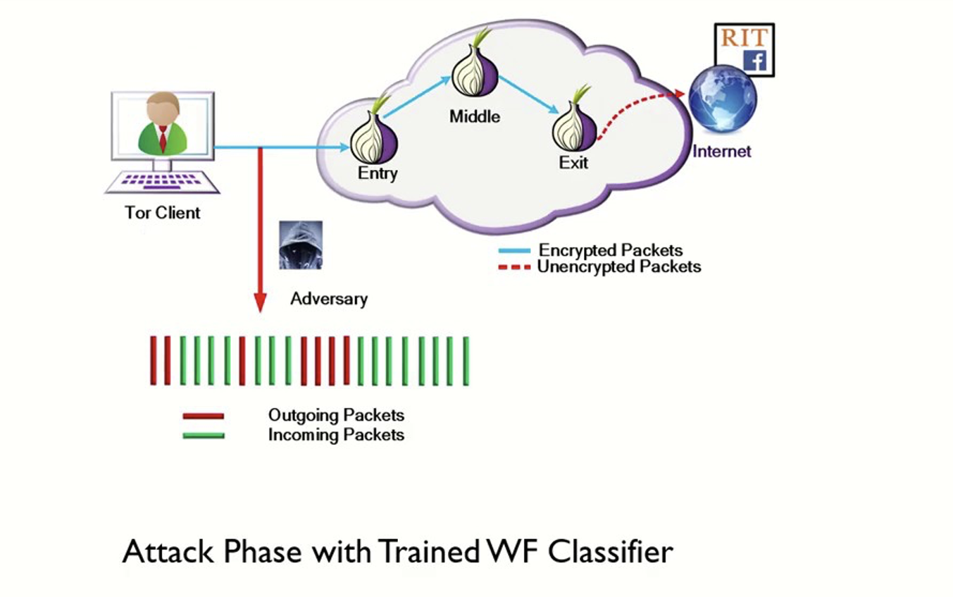
How does a Website Fingerprinting attack work?
Attack phase

Slide 6
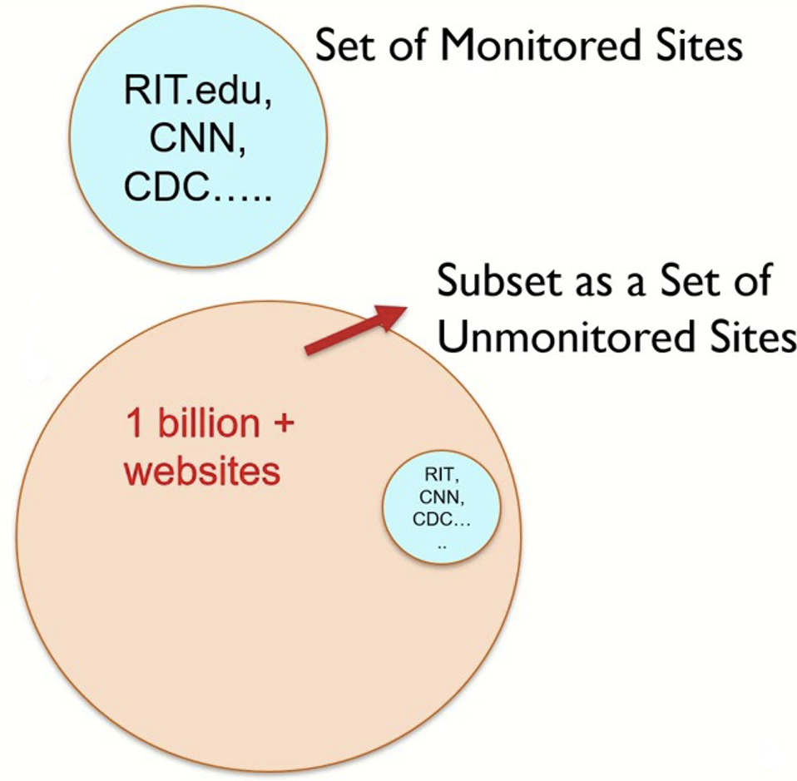
How does a Website Fingerprinting attack work?
Closed-world scenario
Classifier trained on n websites
Open-world scenario
Monitored and unmonitored websites

Slide 7
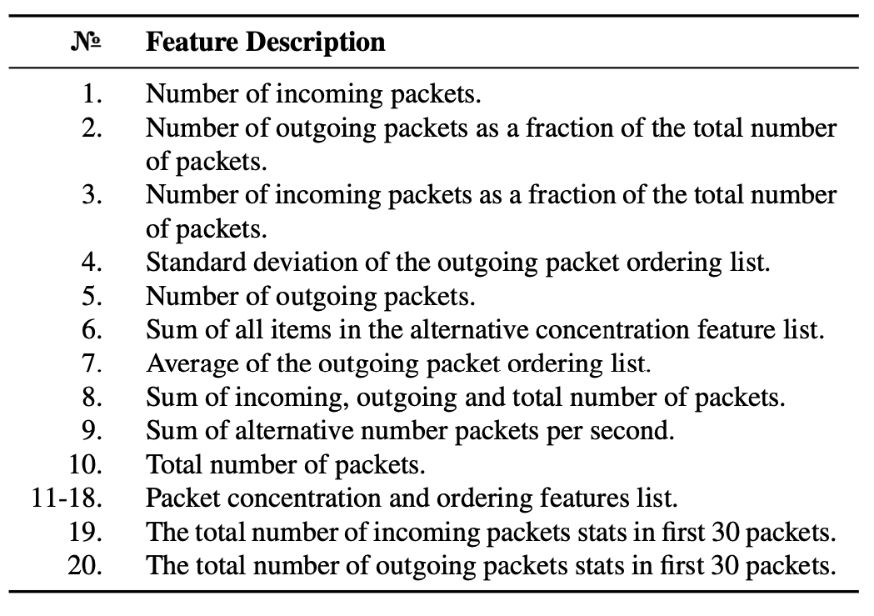
Website Fingerprinting Attacks
Machine Learning Based Attacks
Manual feature extraction
k-FP attack
150 features, 90% accuracy
Not as efficient as deep learning attacks

Slide 8
Website Fingerprinting Attacks
Machine Learning Based Attacks
Manual feature extraction
k-FP attack
150 features, 90% accuracy
Not as efficient as deep learning attacks
Deep Learning Based Attacks
Automatic feature extraction
Tik-Tok attack
Directional-timing vector, 98% accuracy
Black box model, difficult interpretability

Slide 9
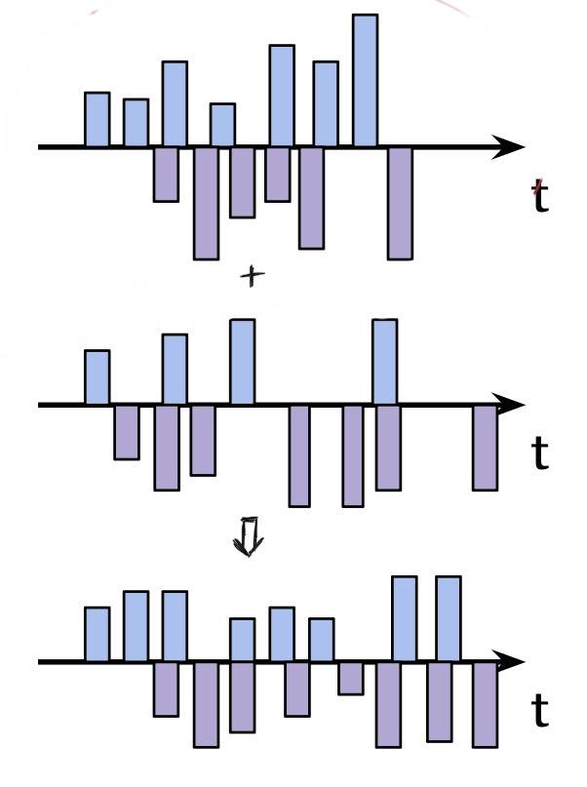
Website Fingerprinting Defences
Work on obfuscating the real characteristics of a trace
Constant-rate padding
Super sequencing
Adaptive and randomized padding
Application-layer defences
Traffic splitting
Traffic merging
Adversarial traces

Slide 10
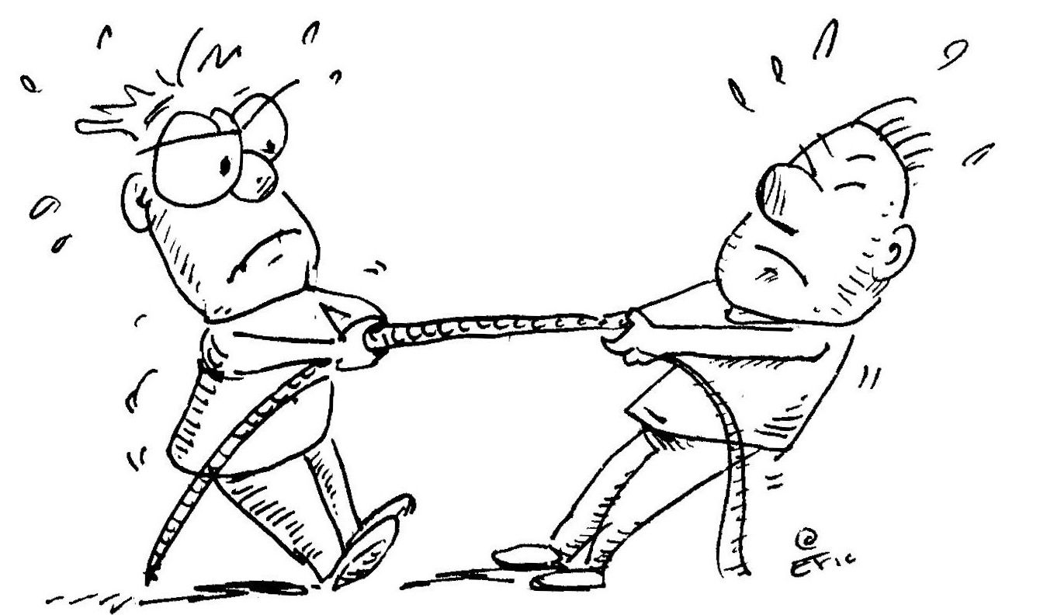
Is website fingerprinting realistically possible ?
User-behaviour realism
Real-world traces have background traffic
Hard to distinguish between simultaneous page loads
Heterogeneity of user’s web browsers and hardware
A dynamic Internet
Traces gets outdated as website is continuously changing
50% reduction over a month period
Different network conditions
Despite these challenges for launching a successful WF attack in the real-world, there are other operational concerns that is the focus of our work, namely launching WF attacks on non-traditional networking environments

Slide 11
Non-Traditional Network Environments
Cellular Networks
Layer two has different sublayers like
RLC (Radio Link Control)
PDCP (Packet Data Convergence Protocol)
Sniffing traffic is very easy
you just need a radio
Affected by proximity to cell tower, interference from other devices

Slide 12
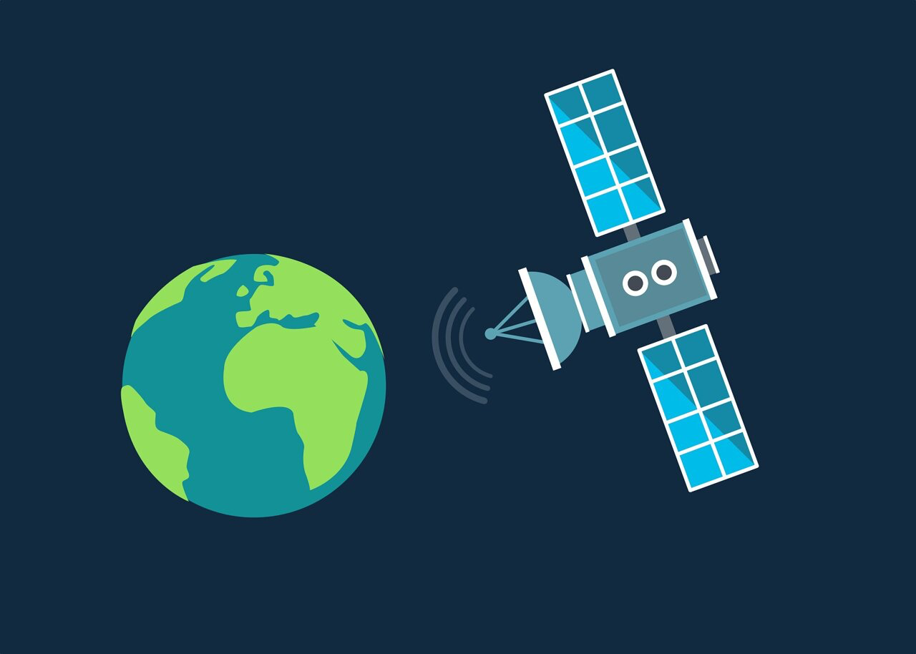
Non-Traditional Network Environments
Cellular Networks
Layer two has different sublayers like
RLC (Radio Link Control)
PDCP (Packet Data Convergence Protocol)
Sniffing traffic is very easy
you just need a radio
Affected by proximity to cell tower, interference from other devices
Satellite Networks
Uses Satellite and ground-station for communication
Use different encapsulations like GSE (Generic Stream Encapsulation), RLE (Return Link Encapsulation)
Affected by weather conditions, distance from earth (GEO/LEO)

Slide 13
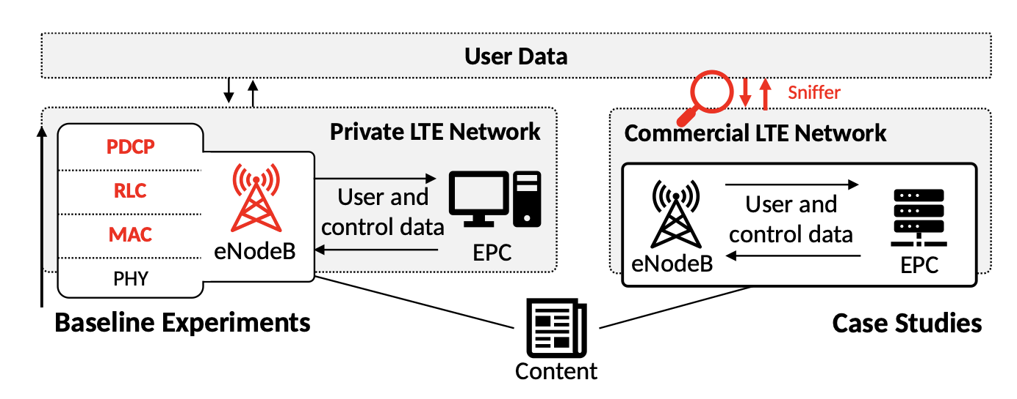
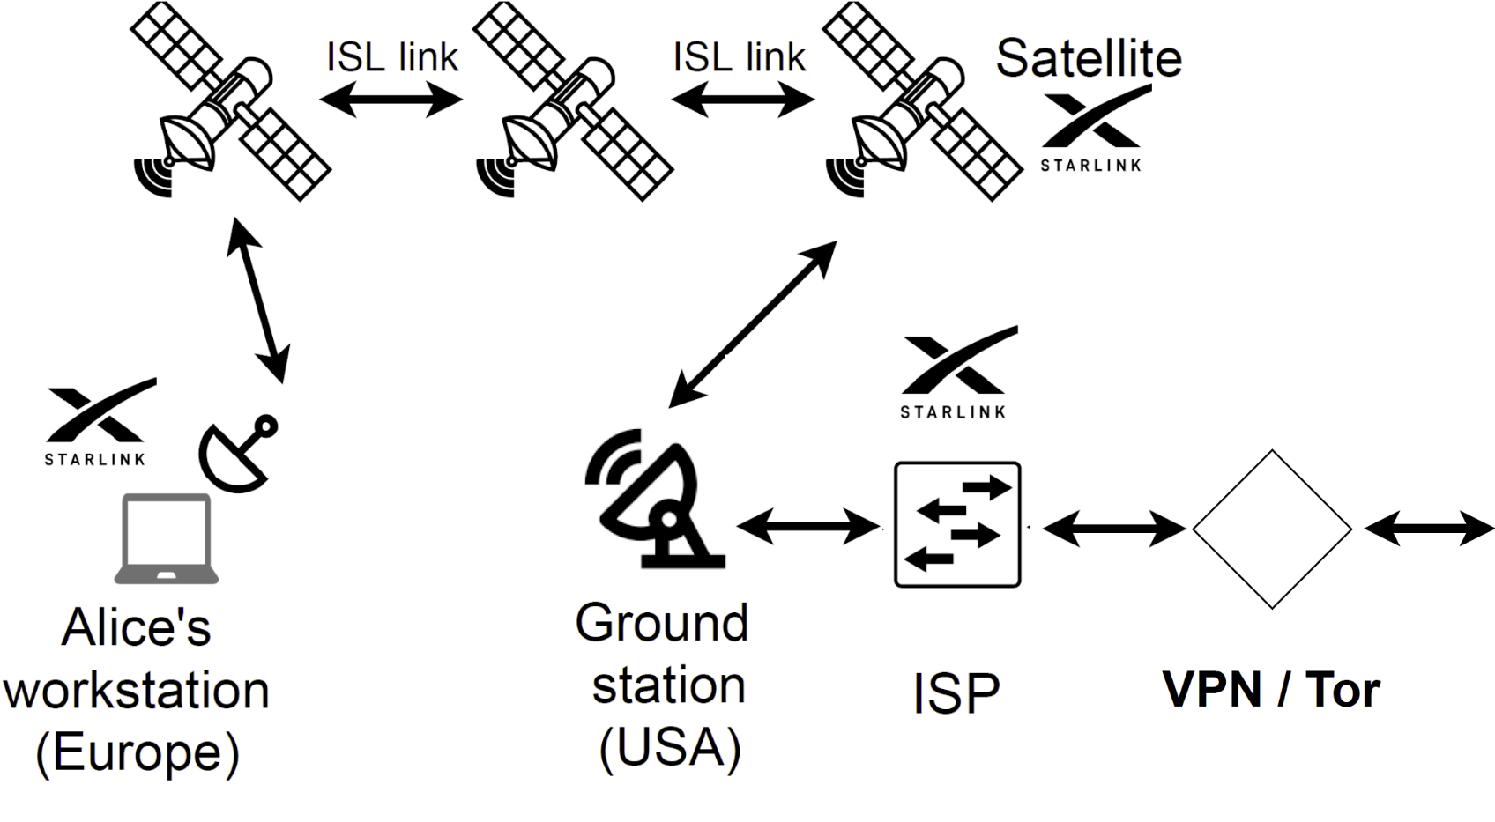
Website Fingerprinting in Non-Traditional Network Environments
Cellular Networks
Tested on simulated 4G network
Layer-2 fingerprinting
Manual Feature Extraction
Used kNN and SVM as classifier
Unexplored Domain - Satellite Networks

Slide 14
Research Questions
Are satellite/cellular network more susceptible to WF attacks than fibre networks ?
What is the efficacy of advanced attacks on cellular networks ?
How successful are WF attacks on satellite networks ?
Is fingerprinting at Layer-2 easier or harder than at Layer-3 ?

Slide 15
Research Questions
What external factors impact WF in satellite and cellular networks ?
Does proximity to cell tower, interference from other devices affect website fingerprinting in cellular networks ?
Do weather conditions, distance from earth (GEO/LEO) affect WF in satellite networks?

Slide 16
Research Questions
How to efficiently deploy defences in satellite and cellular networks ?
Are defences as effective as in fibre based networks ?
How to manage restrictive data plans in cellular networks?

Slide 17
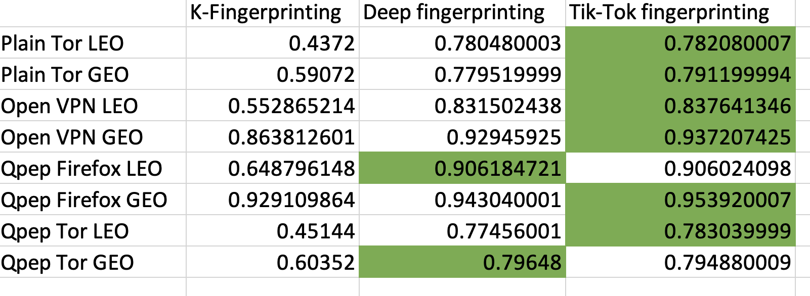
Progress
Tested different attacks on simulated satellite networks
100 websites with 125 instances each
GEO a bit more fingerprintable
Tik-Tok best result

Slide 18
Progress
Tested different attacks on simulated satellite networks
Designed code for data collection
Docker container for data collection to avoid dependencies
Selenium over Tor bundle, as automated browser
Timing analysis on dataset for faster data collection
95% of website browsing time < 40s
Getting access to Starlink satellite and 5G testbed

Slide 19
Summary
Website Fingerprinting attacks are very effective in lab environments, but success needs to be reflected in real world scenarios.
Website Fingerprinting attacks in cellular and satellite remains under-explored.
We are working forward towards checking the effectiveness and realism of website fingerprinting attacks in cellular and satellite networks.
Thank you!
Questions?

