Slide 1


Slide 2

A Path Space Extension for Robust Light Transport Simulation
T.Hachisuka¹, J.Pantaleoni², H.W. Jensen³
1. Aarhus University
2. NVIDIA Research
3. UC San Diego

Slide 3
Previous Frameworks
Local Monte Carlo Path Sampling (e.g. Path Tracing)
Photon Density Estimation (e.g. Photon Mapping)

Slide 4
Previous Frameworks
Local Monte Carlo Path Sampling (e.g. Path Tracing)
Photon Density Estimation (e.g. Photon Mapping)
  unbiased: average error across an infinite number of runs = 0
  consistent: the limit error for an infinite run = 0

Slide 5
Previous Frameworks
Local Monte Carlo Path Sampling (e.g. Path Tracing)
Photon Density Estimation (e.g. Photon Mapping)
  unbiased: average error across an infinite number of runs = 0
  cannot capture singular paths that do not contain 2 non-specular scattering events in a row
  consistent: the limit error for an infinite run = 0
  can capture any transport path (introducing an approximation)

Slide 6
Previous Frameworks
Local Monte Carlo Path Sampling (e.g. Path Tracing)
Photon Density Estimation (e.g. Photon Mapping)
  unbiased: average error across an infinite number of runs = 0
  cannot capture singular paths that do not contain 2 non-specular scattering events in a row
  is inefficient at sampling nearly singular transport phenomena
  consistent: the limit error for an infinite run = 0
  can capture any transport path (introducing an approximation)
  can be inefficient at sampling glossy reflections

Slide 7
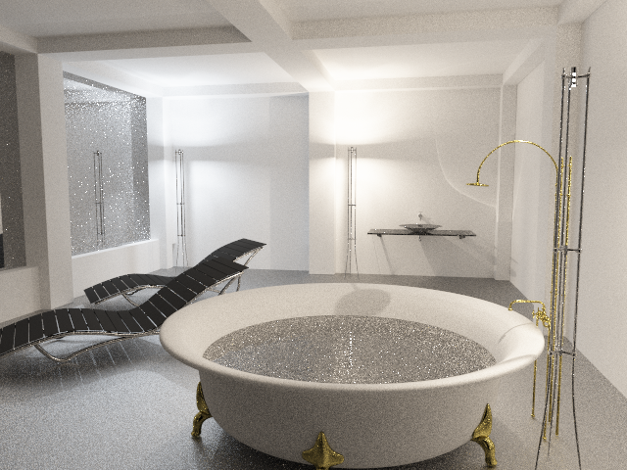
Monte Carlo Integration

Slide 8

Monte Carlo Integration

Slide 9
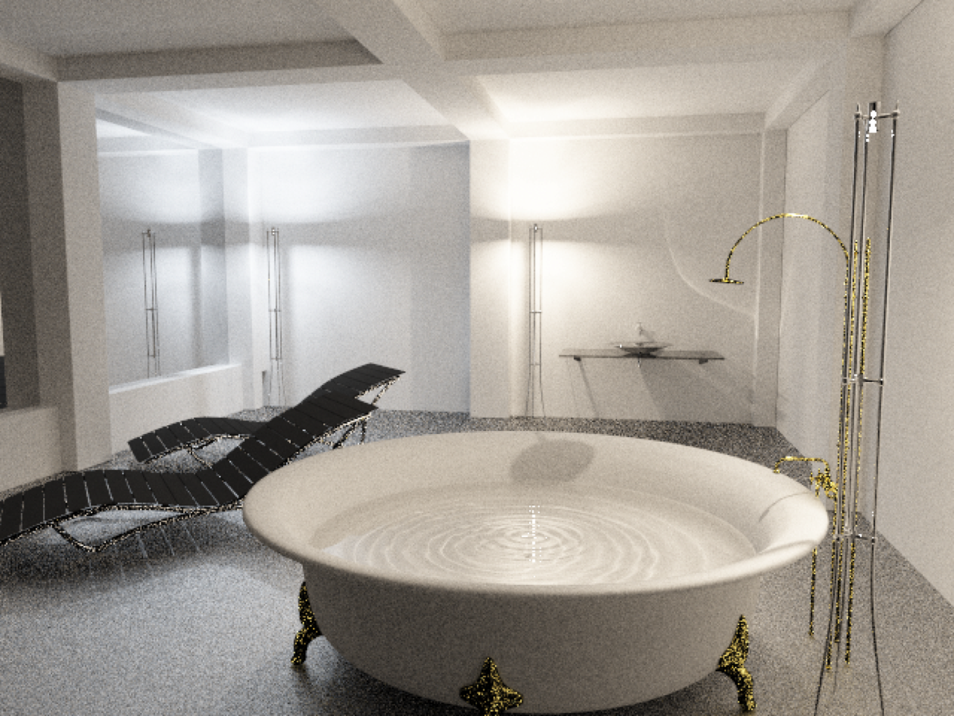
Photon Density Estimation

Slide 10

Photon Density Estimation

Slide 11
Density Estimation or Path Sampling?
BPT: explicit connection
PM: implicit connection

Slide 12
Can we get the best of both?
Multiple Importance Sampling seems ideal

Slide 13
Can we get the best of both?
Multiple Importance Sampling seems ideal
n_{i}
# samples from the i^{th} technique
x_{i,k}
k^{th} sample from the i^{th} technique
p_{i}
i^{th} probability density function

Slide 14
Can we get the best of both?
Multiple Importance Sampling seems ideal
But there’s a big challenge:
MIS is designed to combine integration methods working in
a same sampling space!

Slide 15
Can we get the best of both?
Multiple Importance Sampling seems ideal
But there’s a big challenge:
MIS is designed to combine integration methods working in
a same sampling space!
But if we look at paths of length N:
the local path sampling space has dimensionality O(N+1)
the photon density estimation space has dimensionality O(N+2)

Slide 16
Can we get the best of both?
MC
3 vertices
DE
4 vertices

Slide 17
Different Sampling Spaces, Different Rules
One might think it’s all fine, you can still use the
standard weights based on the samples’ PDFs
in the respective spaces…
…but this leads to a solution that is not scale invariant!

Slide 18
Different Sampling Spaces, Different Rules
One might think it’s all fine, you can still use the
standard weights based on the samples’ PDFs
in the respective spaces…
…but this leads to a solution that is not scale invariant!
the problem is that the PDF of an MC path
is proportional to dA but the PDF of a
corresponding DE path is proportional to dA
(N+1)
(N+2)

Slide 19
Different Sampling Spaces, Different Rules
MC
DE
For each classical path, there’s
an infinity of DE paths!
Notes:
Fairly intuitive: DE considers an infinity of paths equivalent

Slide 20
Our solution: we craft a New Path Space!
MC
We extend MC paths with
vertex perturbations
DE
Notes:
Fairly intuitive: DE considers an infinity of paths equivalent

Slide 21
Our solution: we craft a New Path Space!
This gives us a common space where to apply
Multiple Importance Sampling
And classical weights have scale invariance!
Notes:
Fairly intuitive: DE considers an infinity of paths equivalent

Slide 22
Our solution: we craft a New Path Space!
This gives us a common space where to apply
Multiple Importance Sampling
And classical weights have scale invariance!
But we also need an efficient sampling strategy
Notes:
Fairly intuitive: DE considers an infinity of paths equivalent

Slide 23
Efficient Sampling: Connecting Path Families
DE
DE integrates the contribution
from all light vertices
to each eye vertex
where some vertices just give
zero contribution
Notes:
Density Estimation integrates the contribution from all light vertices to each eye vertex

Slide 24
Efficient Sampling: Connecting Path Families
DE
Can we reuse these path families
for MC integration?
Notes:
Density Estimation integrates the contribution from all light vertices to each eye vertex

Slide 25
Efficient Sampling: Connecting Path Families
MC
Of course!
For example, we could pick 1 light path, and connect the perturbed eye path to all its vertices
Notes:
Density Estimation integrates the contribution from all light vertices to each eye vertex

Slide 26
Efficient Sampling: Connecting Path Families
MC
Of course!
Or even go wild and pick a few different light vertices to connect to
Notes:
Density Estimation integrates the contribution from all light vertices to each eye vertex

Slide 27
Efficient Sampling: Connecting Path Families
MC
Of course!
But we need to take into account the number of samples we consider in
the MIS weights
Notes:
Density Estimation integrates the contribution from all light vertices to each eye vertex

Slide 28
Efficient Sampling: Connecting Path Families
MC
For example, if we do only 1 connection, we will have to consider that
the ratio of DE samples to MC samples is N:1
N = # light paths
Notes:
Density Estimation integrates the contribution from all light vertices to each eye vertex

Slide 29
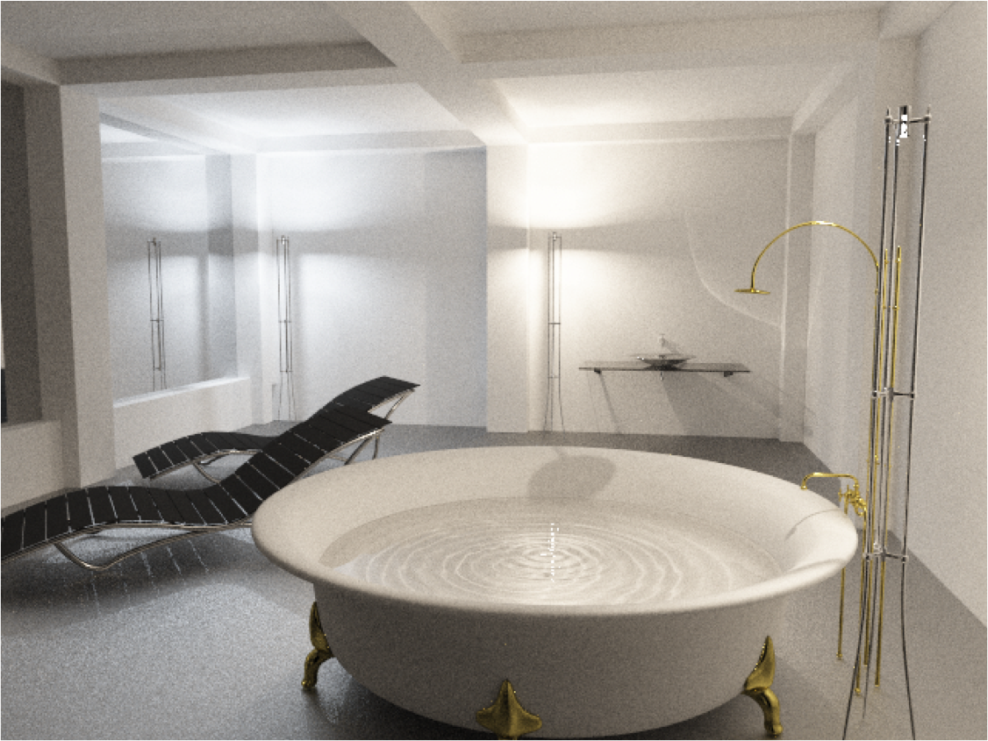
Unified Path Sampling
Notes:
Density Estimation integrates the contribution from all light vertices to each eye vertex

Slide 30
Monte Carlo Integration

Slide 31
Unified Path Sampling
Notes:
Density Estimation integrates the contribution from all light vertices to each eye vertex

Slide 32
Photon Density Estimation

Slide 33
Results

Slide 34
Results

Slide 35
Results
BPT (0.050)
PPM (0.059)
SPPM (0.033)
UPS (0.022)

Slide 36
Results
BPT
PPM
UPS
Reference
1 min
2 min
4 min

Slide 37
MIS Weights
MC Path Integration
Photon Density Estimation

Slide 38
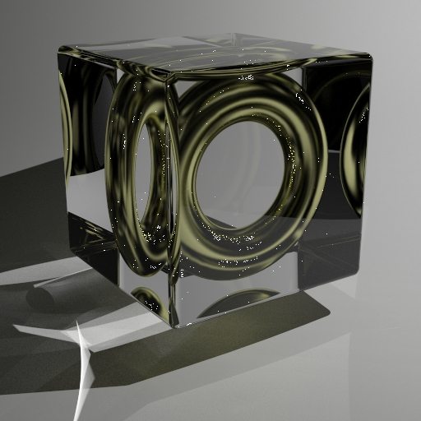
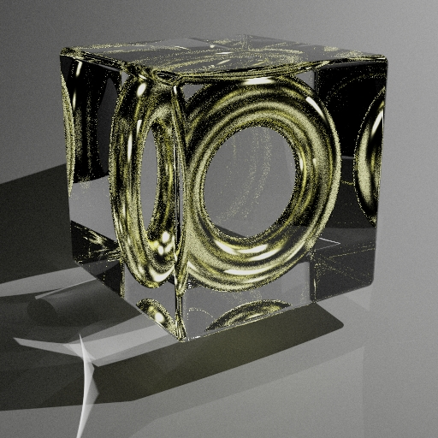
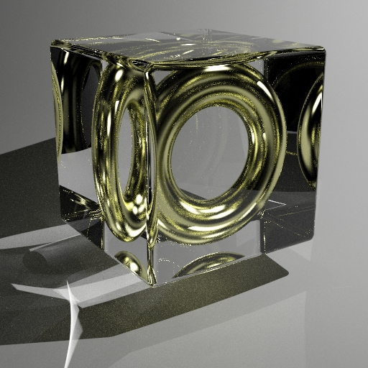
Results
BPT
PPM
UPS

Slide 39
Conclusions:
An Extended Path Space for Robust Light Transport
  a novel basis for more efficient sampling of complex phenomena
  can be combined with advanced MCMC techniques,
  e.g. Manifold Exploration [Jakob and Marschner 2012]
Unified Path Sampling
  an efficient algorithm allowing to combine PPM and BPT
An analysis of Optimal MIS Weights
  details in the paper
Notes:
Fairly intuitive: DE considers an infinity of paths equivalent

Slide 40
Aknowledgements
Youichi Kimura (Studio Azurite) (bathroom scene)
Dan Konieczka and Juan Carlos Silva (treasure scene)
Jaakko Lehtinen (comments on first draft)
Leonhard Gruenschloß (inspiring technical feedback)
Notes:
Fairly intuitive: DE considers an infinity of paths equivalent

Slide 41


