Slide 1


Joint Importance Sampling of
Low-order Volumetric Scattering
Iliyan Georgiev Jaroslav Křivánek Toshiya Hachisuka
Derek Nowrouzezahrai Wojciech Jarosz

Slide 2

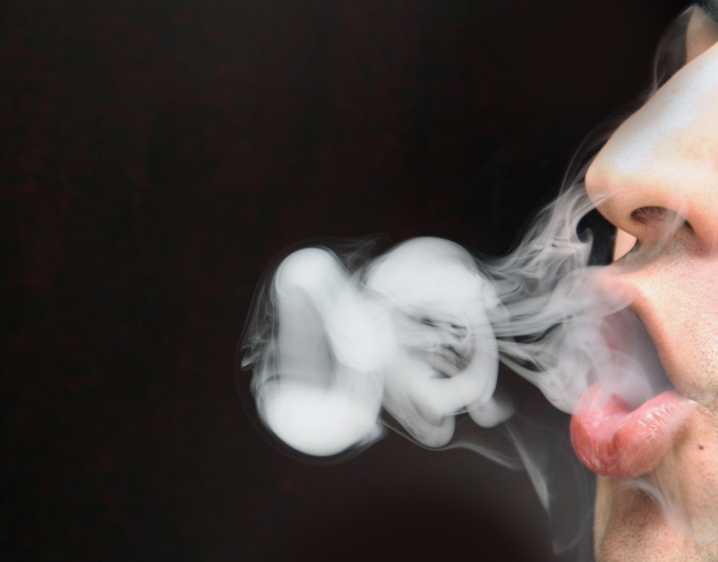
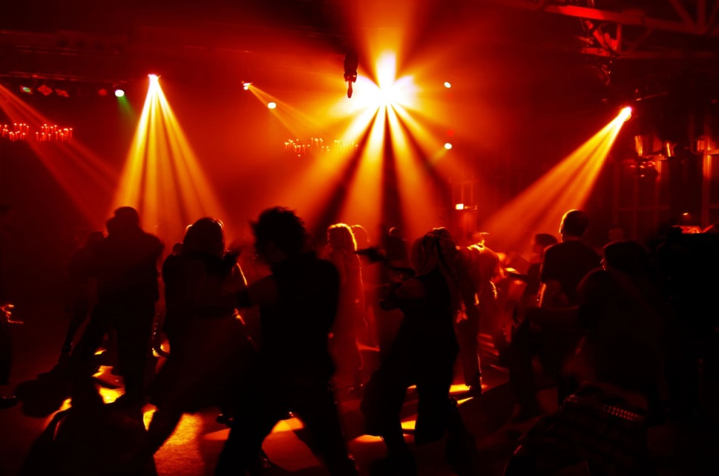
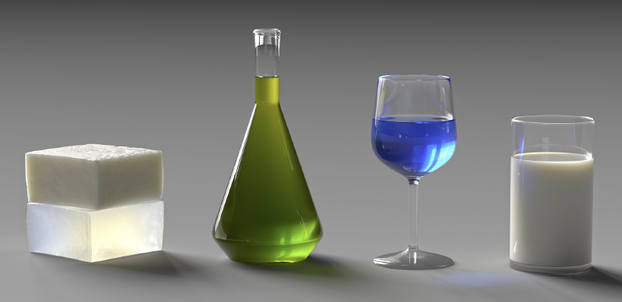
Motivation
[Diaan Mynhardt, dreamfoundry]
[Kees Straver, Flickr]
[a fun place]
[Gkioulekas et al. 2013]
Notes:
In this work we consider the problem of rendering participating media. Media such as clouds, smoke, skin, fog and liquids are ubiquitous in the world and are responsible for many important visual phenomena which are of interest to computer graphics and related fields.

Slide 3
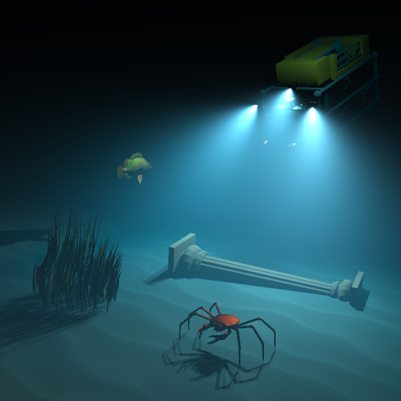
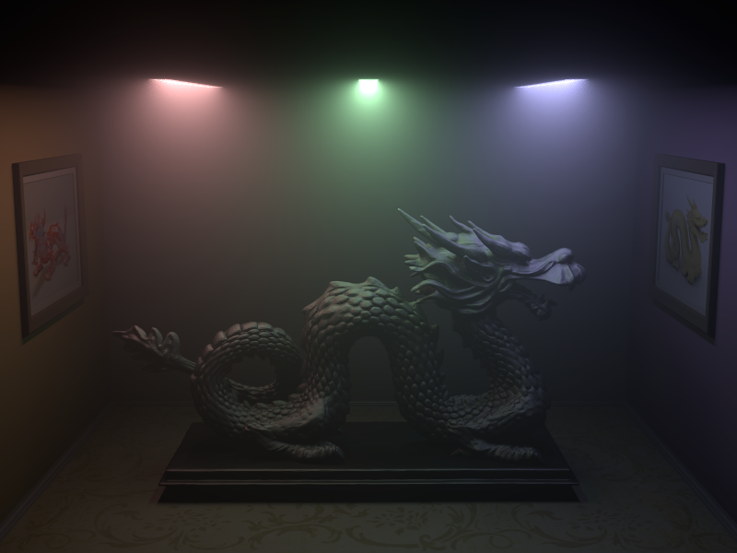
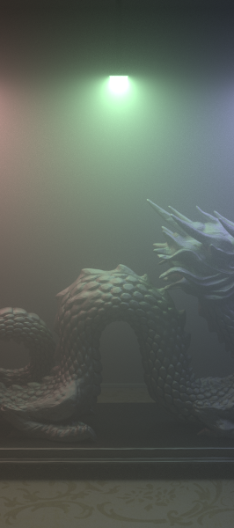
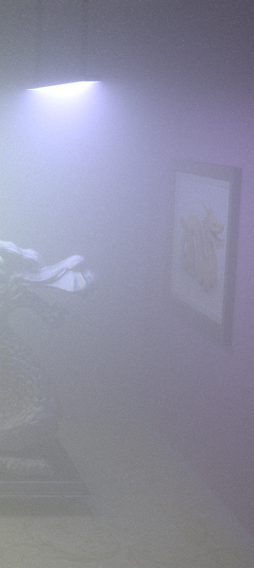
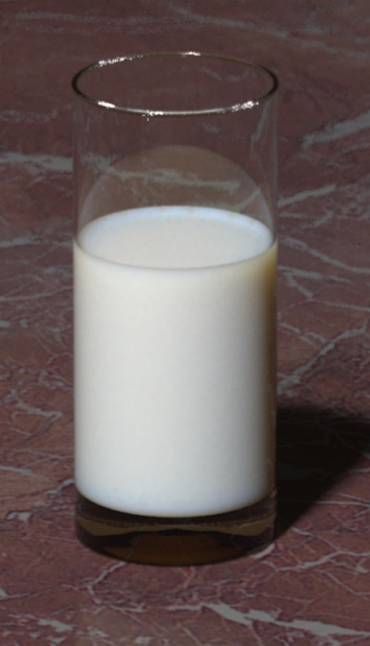


Motivation
Analytic
Monte Carlo
Analytic
[Pegoraro et al. 2010]
[Jensen et al. 2001]
[Pegoraro et al. 2010]
[Jensen et al. 2001]
1-scattering
1-scattering
1-2-scattering
1-7-scattering
$∞$-scattering
homogeneous
heterogeneous, anisotropic phase functions
high albedo, homogeneous
Notes:
Light transport in participating media has a long history in computer graphics research. For homogeneous media, a number of good approximations have been developed for single scattering effects, [CLICK] as well as for infinite isotropic scattering in dense media with high albedo.
[CLICK] However, in the general case of media that are heterogeneous or have medium albedo or anisotropic scattering, we still have to resort to Monte Carlo integration methods. These methods are very general but take a long time to converge, even for low-order anisotropic scattering in homogeneous media.
In this work, we focus on such general Monte Carlo techniques and aim to significantly improve their efficiency.

Slide 4
Monte Carlo rendering
Notes:
The entire computation in Monte Carlo rendering boils down to sampling random light transport paths that bring some energy from the light sources to the camera. A large number of such paths are generated and their contribution is averaged to produce an image.
Different methods sample paths in different ways, and their efficiency is measured by the amount of noise in the image.

Slide 5
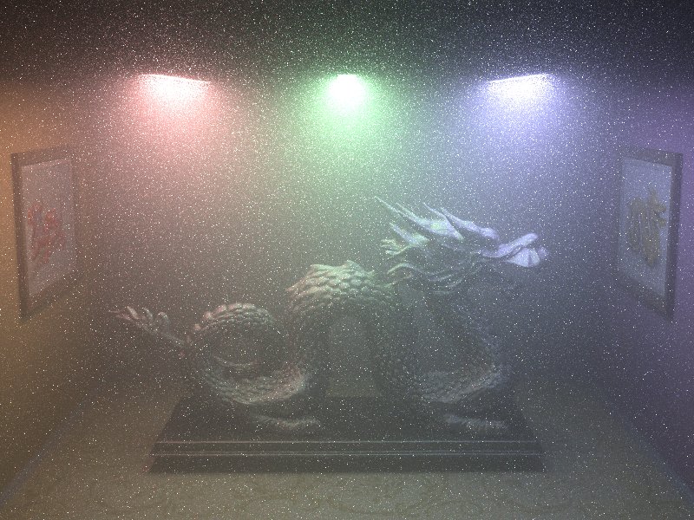



Monte Carlo rendering
RMSE: 0.03
RMSE: 1.19
Our method
$$O(\sqrt{N})$$
Traditional method
$O\left(\sqrt[3]{N}\right)$ [Kalos 1963]
Over 1000x variance reduction
Notes:
Unfortunately, the most widely used method, path tracing with shadow connections to light sources, can be very inefficient in the presence of participating media, producing extremely noisy images.
In fact, research in neutron transport has shown a long time ago that this approach leads to infinite variance and a lower-than-standard convergence rate with the number of paths.
[CLICK] The method I will present today recovers the more favorable convergence rate and brings substantial variance reduction, a factor of over 1000 times for this particular scene.

Slide 6
Talk outline
Why current techniques have so much noise?
New path sampling techniques
Practical applications
  Path tracing
  Bidirectional path tracing
  Virtual ray lights
Notes:
[CLICK] In the rest of this talk, I will first discuss why existing Monte Carlo techniques can be so inefficient.
[CLICK] I will then present a set of new techniques for more efficient path sampling in participating media…
[CLICK] and will then demonstrate how these techniques can be integrated into various rendering methods.

Slide 7























Monte Carlo path sampling
$$ρ\left(c\right)$$
$$ρ\left(a\right)≡L_{e}(a)$$
$$G\left(b\text{,}c\right)=\frac{1}{{\left\|b\text{−}c\right\|}^{2}}$$
$$ρ\left(d\right)≡W_{e}(d)$$
$$c$$
$$a$$
$$ρ\left(b\right)$$
$G(a\text{,}b)$
$$c$$
$V(a\text{,}b)$
$G(a\text{,}b)$
$V(c\text{,}d)$
$T(a\text{,}b)$
$G(c\text{,}d)$
$T(c\text{,}d)$
$G(b\text{,}c)$
$T(b\text{,}c)$
$V(b\text{,}c)$
$G(c\text{,}d)$
$$b$$
$$d$$
$$b$$
Contribution
  Pixel estimator:
$$\left\langle I\right\rangle =\frac{f(a\text{,}b\text{,}c\text{,}d) }{p\left(a\text{,}b\text{,}c\text{,}d\right)}$$
PDF
Scattering
Geometry
Transmittance
Visibility
  Path contribution:
$$f(a\text{,}b\text{,}c\text{,}d)=ρ(a\text{,}b\text{,}c\text{,}d) G(a\text{,}b\text{,}c\text{,}d) T(a\text{,}b\text{,}c\text{,}d) V(a\text{,}b\text{,}c\text{,}d)$$
high frequency
singularity
bounded, low variation
Notes:
But first, let me give you a brief introduction into Monte Carlo light transport integration.
Having sampled a random path, we can obtain a pixel estimate by computing [CLICK] the contribution of the path and [CLICK] dividing it by its sampling PDF.
[CLICK] In the path contribution, [CLICK] the scattering term accounts for the light emission, camera sensitivity and phase function profiles. [CLICK] Highly anisotropic phase functions have very sharp peaks.
[CLICK] The geometry term accounts for the distances between the path vertices. This term and can vary hugely, [CLICK] and in fact diverges when two vertices are arbitrarily close to each other.
[CLICK] The transmittance and [CLICK] visibility terms account for the light attenuation along each path segment. [CLICK] These terms have low variation, because their values are constrained to the interval [0; 1].
[CLICK] And now let’s take a closer look at the path PDF. The accuracy of the estimate depends on this PDF, which is the joint distribution of all vertices, and is a direct consequence of how we choose to sample the path. The theory of importance sampling tell us that the PDF should be ideally exactly proportional to the path contribution. In practice it is often sufficient for it to be proportional to the terms with most variation.

Slide 8












Monte Carlo path sampling
$$c$$
$$a$$
$$c$$
$$a$$
$$d$$
$$d$$
$$b$$
$$b$$
[Kajiya 1986]
[Laforutune et al. 1993]
[Veach et al. 1994]
  Pixel estimator:
$$\left\langle I\right\rangle =\frac{f(a\text{,}b\text{,}c\text{,}d) }{p\left(a\text{,}b\text{,}c\text{,}d\right)}$$
  Path contribution:
$$f(a\text{,}b\text{,}c\text{,}d)=ρ(a\text{,}b\text{,}c\text{,}d) G(a\text{,}b\text{,}c\text{,}d) T(a\text{,}b\text{,}c\text{,}d) V(a\text{,}b\text{,}c\text{,}d)$$
  Path PDF:
$$p\left(d\right)$$
$$p\left(c|d\right)$$
$$p\left(b|c\right)$$
$$p\left(a\right)$$
$$=p\left(a\text{,}b\text{,}c\text{,}d\right)$$
local sampling PDFs
resulting joint PDF
Notes:
Unfortunately, sampling from such a high dimensional joint distribution is hard, and therefore in reality paths are constructed incrementally by importance sampling some of the contribution terms and only locally at each vertex.
For example, traditional path tracing starts from the camera, [CLICK] by sampling segment directions proportionally to the phase function, and propagation distances along these segments proportionally to transmittance. [CLICK] It then creates a shadow connection to a random vertex on a light source.
[CLICK] The resulting joint path PDF is then a consequence of these local decisions. We can only hope that it is somewhat proportional to the path contribution, but we have no explicit control over this. And bidirectional path tracing, which samples paths from both ends also suffers from the same problem. When constructing two paths independently, they can go in totally opposite directions.

Slide 9




Problem setting
Traditional approach: incremental vertex sampling
$$p\left(a\right) p\left(b|a\right) p\left(c|d\right) p\left(d\right)$$
$$→p\left(a\text{,}b\text{,}c\text{,}d\right)$$
  Prescribe local sampling decisions
  Joint distribution is a consequence
Our approach: joint vertex sampling
$$p\left(a\text{,}b\text{,}c\text{,}d\right)$$
$$→p\left(a\right) p\left(b|a,c\right) p\left(c|a,d\right) p\left(d\right)$$
  Prescribe joint distribution
  Derive sampling decisions
Notes:
And this answers the question why existing methods can produce so noisy images. It is because they [CLICK] prescribe the local sampling decisions, [CLICK] and the final joint distribution is only a consequence of these decisions.
[CLICK] And actually, what we want to do, and what is the approach we take in this work, is the opposite of this. [CLICK] We first prescribe a joint distribution for the entire path, [CLICK] and then derive the vertex sampling decisions from that joint. Only this way can we make sure that the PDF of a path is indeed proportional to its contribution.

Slide 10


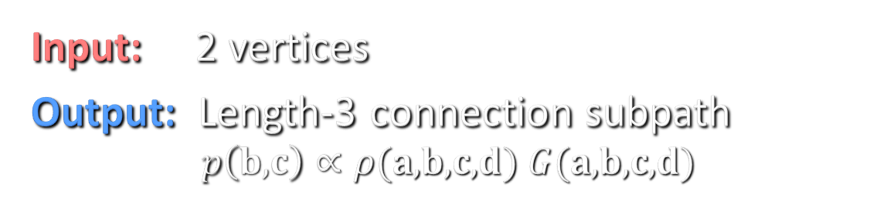















Problem statement
$$\text{a}$$
$$\text{b}$$
$$ρ$$
$$GTV$$
$$ρ$$
$$ρ\left(\text{a}\right)$$
$G(\text{a}\text{,}\text{b})$
$$ρ\left(\text{b}\right)$$
$$GTV$$
$G(\text{b}, c)$
$$GTV$$
$$ρ$$
$$ρ$$
$$ρ\left(\text{c}\right)$$
$$\text{c}$$
$$\text{d}$$
$G(\text{c}\text{,}\text{d})$
, 1 direction
Input: 2 vertices
Output: Length-3 connection subpath
$$p\left(b\text{,}c\right)∝ρ(a\text{,}b\text{,}c\text{,}d) G(a\text{,}b\text{,}c\text{,}d)$$
Notes:
And this brings us to our problem statement.
[CLICK] We are given one vertex on a camera subpath and another one on a light path.
[CLICK] Our goal is to construct a subpath of length 3 connecting these two vertices by sampling two new vertices from a prescribed joint distribution.
[CLICK] We choose this distribution to be proportional to the product of the geometry and scattering terms of this connection subpath (the terms shown in blue), as these terms contribute most to the variation in the path contribution.
Having prescribed the joint distribution, we then need to derive the corresponding vertex sampling routines. [CLICK] To make this problem tractable, we also assume that we are given a direction from the camera vertex.

Slide 11




Related work
$$ρ$$
$$G$$
$$G$$
$$ρ$$
Equiangular sampling
[Kalli and Cashwell 1977; Rief et al. 1984;
Kulla & Fajardo 2012]
Virtual ray lights
[Novák et al. 2012]
Notes:
Some prior work that has also considered using more knowledge about subpaths for connections in isolated cases.
In the context of rendering, Kulla & Fajardo used equiangular sampling to compute single scattering along a given camera ray by importance sampling the geometry term along the connection edge.
The VRL method computes double scattering from a given virtual ray light and a given camera ray by importance sampling the propagation distances along these rays from a joint distribution that is proportional to the phase functions and the geometry term.
We will later interpret these two methods as general-purpose connection techniques and show how to incorporate them in a bidirectional framework. Furthermore, we build upon this work and extend it to importance sample even more contribution terms.

Slide 12
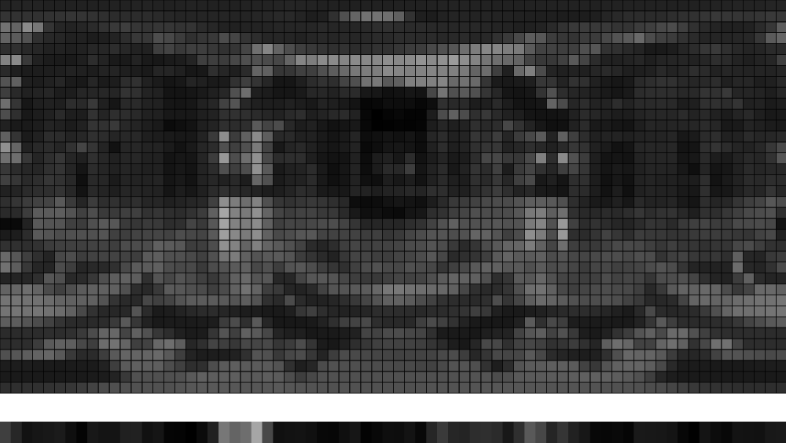





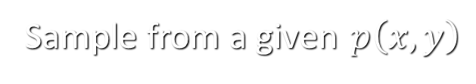



Joint importance sampling
Sample from a given $p\left(x,y\right)$
$$=p\left(y\right)$$
$$p(x|y)$$
$$x$$
$$y$$
$$y$$
$$p(x|y)$$
$$p(y)$$
$$x$$
image courtesy of Matt Pharr
  Generally difficult for high dimensions
  Feasible for sampling path vertices in media
Notes:
To get back to our problem, we need to know how to sample from a given joint PDF. Joint importance sampling has been already used for a number of problems in graphics. A prominent example is environment map lighting, [CLICK] where you need to first sample the Y coordinate from a marginal distribution that is proportional to the total energy in the scan-lines, and then [CLICK] you sample the X coordinate from a conditional distribution proportional to the energy in the chosen scan-line.
For such simple low-dimensional problems, joint sampling via marginalization is the standard way to go.
[CLICK] For higher-dimensional problems, however, analytical marginalization is rarely possible, and numerical marginalization, as done for environment maps, is generally infeasible due to the explosion in computational complexity with dimensionality.
[CLICK] We show that joint sampling is still feasible for constructing paths in participating media, and in fact we employ both analytical and numerical marginalization.

Slide 13







Joint path sampling
$$\text{a}$$
$$\text{a}$$
$$\text{b}$$
$$\text{b}$$
$$\text{c}$$
$$\text{c}$$
$$\text{d}$$
$$\text{d}$$
Unidirectional factorization
Bidirectional factorization
Notes:
Given our problem statement, we consider two possible ways to sample our connection subpath, corresponding to two different factorization of the joint distribution into a series of sampling decisions.
[CLICK] We can either sample a distance along the camera ray, then a direction, and then another distance.
[CLICK] Or we wan first sample a direction from the light vertex, then a distance along the resulting ray, and the final distance along the camera ray.
In the paper we provide full details how we use successive marginalization to derive the sampling decisions for both factorizations. The full derivation process is somewhat involved, but the results are simple, and I will try to give you a high-level explanation here.
[CLICK] I will start with the special case of isotropic scattering, where the phase functions are constant, for which we were able to find analytic sampling routines for the unidirectional factorization.

Slide 14







Unidirectional: Isotropic scattering
$$\text{a}$$
$$∝\frac{1}{{\left\|b−c\right\|}^{2}}$$
$$\text{b}$$
singularity
at $θ=0$
$$∝\frac{1}{\left\|a−c\right\|}$$
$$θ$$
$$\text{c}$$
$$\text{d}$$
$$p\left(b\text{,}c\right)∝G\left(a\text{,}b\text{,}c\text{,}d\right)$$
Notes:
In this case, the joint PDF is proportional to the geometry terms.
[CLICK] In the paper we show that the first propagation distance needs to be sampled proportionally to the inverse distance between the resulting vertex and the light vertex.
[CLICK] It is then particularly crucial to properly importance sample the subsequent direction, as the path contribution has a singularity at theta=0, and our corresponding importance sampling routine correctly cancels this singularity.
[CLICK] The final distance needs to be sampled from a PDF proportional to the inverse squared distance between the resulting vertex and the light vertex, which is the equiangular PDF.

Slide 15



Anisotropic tabulation
$$\text{a}$$
$$\text{a}$$
$$\text{a}$$
$$\text{b}$$
$$\text{b}$$
$$\text{b}$$
$$\text{c}$$
$$\text{c}$$
$$\text{c}$$
$$\text{d}$$
$$\text{d}$$
$$\text{d}$$
Unidirectional factorization
Bidirectional factorization
VRL [Novák et al. 2012]
  Virtual ray lights
    No direction importance sampling
    Approximations
    On-the-fly tabulation
  Our tabulations
    No approximations
    Both factorizations (+ extra direction sampling)
    Compact pre-computed tabulation by exploiting symmetries
Notes:
In the general case, where the phase functions are anisotropic [CLICK] we were unable to find analytic expressions for either sampling factorization, and had to resort to numerical marginalization via PDF tabulation.
[CLICK] For VRLs Novak et al. considered a very similar configuration to our bidirectional factorization. However, they
[CLICK] Did not include the VRL direction in their joint distribution
[CLICK] They also assumed isotropic scattering and infinite camera ray when sampling the propagation distance along the VRL
[CLICK] And they tabulated only the camera ray distance PDF and on-the-fly
[CLICK] In contrast, our tabulations:
Work for both joint factorizations, which include an extra direction sampling;
Make no simplifying approximations;
And are pre-computed once before rendering, where we exploit unique symmetries in geometric configurations to significantly reduce the table dimensionality and thus keeping the full joint tabulation compact and practical. To give you an idea, our joint PDF is generally a function of 4 vertices, i.e. 12 dimensions. Our tabulation requires 3 tables with 3 dimensions each, which altogether take 35MB of storage and less than 1 second to compute.

Slide 16
Applications
new
improved tabulation
improved tabulation
3 random decisions
2 random decisions
1 random decision
Traditional path-based methods
  0-random-decision shadow connections
  Surface rendering legacy
Our approach
  Smarter connections via path segment coupling
  Path tracing, bidirectional path tracing, VRL
Notes:
We are now done describing the sampling techniques, and let’s make a quick recap: [CLICK] We have new techniques for connecting a segment to a vertex with a length-3 connection subpath, which can be sampled in two different ways.
[CLICK] We also interpret the VRL method as a general technique for connecting two segments and [CLICK] improve it for both isotropic and anisotropic scattering via better PDF tabulation. [CLICK] We can also make use of equiangular sampling as a general length-2 vertex-segment connection technique, [CLICK] along with our tabulation for anisotropic scattering.
[CLICK] These techniques can be categorized by the number of random decisions they jointly importance sample in making the connection. Our techniques sample 2 distances and 1 direction, VRLs sample 2 distances, and equiangular sampling – 1 distance.
[CLICK] However, existing path-based methods only perform connections via deterministic vertex-vertex shadow connections. [CLICK] We challenge this traditional approach, which is in fact a legacy from surface rendering, and actually take advantage of the extra dimension in media to perform smarter connections by considering the path segments. We incorporate the above techniques into path tracing, bidirectional path tracing and virtual ray lights.

Slide 17
Unidirectional path tracing
Notes:
We start with unidirectional path tracing. [CLICK] The traditional method constructs a camera subpath via phase function and transmittance importance sampling, [CLICK] and connects its vertices by placing deterministic shadow connection edges to the lights.

Slide 18
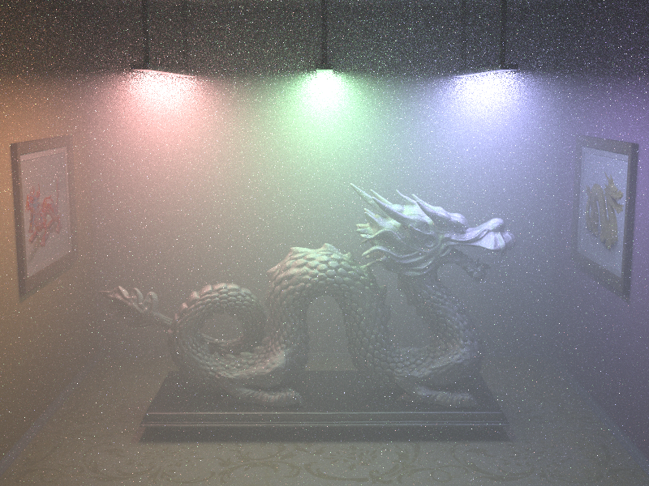
Unidir: Single + double scattering
Traditional $O\left(\sqrt[3]{N}\right)$
Isotropic medium (30 min)
Notes:
In 30 minutes, we obtain a very noisy result from this algorithm, which, as I discussed earlier has infinite variance due to a singularity in the geometry term, which leads to a lower convergence rate than expected.

Slide 19
Unidirectional path tracing
1-random-decision connections
Notes:
The problem is that the camera path is constructed with complete ignorance of where the light is, and there is no intelligence in performing the deterministic connections.
[CLICK] We can address this issue by considering the segments of the path [CLICK] and using the 1-random-decision connection technique to construct connections by importance sampling the geometry term of the connection edge.

Slide 20



Unidir: Single + double scattering
RMSE: 0.05
RMSE: 0.23
[Dubi et al. 1982]
[Reif 1993]
Our (1-conn.) $O\left(\sqrt{N}\right)$
Traditional $O\left(\sqrt[3]{N}\right)$
Isotropic medium (30 min)
Notes:
With this algorithm, we obtain significant noise reduction in the same time. Furthermore, researchers in neutron transport have already used this method for the adjoint problem, which in our setting corresponds to light tracing, and have shown that it recovers the more favorable inverse-square-root convergence rate.

Slide 21
Unidirectional path tracing
1- and 3-random-decision connections
Notes:
But with our unidirectional 3-random-decision technique we can do even better: [CLICK] Instead of sampling a single connection segment, we can use this techniques to construct length-3 connections to the light sources. Making these longer connections allows us to importance sample more terms of the path contribution. [CLICK] We still need to connect the first camera segment via a 1-random-decision connection to account for single scattering.

Slide 22




Unidir: Single + double scattering
RMSE: 0.01
RMSE: 0.05
RMSE: 0.23
Our (1- & 3-conn.) $O\left(\sqrt{N}\right)$
Our (1-conn.) $O\left(\sqrt{N}\right)$
Traditional $O\left(\sqrt[3]{N}\right)$
Isotropic medium (30 min)
Notes:
With this improvement, we still get the same convergence rate as with the previous one, but reduce variance by yet another order of magnitude. Note that the connection techniques used to render the left image are completely analytic and take only a few lines of code to implement. You can find the formulas in the paper.

Slide 23

Unidir: Single + double scattering
RMSE: 0.03
RMSE: 0.19
RMSE: 1.19
Our (1- & 3-conn.) $O\left(\sqrt{N}\right)$
Our (1-conn.) $O\left(\sqrt{N}\right)$
Traditional $O\left(\sqrt[3]{N}\right)$
Anisotropic medium (30 min)
Notes:
For anisotropic media, we use our tabulated versions of these techniques. Here, the improvement on the left is even more visually striking, which is due to the fact that we importance sample more phase functions when performing the connections.

Slide 24
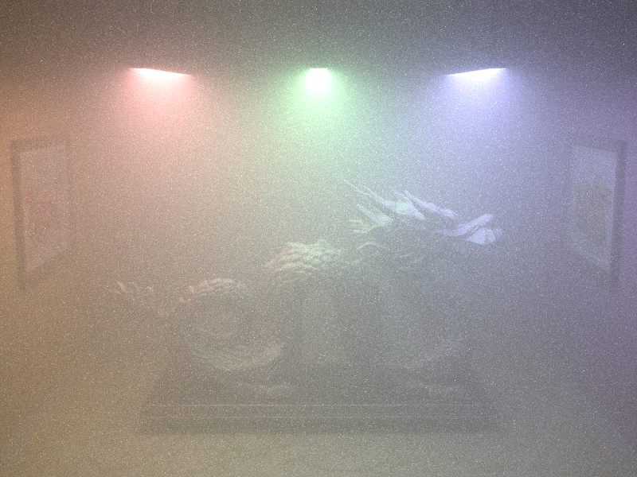
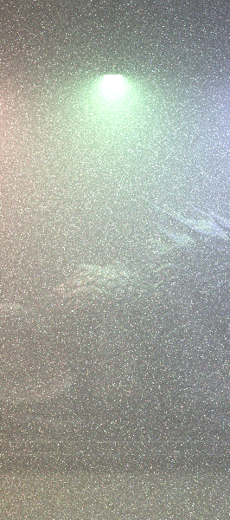
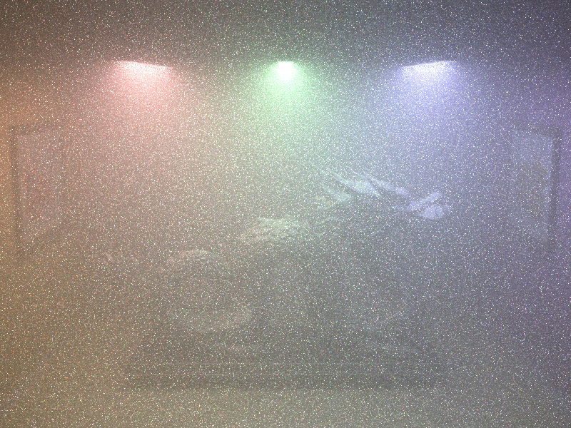
Unidir: Single – 7th-order scattering
RMSE: 0.09
RMSE: 0.68
RMSE: 2.39
Our (1- & 3-conn.) $O\left(\sqrt{N}\right)$
Our (1-conn.) $O\left(\sqrt{N}\right)$
Traditional $O\left(\sqrt[3]{N}\right)$
Anisotropic medium (120 min)
Notes:
And even though our techniques can do joint importance sampling for paths of up to length 3, using them as general-purpose connection techniques delivers significant variance reduction for higher-order scattering as well.

Slide 25
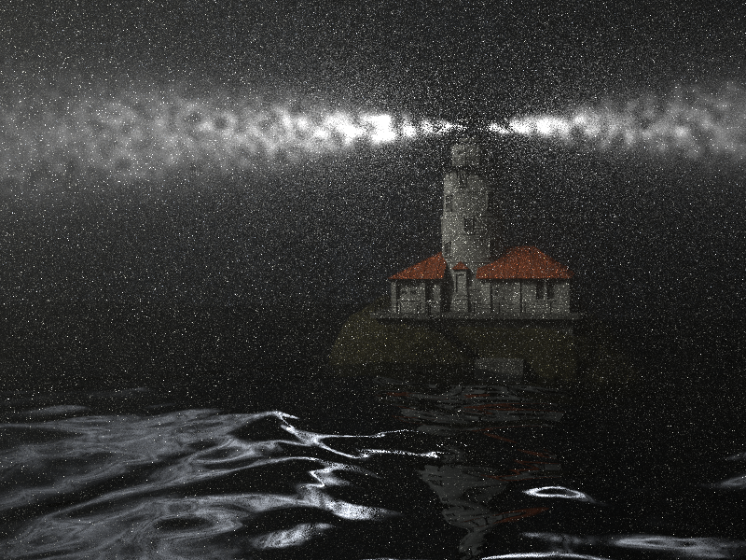
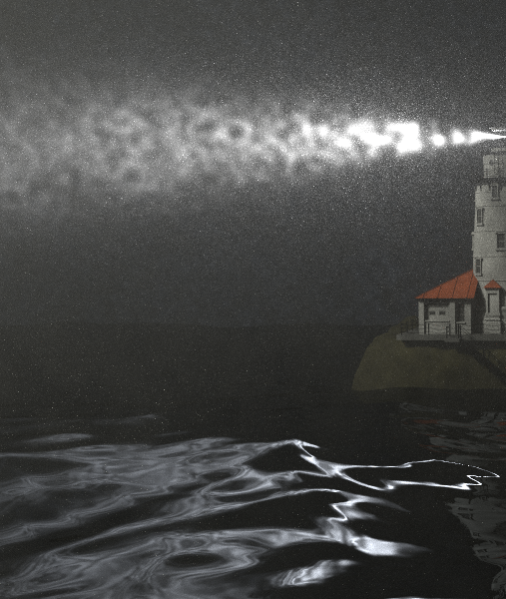
Unidir: Single + double scattering
RMSE: 0.03
RMSE: 0.50
Our (1- & 3-conn.)
Traditional
Heterogeneous anisotropic medium & light (120 min)
Notes:
This scene has a heterogeneous anisotropic medium and an anisotropic light. Our improved path tracing again achieves orders of magnitude variance reduction. Note that it is not a bug that the right image looks a lot darker – simply all energy is concentrated into a few very noisy bright pixels.

Slide 26
Bidirectional path tracing
Notes:
Let us now take a look at bidirectional path tracing, [CLICK] which first constructs independent subpaths from both the light and the camera and [CLICK] then connects their vertices deterministically. This more sophisticated algorithm is generally much more robust than unidirectional path tracing, but because it samples the two subpaths completely independently, there is still no explicit control over the final joint path PDF.

Slide 27
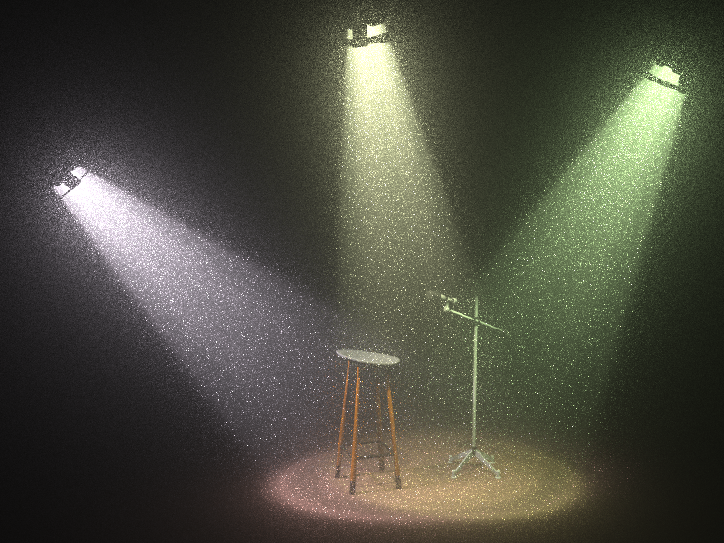
Bidir: Single + double scattering
Anisotropic medium (30 min)
Notes:
This deficiency is particularly noticeable with anisotropic media, since the phase functions involved in these blind connections are not importance sampled.

Slide 28
Bidirectional path tracing
1- and 2-random-decision connections
Notes:
Instead of performing deterministic vertex-vertex connections, [CLICK] we can consider each segment-segment pair, [CLICK] and use the 2-random-decision technique construct a better connection by importance sampling the product of phase functions and geometry terms. The resulting algorithm can be considered an extension of the VRL method to a full bidirectional framework.
For connecting segments to the lights and the camera, we still use 1-random-decision connections, as we did for unidirectional path tracing.

Slide 29

Bidir: Single + double scattering
RMSE: 0.06
RMSE: 0.23
Our (2-conn.)
Traditional
Anisotropic medium (30 min)
Notes:
And thanks to the joint importance sampling, the result is again significant variance reduction…

Slide 30
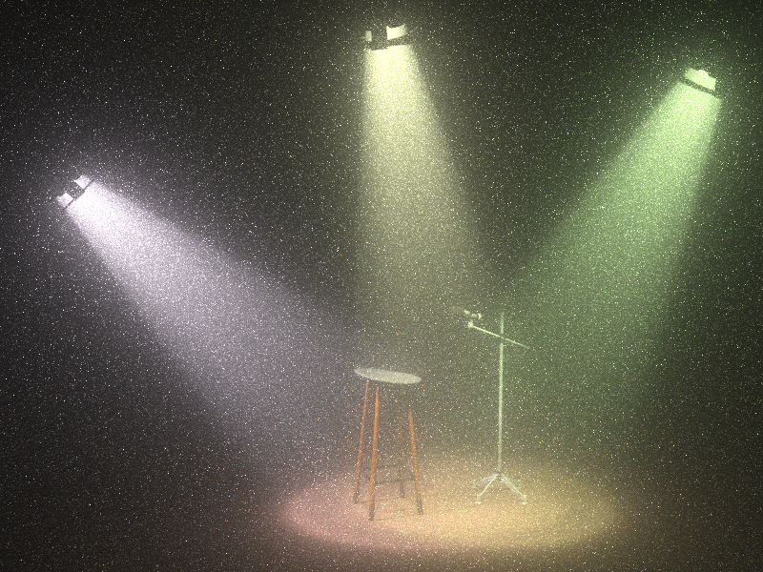
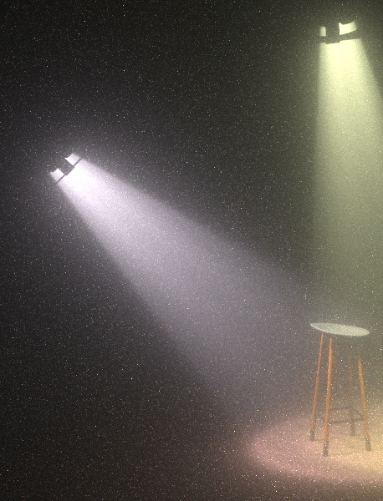
Bidir: Single – 7th-order scattering
RMSE: 0.01
RMSE: 0.4
Our (2-conn.)
Traditional
Anisotropic medium (240 min)
Notes:
…which also translates into higher bounces, albeit to a slightly lesser degree.

Slide 31
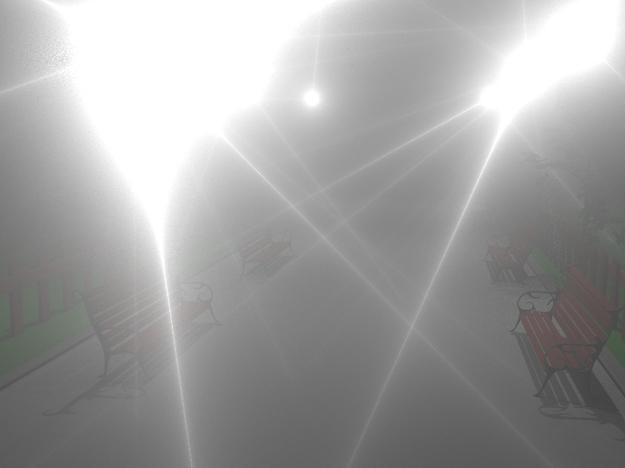
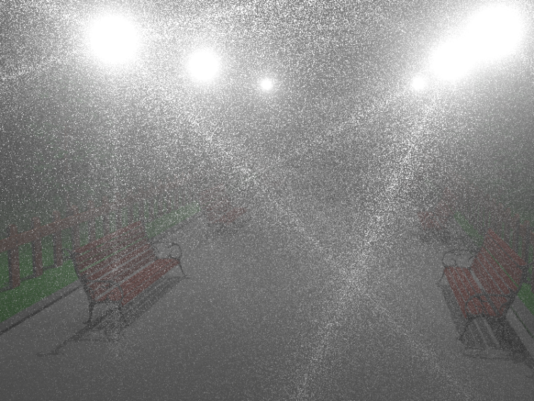
VRL: Single + double scattering
Our (2-conn.)
Novák et al. [2012]
Anisotropic medium (10 min)
Notes:
We finally demonstrate our improvements in the VRL framework. Here we intentionally shoot a small number of virtual ray lights to showcase our improved segment-segment tabulation, which brings significant noise reduction.

Slide 32
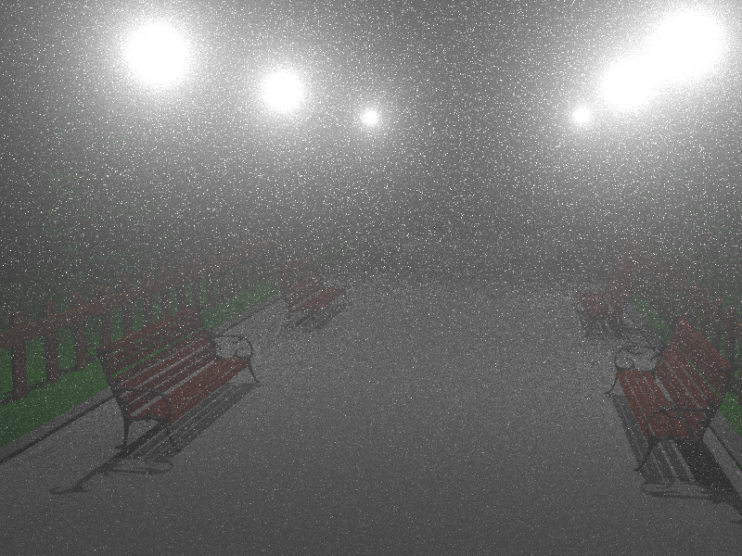

VRL: Single+double scattering
Our (2-conn.)
Novák et al. [2012]
Anisotropic medium (2 min)
Notes:
However, modifying the algorithm to sample a unique random VRL for each camera ray, we see that our improvement in the connections is diminished by the fact that the VRL direction is sampled completely independently of the camera ray.

Slide 33
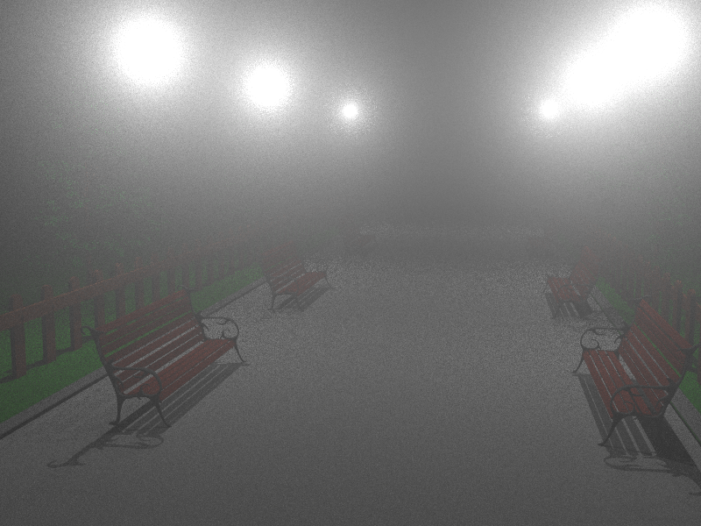
VRL: Single+double scattering
Our (3-conn.)
Our (2-conn.)
Novák et al. [2012]
Anisotropic medium (2 min)
Notes:
Our bidirectional 3-random-decision technique allows us to include the direction sampling decision in the joint importance sampling, dramatically improving the output.

Slide 34



Limitations
Longer paths
Surfaces
Single + double
scattering (30 min)
Single – 7th-order
scattering (120 min)
Notes:
Even though our method can significantly outperform previous approaches, there is still a lot of room for improvement.
[CLICK] For instance, since we only importance sample connections of up to length 3, our method is not as efficient for higher-order scattering as it is for single and double scattering.
[CLICK] In addition, our distributions do not take into account surface scattering properly, making our method suboptimal even for double scattering paths that include a surface interaction.

Slide 35
Conclusion
Traditional methods – legacy from surface rendering
Joint vertex importance sampling
  Importance sampling across bounces
Can we do… 17 bounces?
Traditional
Our
Notes:
In this talk we showed that traditional Monte Carlo path sampling in participating media is an unnecessary legacy from surface rendering and can be very inefficient.
[CLICK] We instead attack the problem for media directly, taking advantage of the extra dimensionality and devising joint importance sampling of sequences of path vertices. We believe this paves the way to think about light transport differently, by considering whole segments instead of individual points.
We expect huge gain from devising even more path efficient sampling techniques, and ask ourselves: Can we do [CLICK] 17 bounces?

Slide 36
