Slide 1
PEGASUS:
A Peta-Scale Graph Mining System
– Implementation and Observations
Presenter: Vivi Ma

Slide 2
CONTENT
Background
PEGUSUS
PageRank Example
Performance and Scalability
Real World Applications

Slide 3
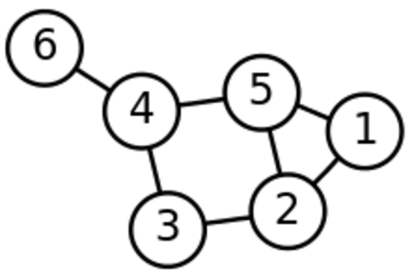
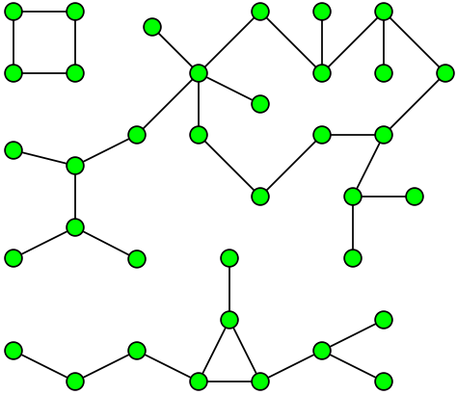
BACKGROUND
What is Graph Mining?
… is an area of data mining to find patterns, rules, and anomalies of graphs
…graph mining tasks such as PageRank, diameter estimation, connected components etc.

Slide 4
BACKGROUND
What is the problem?
Why is it important?
Large volume of available data
Limited scalability
Rely on a shared memory model
- limits their ability to handle large disk-resident graph
Graphs or networks are everywhere
We must find graph mining algorithms that are faster and can scale up to billions of nodes and edges to tackle real world applications

Slide 5
PEGASUS
First open source Peta Graph Mining library

Slide 6
PEGASUS
Based on Hadoop
Handling graphs with billions of nodes and edges
Unification of seemingly different graph mining tasks
Generalized Iterated Matrix-Vector multiplication(GIM-V)

Slide 7
PEGASUS
Linear runtime on the numbers of edges
Scales up well with the number of available machines
Combination of optimizations can speed up 5 times
Analyzed Yahoo’s web graph (around 6,7 billion edges)

Slide 8
GIM-V
Generalized Iterated Matrix-Vector multiplication
Main idea
Matrix-Vector Multiplication
Three operations
n by n matrix M, vector v of size n, m_{i,j} denote the (i,j) element of M
Combine2: multiply m_{i,j}, and v_{j}
CombineAll: sum n multiplication results for node i
Assign: overwrite previous value of v_{i} with new result to make v_{i}’

Slide 9
GIM-V
Main idea
Operator X_{G}, where the three functions can be defined arbitrarily
where v_{i}’=assign(vi, combineAll_{i} ({x_{j}|j=1…n, and x_{j}=combine2(m_{i,j}, v_{j})}))
Three functions
Strong connection of GIM-V with SQL
Combine2(m_{i,j},v_{j}), CombineAll(x₁,…,x_{n}), Assign(v_{i},v_{new})

Slide 10
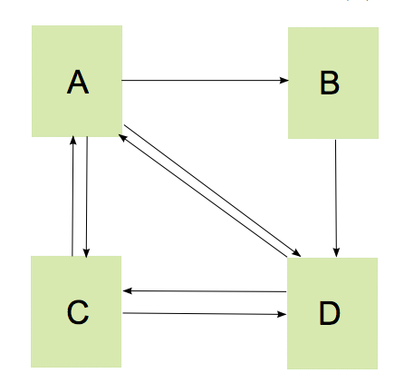
Eample1. PageRank
PageRank: calculate relative importance of web pages
Main idea
Formula

Slide 11
Eample1. PageRank
Three operations
Combine2(m_{i,j},v_{j}) = c x m_{i,j} x v_{j}
CombineAll(x₁,…,x_{n}) =
Assign(v_{i},v_{new}) = v_{new}

Slide 12
GIM-V Base: Naïve Multiplication
How can we implement a matrix by vector multiplication in MapReduce?
Stage1: performs combine2 operation by combing columns of matrix with rows of vector.
Stage2: combines all partial results from stage1 and assigns the new vector to the old vector.

Slide 13
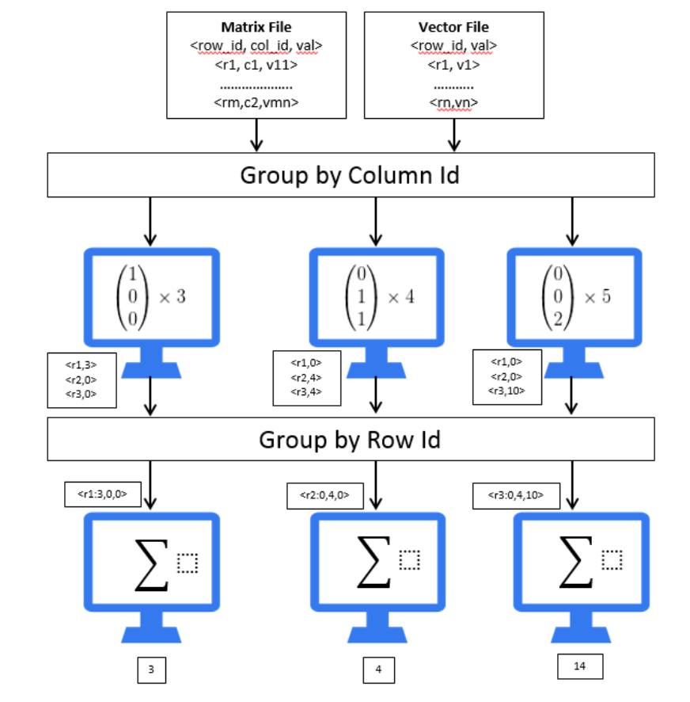
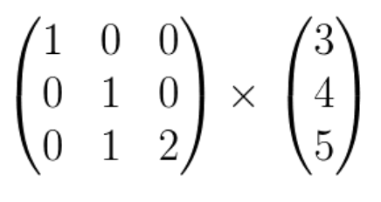
Stage 1
Stage 2
Distribution of work among machines during GIM-V execution

Slide 14
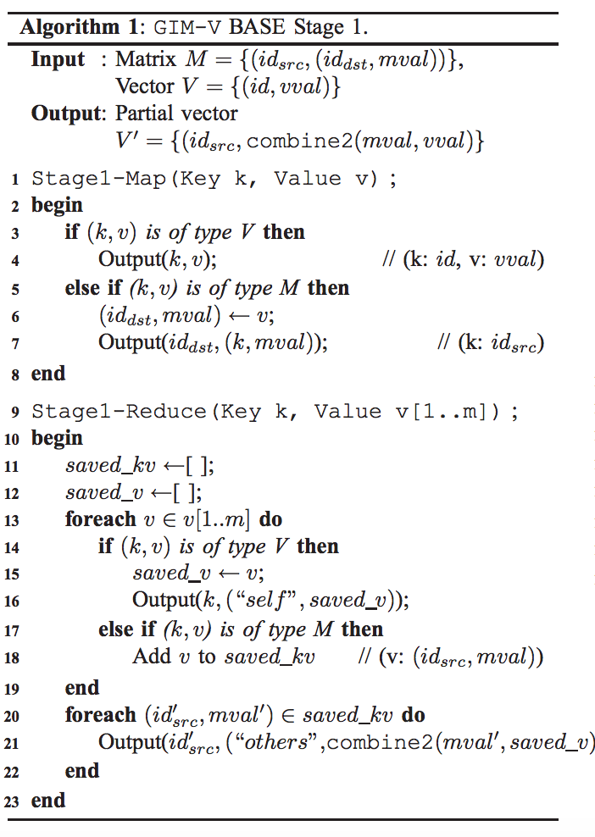
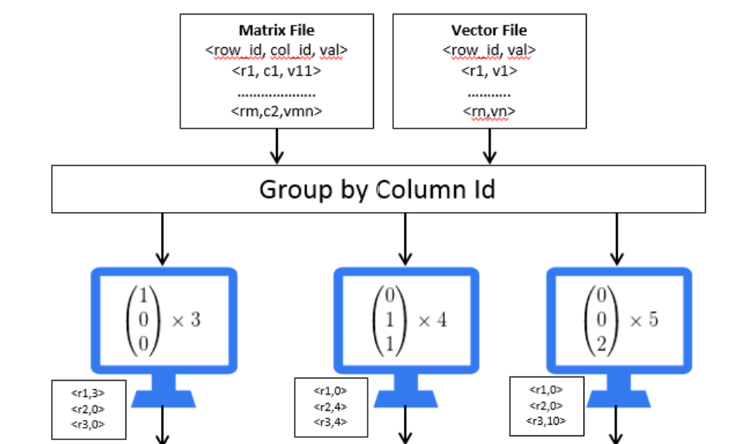

Slide 15
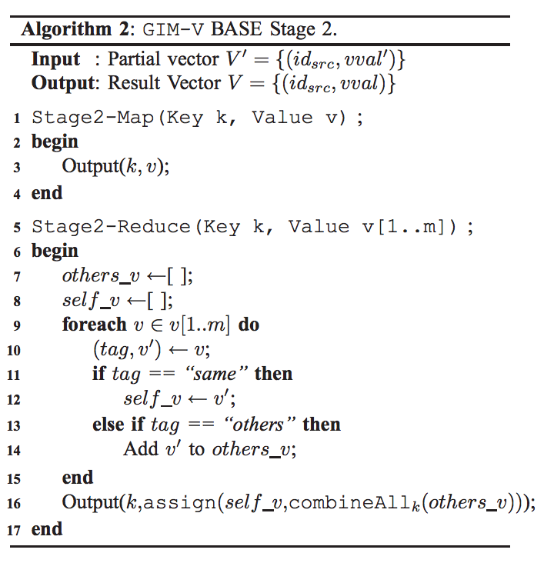
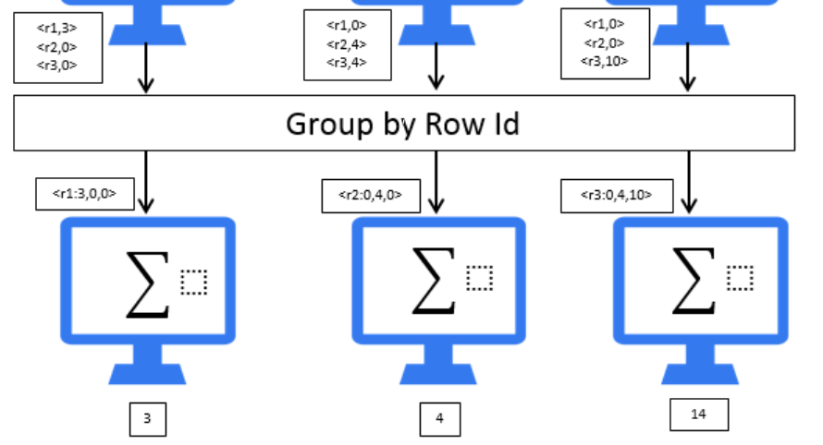
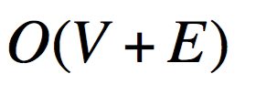

Slide 16
Example 2. Connected Components
Main idea
Formula
Three operations
Combine2(m_{i,j},v_{j}) = m_{i,j} x v_{j}
CombineAll(x₁,…,x_{n}) = MIN{X_{j} | j=1…n}
Assign(v_{i},v_{new}) = MIN(v_{i}, v_{new)}

Slide 17
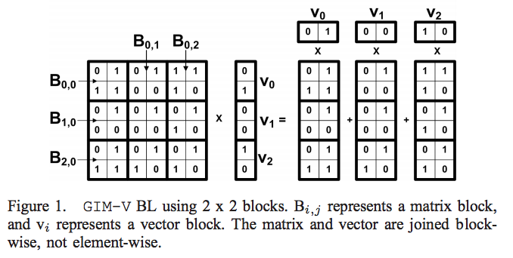
Fast Algorithm for GIM-V
GIM-V BL: Block Multiplication
Main idea: Group elements of the input matrix into blocks of size b by b. Elements of the input vectors are also divided into blocks of length b

Slide 18
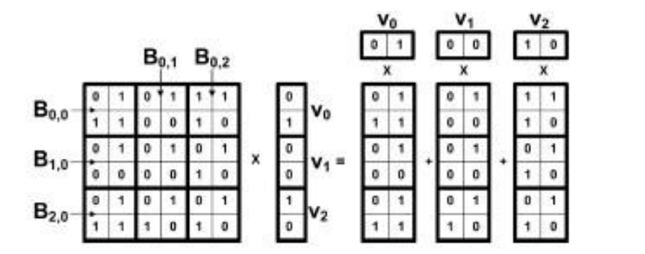
Only blocks with at least one non-zero element are saved to disk
More than 5 times faster than GIM-V Base since
The bottleneck of naïve implementation is the grouping stage which is implemented by sorting. GIM-BL reduced the number of elements sorted. [shuffling stage of HADOOP]
E.g. 36 elements are sorted before, 9 elements sorted now
Compression – the size of the data decreases significantly by converting edges and vectors to block format, which speeds up as fewer I/O operations are needed

Slide 19
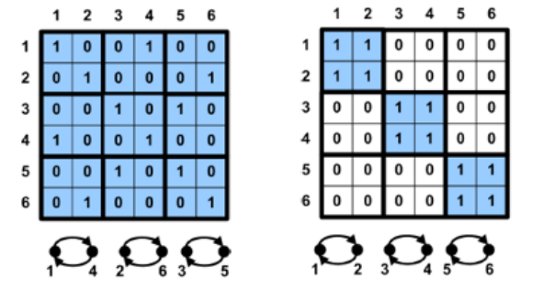
Fast Algorithm for GIM-V
GIM-V CL: Clustered Edges
Main idea: Clustering is a pre-processing step which can be ran only once on the data file and reused in the future. This can be used to reduce the number of used blocks.
Only useful when combined with block encoding.

Slide 20
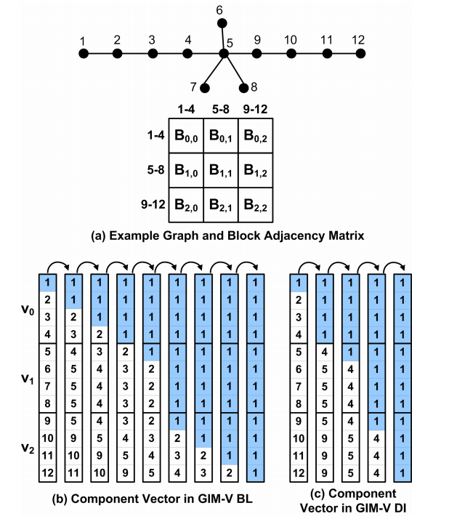
Fast Algorithm for GIM-V
GIM-V DI: Diagonal Block Iteration
Main idea: Reduce the number of iterations required to converge.
In HCC, (algorithm for finding connected component),the idea is to multiply diagonal matrix blocks and corresponding vector blocks until
the contents of the vector don’t
change in one iteration.

Slide 21
Performance and Scalability
How the performance of the methods changes as we add more machines?

Slide 22
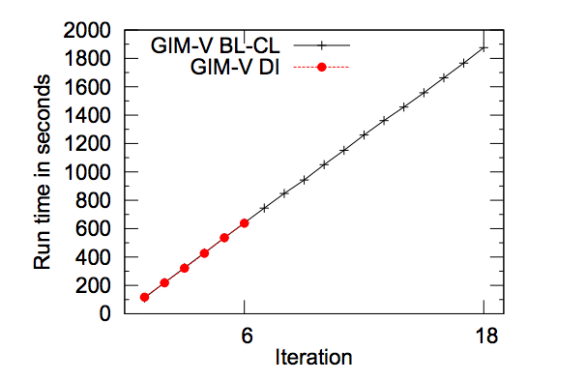
Performance and Scalability
GIM-V DI vs. GIM-V BL-CL for HCC

Slide 23
Real World Applications
PEGASUS can be useful for finding patterns, outliers, and interesting observations.
Connected Components of Real Networks
PageRanks of Real Networks
Diameter of Real Networks

Slide 24
Interesting discussion question…
Standalone alternatives like SNAP, NetworkX, iGraph
Distributed alternatives like Pregel, PowerGraph, GraphX
Interesting to compare Pegasus against all these alternatives not only performance-wise but also types of problem

Slide 25
Reference
[1] U Kang, Charalampos E. Tsourakakis, and Christos Faloutsos, PEGASUS: A Peta Mining System - Implementation and Observations. Proc. Intl. Conf. Data Mining, 2009, 229-238
[2] U Kang. "Mining Tera-Scale Graphs: Theory, Engineering and Discoveries." Diss. Carnegie Mellon U, 2012. Print.
[3]Kenneth Shum. “Notes on PageRank Algorithm.”
Http://home.ie.cuhk.edu.hk/~wkshum/papers/pagerank.pdf .N.p., n.d.Web.20 Sept.2016.

Slide 26
Thanks!
Any questions?

