Slide 1
Declarative Networking
Authors:
Presenter: Weicong (Vivi) Ma
Boon Thau Loo, Tyson Condie, Minos Garofalakis, David E. Gay, Joseph M. Hellerstein, Petros Maniatis, Raghu Ramakrishnan Timothy Roscoe, Ion Stoica

Slide 2
Outlines
Motivation
Declarative Network
Review of Datalog
Network Datalog (NDlog)
Extensions to NDlog
Execution Plan Generation
Use Cases
Related work

Slide 3
Motivation
Network protocol design is challenging
Distributed nature and large scale of typical networks
Consider Tradeoffs
E.g. extensibility and flexibility vs. robustness and efficiency
Hard to accommodate the needs of new applications/services
Conventional programming language makes the process tedious and error-prone

Slide 4
Declarative Networking
“…programming methodology that enables developers to concisely specific network protocols and services, which are directly compiled to a dataflow framework that executes the specifications…”
Observations:
Network protocols deal at their core with computing and maintaining distributed state according to basic information locally available at each node while enforcing constrains such as routing policies.
Recursively query languages are a natural fit for routing

Slide 5
Review of Datalog
A well-known recursively query language designed for querying graph-structured data in centralized database.
Datalog Rule:
p:- q1,q2,…,qn
“q1 and q2 and … and qn implies p”
p -> head
q1,…qn -> body, list of literals [literals are either predicates or functions]

Slide 6
Network Datalog (NDlog)
Network protocols – computations over distributed network states
NDlog – supports rules that express distributed computations
Based on traditional Datalog – providing control over the storage location of tuples via a location specifier (@), which indicates the partitioning of the table

Slide 7
Path-Vector Protocol Example
sp1 path(@Src,Dest,Path,Cost) :- link(@Src,Dest,Cost), Path=f_init(Src,Dest)
sp2 path(@Src,Dest,Path,Cost) :- link(@Src,Nxt,Cost1), path(@Nxt,Dest,Path2,Cost2), Cost=Cost1+Cost2, Path=f_concatpath(Src,Path2)
sp3 spCost(@Src,Dest,min<Cost>) :- path(@Src,Dest,Path,Cost)
sp4 shortestpath(@Src,Dest,Path,Cost) : spCost(@Src,Dest,Cost), path(@Src,Dest,Path,Cost).
Query shortestpath(@Src,Dest,Path,Cost).
Notes:
f_ means a set of side-effect–free function calls

Slide 8
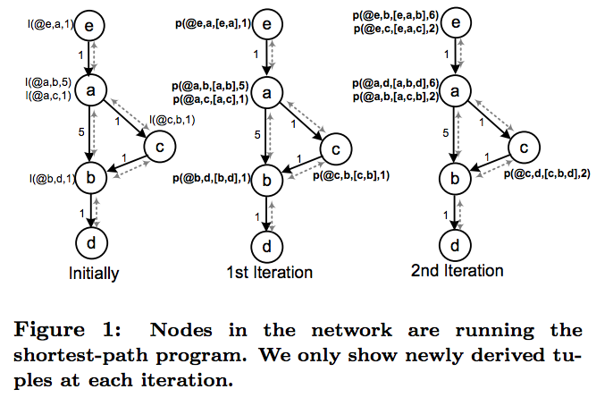
Network Datalog (NDlog)
Notes:
In Ndlog the communication in implicit, there is no explicit communication primitives. All communication is implicitly generated during rule execution as a result of data placement specification. So again, the common variable Nxt in sp2 corresponds to a join operation used in relational database

Slide 9
Link-Restricted Rule – NDlog Extension
Model physical networking components where full connectivity is not available
Ensure rule execution results in communication only among nodes that are physically connected
Special link predicate
A link-restricted rule is…
p(@Dest,...):link(@Src,Dest...),p1(@Src,...), ...,pn(@Src,...)
Local rule (same location specifier variable in each predicate) or
All other predicates (including head predicate) have their location specifier set to either first (src) or second (dest) field of the link predicate

Slide 10
Soft-state Storage Model – NDlog Extension
Stored data have an associated time-to-live (TTL)
Soft state datum needs to be periodically refreshed
Favored in networking implementations – provide eventual consistency
More than TTL passed, without datum being refreshes, datum is deleted
Eventual values obtained even if there are transient errors (reordered message, node disconnection or link failures…)
For persistent failure, no coordination is required to register the failure since any data provided by failed node would be forgotten in the absence of refreshed

Slide 11
Soft-state Storage Model – NDlog Extension
Overlog – extension of Ndlog, involved soft-state
Additional Feature: availability of materialized keyword, specifying the TTL
materialized(link,{1,2},10)
TTL = infinity -> hard state
No materialized keyword, means TTL = 0 -> event predicate
Event predicate: transient table (used as input to rules but no storage) and use to trigger rules periodically or in response to network event
ping(@Y, X) :- periodic(@X, 10) , link(@X, Y)

Slide 12
Soft-state Storage Model – NDlog Extension
Overlog soft-storage semantics:
When a tuple is derived, if there exists another tuple with the same primary key but differences on other fields, update occurs, in which the new tuple replaced the prvious one.
If two tuples are identical, a refresh occurs, in which the existing tuple is extened by its TTL

Slide 13
Execution Plan Generation
Network protocols implementations often center around local state machines
NDlog / Overlog – distributed data execution engines
Recursive flows and asynchronous communication are challenging
Centralized / Distributed

Slide 14
Centralized - Execution Plan Generation
Semi-naïve (SN) evaluation:
New tuples that are generated for the first time in the current iteration, and only these new tuples, are then used as input to the next iteration.
This is repeated until a fixpoint is achieved (e.g.no new tuples are produced).
Notes:
p2 is a system which use a high-level declarative language to express overlay networks in a highly compact reusable form. And it’s consist of elements that are connected together to implement a variety of network and flow control components. Since it’s inspired by database query engines, P2 elements include database operators such as join, selections, projects and so on and these are directly generated from the rule. Each rule is implemented as a rule strand, and each strand consists of number of relational operators.

Slide 15
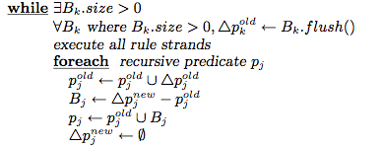
Centralized - Execution Plan Generation
Buffer for p_{k} tuples generated from previous iteration
New p_{j} tuples generated in current iteration insert to B_{j,} and will be used for next iteration
Each semi-naïve rule has the form:
p1,…,pn: recursive predicates b1,...,bm: base predicates
: p_{k} tuples generated for the first time in previous iteration
p_{k}^{old}: all p_{k} tuples generated before the previous iteration

Slide 16
Distributed - Execution Plan Generation
Non local rules whose body predicates have different location specifiers, cannot be executed as a single node
Tuples to be joined are situated at different node
Rule localization rewrite ensures all tuples to be joined at same node

Slide 17
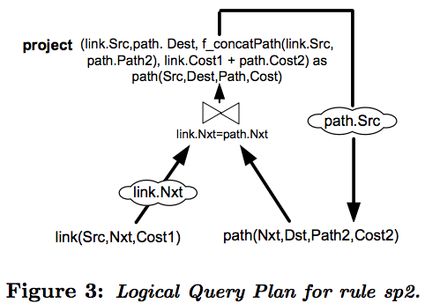
Distributed - Execution Plan Generation
sp2 path(@Src,Dest,path,Cost) :-
link(@Src,nxt,Cost1), path(@Nxt,Dest,path2,Cost2), Cost=Cost1+Cost2, path=f_concatpath(src,path2)
sp2a linkD(@Nxt,Src,Cost) :- link(@Src,Nxt,Cost).
sp2b path(@Src,Dest,Nxt,Path,Cost) :- linkD(@Nxt,Src,Cost1), path(@Nxt,Dest,Path2,Cost2), Cost=Cost1+Cost2, Path = f_concatPath(Src,Path2).
Cloud: “exchange”-like operator, forwards tuple from one node to another

Slide 18
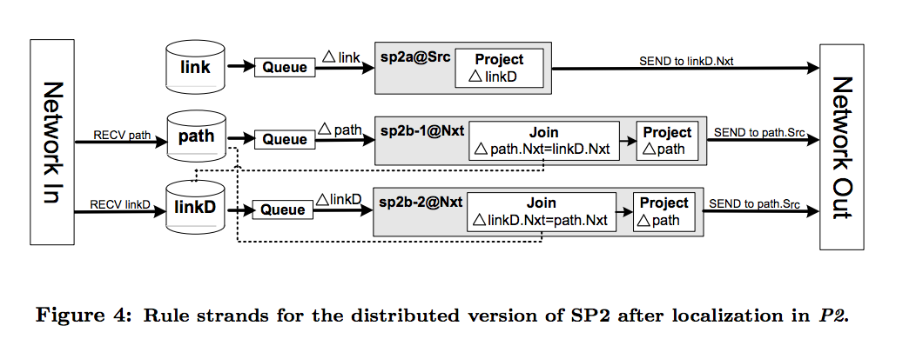
Distributed - Execution Plan Generation
Rule sp2@Src sends links to dest, add linkD tuples
Rule sp2b-2@Nxt takes linkD and performs join with path tuples
Notes:
Here is the rule stands for distributed version of sp2 in P2 after we do the rule rewrite.

Slide 19
Pipelined Semi-naïve Evaluation
Traditional semi-naïve Evaluation
Problems: delays and failures
Results from the previous iteration used in the current iteration
Iterations of synchronous computation
5
6
4
1
2
5
2-hop
0
10
4
9
3
3
6
2
1-hop
8
7
1
link
Path

Slide 20
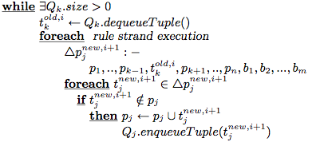
Pipelined Semi-naïve Evaluation
Computed tuples in any iteration pipelined to the next iteration
Pipelined Semi-naïve Evaluation – asynchronous distributed settings
Node received from new tuples can be used immediately to computer new tuples without waiting for current iteration to complete

Slide 21
Pipelined Semi-naïve Evaluation
8
7
6
5
3
4
1
2
9
10
0
link
5
9
3
6
2
8
10
7
4
1
Path
Notes:
without waiting for current local iteration to complete.

Slide 22
Incremental Maintenance
Underlying network changes
Support for continuous rule execution and result materialization, where all tuples derived from NDlog rules are materialized and incrementally updated
Bursty update model
Updates occur frequently – results can't fully reflect the network state
Assumption: after a burst of updates during query process, the network eventually quiesces for enough time to allow all queries to reach fixpoints.
Eventual consistency

Slide 23
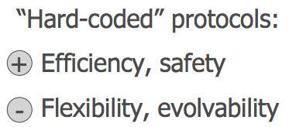
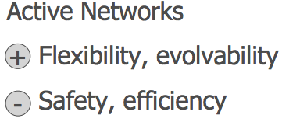
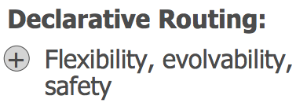
Use Cases – Declarative Routing
Strike a better balance between the extensibility and robustness of a routing infrastructure.
Simple query in NDlog, then executed in a distributed fashion at the nodes that receive the query. [in a compact and clean way]
Key concern: security – static analysis & other verification techniques
Notes:
Ease of programming: Compact and high-level representation of protocols Orders of magnitude reduction in code size 
Easy customization
Safety: Queries are “sandboxed” within query processor 
Potential for static analysis techniques on safety

Slide 24
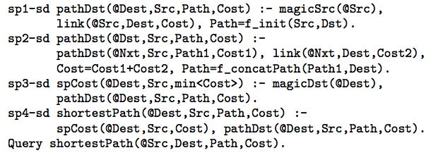
Use Cases – Declarative Routing
Magic sets rewriting – limit query computation to relevant portion of the network
The approach doesn’t introduce any fundamental overheads
Notes:
What about efficiency? No fundamental overhead when executing standard routing protocols Application of well-studied query optimizations

Slide 25
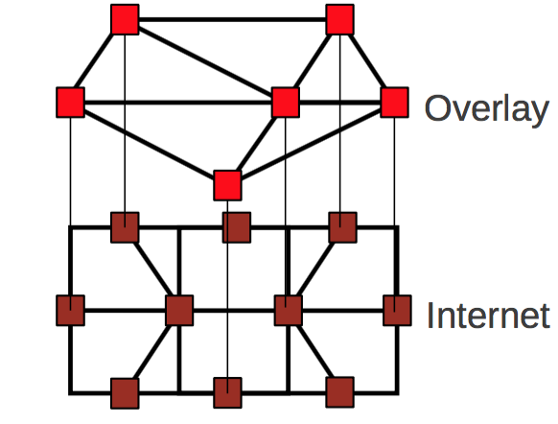
Use Cases – Declarative Overlays
Overlay network : Virtual nodes built on top of internet
To provide services that are not available in existing network
Complex - need to handle message delivery, acknowledgement, failure detection and timeouts etc.
Use Overlog to implement practical application-level overlay networks
Notes:
Heavily utilize the soft-state data and rules in overlog.

Slide 26
Related Work
Many other domains using declarative programming idea
Secure Distributed System
– Notion of context to identify components in distributed system
– Secure Network Datalog – extends NDlog
Datacenter Programming
– BOOM project
– in the setting of Cloud Computing

Slide 27
References
B. T. Loo, T. Condie, M. Garofalakis, D. E. Gay, J. M. Hellerstein, P. Maniatis, R. Ramakrishnan, T. Roscoe, and I. Stoica. Declarative networking. Commun. ACM, 52(11):87–95, 2009.
The Design and Implementaion of Declarative Networks, Boon Thau Loo, powerpoint presentation, available online, URL : www.cis.upenn.edu/~boonloo/research/talks/dn-sigmod07.ppt
Declarative Network, Sandeep Kale, powerpoint presentation, available online, URL : http://www.cse.iitb.ac.in/infolab/Data/Courses/CS632/Talks/DeclarativeNetworkingTalk2014.pdf
Declarative Routing: Extensible Routing with Declatative Queries, powerpoint presentation, available online, URL : http://conferences.sigcomm.org/sigcomm/2005/slides-LooHel.pdf
You don’t need to keep this slide in your presentation. It’s only here to serve you as a design guide if you need to create new slides or download the fonts to edit the presentation in PowerPoint®

Slide 28
Useful Links and Related Papers
P2:Declatative Netwokting System. http://p2.cs.berkeley.edu./p2talks.php
The Design and Implementaion of Declarative Networks, Boon Thau Loo, powerpoint presentation, available online, URL : www.cis.upenn.edu/~boonloo/research/talks/dn-sigmod07.ppt
Declarative Network, Sandeep Kale, powerpoint presentation, available online, URL : http://www.cse.iitb.ac.in/infolab/Data/Courses/CS632/Talks/DeclarativeNetworkingTalk2014.pdf
B. T. Loo, T. Condie, M. Garofalakis, D. E. Gay, J. M. Hellerstein, P. Maniatis, R. Ramakrishnan, T. Roscoe, and I. Stoica. Declarative networking with distributed recursive query processing. In ACM SIGMOD International Conference on Management of Data, June 2006.
Loo, B. T., Condie, T., Hellerstein, J. M., Maniatis, P., Roscoe, T., & Stoica, I. (2005). Implementing declarative overlays. Proceedings of the Twentieth ACM Symposium on Operating Systems Principles - SOSP '05. doi:10.1145/1095810.1095818

Slide 29
Thanks!
Any questions ?

