Slide 1
Project Adam Building an Efficient and Scalable Deep Learning Training System
Chilimbi, et al. (2014)
Microsoft Research
Saifuddin Hitawala
October 17, 2016
CS 848, University of Waterloo

Slide 2
Traditional Machine Learning
Objective Function
Humans
Data
Hand-crafted features
Classifier
Prediction

Slide 3
Deep Learning
Objective Function
Humans
Data
Deep Learning
Prediction

Slide 4
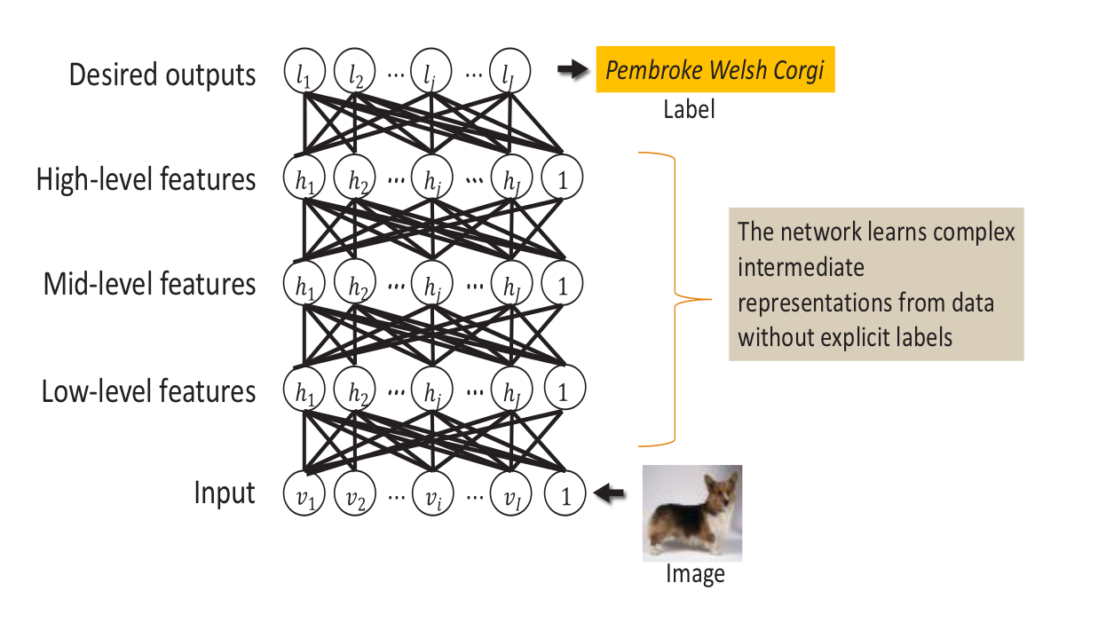
Deep Learning
face, object
properties
textures,
shapes
edges

Slide 5
Problem with Deep Learning
Size of model
Amount of
(weakly labelled)
data
Computation required
Complexity of task
Size of model
Complexity of task

Slide 6
Problem with Deep Learning
Size of model
Amount of
(weakly labelled)
data
Computation required
Complexity of task
Size of model
Complexity of task
Current computational needs on the order of petaFLOPS!

Slide 7
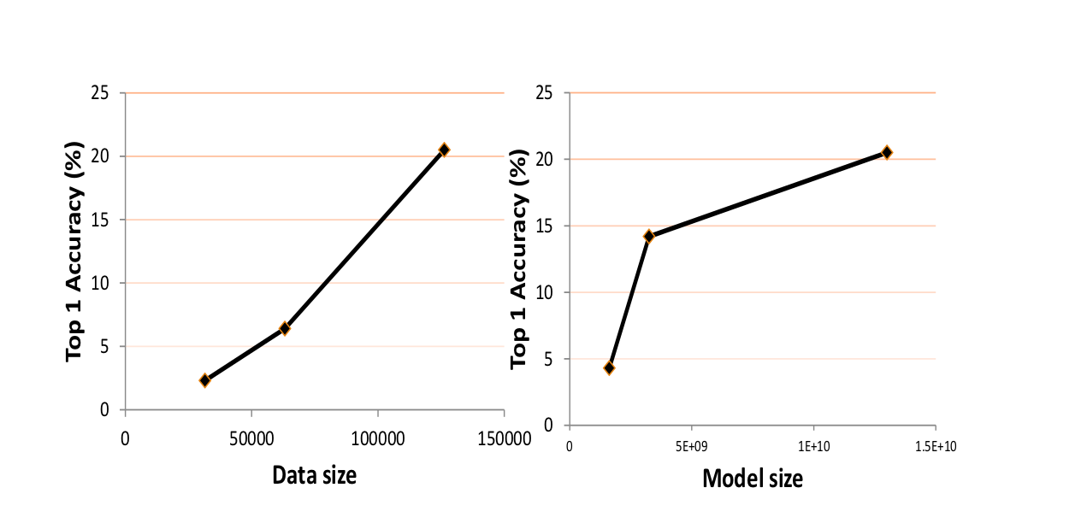
Accuracy scales with data and model size

Slide 8
Adam: Scalable Deep Learning Platform
Data server:
Perform transformations
Prevent over-fitting
Model training system:
Executing input
Check for errors
Use errors to update weights
Parameter server:
Maintain weight updates
Model parameter server
Data server
Model training system

Slide 9
System Architecture
Global Model Parameter Store
Model
Replica
Model
Workers
Model Parallelism
Data Parallelism
Data Shards

Slide 10
Asynchronous weight updates
Multiple threads on a single machine
Each thread processing a different input i.e. computing a weight update
Weight updates are associative and commutative
Thus, no locks required on shared weights
Useful for scaling on multiple machines
Single training machine
$$I_{1}$$
$$I_{7}$$
$$I_{12}$$
$$I_{5}$$
$$I_{6}$$
$$I_{15}$$
$$I_{24}$$
$$I_{19}$$
$∆w= ∆w_{7}+∆w_{24}+∆w_{6}+$…

Slide 11
Model partitioning: less is more
Partition model across multiple machines
Don’t want to stream from disk so put it in memory to take advantage of memory bandwidth
Single training machine
DRAM
CPU

Slide 12
Model partitioning: less is more
Partition model across multiple machines
Don’t want to stream from disk so put it in memory to take advantage of memory bandwidth
But, memory bandwidth still a bottleneck
Single training machine
DRAM
Model Shard
CPU

Slide 13
Model partitioning: less is more
Partition model across multiple machines
Don’t want to stream from disk so put it in memory to take advantage of memory bandwidth
But, memory bandwidth still a bottleneck
Go one level lower and fit model in L3 Cache
Single training machine
DRAM
L3 Cache
CPU

Slide 14
Model partitioning: less is more
Partition model across multiple machines
Don’t want to stream from disk so put it in memory to take advantage of memory bandwidth
But, memory bandwidth still a bottleneck
Go one level lower and fit model in L3 Cache
Speed significantly higher on each machine
Single training machine
DRAM
L3 Cache
Model Shard WS
CPU

Slide 15
Asynchronous batch updates
Replica publishes updates to the parameter server
Bottleneck: communication between the model replicas and the parameter server

Slide 16
Asynchronous batch updates
Replica publishes updates to the parameter server
Bottleneck: communication between the model replicas and the parameter server
Aggregate weight updates and then apply them
$${∆w}_{1}$$
$${∆w}_{2}$$
$${∆w}_{3}$$

Slide 17
Asynchronous batch updates
$$∆w= ∆w_{3}+∆w_{2}+∆w_{1}+ …$$
Replica publishes updates to the parameter server
Bottleneck: communication between the model replicas and the parameter server
Aggregate weight updates and then apply them
Huge improvement in scalability
$${∆w}_{1}$$
$${∆w}_{2}$$
$$w$$
$${∆w}_{3}$$

Slide 18
Local weight computation
Asynchronous batch update does not work well for fully connected layers
Weight updates are $O(N^{2})$
O($N^{2}$)
$∆w= α∗δ∗$ a
$$∆w$$

Slide 19
Local weight computation
$∆w= α∗δ∗$ a
Send the activation and error gradient vectors where matrix multiply can be performed locally
Reduces communication overhead from $O\left(N^{2}\right)$ to $O(K∗(M+N))$
Also offloads computation from model training machines to parameter server machines
O(K*(M+N))
$$<δ,α>$$

Slide 20
System optimizations
Whole system co-design:
Model partitioning: less is more
Local weight computation
Exploiting Asynchrony:
Multi-threaded weight updates without locks
Asynchronous batch updates

Slide 21
Model size scaling

Slide 22
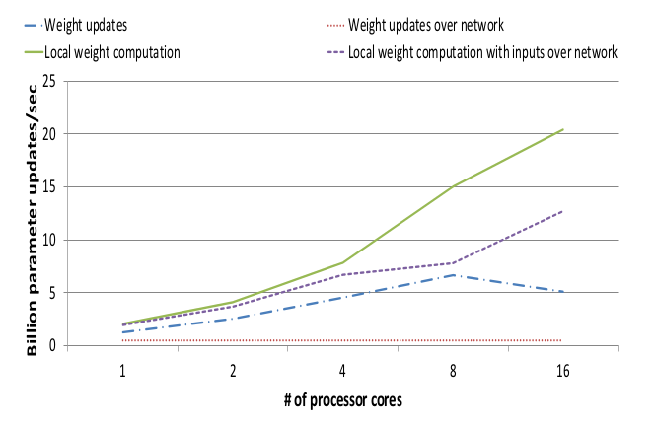
Parameter server performance

Slide 23
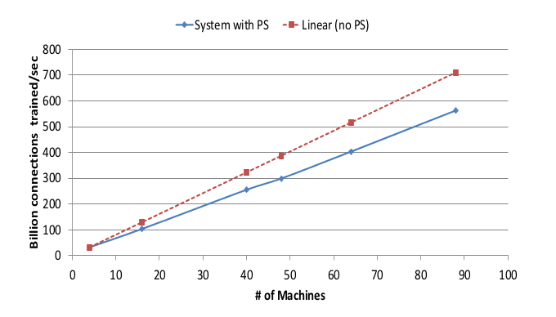
Scaling during ImageNet training

Slide 24
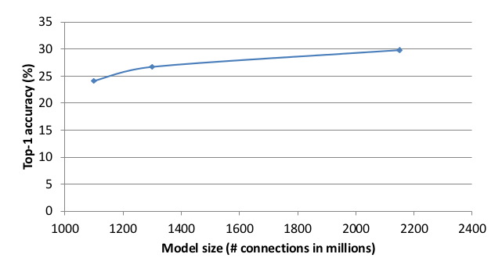
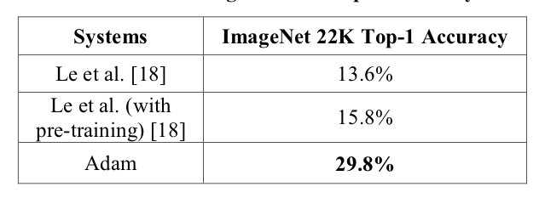
Trained model accuracy at scale

Slide 25
Summary
Pros
World record accuracy on large scale benchmarks
Highly optimized and scalable
Fault tolerant
Cons
Thoroughly optimized for Deep Neural Networks; Unclear if it can be applied to other models
Focused at solving the ImageNet problem and improving Google’s benchmark
No efforts in improving or optimizing the algorithm itself

Slide 26
Questions
Can this model be generalized and work as well as it works for vision to solve for other AI problems such as speech, sentiment analysis or even robotics?
How well does the model compare when evaluated on other types of models not using backpropagation?
Thank You!

