Slide 1
MillWheel Fault-Tolerant Stream Processing at Internet Scale
Akidau, et al. (2013)
Google
Saifuddin Hitawala
October 31, 2016
CS 848, University of Waterloo

Slide 2
Introduction
Streaming systems at Google require fault tolerance, persistent state and scalability
Programming models like MapReduce hide framework’s implementation details allowing users to focus solely on application logic
MillWheel is such a programming model designed for streaming, low-latency systems

Slide 3
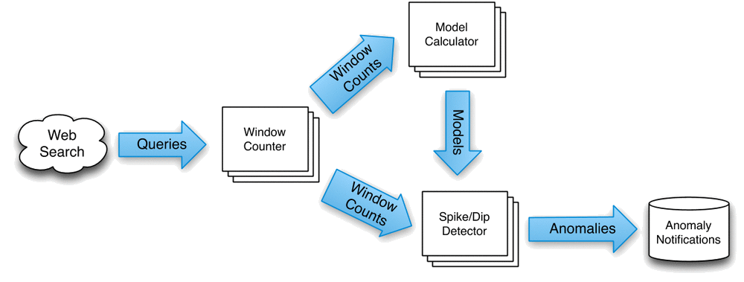
Motivation
Zeitgeist System:
Ingests continuous input of search queries
Performs anomaly detection
Outputs queries which are spiking or dipping as quickly as possible
For e.g. Google Trends

Slide 4
Requirements
Data available as soon as it is published
Persistent state integrated into overall system’s consistency model
Out-of-order data handled gracefully
Monotonically increasing low watermarks of data timestamps
Constant latency as system scales
Provide exactly once delivery of records

Slide 5
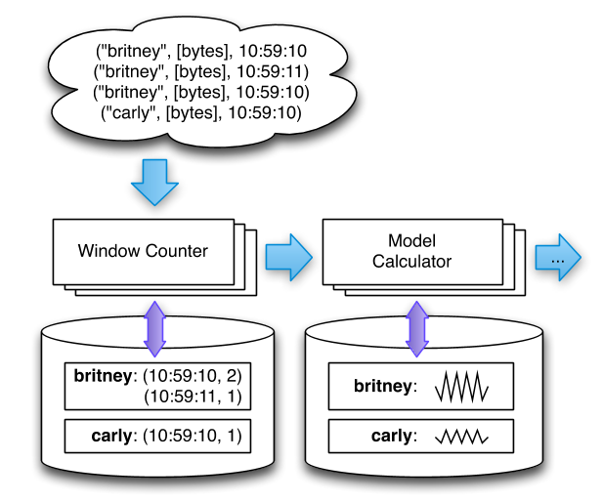
Overview
A graph of user defined transformations on input data that produces output data
These transformations or computations can be parallelized
Essentially, inputs and outputs represented by (key, value, timestamp) pairs
Computations can be added or removed dynamically without having to restart the entire system
Record processing is idempotent

Slide 6
Core Concepts
Computations:
Contain the application logic
Invoked upon receipt of input data at which point user-defined actions are triggered
Code written to operate in the context of single key
Keys:
Primary abstraction for aggregation and comparison between different records
For each record in system, a key extraction function is used which assigns a key to the record
For e.g.: Zeitgeist system’s key: query text, Spam detector’s key: cookie fingerprint

Slide 7
Core Concepts
Streams:
Delivery mechanisms between different computations in MillWheel
Uniquely identified by their names
Persistent State:
Opaque byte string managed on a per-key basis
Backed by a replicated, highly available data store (BigTable)
Low Watermark:
Provides a bound on the timestamp of future records
min(oldest work of A, low watermark of C : C -> A)
Seeded by injectors which send data from external systems
Reflects all pending work in the system

Slide 8
Core Concepts
Timers:
Per-key programmatic hooks that trigger at a specific wall time or low watermark value
Created and run in the context of computation
For e.g.:- Push hourly emails: wall time timers, Windowed aggregates: low watermark timers
Guaranteed to fire in increasing timestamp order

Slide 9
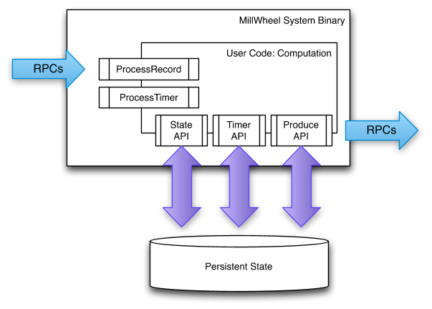
API
Custom subclass of Computation class is implemented
Two main entry points into user code provided by ProcessRecord and ProcessTimer hooks
These constitute the application logic of a computation
Provision of system functions to fetch and manipulate per-key state, produce additional records and set timers

Slide 10
Fault Tolerance
Exactly-Once Delivery:
Upon receipt of input record for a computation, following steps are performed:
Record checked against deduplication data from previous deliveries; duplicates discarded
User code run for input record, possibly resulting in pending changes to timers, state and productions
Pending changes committed to backing store
Senders acknowledged
Pending downstream productions sent
Deliveries are retried until they are ACKed in order to meet at-least-once requirement
Unique IDs assigned to all records at production time

Slide 11
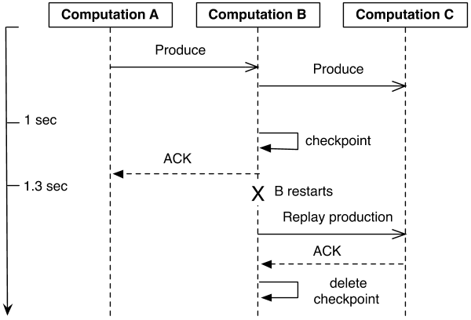
Fault Tolerance
Strong Productions:
Records are checkpointed before delivery
For e.g. : A computation produces window counts downstream, but crashes before saving its state. After restart, it might create a count distinct from predecessor for same logical window
Implemented using blind writes in BigTable
Weak Productions:
Records are checkpointed after delivery if computations are already idempotent
Problem: Increased latency as pipeline stages wait for downstream ACKs of records
Solution: Checkpoint a small percent of straggler productions allowing those stages to ACK their senders

Slide 12
Fault Tolerance
State Manipulation:
Hard State: Persisted to backing store
Soft State: In-memory caches or aggregates
Following guarantees must be satisfied:
System should not lose data
Updates must obey exactly-once semantics
All persisted data must be consistent
Low watermarks must reflect all pending states
Timers must be fired in-order for a key
Problem: Possibility of zombie writers and network remnants issuing stale writes
Solution: Attaching sequencer tokens for each write and invalidating extant sequencers for new workers

Slide 13
System Architecture
Each computation runs on one or more machines and streams delivered via RPC
Master handles load distribution and balancing dividing each computation on basis of lexicographic key intervals
Each interval assigned unique sequencer
For persistent state, databases such as BigTable or Spanner is used
Recovery from failures done by scanning metadata from the data store
This scan populates in-memory structures like heap of pending timers and queue of checkpointed productions

Slide 14
Evaluation
Output Latency:
Latency measured for single stage pipeline that buckets and sorts numbers
For strong productions and exactly-once disabled:
Median record latency: 3.6ms
95th percentile latency: 30ms
For strong productions and exactly-once enabled:
Median record latency: 33.7ms
95th percentile latency: 93.8ms
Median latency stays roughly constant as system scales

Slide 15
Evaluation
Watermark Lag:
As low watermark propagates from injectors through the graph, a lag is expected for a computation proportional to its maximum pipeline distance from injector
For simple three-stage pipeline on 200 CPUs:
First Stage: 1.8s
Second Stage: ~2s
Third Stage: ~2.2s

Slide 16
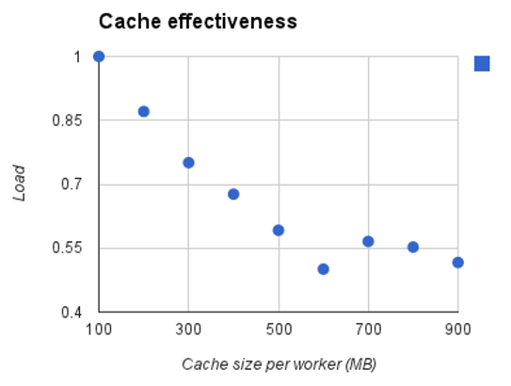
Evaluation
Framework-Level Caching:
Problem: High traffic due to checkpointing. Thus reads have higher costs than writes
Solution: Use framework level cache to buffer data until watermark passes boundary
Increasing cache size linearly improves CPU usage
MillWheel’s cache able to decrease CPU usage by a factor of 2

Slide 17
Questions
How can this system be modified in order for it to work well for problems that are not easily parallelized between different keys?
How can the progress of low watermarks across the graph be improved for data delays that hold back such low watermarks?
Thank You!

