Slide 1
TAO: Facebook’s Distributed Data Store for the Social Graph
Facebook, Inc.
Lei Yao
Nov 30, 2016
CS848 - University of Waterloo

Slide 2
Outline
Background
Social Graph and Challenges
TAO’s data model and API
TAO Architecture
Consistency
Fault Tolerance
Conclusion
Notes:
Of different real time systems used in Facebook to show why facebook picks certain solutions for certain problems
social graph, the challenges it poses, why it is difficult, considerations around solution
the data model used in facebook to represent social graph and TAO, an implementation of this data model
How does TAO achieve consistency and fault tolerance using its unique architecture?

Slide 3
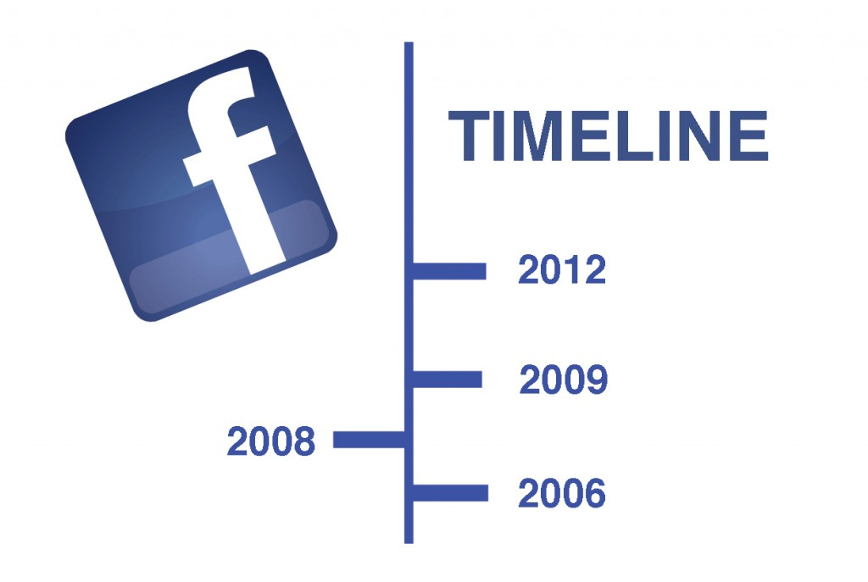
Different Real-time Systems in Facebook
Large historical dataset
Mostly recent data
Private data (Low amount of viewers)
Hbase + caches
Lots of writes
Read data of a single user
Read recent data
Large range of reads of older data
MySQL + Aggregator + Memcache
Notes:
The considerations for building messenger system: go back for a long time. However, most of that data is not accessed.
The hottest data is the recent data, the new messages you send.
Different from the graph data which will be talked about later.
Very write heavy! => Hbase recent data => caches
Every time you click on someone’s name
However, there are large range of reads of older data, which is the difference between

Slide 4
What is social graph?
Uploads
Author
User1
Album
photo
Friends
Post
Photo
Uploads
Contains
User2
Like
Follows
Replies
Photos
Comments
Author
User3
Map a shortcut of Facebook into graph system
Visible things and hidden implementation details
Notes:
Before talking about facebook’s data store for social graph, we need to understand …
Graph data is almost everything you see on the website of facebook. Here is an abstraction of social graph
In this abstraction, we have nodes and edges, we have users, friends link between them
These edges can be either single directional or bidirectional, for example
Data store for social graph…
Social graph not only encodes

Slide 5
Challenges
The social graph stored in FB consists of billions of nodes and trillions of edges, many petabytes of data.
Social graph is highly interconnected.
Extremely high read load (99.99%+ reads), dynamically rendering the graph, due to freshness and privacy filtering
Low response time (<1ms average) and near 100% correct
The data model needs to be scalable and extensible
Notes:
There are lots of challenges before reaching a good solution for storing social graph. Billions of users record..
2. We cannot easily partition data. Unfortunately...
3. Every time facebook gets a request, it goes to the graph, queries nodes and edges, filter them, aggregate them
Freshness: get all the fresh content
Privacy filtering: every user sees a different subset of the graph.
4. Searching engine, different comments
5. Facebook needs to develop awesome products very quickly

Slide 6
Previous approach: lookaside memcache + MySQL
Inefficient edge lists: A key-value cache is not good. Queries need to fetch the entire edge list and changes to a single edge require the entire list to be reloaded.
Distributed control logic: No communication in control logic may lead to thundering herds.
Expensive read-after-write consistency: Asynchronous master/slave replication for MySQL poses a problem for caches in data centers using a replica. Writes are forwarded to the master before they are reflected in the local replica.
Notes:
Queries need to fetch the entire edge list and changes to a single edge require the entire list to be reloaded.
Thundering herd problem occurs when a large number of processes waiting for an event are awoken when that event occurs, but only one process is able to proceed at a time.
Writes are forwarded to the master before they are reflected in the local replica.

Slide 7
Brief conclusion
Application are increasingly data-driven
Different systems for different needs
Clearly identify your goals and build towards these goals
Notes:
We should not pick a technology and use it, instead of figuring out the problem and think what is the best technology for solving that problem.

Slide 8
What is TAO?
Tao is a geographically distributed, read-optimized graph data store built on top of MySQL
It provides efficient and timely access to the constantly changing social graph for Facebook
It favors efficiency and availability over consistency
Notes:
It do provide consistency, but efficiency and availability come first. I will explain this point in later slides.

Slide 9
TAO Data Model and API
People
Actions
Edges
Posts
Nodes
Relationships
Comments
Users: Alice, Bob, Cathy and David
Relationships: friendship
Actions: checking in, commenting, and liking
Physical location: the Golden Gate Bridge
Notes:
Facebook focuses on people, their actions and relationships. TAO maps people, actions and relationships as nodes and edges in a graph.
This representation is very flexible. It provides sufficient expressiveness to handle most application needs
Consider the picture here, which is a checkin of Alice. She and Bob were at a famous landmark, Cathy commented on this checkin and David liked it.
This social graph includes….

Slide 10
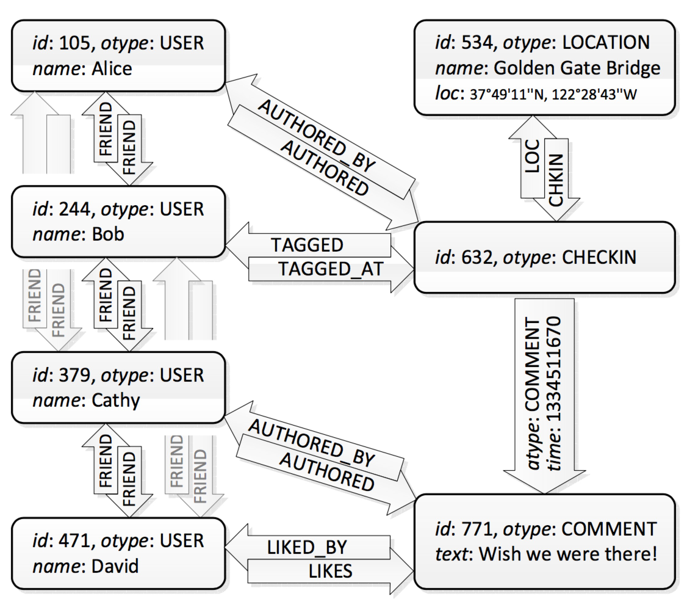
Objects and Associations
Objects = Nodes
Identified by a 64-bit IDs
Typed, with a schema for fields
Object: (id) (otype, (key value)* )
Associations = Edges
Identified by <id1, atype, id2>
A 32-bit time field
Single directional or Bidirectional
Assoc: (id1, atype, id2) (time, (key value)* )
Notes:
Source node, association type, destination node. Each association has a 32-bit time field.
Both objects and associations may contain data as key-value pairs
Picture in the right shows how TAO objects and associations encode the example we saw before.
Users, comment, checkin and location are mapped as objects
Friendships, authorship of checkin and comment are mapped as associations.

Slide 11
Association Lists
<id1, atype, *>
Descending order by time
Query sublist by position or time
Query size of entire list
<632, COMMENT, 120>
Time: 12:31 Nov 11th, 2016
Id: 120 => otype: COMMENT
Str: “I am also…
newer
Id: 632 =>
otype: POST
Str: “ We are…
<632, COMMENT, 1421>
Time: 21:02 Nov 10th, 2016
Id: 1421 => otype: COMMENT
Str: “Good…
<632, COMMENT, 3802>
Time: 16:10 Nov 10th, 2016
Id: 3802 => otype: COMMENT
Str: “The building is…
older
Notes:
Most of the time, you can see edges coming out of a node, they are identified by id1 and a type.
Through API provided by TAO
These edges are in….
We can also query the size of this list.

Slide 12
API
Object API （allocate, retrieve, update or delete）
Association API
assoc_add(id1, atype, id2, time, (k->v)*)
assoc_delete(id1, atype, id2)
assoc_change_type(id1, atype, id2, newtype)
3. Association Query API (association lists)
assoc_get(id1, atype, id2set, high?, low?)
assoc_count(id1, atype)
assoc_range(id1, atype, pos, limit)
assoc_time_range(id1, atype, high, low, limit)
“50 most recent comments on Alice’s checkin” =>
assoc_range(632, COMMENT, 0, 50)
“How many checkins at the GG Bridge?” =>
assoc_count(534, CHECKIN)
Notes:
TAO provides three different kinds of APIs for us.
Through the object API, we can….
Using the association API, we can
The most interesting API is….,
Get association between a period of time
Count the number of edges of type atype that originate at id1

Slide 13
TAO Architecture
Web servers
Caching layer
Storage Layer
Notes:
How does TAO actually serve graph data?
This is an overview of TAO architecture. It consists of three layers, from top to bottom,we have web servers, caching layer and storage layer.

Slide 14
Storage Layer (Database)
MySQL (Lots of features: built in compression,transactions, etc.)
Master Region
MySQL
Sharded by id
MySQL
MySQL
MySQL
Slave Region
Slave Region
Slave Region
Asynchronous replication
TAO API is mapped to a small set of simple SQL queries
Data is divided into logical shards, each shard is contained in logical database
All objects types are stored in one table and all associations types in another
Notes:
Firsr of all, I will talk about storage layer. MySQL is the persistent storage for facebook, where data gets in and out.
TAO uses MySQL because it ….
In fact, data is stored in different regions. Databases are deployed in different areas.
Object id contains an embedded shard_id
Association is stored on the shard of the id of its source object

Slide 15
Caching Layer
Serves as an intermediary between clients and the databases
Consists of cache servers that together form a tier
Handles all communication with databases
Uses a least recently used (LRU) policy
Caching layer
Objects
association lists association counts
tier
Write operation on an association with an inverse may involve two shards
Notes:
Secondly, I will talk about caching layer, which is the most important part of the architecture of TAO.
It contains...
LRU, which makes sure that data in the caches is the hottest.
Since forward edge is stored on the shard for id1 and the inverse edge is stored on the shard for id2
Now, we all have a clear idea of the architecture of TAO, but it still has some problems.

Slide 16
Challenge: Read load is too high
Add more servers to the caching layer
Challenge: Social graph grows larger
Add more database shards to the storage layer
Challenge: A single, large tier of cache servers doesn’t scale well
Two-layer hierarchical caching
Notes:
Thundering herds
Deal with distributed write control logic

Slide 17
Two-layer hierarchical caching
Web servers
Each tier contains a set of cache servers, forward read misses and writes to a leader
Follower Cache
Leader Cache
Read from and write to the storage layer
Storage layer
keep TAO caches consistent
Notes:
Handle a high workload, because read throughput scales with the number of follower server in all tiers
Leader cache: coordinate writes, updating caches in the followers, protecting the database from thundering herds (serialize concurrent writes that arrive from followers)
If the closest follower is unavailable, they fail over to another nearby follower tier
Shard is hosted by one leader, all writes to the shard go through that leader
Given the two layer caching hierarchy, we need to...

Slide 18
Scaling geographically
Challenge: Network latencies become the bottleneck of the overall architecture
Read misses by followers are 25 times as frequent as writes
A master/slave architecture
requires writes to be sent to the master, read misses to be serviced locally
This architecture maximize performance and availability at the expense of data freshness
Notes:
Since facebook has billions of users around the world, TAO system needs to be able to scale geographically.
But...
Follower to leader, leader to database
Fortunately, since
I will explain this concept using a diagram in the next slide.

Slide 19
Asynchronous DB replication
Master data center
Slave data center
Web servers
Follower Cache
Leader Cache
Writes forwarded to master
Delivery after DB replication done
Storage layer
Asynchronous replication
Read latency is independent of inter-region latency

Slide 20
Write-through caching - Association lists
Consistency（eventual consistency）
Web servers
X -> Y
OK
Follower Cache
X,A,B,C
Y,A,B,C
X,A,B,C
Y,A,B,C
Refill x
X -> Y
OK
Leader Cache
Refill x
Query
X,A,B,C
Y,A,B,C
X -> Y
Storage layer
OK
X..
Y..
Notes:
Although TAO favors performance and availability over consistency, it do provide consistency.
It uses a strategy called eventual consistency.
Here is a write-through caching of association lists.
Write through means ….. And then the confirmation comes back
We have to fix the contents in followers
An object update in the leader, we just send invalidation messages to each corresponding followers.
This strategy doesn’t work well for association lists.
Since we cache only contiguous prefixes of association lists, invalidating an association might truncate the list and discard many edges. Instead, the leader sends a refill message to notify followers about an association write. If a follower has cached the association, then the refill request triggers a query to the leader to update the follower’s association list.

Slide 21
Failure detection and handling
Master data center
Slave data center
Web servers
Follower Cache
Leader Cache
Storage layer
TAO sacrifices consistency under failure modes
Notes:
1.If a follower fails, followers in other tiers share the responsibility.
So, follower failure cost is the same of a normal read
2. Read misses bypass directly to the database
Write misses are rerouted to a random member of the leader’s tier.
3. If they crash, or if they are taken offline for maintenance.
When master database is down, one of its slaves is automatically promoted to be the new master.
When a slave database is down, cache misses are redirected to the leader in the region hosting the master database.

Slide 22
Conclusion
Separate cache and DB
Graph specific caching
Subdivide data center
Efficiency
Scaling geographically
Low read latency
TAO
Write-through cache
Asynchronous replication
Write timeliness
Master/slave architecture
Data availability

Slide 23
Discussion
Why does TAO use MySQL instead of graph database?
How are the cached values stored in internally?
More questions?

Slide 24
Thanks!

