Slide 1
Coordination Avoidance in Distributed Databases
[Peter David Bailis, UC Berkeley, 2015]
Presenter: Anil Pacaci
apacaci@uwaterloo.ca

Slide 2
Outline
Background
ACID - Isolation Levels
Cost of Coordination
Motivation
Why Coordination Free Execution
Invariant Confluence
A Case Study: TPC-C Benchmark
Discussion & Conclusion

Slide 3
Database Abstraction
Application Requirements
Correctness
Concurrency
Transaction Abstraction
ACID Properties
Distributed Databases
Distributed Transactions
Replica Management

Slide 4
ACID Transactions
Atomicity
Atomic Tx, all-or-nothing
Consistency
Application level correctness
Isolation
Consistency across concurrent Tx
Durability
Permanent side-effects upon commit
Notes:
Consistency and isolation are often hand to hand together

Slide 5
Isolation Levels
SALARY = 1000
Serializable
Golden standard for consistency
No data anomaly allowed
Some serial execution of Txs
Each Tx is consistent
So as their serial execution
Requires Coordination
2 Phase Locking
UPDATE EMPLOYEE
SET SALARY = SALARY + 100
WHERE ID = 123
UPDATE EMPLOYEE SET SALARY = SALARY * 0.95
WHERE ID = 123
READ SALARY
READ SALARY
SET SALARY = SALARY + 100
SET SALARY = SALARY * 0.95
SALARY = 1100
SALARY = 950
Notes:
Execution of Txs required to have same result as if sync executed

Slide 6
Isolation Levels
SALARY = 1000
Serializable
Golden standard for consistency
No data anomaly allowed
Some serial execution of Txs
Each Tx is consistent
So as their serial execution
Requires Coordination
2 Phase Locking
UPDATE EMPLOYEE
SET SALARY = SALARY + 100
WHERE ID = 123
UPDATE EMPLOYEE SET SALARY = SALARY * 0.95
WHERE ID = 123
READ SALARY
SET SALARY = SALARY + 100
SALARY = 1100
READ SALARY
SET SALARY = SALARY * 0.95
SALARY = 1045
Notes:
Execution of Txs required to have same result as if sync executed

Slide 7
Isolation Levels
Repeatable Reads
Phantom Reads might occur
Transaction 1
Transaction 2
SELECT * FROM EMPLOYEE
WHERE SALARY > 1000
INSERT INTO EMPLOYEE (EMP_ID, NAME, SALARY)
VALUES(“123”, “Anil”, 1200);
COMMIT;
SELECT * FROM EMPLOYEE
WHERE SALARY > 1000

Slide 8
Isolation Levels
Read Committed
Non-repeatable reads might occur
Transaction 1
Transaction 2
SELECT * FROM EMPLOYEE
WHERE EMP_ID = 123
UPDATE EMPLOYEE SET SALARY = 1300
WHERE EMP_ID = 123;
COMMIT;
SELECT * FROM EMPLOYEE
WHERE EMP_ID = 123

Slide 9
Isolation Levels
Read Uncommitted
Dirty reads might occurs
Transaction 2
Transaction 1
UPDATE EMPLOYEE SET SALARY = 1300
WHERE EMP_ID = 123
SELECT * FROM EMPLOYEE
WHERE SALARY > 1000
ABORT;

Slide 10
Cost of Coordination
Multiplied in case of Distributed Databases
Latency
Coordination needs network communication
Availability
Stalls in case of node failures
Throughput – Scalability
Upper-bounded by latency

Slide 11
Cost of Coordination
Notes:
Integers stored on separate servers (read and increment)
Optimizes acquires locks in batch

Slide 12
Coordination-Free Execution
Rise of NoSQL
Low Latency
High Availability
Scalability
Consistency is expensive
CAP Theorem
Limits Scalability
Eventual Consistency
Gives up correctness
Consistency
Availability
Partition Tolerance
Notes:
EC: If no additional updates are present, all reads to that item will eventually return the same value

Slide 13
Coordination Free Execution
 | Execution with Coordination | Coordination Free Execution
Latency | Network RTT | Immediate Response
Throughput | Limited by coordination | Can scale with # of machines
Availability | Unavailable during failures | Can progress during failures

Slide 14
Objective
Correctness vs Coordination trade-off
Coordinate only when it is strictly necessary
When to avoid coordination
How to preserve safety guarantees
Formal Model for Coordination-Free Execution
Invariant Confluence

Slide 15
Formal Model
Invariants
$I :D→\{true, false\}$
Transactions
$T :D→D$
Merge Operator
$⊔ :D x D→D$

Slide 16
When to Avoid Coordination
Transactions can progress independently
No need for synchronous coordination
Transactions do not violate invariants
Each transaction is individually valid
Combination of side-effect makes ‘sense’
Invariants holds on merged state
Operations are globally valid

Slide 17
Invariant Confluence

Slide 18
Invariant Confluence
Invariant Confluence is necessary and sufficient
IC Holds → There is coordination-free execution
IC Fails → You have to coordinate
Properties of Distributed Systems
Safety: merge state is valid
Liveness: databases states converge

Slide 19
Invariant Confluence – An Example
{}
Invariant: ID’s are positive
Transaction: Add new User with ID
Merge: Add both records to DB
add:
{Anil, ID:1}
add:
{Peter, ID:1}
{Anil, ID:1}
{Peter, ID:1}
{Anil, ID:1}
{Peter, ID:1}
✔️ IC Holds

Slide 20
Invariant Confluence – An Example
{}
Invariant: ID’s are globally unique
Transaction : Add new User with ID
Merge: Add both records to DB
add:
{Anil, ID:1}
add:
{Peter, ID:1}
{Anil, ID:1}
{Peter, ID:1}
{Anil, ID:1}
{Peter, ID:1} }
✖️ IC does NOT hold

Slide 21
Invariant Confluence – An Example
{}
Invariant: ID’s are globally unique
Transaction : Add new User
Merge: Add both records to DB
add:
{Anil, ID:?}
add:
{Peter, ID:?}
{Anil, ID:11}
{Peter, D:21}
{Anil, ID:11}
{Peter, ID:21}
✔️ IC Holds

Slide 22
Invariant Confluence – More Realistics Example
Read Committed Isolations
No Tx reads uncommitted data
Traditional Lock Based Implementation
Write-locks: keep end-of-Tx
Read-lock: release once SELECT performed
Coordination-Free Implementation
Tx’s work on local buffer
Multi-version with commit tags

Slide 23
Invariant Confluence Analysis
Notes:
Ruby and Rails analysis from GitHub
67 projects
~10K invariants
86% pass ICT test

Slide 24
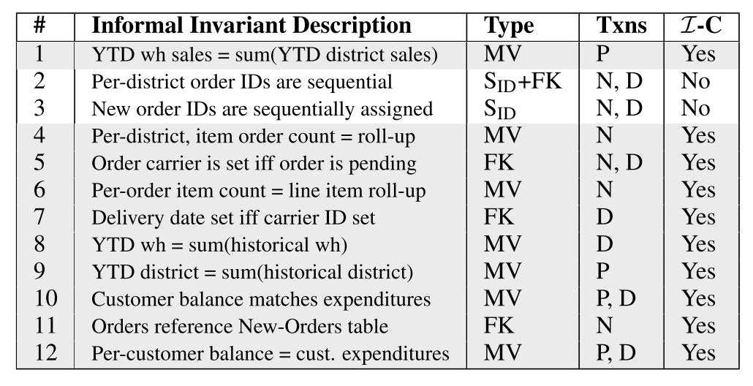
Case Study
TPC-C Benchmark
Industry standard OLTP
Simulates order entry
Read-write Mix
3 Read-Write Tx
2 Read-Only Tx

Slide 25
Case Study
Varying concurrency
Varying Contention
Varying Distribution
Notes:
8 nodes on a single data-center

Slide 26
Case Study

Slide 27
Conclusions
Distributed Systems suffer from coordination
Most applications over-coordinate
TPC-C: 10/12 ICT holds
Ruby on Rails: ~86% of invariants are IC
Understand application requirements
Not all safety guarantees requires coordination
Invariant Confluence
Necessary and sufficient condition for Coordination-free Execution

