Slide 1
Apache Spark
Resilient Distributed Datasets: A Fault-Tolerant Abstraction for In-Memory Cluster Computing
Aditya Waghaye
October 3, 2016
CS848 – University of Waterloo

Slide 2
Introduction
MapReduce, Spark Overview, Spark vs MapReduce

Slide 3
MapReduce
Pioneered commodity machine cluster model
Scalable and fault-tolerant programming model
Acyclic dataflow through high-level operators

Slide 4
MapReduce Deficiencies
Inefficient for multi-pass applications that reuse intermediate results:
Iterative algorithms: machine learning, PageRank
Interactive analytics: only possible with Pig/Hive
Streaming applications with aggregate state
In short, acyclic data-flow is suboptimal for these application types.

Slide 5
MapReduce Deficiencies
MapReduce use cases show two major limitations:
Difficulty of programming directly
Performance bottlenecks (disk read/write, network)
MapReduce does not translate well to large applications.
People built specialized systems as workarounds.

Slide 6
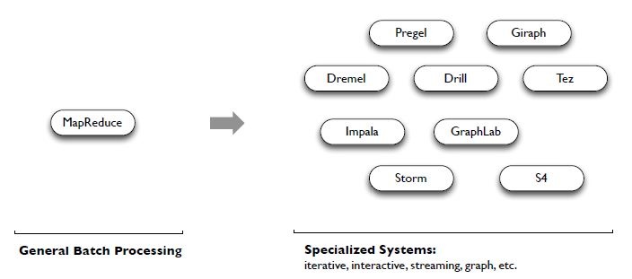
Specialized MapReduce
The State of Spark, and Where We’re Going Next
Matei Zaharia
Spark Summit (2013) - youtu.be/nU6vO2EJAb4

Slide 7
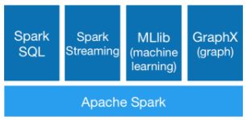
Why Spark?
Spark’s goal has been to generalize MapReduce on top of a core engine.
Key additions:
Leverages distributed memory
Replication-free fault tolerance
Interactive data-mining via Scala interpreter

Slide 8
Spark Key Points
Handles batch, streaming, and interactive processing in a single framework
Native integration with Java, Python, and Scala
Higher abstraction programming and ease of use
More operators than just Map/Reduce (join, filter, flatMap, etc.)

Slide 9
Spark vs MapReduce
Generalized processing patterns
=> Unified engine for multiple use cases
Generational differences in hardware
=> Use of large off-heap memory
Functional programming and ease of use
=> Apps easier to write and maintain
Locality based task scheduling
=> Less expensive data shuffles

Slide 10
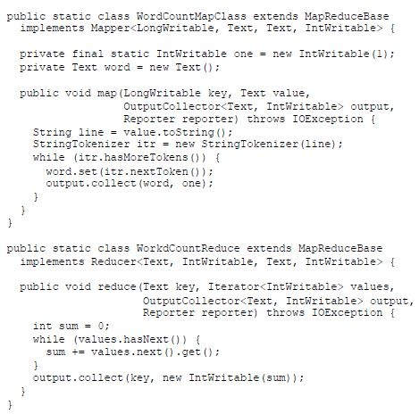
Spark vs MapReduce

Slide 11
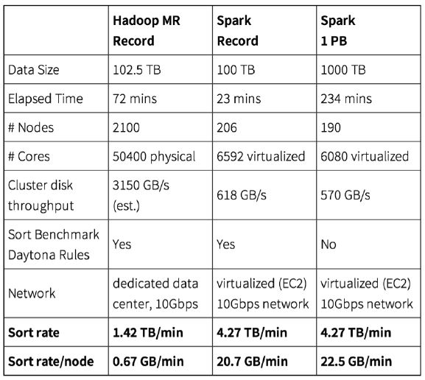
Spark vs MapReduce

Slide 12
Spark Essentials
RDDs, Transformations, Actions, Runtime Model

Slide 13
Spark Essentials - RDD
Resilient Distributed Datasets (RDD) are the main abstraction in Spark – a read-only collection of objects partitioned across machines that can be rebuilt through the notion of lineage
RDDs can be constructed:
From a file on distributed storage (HDFS)
By partitioning a Scala collection (e.g. array)
By transforming an existing RDD (e.g. map,flatMap)
By changing persistence of a existing RDD

Slide 14
Spark Essentials – RDD
There are two types of operations on RDDs:
Transformations (lazy – not computed immediately)
Actions (return a value to app, or storage)
A transformed RDD is recomputed when an action runs on it.
But it can be persisted into memory or disk.

Slide 15
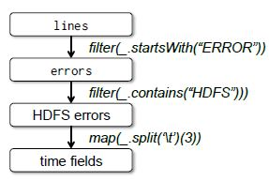
Spark Essentials – RDD Lineage
1. lines = spark.textFile(“hdfs://..”)
2. errors = lines.filter(_.startsWith(“ERROR”))
3. errors.persist()
4. errors.count()
5. errors.filter(_.contains(“HDFS”))
.map(_.split(‘\t’)(3))
.collect()
Lineage is based on course-grained transformations
Lineage helps avoid the overhead from checkpointing RDDs

Slide 16
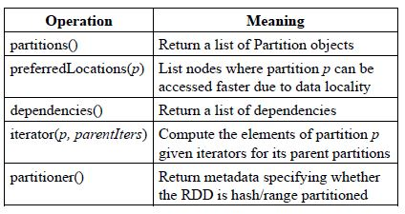
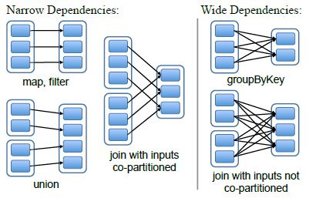
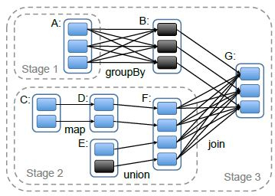
Spark Essentials – RDD Representation
Dependency types:
Narrow
Wide

Slide 17
Spark Essentials – Transformations
Transformations create a new RDD from an existing one
Lazy
Recomputed as needed
Used to build lineage graph of base dataset
Recover lost data partitions
Optimize required data computations

Slide 18
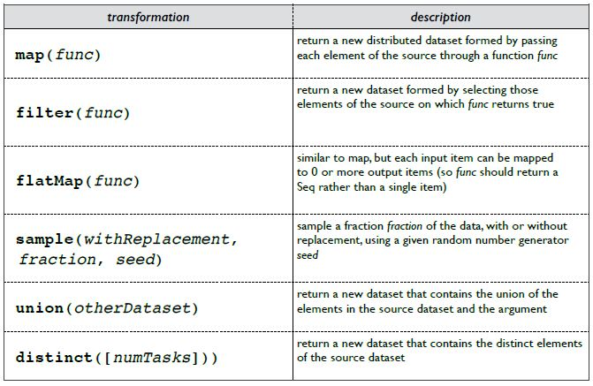
Spark Essentials – Transformations

Slide 19
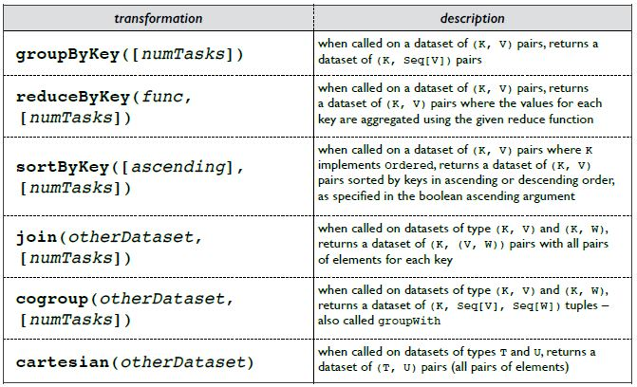
Spark Essentials – Transformations

Slide 20
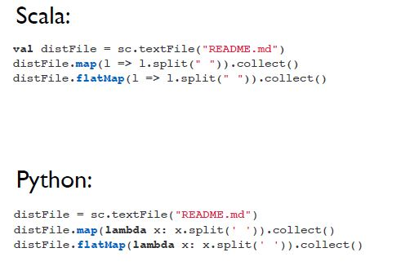
Spark Essentials – Transformations
Collection of lines
Closures

Slide 21
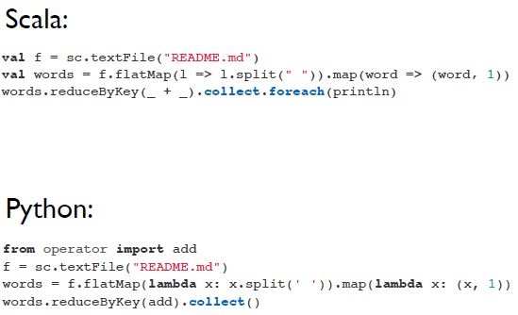
Spark Essentials – Actions
Actions launch a computation to return a value to the driver program or write to external storage

Slide 22
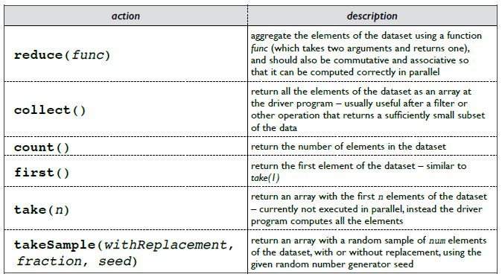
Spark Essentials – Actions

Slide 23
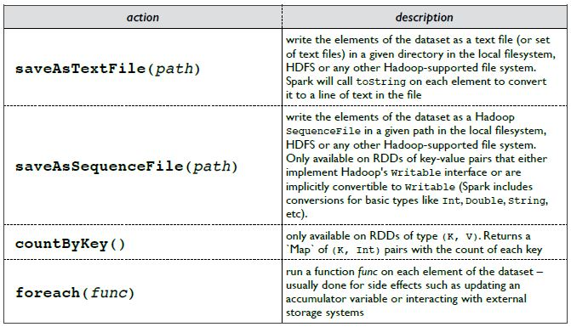
Spark Essentials – Actions

Slide 24
Spark Essentials – RDD Persistence
Spark can persist an RDD in memory across operations
Has to be explicitly stated
Each node stores in memory slices of the dataset for reuse in future actions
Cached RDD is fault-tolerant
Can be computed using lineage graph

Slide 25
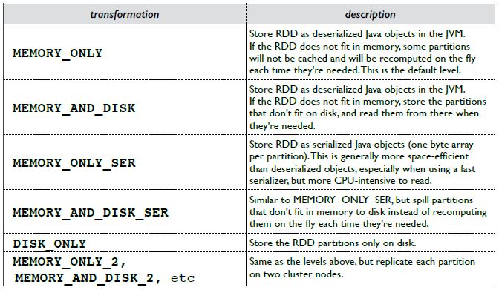
Spark Essentials – RDD Persistence

Slide 26
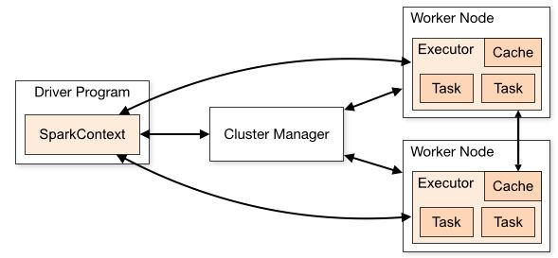
Spark Essentials – Runtime Model
Driver program connects to a cluster manager to allocate resources
Acquires Executors on cluster nodes – run parallel tasks/cache data
Sends application code to executors
Sends tasks for executors to run

Slide 27
Spark Deconstructed
Quick Example Runthrough

Slide 28
Spark Deconstructed – Log Mining
// load error messages from a log into memory
// then interactively search for various patterns
// base RDD
val lines = sc.textFile("hdfs://...")
// transformed RDDs
val errors = lines.filter(_.startsWith("ERROR"))
val messages = errors.map(_.split("\t")).map(r => r(1))
messages.cache()
// action 1
messages.filter(_.contains("mysql")).count()
// action 2
messages.filter(_.contains("php")).count()

Slide 29
Spark Deconstructed – Log Mining
// load error messages from a log into memory
// then interactively search for various patterns
// base RDD
val lines = sc.textFile("hdfs://...")
// transformed RDDs
val errors = lines.filter(_.startsWith("ERROR"))
val messages = errors.map(_.split("\t")).map(r => r(1))
messages.cache()
// action 1
messages.filter(_.contains("mysql")).count()
// action 2
messages.filter(_.contains("php")).count()

Slide 30
Spark Deconstructed – Log Mining
At program start we have Spark running on a cluster and submitting application code to it. Below is the operator graph for messages:

Slide 31
Spark Deconstructed – Log Mining
// load error messages from a log into memory
// then interactively search for various patterns
// base RDD
val lines = sc.textFile("hdfs://...")
// transformed RDDs
val errors = lines.filter(_.startsWith("ERROR"))
val messages = errors.map(_.split("\t")).map(r => r(1))
messages.cache()
// action 1
messages.filter(_.contains("mysql")).count()
// action 2
messages.filter(_.contains("php")).count()
Worker
Driver
Worker
Worker

Slide 32
Spark Deconstructed – Log Mining
// load error messages from a log into memory
// then interactively search for various patterns
// base RDD
val lines = sc.textFile("hdfs://...")
// transformed RDDs
val errors = lines.filter(_.startsWith("ERROR"))
val messages = errors.map(_.split("\t")).map(r => r(1))
messages.cache()
// action 1
messages.filter(_.contains("mysql")).count()
// action 2
messages.filter(_.contains("php")).count()
Worker
Block 1
Driver
Worker
Block 2
Worker
Block 3

Slide 33
Spark Deconstructed – Log Mining
// load error messages from a log into memory
// then interactively search for various patterns
// base RDD
val lines = sc.textFile("hdfs://...")
// transformed RDDs
val errors = lines.filter(_.startsWith("ERROR"))
val messages = errors.map(_.split("\t")).map(r => r(1))
messages.cache()
// action 1
messages.filter(_.contains("mysql")).count()
// action 2
messages.filter(_.contains("php")).count()
Worker
Block 1
Driver
Worker
Block 2
Worker
Block 3

Slide 34
Spark Deconstructed – Log Mining
// load error messages from a log into memory
// then interactively search for various patterns
// base RDD
val lines = sc.textFile("hdfs://...")
// transformed RDDs
val errors = lines.filter(_.startsWith("ERROR"))
val messages = errors.map(_.split("\t")).map(r => r(1))
messages.cache()
// action 1
messages.filter(_.contains("mysql")).count()
// action 2
messages.filter(_.contains("php")).count()
Worker
Read
HDFS
Data
Block 1
Driver
Worker
Read
HDFS
Data
Block 2
Worker
Read
HDFS
Data
Block 3

Slide 35
Spark Deconstructed – Log Mining
// load error messages from a log into memory
// then interactively search for various patterns
// base RDD
val lines = sc.textFile("hdfs://...")
// transformed RDDs
val errors = lines.filter(_.startsWith("ERROR"))
val messages = errors.map(_.split("\t")).map(r => r(1))
messages.cache()
// action 1
messages.filter(_.contains("mysql")).count()
// action 2
messages.filter(_.contains("php")).count()
Worker
Cache 1
Block 1
Driver
Worker
Cache 2
Block 2
Worker
Cache 3
Block 3

Slide 36
Spark Deconstructed – Log Mining
// load error messages from a log into memory
// then interactively search for various patterns
// base RDD
val lines = sc.textFile("hdfs://...")
// transformed RDDs
val errors = lines.filter(_.startsWith("ERROR"))
val messages = errors.map(_.split("\t")).map(r => r(1))
messages.cache()
// action 1
messages.filter(_.contains("mysql")).count()
// action 2
messages.filter(_.contains("php")).count()
Worker
Cache 1
Block 1
Driver
Worker
Cache 2
Block 2
Worker
Cache 3
Block 3

Slide 37
Spark Deconstructed – Log Mining
// load error messages from a log into memory
// then interactively search for various patterns
// base RDD
val lines = sc.textFile("hdfs://...")
// transformed RDDs
val errors = lines.filter(_.startsWith("ERROR"))
val messages = errors.map(_.split("\t")).map(r => r(1))
messages.cache()
// action 1
messages.filter(_.contains("mysql")).count()
// action 2
messages.filter(_.contains("php")).count()
Worker
Cache 1
Block 1
Driver
Worker
Cache 2
Block 2
Worker
Cache 3
Block 3

Slide 38
Spark Deconstructed – Log Mining
// load error messages from a log into memory
// then interactively search for various patterns
// base RDD
val lines = sc.textFile("hdfs://...")
// transformed RDDs
val errors = lines.filter(_.startsWith("ERROR"))
val messages = errors.map(_.split("\t")).map(r => r(1))
messages.cache()
// action 1
messages.filter(_.contains("mysql")).count()
// action 2
messages.filter(_.contains("php")).count()
Worker
Cache 1
Block 1
Driver
Worker
Cache 2
Block 2
Worker
Cache 3
Block 3

Slide 39
Thank You!
Questions?

