Slide 1
Spark vs Storm in Pairs Trading Predictions
Aditya Waghaye
Irene (Ying Yu)
CS848 - Dec. 5th, 2016

Slide 2
Pairs Trading - Background
Key Notion: Asset pricing can be viewed in relative terms
Asset prices converge to long-term equilibrium
Pricing equilibrium for near-equivalent shares
Hedging
Short sell an overvalued asset
Long buy an undervalued asset
Focus is on Cointegration approach to Pairs Trading
Notes:
The key notion is that asset pricing can be viewed in absolute and relative terms. A pairs trading strategy speculates on the convergence of securities with similar characteristics to a long-term stable equilibrium. you are betting on the preservation of the "long run equilibrium"
pairs trading relies on the principle of equilibrium pricing for near-equivalent shares
Hedging: notions of relative pricing are implemented by shorting an over-valued security and going long an under-valued one, with the expectation that the mispricing will correct itself, at which point the trade is closed out.
The resulting portfolio of ‘pairs’ is typically constructed in such a way that it has negligible exposure to the market.

Slide 3
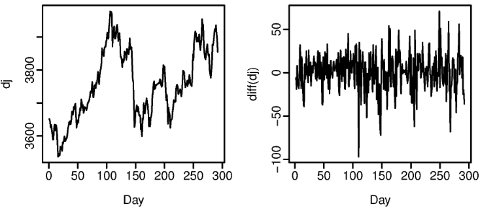
Cointegration - Glossary
Stationary Time Series: Properties do not depend on observation time
Cointegration is applied to non-stationary I(1) time series
Trends and seasonality
Differencing
Notes:
Compute the differences between consecutive observations of a time series
Dow Jones index data was non-stationary, but the daily changes were.

Slide 4
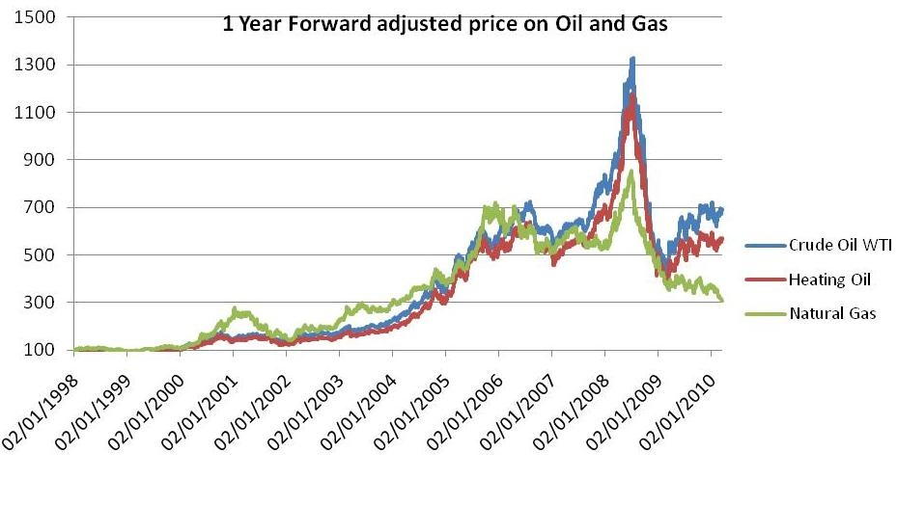
Cointegrated Time series
Random Walk model
Two non-stationary time series X and Y are cointegrated if:
They are both I(1)
Some linear combination of X and Y is stationary
Notes:
Other examples:
Income and consumption: as income increases/decreases, so too does consumption.
Size of police force and amount of criminal activity
Stock ticker price time series are historically mean reverting so I(1)

Slide 5
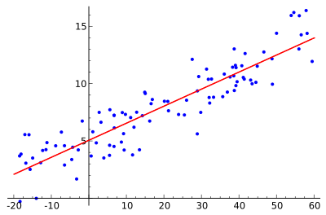
Detect Cointegration
Steps:
Check that two time series X and Y are I(1)
Estimate the cointegrating relationship Y_{t} = aX_{t} + e_{t}
Check that cointegrating regression residuals e_{t} are stationary
Notes:
Residuals are deviations of actual time series observations from the fitted function observations
Goal of cointegration is to find an equilibrium relationship between two time series that individually aren’t in equilibrium

Slide 6
Pairs Trading Example
Consider Cointegrated relationship: X - 2Y = Z
X tends to be priced twice as high as Y
Z is stationary series of zero mean
If X > 2Y => sell X and buy Y
If X < 2Y => buy X and sell Y

Slide 7
Project Goals
Central Objective: Evaluate Spark Streaming vs Storm
Implement Cointegration algorithm in both frameworks
Evaluate computation time on similar dataset
Evaluate computation latency on each framework
Usage differences and benchmarking considerations

Slide 8
Benchmarks design
To compare two systems, main operations:
Read time series data from kafka
Run algorithm on each system
Run tests
Store relevant pairs into database

Slide 9
Benchmark design
Topic
events
Apache Kafka
partition1
Kafka clusters
events
partition2
partition3
events
parse json
OLS
Dickey Fuller Test
Store
key-value

Slide 10
Framework
Storm Streaming
spout
1
kafka
1
spout
bolt
2
bolt
1
spout
topology

Slide 11
Framework
Spark streaming
Dstream
RDD
transformation
kafka
Dstream
RDD
Dstream
RDD

Slide 12
How to measure the performance
Time needed to build the model
The latency to test the model
With backup pressure
storm
APPL: [
{C:GOOGLE,R:Y=AX+B},
{C:MICRO,R:Y=CX+D}
...] ...
kafka
redis
spark

Slide 13
Differences and considerations
Spark streaming vs. Storm
Micro batching vs. Pure streaming
Increase batch duration
Maintain throughput
Increase parallelism

Slide 14
THANKS!

