Slide 1
Cof low
A Networking Abstraction for Distributed
Data-Parallel Applications
by Mosharaf Chowdhury
Aditya Waghaye
November 21, 2016
CS848 - University of Waterloo
UC Berkeley

Slide 2
Introduction
Modern Applications/Datacenters, Application-Agnostic Networking, Coflow Primer

Slide 3
Modern Distributed Applications
Process massive datasets
Run in parallel on 10-1000 machine clusters
Wide spectrum of use cases:
Interactive Analytics
Graph Processing
Machine Learning
Interact with cluster managers for resources, scheduling, and error handling
Communication involves large data transfers over the network

Slide 4
Modern Datacenters
10,000-100,000 machines
Hundreds of racks
High capacity networking
Storm
Spark-Streaming
Pregel
GraphLab
GraphX
DryadLINQ
Spark
Dremel
MapReduce
Hadoop
Dryad
Hive
2005
2010
2015
Notes:
So, we are building big datacenters with thousands of machines, and a high capacity network connecting them.
And to make use of such large datacenters in an efficient, fault-tolerant, and scalable way, we are building distributed data analytics systems.
It started with Google publishing the MapReduce paper in 2004.
Soon, it was followed by Hadoop and Microsoft Dryad.
Soon after, simple analytics were replaced by more complex higher-level engines like Hive for Hadoop and DryadLINQ over Dryad.
Around 2010, we open-sourced Spark for in-memory, iterative computing, which has grown to become a great success today!
As time went on, we have seen specialized frameworks for graph queries, for streaming analytics, and for approximate queries.
And this figure only shows the tip of the iceberg!
We are seeing newer and newer programming models, resource schedulers, and datacenter designs, all aiming different aspects of big data analytics.

Slide 5
Transfers data from a source
to a destination
Flow
Independent unit of allocation, sharing, load balancing, and/or
prioritization

Slide 6
So what’s the problem?
Data-parallel applications and networks are out of touch:
Applications holistically care about their flows
Current networks treat each flow independently
No widely adopted communication paradigm
Potential for performance loss
Networking research has focused on flow completion times and per-flow fairness
Focus is still on independent point-to-point flows
Application needs are ignored

Slide 7
App-Agnostic vs App-Aware flows
Scenario:
Application 1: Two flows of size 1 – c/1 + c (orange)
Application 2: One flow of size 1 (blue)
Both start at same time
Bandwidth
Bandwidth
1
2
3
1
2
3
time
time
Per-flow fairness
App-aware fairness

Slide 8
App-Agnostic vs App-Aware flows
Scenario:
Application 1: Two flows of size 1 – c/1 + c (orange)
Application 2: One flow of size 1 (blue)
Both start at same time
Bandwidth
Bandwidth
1
2
3
1
2
3
time
time
Per-flow Prioritization
App-aware prioritization

Slide 9
App-Agnostic Networking = Bad
Optimization of irrelevant metrics
Avg. flow completion/Per flow fairness
Simplistic
Cannot represent collective flows of even a single stage
No reusable distributed communication pattern
Shuffle/Broadcast/Aggregate
Every app for itself
Custom communication libraries mean there is no shared global objective
Lowered usability
Multiple apps in a shared cluster must be tuned differently

Slide 10
Why App-Agnostic Networking = Bad
r₁
r₂
r₁
r₂
Datacenter
Network
1
1
2
2
s₁
s₂
s₃
s₁
s₂
s₃
3
3
Input Links
Output Links
Notes:
Let’s take a simple example to see why flow-based approaches fall short.
In this example, we have a shuffle with three senders and two receivers.
The tasks are represented by circles.
The six arrows represent the six flows between these tasks.
Each rectangle represent one unit of data.
For example, sender s2 has two units of data to send to receiver r1 and two for receiver r2.
This is a logical plan.
But what do this shuffle look like in the datacenter network?
Now consider a datacenter without any congestion in its core.
We can assume this because modern datacenters have full bisection bandwidth, pushing resource contention to the edge links.

Slide 11
Why App-Agnostic Networking = Bad
r₁
r₂
r₁
r₂
Datacenter
Network
s₁
1
1
r₁
s₂
2
2
r₂
s₁
s₂
s₃
s₁
s₂
s₃
s₃
3
3

Slide 12
Why App-Agnostic Networking = Bad
s₁
Datacenter
Network
r₁
1
1
s₂
2
2
r₂
s₃
3
3
Per-Flow Fair Sharing
Shuffle
Completion
Time = 5
Solutions focusing on flow completion time cannot further decrease the shuffle completion time
Link to r₁
3
3
5
Link to r₂
3
Avg. Flow
Completion
Time = 3.66
3
5
2
time
4
6

Slide 13
Improve App-level Performance
s₁
Datacenter
Network
r₁
1
1
Slow down faster flows to accelerate slower flows
s₂
2
2
r₂
s₃
3
3
Per-Flow Fair Sharing
Data-Proportional Allocation
Per-Flow Fair Sharing
Shuffle
Completion
Time = 5
Shuffle
Completion
Time = 4
Link to r₁
3
Link to r₁
4
3
4
5
4
Link to r₂
3
Avg. Flow
Completion
Time = 3.66
Link to r₂
4
Avg. Flow
Completion
Time = 4
3
4
5
4
2
time
4
6
2
time
4
6

Slide 14
Coflow Primer – Motivation/Features
A communication stage of a distributed app cannot complete until all its flows are complete (all-or-nothing)
Completion/fair sharing of singular flows are irrelevant
Coflows represent a collection of flows
Coflows allow for network level optimizations that incorporate application level objectives

Slide 15
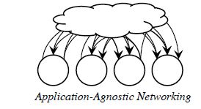
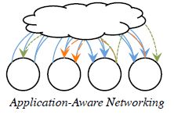
Coflow Primer – Motivation/Features

Slide 16
Coflow Primer – Characterizations
Coflows can be characterised by:
Length: Size (bytes) of its largest flow
Width: Total number of flows in a coflow
Skew: Coefficient of variation of flow sizes
Size: The sum of flow sizes (bytes)

Slide 17
Coflow Primer – Scheduling
Clairvoyant Inter-Coflow Scheduling
Coflow information (width,size) known before scheduling
Uses Minimum Allocation for Desired Duration (MADD)
Smallest Bottleneck first (improves upon shortest-first)
Non-Clairvoyant Inter-Coflow Scheduling
Coflow information unavailable while scheduling
Intra-Coflow Scheduling
Shuffle (Clairvoyant) - MADD
Broadcast (Non-Clairvoyant) – Cornet (BitTorrent like)

Slide 18
Cornet – Cooperative Broadcast
Key Idea: Broadcasting in distributed apps is similar to data distribution mechanisms like BitTorrent
Cornet is BitTorrent like and optimized for datacenters
Split data into blocks and distribute across cluster nodes
On Receive: Request/Gather blocks from other nodes
Receivers of blocks become senders of those blocks
Differences from BitTorrent
Larger data blocks (4mb)
No incentives (there are no selfish peers)
Topology aware (receivers choose senders on same rack)

Slide 19
Scheduler Architecture
Master coordinates coflows
Apps register coflows with the master using coflow API
Master aggregates flow interactions and determines schedules
Daemon on each cluster node enforces schedule from master

Slide 20
Background
Data-Parallel Applications, Clos Network Topology, Coflow Primer

Slide 21
Parallel Applications - MapReduce
Multi-stage dataflow
Computation interleaved with communication
Computation Stage (e.g., Map, Reduce)
Distributed across many machines
Tasks run in parallel
Communication Stage (e.g., Shuffle)
Between successive computation stages
Reduce Stage
A communication stage cannot complete until all the data have been transferred
Shuffle
Map Stage
Notes:
Yes, big data applications can differ a lot, ranging from SQL queries to machine learning algorithms.
But they are quite similar as well.
Deep down, most big data applications are multi-stage dataflows with interleaved computation and communication stages.
Let’s take the simplest example, a MapReduce application.
It has two computation stages Map and Reduce, and in between there is a communication stage called shuffle.
Computation tasks run in parallel distributed throughout the cluster.
The shuffle stage transfers outputs of all map tasks to the reduce tasks, creating an many-to-many communication pattern.
Note that the shuffle has a unique collective behavior.
It cannot complete all the data have been transferred to the next computation stage.
Modern data-parallel applications consist of many such stages, not just two.
But the collective behavior of communication is still very common.

Slide 22
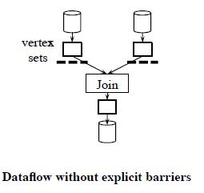
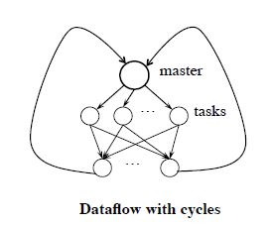
Parallel Applications – Dataflow Pipelines

Slide 23
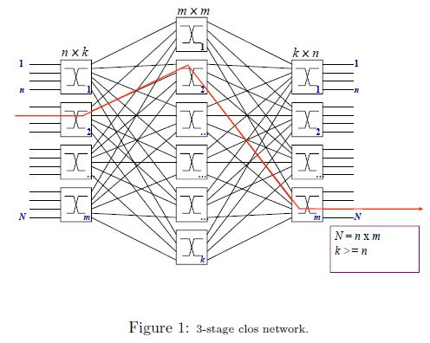
Clos Network Topology
Connections between a large number of input and output ports can be made using small sized switches
Exactly one connection between each ingress switch and middle stage switch
Exactly one connection between each middle switch and egress switch

Slide 24
Switch-Centric Datacenters
The most widely deployed datacenter topology
Uses a modified Clos topology to emulate a fat tree
Can provide full bisection bandwidth
Bisection Bandwidth is the max bandwidth measured after bisecting the network graph at any point.
In full bisection bandwidth networks, machines on one side can use their entire bandwidth to communicate with machines on the other side.

Slide 25
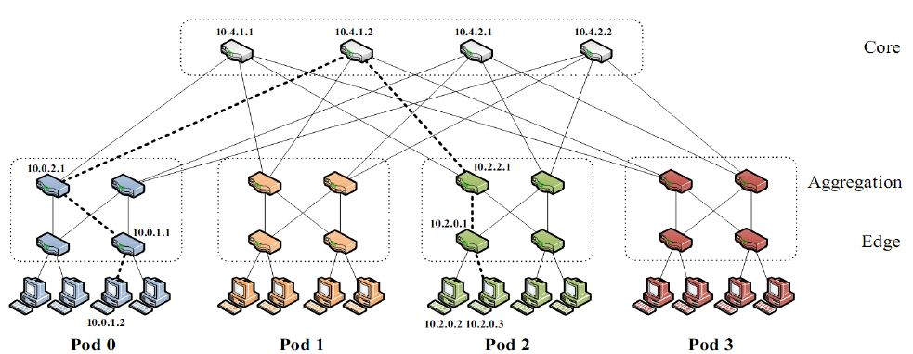
Switch-Centric Datacenters
K-ary fat tree: three-layer topology (edge, aggregation and core)
each pod consists of (k/2)^2 servers & 2 layers of k/2 k-port switches
each edge switch connects to k/2 servers & k/2 aggr. switches
each aggr. switch connects to k/2 edge & k/2 core switches
(k/2)^2 core switches: each connects to k pods

Slide 26
Coflows
Definition, Benefits of Inter-Coflow, Non-Clairvoyant Scheduling

Slide 27
Coflows
A coflow is a collection of flows that share a common performance goal, e.g., meet a deadline.
Flows of a coflow are independent in that the input of one does not depend on the output of another.
Coflows can be:
Clairvoyant (size known beforehand, e.g., MapReduce)
Non-Clairvoyant (e.g., task failuire recovery)

Slide 28
Broadcast
Single Flow
Aggregation
All-to-All
Parallel Flows
Shuffle
Notes:
Using coflows as building blocks, we can now represent the entire dataflow as a sequence of computation stages and coflows.
In this example, we have three coflows a shuffle, an aggregation, and a broadcast.
An all-to-all communication pattern, as seen in many graph analytics and linear algebra platforms, is also a coflow.
Similarly, the parallel flows pattern, as used by replication flows when we write data or read from remote machines is also a coflow.
In fact, the simple flow abstraction we have used forever is also a coflow with just one flow.
However, in a shared cluster, there are many different jobs from many different users and frameworks coexisting.
What happens when all of these applications start using coflows?

Slide 29
Benefits of Inter-Coflow Scheduling
Coflow 1
Coflow 2
6 Units
Link 2
3 Units
2 Units
Link 1
Fair Sharing
Smallest-Flow First^{1,2}
The Optimal
L2
L2
L2
L1
L1
L1
2
time
4
6
2
time
4
6
2
time
4
6
Coflow1 comp. time = 5
Coflow2 comp. time = 6
Coflow1 comp. time = 5
Coflow2 comp. time = 6
Coflow1 comp. time = 3
Coflow2 comp. time = 6
Notes:
Let us see the potentials of inter-coflow scheduling through a simple example.
We have two coflows: coflow1 in black with one flow on link1 and coflow2 with two flows.
Each block represent a unit of data.
Assume, it takes a unit time time to send each unit of data.
Let’s start with considering what happens today.
In this plot, we have time in the X-axis and the links on Y-axis.
Link1 will be almost equally shared between the two flows from two different coflows and the other link will be used completely by coflow2’s flow.
After, 6 time units, both coflows will finish.
Recently, there has been a lot of focus on minimizing flow completion times by prioritizing flows of smaller size.
In that case, the orange flow in link1 will be prioritized over the black flow.
After 3 time units, the orange flow will finish.
Note that coflow2 hasn’t finished yet, because it still has 3 more data units from its flow on link2.
Eventually, when all flow finishes, the coflow completion times remain the same even thought the flow completion time has improved.
The optimal solution for minimizing application-level performance, in this case, would be to let the black coflow finish first.
As a result, we can see application-level performance improvement for coflow1 without any impact on the other coflow.
In fact, it is quite easy to show that significantly decreasing flow completion times might still not result in any improvement in user experience.

Slide 30
Ordering in Clairvoyant Inter-Coflow Sched.
C₁ ends
C₂ ends
C₃ ends
Datacenter
O₁
6
3
1
1
O₂
5
2
2
O₃
3
5
3
13
19
3
3
Time
3
Shortest-First
(Total CCT = 35)
 | C₁ | C₂ | C₃
Length | 3 | 5 | 6

Slide 31
Ordering in Clairvoyant Inter-Coflow Sched.
C₁ ends
C₂ ends
C₃ ends
C₁ ends
C₃ ends
C₂ ends
Datacenter
O₁
O₁
6
3
1
1
O₂
O₂
5
2
2
O₃
O₃
3
5
3
13
19
3
9
19
3
3
Time
Time
3
Shortest-First
(35)
Smallest-Bottleneck
(31)
 | C₁ | C₂ | C₃
Bottleneck | 3 | 10 | 6

Slide 32
Non-Clairvoyant Coflows
How do we schedule coflows without complete knowledge?
Coflow Aware LAS(Least Attained Service):
Set priority that decreases with how much a coflow has already sent
The more a coflow has sent, the lower its priority
Smaller coflows finish faster
Use total size of coflows to set priorities
Avoids the drawbacks of full decentralization

Slide 33
Discretized Coflow-Aware LAS (D-CLAS)
Priority discretization
Change priority when total size exceeds predefined thresholds
Scheduling policies
FIFO within the same queue
Prioritization across queue
Weighted sharing across queues
Guarantees starvation avoidance
Lowest-
Priority
Queue
FIFO
Q_{K}
…
FIFO
Q₂
FIFO
Q₁
Highest-
Priority
Queue
Notes:
Instead of changing priorities continuously, we change priorities on predefined thresholds of sizes.
We can think of these thresholds to form a number of logical queues to hold coflows.
Coflows within the same thresholds have the same priority and scheduled in the FIFO order, whereas the ones in different thresholds have different priorities.
Consequently, we combine FIFO and prioritization without complete knowledge of coflows.
<DESCRIBE>
However, how do we determine the thresholds?
It turns out that determining the optimal number of queues is difficult even for a single link.
We use exponentially spaced queue thresholds for practical reasons.
First, it keeps the number of queues small.
Second, it allows each slave to take local decisions with loose coordination to calculate global coflow sizes.
Finally, small coflows are scheduled in the FIFO order avoiding global coordination overheads.

Slide 34
Conclusions
SSD and memory based systems have led to network infrastructure being the primary bottleneck
Coflows are more appropriate for distributed applications rather than point-to-point flows
Coflows allow for application-aware networks that enforce app needs in their scheduling/prioritization

Slide 35
Questions?

