Slide 1
Question Answering
Alexandra Vtyurina
Bahareh Sarrafzadeh

Slide 2
Question Answering
One of the oldest NLP tasks (punched card systems in 1961)
Simmons, Klein, McConlogue. 1964. Indexing and Dependency Logic for Answering English Questions. American Documentation 15:30, 196-204
Notes:
One of the ealiest QA systems appeared in 1960s.
It would answer questions like “what do worms eat?”, parse it into its dependecy format
And matching them against a large dataset of answers.
So the idea of finding an answer that looks like a question, but answers it is an old intiution.

Slide 3
Question answering in TREC
annual competition
TREC-1 - 1992
many QA approaches start there
factoid and complex questions
Notes:
Before we start discussing QA systems, I would like to mention an annual competition, called TREC. Many algorithms for IR in general and QA in particular are first tried at TREC.

Slide 4
Question Answering: IBM’s Watson
Won Jeopardy on February 16, 2011!
WILLIAM WILKINSON’S
“AN ACCOUNT OF THE PRINCIPALITIES OF WALLACHIA AND MOLDOVIA”
INSPIRED THIS AUTHOR’S
MOST FAMOUS NOVEL
Bram Stoker
Notes:
In 2011 IBM’s Watson won Joepardy challenge.
The questions there are not posed as usually, but rather have placeholders in place of an answer. Like ‘this author’.

Slide 5
Question Answering: IBM’s Watson
Rhyme time category
Before and After Goes to the Movies
It’s where Pele stores his ball.
Film of a typical day in the life of the Beatles, which includes running from bloodthirsty zombie fans in a Romero classics.
soccer locker
A Hard Day’s Night of the Living Dead
Notes:
Another interesting categories included Rhyme Time category, where two subclue answers must rhyme with each other.
The two subclues here are: Pele ball (which implies soccer) and where stores (cabinet, drawer, locker, etc)
The Category ‘Before and after category’ contains two subclues which overlap typically with one word.
In the example here the first part is assumes “Hard Day’s Night” and the second - Night of the Living Dead. Which when combined together, produce the answer.

Slide 6
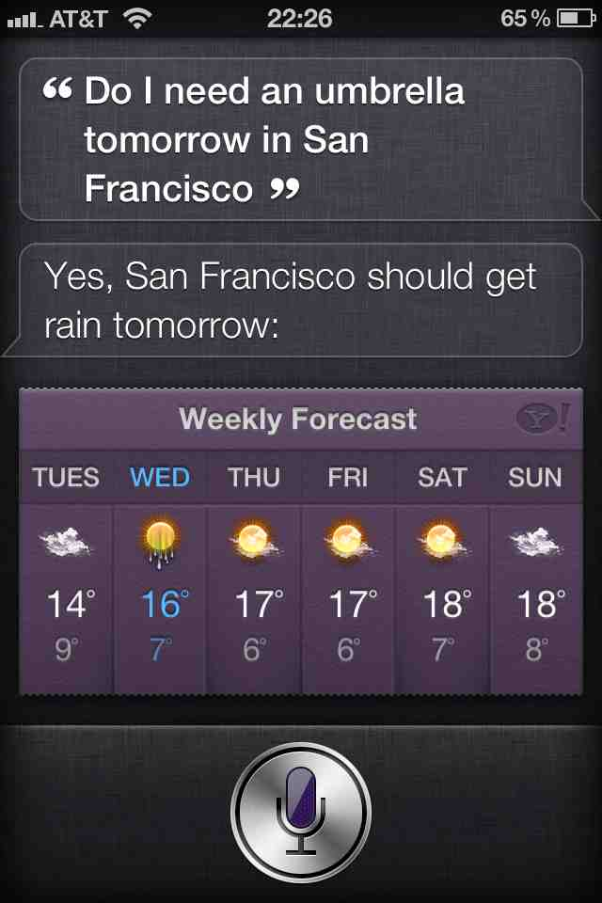
Apple’s Siri
Notes:
There’re a lot of tricks you can do with Apple’s Siri.

Slide 7
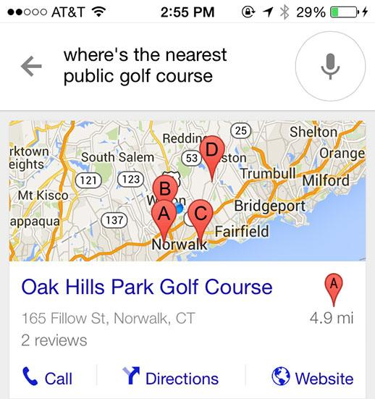
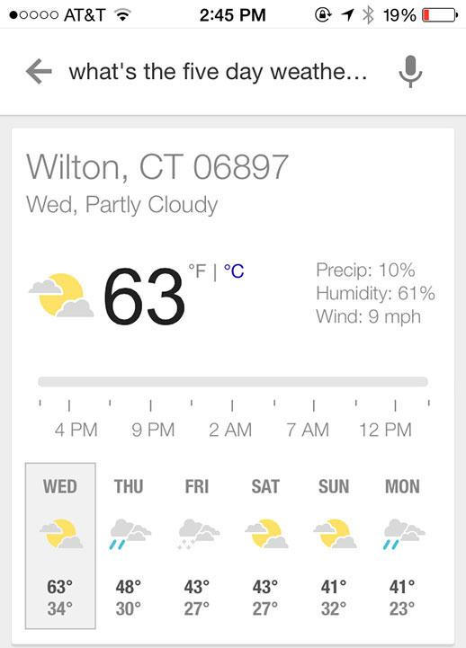
Google now
Notes:
Google’s voice search does not have a name, but it is also quite powerful in a sense that it can answer many questions, has access to weather channels and maps. (Probably also your calendar, contacts, etc). And therefore can adjust to your needs.

Slide 8
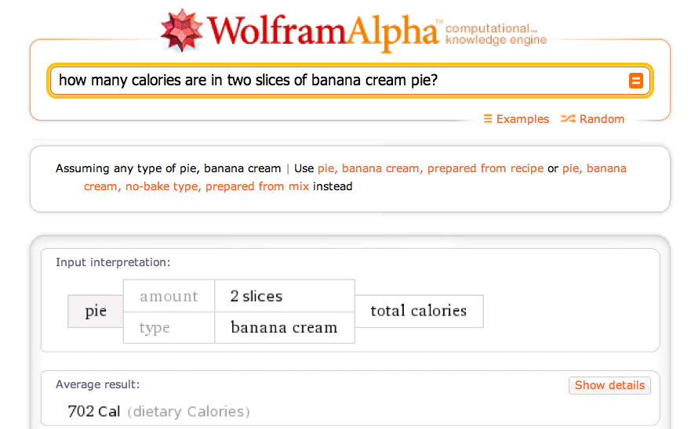
Wolfram Alpha
Notes:
Wolfram can answer

Slide 9
Types of Questions in Modern Systems
Factoid questions
Who wrote “The Universal Declaration of Human Rights”?
How many calories are there in two slices of apple pie?
What is the average age of the onset of autism?
Where is Apple Computer based?
Complex (narrative) questions:
In children with an acute febrile illness, what is the efficacy of acetaminophen in reducing fever?
What do scholars think about Jefferson’s position on dealing with pirates?
Notes:
Factoid questions can be answered by some short fact, often a named entity.
Complex questions require a longer, more elaborative answer.
While factoid questions are widely used in commercial systems, answering complex questions is still an open research topic.
The first part of the presentation we’ll look at answering factoid questions and then move on to complex questions.

Slide 10
Commercial systems: mainly factoid questions
Where is the Louvre Museum located? | In Paris, France
What’s the abbreviation for limited partnership? | L.P.
What are the names of Odin’s ravens? | Huginn and Muninn
What currency is used in China? | The yuan
What kind of nuts are used in marzipan? | almonds
What instrument does Max Roach play? | drums
What is the telephone number for Stanford University? | 650-723-2300
Notes:
Factiod questions may require a location, named entity, a phone number as an answer.

Slide 11
Paradigms for QA
IR-based approaches
TREC; IBM Watson; Google
Knowledge-based and Hybrid approaches
IBM Watson; Apple Siri; Wolfram Alpha; True Knowledge Evi
Notes:
There’re two main approaches for question answering - IR-based methods and KB-methods. And Hybrid approaches, that combine the two.
IT-based approach use the Web to find a short string that would answer the question.
KB-based approaches use knowledge bases to answer a question. We will talk about those later.

Slide 12
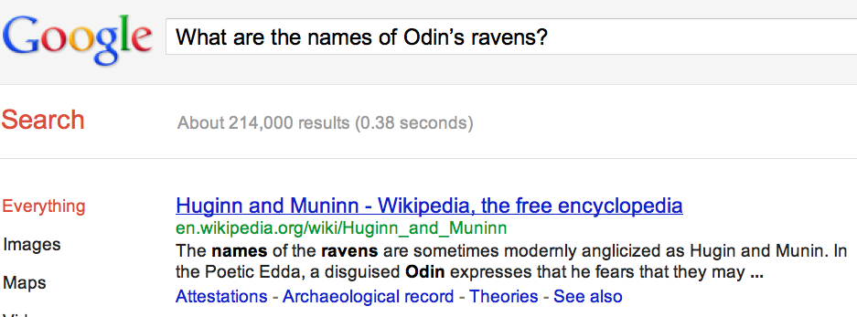
Many questions can already be answered by web search
a
Notes:
A simple web search already provides an answer to the question (which is the intuition behind IR-based approach)

Slide 13
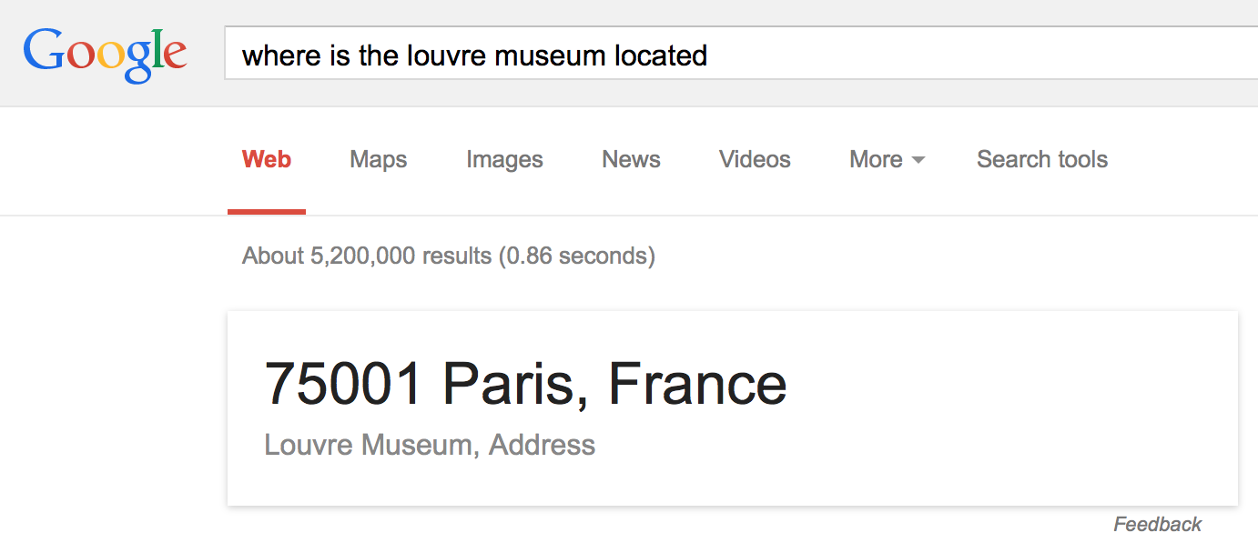
IR-based Question Answering
Notes:
Sometimes Google will pull out the best guess for you, so that you don’t even need to read a snippet.

Slide 14
IR-based Factoid QA
Notes:
Let’s look at how IR-based approaches work.
We start with a question; formulate a query and detect the type of answer that this questions requires.
Go to a search engine, that has access to a lot of documents, pull out relevant documents, then from the documents pull out relevant paragraphs.
Finally using the type of the answer and the paragraphs retrieved, we can form a final answer.

Slide 15
IR-based Factoid QA
QUESTION PROCESSING
Detect question type, answer type, focus, relations
Formulate queries to send to a search engine
PASSAGE RETRIEVAL
Retrieve ranked documents
Break into suitable passages and rerank
ANSWER PROCESSING
Extract candidate answers
Rank candidates
using evidence from the text and external sources
Notes:
There are three main parts to the IR-based approaches of QA:

Slide 16
IR-based Factoid QA
Notes:
Let’s look at how IR-based approaches work.
We start with a question; formulate a query and detect the type of answer that this questions requires.
Go to a search engine, that has access to a lot of documents, pull out relevant documents, then from the documents pull out relevant paragraphs.
Finally using the type of the answer and the paragraphs retrieved, we can form a final answer.

Slide 17
Question Processing Things to extract from the question
Answer Type Detection
Decide the named entity type (person, place) of the answer
Query Formulation
Choose query keywords for the IR system
Question Type classification
Is this a definition question, a math question, a list question?
Focus Detection
Find the question words that are replaced by the answer
Relation Extraction
Find relations between entities in the question
Notes:
What things can we extract from a question?
we can detect answer type based on the question
we can formulate a query to later send it to the search engine
Depending on a system, other things can be done as well:
question type classification, focus detection, relation extraction

Slide 18
Question Processing They’re the two states you could be reentering if you’re crossing Florida’s northern border
Answer Type: US state
Query: two states, border, Florida, north
Focus: the two states
Relations: borders(Florida, ?x, north)
Notes:
Let’s look at an example of a Jeopardy question

Slide 19
Answer Type Detection: Named Entities
Who founded Virgin Airlines?
PERSON
What Canadian city has the largest population?
CITY.

Slide 20
Answer Type Taxonomy
Xin Li, Dan Roth. 2002. Learning Question Classifiers. COLING'02
6 coarse classes
ABBEVIATION, ENTITY, DESCRIPTION, HUMAN, LOCATION, NUMERIC
50 finer classes
LOCATION: city, country, mountain…
HUMAN: group, individual, title, description
ENTITY: animal, body, color, currency…

Slide 21
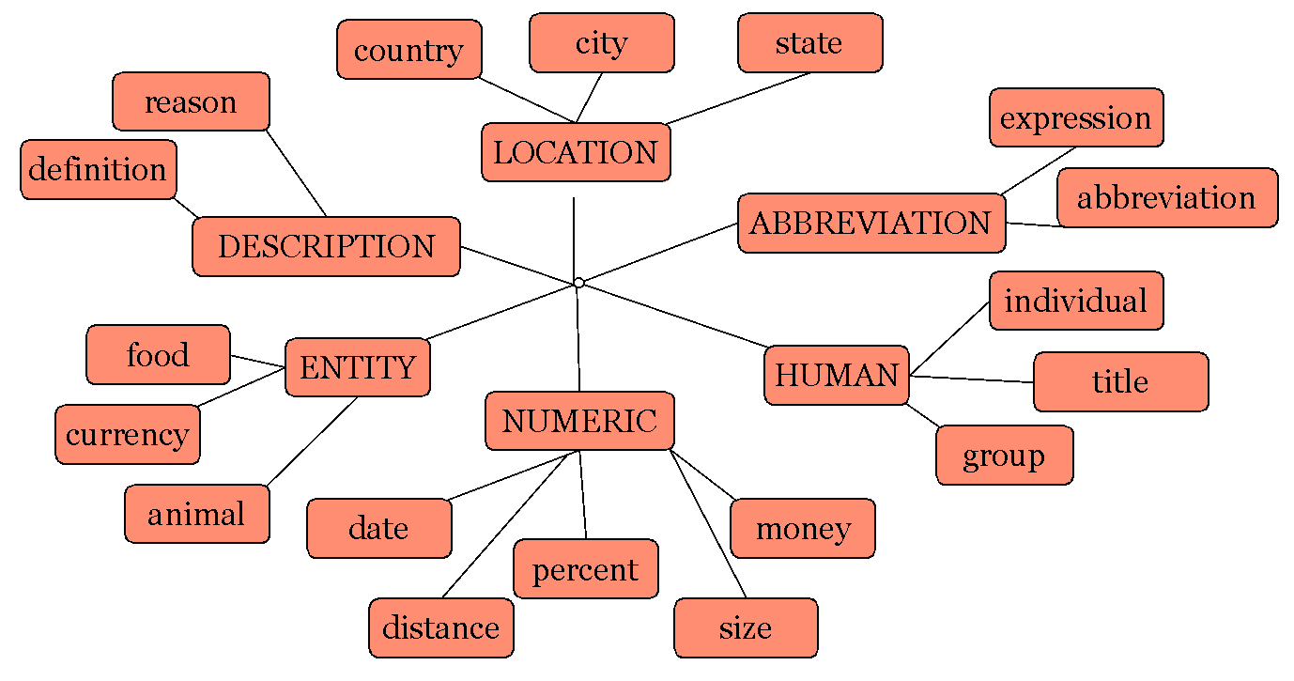
Part of Li & Roth’s Answer Type Taxonomy

Slide 22
Answer Types

Slide 23
Answer Type Detection
Hand-written rules
Machine Learning
Hybrids

Slide 24
Answer Type Detection
Regular expression-based rules can get some cases:
Who {is|was|are|were} PERSON
PERSON (YEAR – YEAR)
Other rules use the question headword:
(the headword of the first noun phrase after the wh-word)
Which city in China has the largest number of foreign financial companies?
What is the state flower of California?

Slide 25
Answer Type Detection
Most often, we treat the problem as machine learning classification
Define a taxonomy of question types
Annotate training data for each question type
Train classifiers for each question class using a rich set of features.
features include those hand-written rules!
Notes:
Rather than write hand-written rules.

Slide 26
Features for Answer Type Detection
Question words and phrases
Part-of-speech tags
Parse features (headwords)
Named Entities
Semantically related words

Slide 27
Answer Type Detection
Xin Li, Dan Roth. 2002. Learning Question Classifiers. COLING'02
Goal: categorize questions into different semantic classes that impose constraints on potential answers.
Who was the first woman killed in Vietnam war? - PERSON
What is a prism? - DEFINITION
Why is the sun yellow? - REASON
Notes:
For the first question, after we define that the type of an answer is PERSON, we reduce our search space dramatically.
For the last two questions, after we define their type, we may use it for picking a specific strategy of answering a definition question, or specific strategy (templates) for reasons.

Slide 28
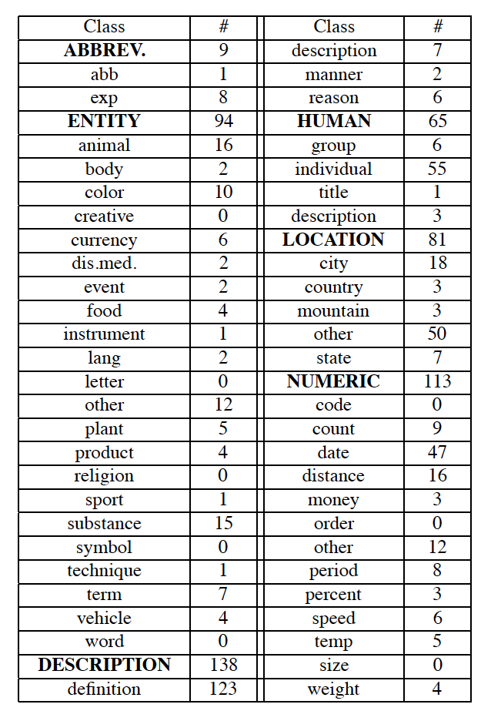
Answer Type Detection
Xin Li, Dan Roth. 2002. Learning Question Classifiers. COLING'02
Existing approaches perform coarse classification (20 classes).
Li and Roth define a finer taxonomy of answer types.
Notes:
For the first question, after we define that the type of an answer is PERSON, we reduce our search space dramatically.
For the last two questions, after we define their type, we may use it for picking a specific strategy of answering a definition question, or specific strategy (templates) for reasons.

Slide 29
Answer Type Detection: Ambiguity
Xin Li, Dan Roth. 2002. Learning Question Classifiers. COLING'02
What is bipolar disorder? - definition or desease_medicine
What do bats eat? - food, plant, or animal
What is PH scale? - numeric_value or definition
One question is allowed to have several class labels
Notes:
There is no completely clear boundary between classes of questions, therefore they are allowed to overlap.
After we assign several labels to one question we have a choice of strategy later.

Slide 30
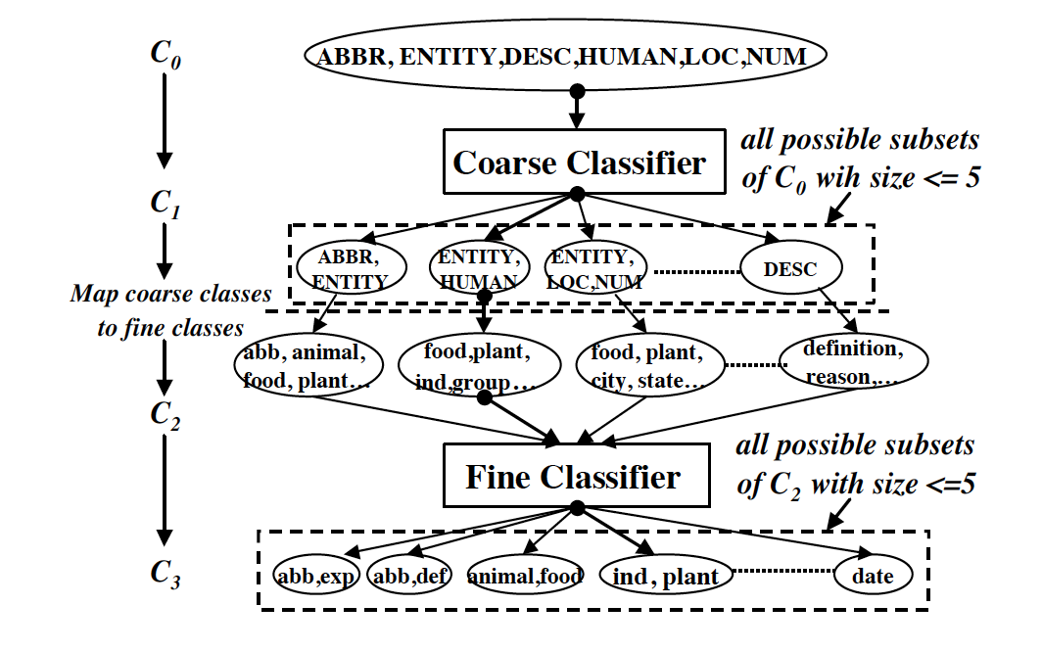
Answer Type Detection: Building a classifier
Xin Li, Dan Roth. 2002. Learning Question Classifiers. COLING'02
Two classifiers:
Coarse classifier
Fine classifier

Slide 31
Answer Type Detection: Building a classifier
Xin Li, Dan Roth. 2002. Learning Question Classifiers. COLING'02
Primitive features (sensors):
words
pos tags
chunks (non-overlapping phases)
named entities
head chunks
semantically related words (for a question type)
6 feature sets

Slide 32
Answer Type Detection: Evaluation
Xin Li, Dan Roth. 2002. Learning Question Classifiers. COLING'02
Study #1: Classification with different feature sets.
Study #2: Hierarchical classification vs. flat classification
Training data:
4500 English questions published by University of Southern California
500 manually constructed questions for rare cases
894 questions from TREC8 and TREC9
Test data:
500 questions from TREC10

Slide 33
Answer Type Detection: Evaluation
Xin Li, Dan Roth. 2002. Learning Question Classifiers. COLING'02

Slide 34
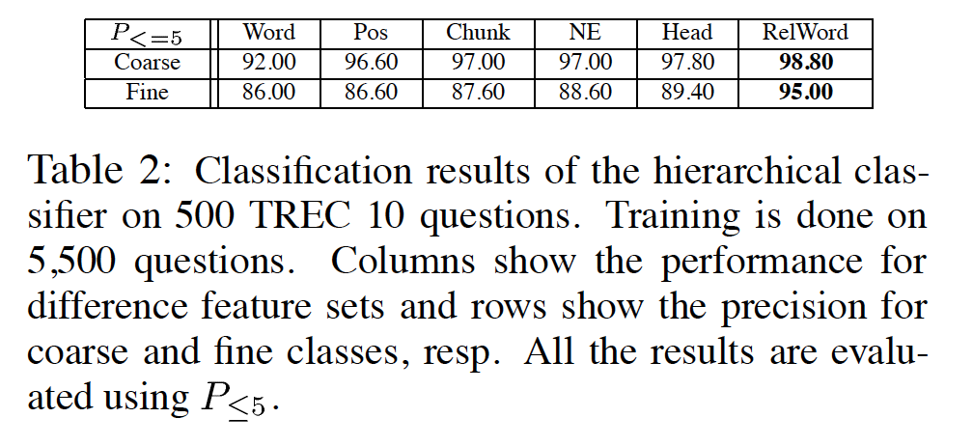
Answer Type Detection: Evaluation
Xin Li, Dan Roth. 2002. Learning Question Classifiers. COLING'02

Slide 35
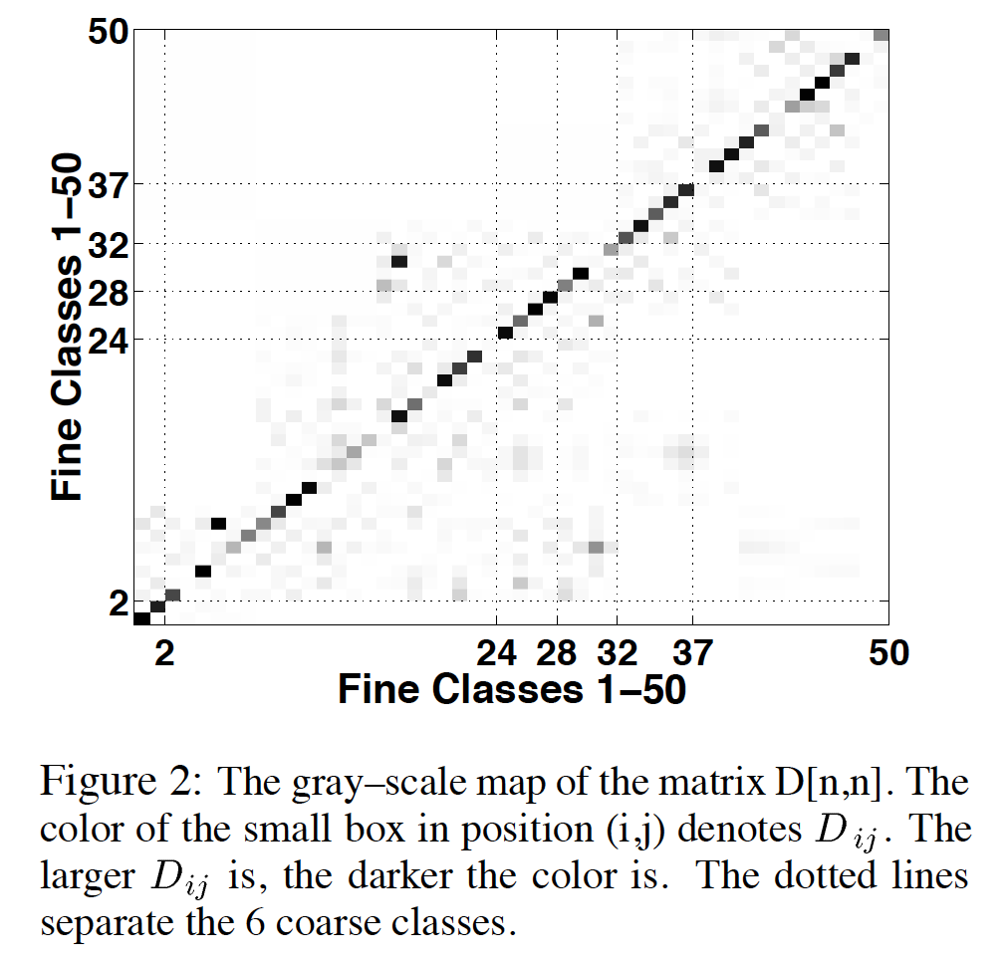
Answer Type Detection: Evaluation
Xin Li, Dan Roth. 2002. Learning Question Classifiers. COLING'02

Slide 36
Factoid Q/A

Slide 37
Keyword Selection Algorithm
Dan Moldovan, Sanda Harabagiu, Marius Paca, Rada Mihalcea, Richard Goodrum, Roxana Girju and Vasile Rus. 1999. Proceedings of TREC-8.
1. Select all non-stop words in quotations
2. Select all NNP words in recognized named entities
3. Select all complex nominals with their adjectival modifiers
4. Select all other complex nominals
5. Select all nouns with their adjectival modifiers
6. Select all other nouns
7. Select all verbs
8. Select all adverbs
9. Select the QFW word (skipped in all previous steps)
10. Select all other words

Slide 38
Choosing keywords from the query
Slide from Mihai Surdeanu
Who coined the term “cyberspace” in his novel “Neuromancer”?
1
1
4
4
7
cyberspace/1 Neuromancer/1 term/4 novel/4 coined/7

Slide 39
Factoid QA

Slide 40
Passage Retrieval
Step 1: IR engine retrieves documents using query terms
Step 2: Segment the documents into shorter units
something like paragraphs
Step 3: Passage ranking
Use answer type to help rerank passages
Notes:
The hard part here is ranking

Slide 41
Features for Passage Ranking
Either in rule-based classifiers or with supervised machine learning
Number of Named Entities of the right type in passage
Number of query words in passage
Number of question N-grams also in passage
Proximity of query keywords to each other in passage
Longest sequence of question words
Rank of the document containing passage
Notes:
Features that we might use for passage ranking

Slide 42
Factoid Q/A

Slide 43
Answer Extraction
Run an answer-type named-entity tagger on the passages
Each answer type requires a named-entity tagger that detects it
If answer type is CITY, tagger has to tag CITY
Can be full NER, simple regular expressions, or hybrid
Return the string with the right type:
Who is the prime minister of India (PERSON)
Manmohan Singh, Prime Minister of India, had told left leaders that the deal would not be renegotiated.
How tall is Mt. Everest? (LENGTH)
The official height of Mount Everest is 29035 feet

Slide 44
Ranking Candidate Answers
But what if there are multiple candidate answers!
Q: Who was Queen Victoria’s second son?
Answer Type: Person
Passage:
The Marie biscuit is named after Marie Alexandrovna, the daughter of Czar Alexander II of Russia and wife of Alfred, the second son of Queen Victoria and Prince Albert

Slide 45
Ranking Candidate Answers
But what if there are multiple candidate answers!
Q: Who was Queen Victoria’s second son?
Answer Type: Person
Passage:
The Marie biscuit is named after Marie Alexandrovna, the daughter of Czar Alexander II of Russia and wife of Alfred, the second son of Queen Victoria and Prince Albert
Notes:
if there’re multiple candidates - rank them

Slide 46
Use machine learning: Features for ranking candidate answers
Answer type match: Candidate contains a phrase with the correct answer type.
Pattern match: Regular expression pattern matches the candidate.
Question keywords: # of question keywords in the candidate.
Keyword distance: Distance in words between the candidate and query keywords
Novelty factor: A word in the candidate is not in the query.
Apposition features: The candidate is an appositive to question terms
Punctuation location: The candidate is immediately followed by a comma, period, quotation marks, semicolon, or exclamation mark.
Sequences of question terms: The length of the longest sequence of question terms that occurs in the candidate answer.

Slide 47
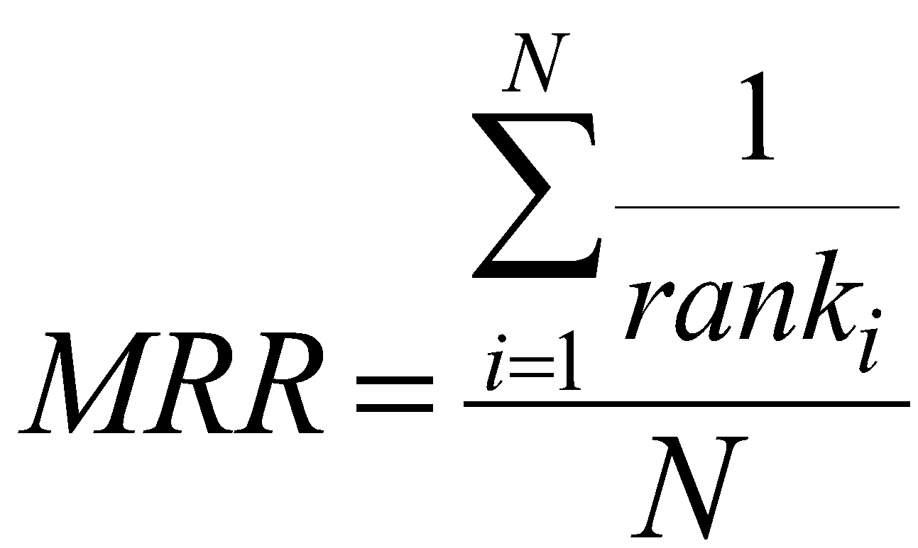
Common Evaluation Metrics
Accuracy (does answer match gold-labeled answer?)
Mean Reciprocal Rank
For each query return a ranked list of M candidate answers.
Query score is 1/Rank of the first correct answer
If first answer is correct: 1
else if second answer is correct: ½
else if third answer is correct: ⅓, etc.
Score is 0 if none of the M answers are correct
Take the mean over all N queries
Notes:
We are done with IR-based approaches

Slide 48
Learning Surface Text Patterns for a Question Answering System: Evaluation
The idea is from TREC-10 QA winning system
It used an extensive list of patterns
Learn patterns automatically
Use suffix trees for implementation

Slide 49
Learning Surface Text Patterns for a Question Answering System: Evaluation
Constructing a pattern
For a given question type (BIRTHYEAR) select an example (Mozart 1756)
*Mozart - question term; 1756 - answer term
Submit a query (Mozart 1756) to a search engine
Get top 1000 documents
Apply sentence breaker
Retain sentences that contain both terms
Pass each sentence through a suffix tree constructor (finds all substrings of all length + their counts)
Only retain phrases that contain Mozart and 1756
Replace question term with <NAME>; replace answer term with <ANSWER>

Slide 50
Learning Surface Text Patterns for a Question Answering System: Evaluation
Evaluating a pattern
Query a search engine using only question term (Mozart)
Download 1000 top documents
Split into sentences
Retain sentences that contain Mozart
Check the presence of each pattern that we earlier constructed
presence of the pattern with <ANSWER> tag matched by any word
presence of the pattern with <ANSWER> tag matched by the correct answer term
Pattern: <NAME> was born in <ANSWER>
Mozart was born in 1756
Mozart was born in <any_word>
Precision of a pattern:

Slide 51
Learning Surface Text Patterns for a Question Answering System: Evaluation
Determine question type. (Hovy et al. 2002b, 2001)
Identify question term in the question
Construct a query using a question term
Split into sentences
Replace question term by its question type (<NAME> for type BIRTHYEAR)
Search for each pattern for this question type
Sort answers by their precision score
Return top 5 answers

Slide 52
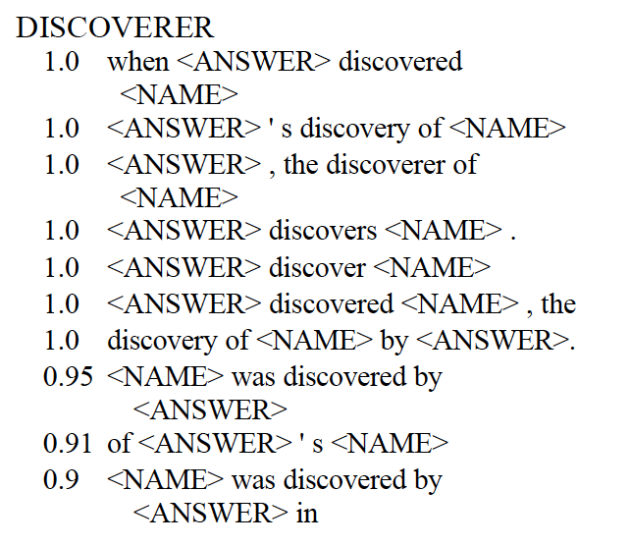
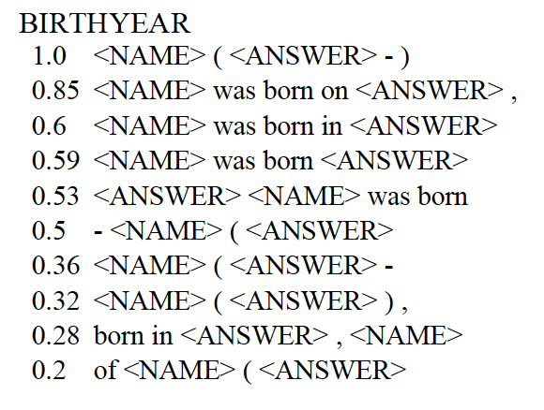
Learning Surface Text Patterns for a Question Answering System: Evaluation

Slide 53
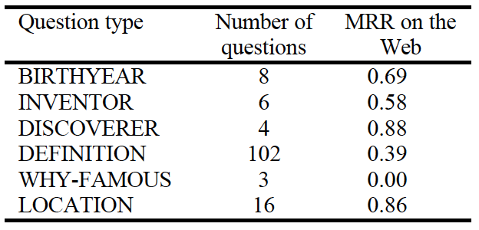
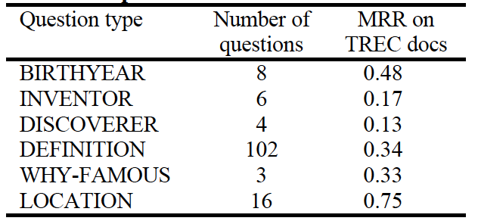
Learning Surface Text Patterns for a Question Answering System: Evaluation
questions from TREC-10
experiment using TREC-10 corpus
experiment using the Web
sort according to their MRR score

Slide 54
Knowledge-based approaches
Build a semantic representation of the query
Times, dates, locations, entities, numeric quantities
Map from this semantics to query structured data or resources
Geospatial databases
Ontologies (Wikipedia infoboxes, dbPedia, WordNet, Yago)
Restaurant review sources and reservation services
Scientific databases
Notes:
Emphasize structure of the data and external resources (Freebase, ontologies)

Slide 55
Relation Extraction
Answers: Databases of Relations
born-in(“Emma Goldman”, “June 27 1869”)
author-of(“Cao Xue Qin”, “Dream of the Red Chamber”)
Draw from Wikipedia infoboxes, DBpedia, FreeBase, etc.
Questions: Extracting Relations in Questions
Whose granddaughter starred in E.T.?
(acted-in ?x “E.T.”)
(granddaughter-of ?x ?y)
Notes:
I will shortly talk about KB.
To answer a question you might want to extract relations between entities from it and search for such relations in a dataset

Slide 56
Temporal Reasoning
Relation databases
(and obituaries, biographical dictionaries, etc.)
IBM Watson
”In 1594 he took a job as a tax collector in Andalusia”
Candidates:
Thoreau is a bad answer (born in 1817)
Cervantes is possible (was alive in 1594)
Notes:
There are already fully constructed Knowledge Bases.
Some of them specialize on a specific aspect.
From temporal databases you get information about dates

Slide 57
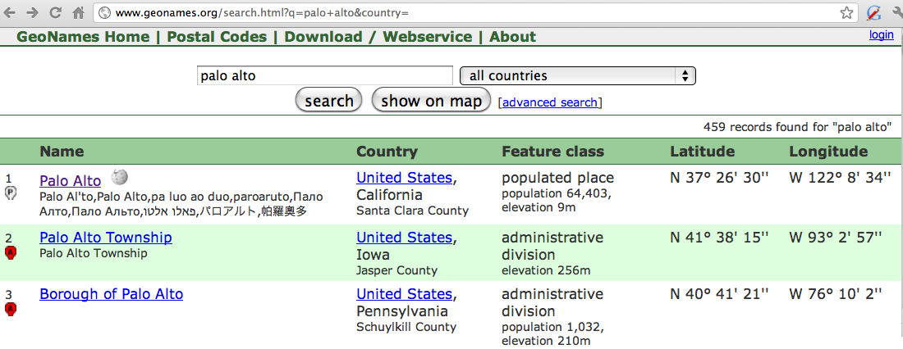
Geospatial knowledge (containment, directionality, borders)
Beijing is a good answer for ”Asian city”
California is ”southwest of Montana”
geonames.org:
Notes:
from geospatial databases you can get information about locations

Slide 58
Questions?

