Slide 1
Smoothing in Language Models
Alexey Karyakin
CS 886: Topics in Natural Language Processing
University of Waterloo
Spring 2015
Includes slides from Stanford “Natural Language Processing” course by Dan Jurafsky and Christopher Manning

Slide 2
Smoothing in Language Models
Due to limited training set size, raw frequency estimates (e.g., MLE) are inaccurate
Better for frequent objects
Worse for rare objects
Specific problems
Unseen objects result in p=0
Objects of equal count -> same p
Non-monotonicity
The need for smoothing
Notes:
Definition of smoothing is unclear. Smoothing seems to be using models other than MLE, that behave in a way that we expect, even with the lack of statistical information.

Slide 3
The intuition of smoothing (from Dan Jurafsky/Dan Klein)
When we have sparse statistics:
Steal probability mass to generalize better
P(w | denied the)
3 allegations
2 reports
1 claims
1 request
7 total
allegations
attack
man
reports
outcome
…
claims
request
P(w | denied the)
2.5 allegations
1.5 reports
0.5 claims
0.5 request
2 other
7 total
allegations
allegations
attack
man
outcome
reports
…
claims
request

Slide 4
Add-one estimation
Also called Laplace smoothing
Pretend we saw each word one more time than we did
Just add one to all the counts!
MLE estimate:
Add-1 estimate:

Slide 5
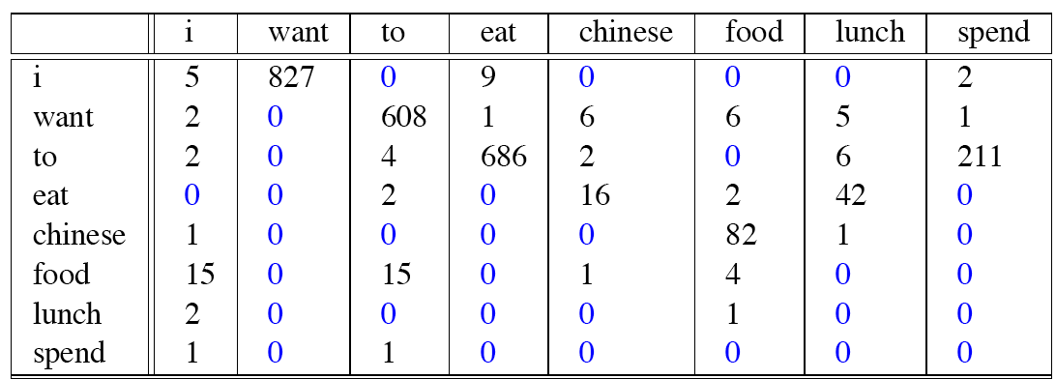
Compare with raw bigram counts
Notes:
C(want to) went from 608 to 238, P(to|want) from .66 to .26!
Discount d= c*/c
d for “chinese food” =.10!!! A 10x reduction

Slide 6
Add-1 estimation is a blunt instrument
So add-1 isn’t used for N-grams:
We’ll see better methods
But add-1 is used to smooth other NLP models
For text classification
In domains where the number of zeros isn’t so huge.

Slide 7
Variations of add-one
Add half, Expected Likelihood Estimate (ELE) [Box , Tiao 1973]

Slide 8
Variations of add-one
“Add tiny”

Slide 9
Advanced smoothing algorithms
Intuition used by many smoothing algorithms
Good-Turing
Kneser-Ney
Witten-Bell
Use the count of things we’ve seen once
to help estimate the count of things we’ve never seen

Slide 10
Notation: N_{c} = Frequency of frequency c
N_{c} = the count of things we’ve seen c times
Sam I am I am Sam I do not eat
I 3
sam 2
am 2
do 1
not 1
eat 1
N₁ = 3
N₂ = 2
N₃ = 1

Slide 11
Good-Turing smoothing intuition
You are fishing (a scenario from Josh Goodman), and caught:
10 carp, 3 perch, 2 whitefish, 1 trout, 1 salmon, 1 eel = 18 fish
How likely is it that next species is trout?
1/18
How likely is it that next species is new (i.e. catfish or bass)
Let’s use our estimate of things-we-saw-once to estimate the new things.
3/18 (because N₁=3)
Assuming so, how likely is it that next species is trout?
Must be less than 1/18
How to estimate?

Slide 12
Good Turing calculations
Unseen (bass or catfish)
c = 0:
MLE p = 0/18 = 0
P*_{GT} (unseen) = N₁/N = 3/18
Seen once (trout)
c = 1
MLE p = 1/18
C*(trout) = 2 * N2/N1
= 2 * 1/3
= 2/3
P*_{GT}(trout) = 2/3 / 18 = 1/27

Slide 13
Resulting Good-Turing numbers
Numbers from Church and Gale (1991)
22 million words of AP Newswire
Count c | Good Turing c*
0 | .0000270
1 | 0.446
2 | 1.26
3 | 2.24
4 | 3.24
5 | 4.22
6 | 5.19
7 | 6.21
8 | 7.24
9 | 8.25

Slide 14
Good-Turing smoothing
The distribution of N_{C} has “gaps” for frequent objects
The GT count for the most frequent word (e.g., “the”) is undefined
Still probabilities of object with same count are assumed equal
Need another “smoothing”!
Many possible GT smoothers
Difficult in general case, hindered use of GT in practice

Slide 15
Good-Turing smoothing
frequency | frequency of frequency
1 | 120
2 | 40
3 | 24
4 | 13
5 | 15
6 | 5
7 | 11
8 | 2
9 | 2
10 | 1
11 | 0
12 | 3
Another example (“Prosody”, Gale 1995)
Typical for linguistic data
Uncertainties in N_{C} vary greatly with c

Slide 16
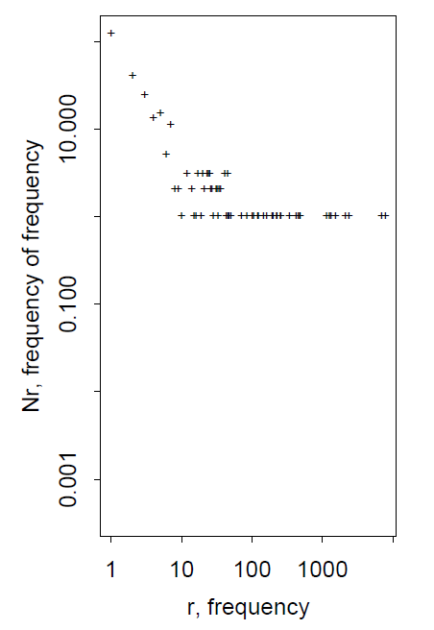
Good-Turing smoothing
Another representation of the same data
Too “granular” due to integer counts

Slide 17
Church and Gate (1991)
Bi-gram smoothing based on unigram frequencies
A type of back-off
Bi-grams are bucketed into N bins based on jii
“joint if independent”
Logarithmic bins, typically 3 per decade
For a bi-gram xy:
Basic estimator is used within each bin
Good-Turing, Held-off, Deleted Estimate, or other (?)
Notes:
Start with this one because it was historically earlier

Slide 18
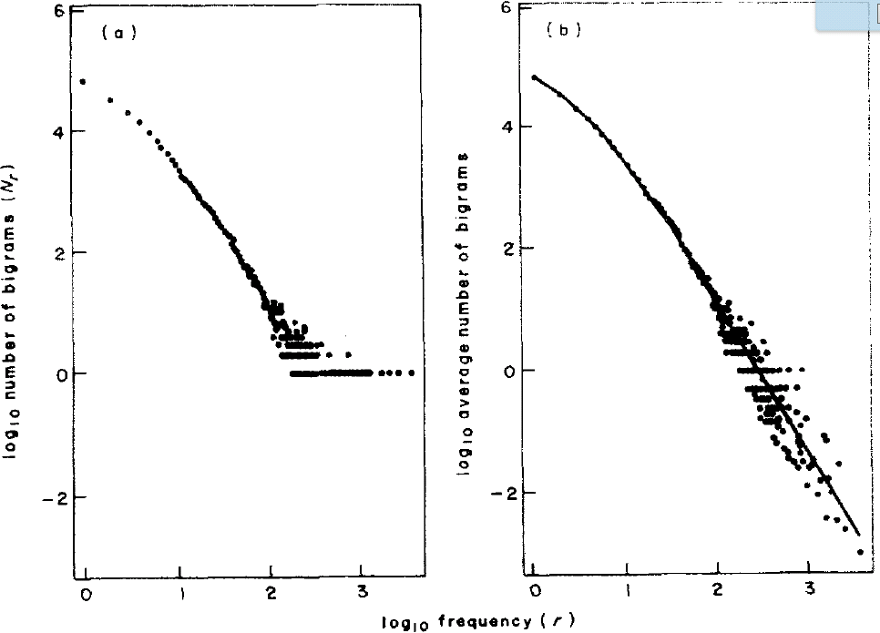
Church and Gale (1991)
Single bin
j = 33, jii=1.4
Averaged around zeros (right)
Hastie and Shirey. A variable bandwidth kernel smoother. AT&T Technical report, 1988.
AP Wire, 4.4x10⁷ words

Slide 19
Church and Gale (1991)
Overall, the smoothing algorithm is complicated
Shown to work well on large corpora [Chen, Goodman 1996]
Defined for bigrams, generalization is ambiguous
Unigram probabilities are estimated using MLE, other methods are possible

Slide 20
Simple Good-Turing (SGT)
By Gale (1995)
Simple linear interpolation between log(r) and log(Nr)
a and b are fit by linear regression
Turing estimates are used for smaller r, linear estimates “kick in” once they become “significantly different”

Slide 21
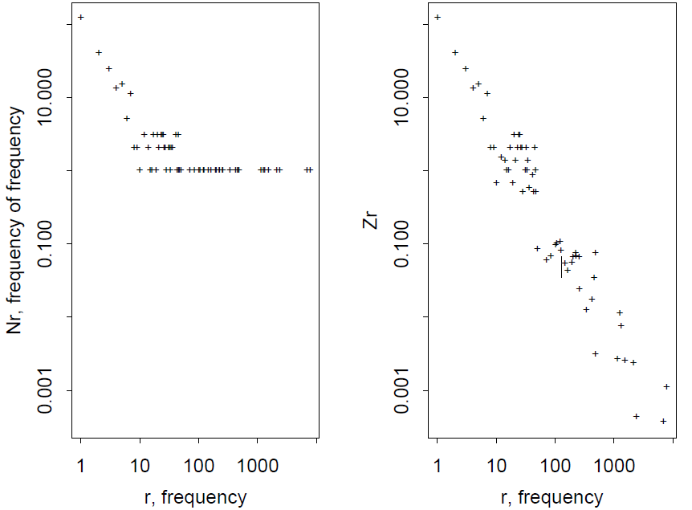
Simple Good-Turing (SGT)
Again, “Prosody” data from Gale (1995)
Good-Turing (left)
Good-Turing with zero averaging (right)

Slide 22
Simple Good-Turing (SGT)
The author claimed that SGT is not only very simple but very accurate too
The claim is based on Monte Carlo simulation, using Zipfian distribution
N₁
N₂
N_{r} vs r
Illustration from Dan Jurafsky lectures

Slide 23
Kneser-Ney smoothing
Originally described by Kneser and Ney (1995)
A form of back-off in the original paper
A form of interpolation (Chen and Goodman, 1998)
Based on two ideas:
Constant discounting to simplify computations
Lower-order probabilities are estimated based on how many continuations the word forms

Slide 24
Kneser-Ney smoothing I
Constant discounting (Ney, Essen, Kneser, 1994)
From AP Wire:
Looks like the difference is ~0.75 between MLE and GT for most objects
Count c | Good Turing c*
0 | .0000270
1 | 0.446
2 | 1.26
3 | 2.24
4 | 3.24
5 | 4.22
6 | 5.19
7 | 6.21
8 | 7.24
9 | 8.25

Slide 25
Kneser-Ney Smoothing II
Better estimate for probabilities of lower-order unigrams!
Shannon game: I can’t see without my reading___________?
“Francisco” is more common than “glasses”
… but “Francisco” always follows “San”
The unigram is useful exactly when we haven’t seen this bigram!
Instead of P(w): “How likely is w”
P_{continuation}(w): “How likely is w to appear as a novel continuation?
For each word, count the number of bigram types it completes
Every bigram type was a novel continuation the first time it was seen
Francisco
glasses

Slide 26
Kneser-Ney smoothing III
Continuation probability: number of prefixes a word, normalized by the total number of prefixes (for all words)

Slide 27
Kneser-Ney Smoothing IV
λ is a normalizing constant; the probability mass we’ve discounted
The number of word types that can follow w_{i-1}
= # of word types we discounted
= # of times we applied normalized discount
the normalized discount

Slide 28
Held-out methods
Basic idea: training set is divided into parts and the statistical relationships between parts are used to build a model
Also called empirical methods

Slide 29
Basic held-out
By Jelinek and Mercer (1985)
Training set is divided into halves
Both halves are assumed to be generated by the same process
The first half (retained) is used to classify objects into frequency classes
The other half (held-out) is used to produce frequency estimations within each class
Notes:
The original paper seems to be unavailable

Slide 30
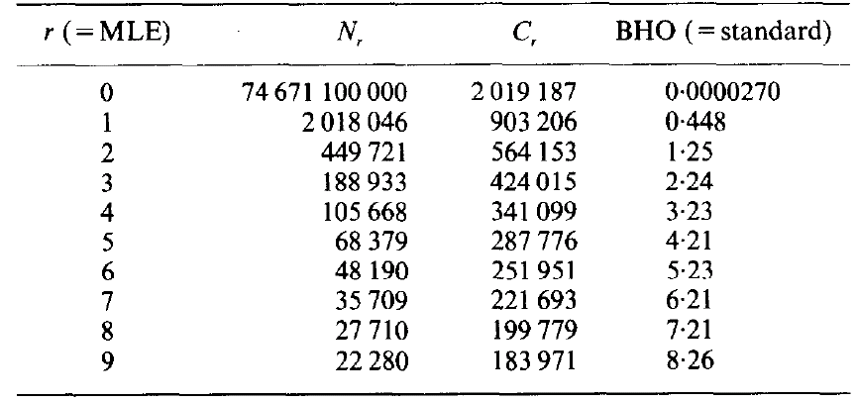
Basic held-out
From AP Wire data (Church and Gale 1991)
Notes:
The original paper seems to be unavailable

Slide 31
Two-way cross validation
Deleted Estimate method by Jelinek and Mercer (1985)
The basic held-out method is applied twice (parts 0 and 1)
The second time, parts are swapped
An average is taken
Notes:
This method is often used to validate the results of other models. In that case, the test part is used as held-out.

Slide 32
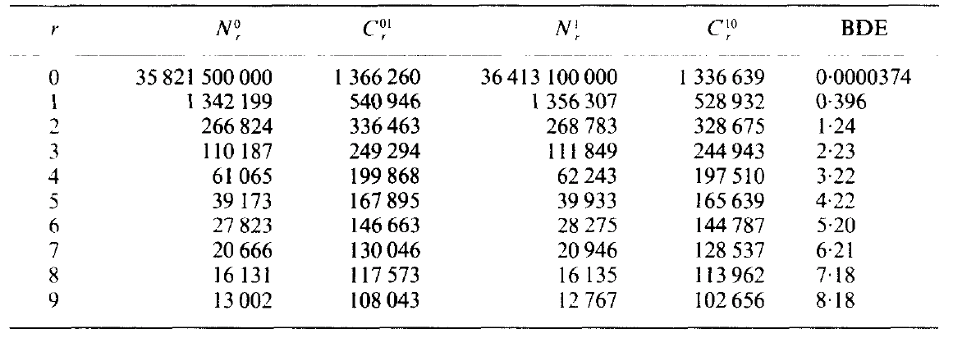
Deleted Estimate Results
From AP Wire data (Church and Gale 1991)
Notes:
The original paper seems to be unavailable

Slide 33
Class-Based n-gram Models
From Brown et al (1992)
Number of possible objects is reduced by combining them into classes
Monday, Tuesday, … -> C₁
Probabilities within one class are assumed the same
Advantages (potential):
Accuracy may be better because of more instances of every object
Less storag
Now how to assign words to classes
Notes:
The original paper seems to be unavailable

Slide 34
Class-Based n-gram Models II
No optimal classification algorithm
Greedy algorithm based on merging while maximizing mutual information
Initially, words are assigned to separate classes
Repeatedly pick to classes merging which the total mutual information loss is minimal
Notes:
The original paper seems to be unavailable

Slide 35
Class-Based n-gram Models III
Notes:
The original paper seems to be unavailable

Slide 36
Class-Based n-gram Models IV
Results, based on the Brown corpus
Class based 3-gram model perplexity: 271
Class-based and word estimators interpolated, perplexity: 236
Word-based model: perplexity 244
Class-based model takes 1/3 space
Notes:
The original paper seems to be unavailable

Slide 37
N-gram Smoothing Summary
Add-1 smoothing:
OK for text categorization, not for language modeling
The most commonly used method:
Extended Interpolated Kneser-Ney
For very large N-grams like the Web:
Stupid backoff

Slide 38
Bibliography
K.W. Church and W.A. Gale. A comparison of the enhanced Good-Turing and deleted methods for estimating probabilities of English bigrams. Computer Speech and Language, 5:1. 1991.
W.A. Gale. Good-Turing Smoothing Without Tears. Journal of Quantitative Linguistics 2: 217-237. 1995.
H. Ney, U. Essen, R. Kneser. On Structuring Probabilistic Dependences in Stochastic Language. Modelling. Computer Speech and Language, Vol. 8, pp. 1-38, 1994.
R. Kneser and H. Ney. Improved backing-off for m-gram language modeling ICASSP-95. 1995.
S. F. Chen and J. Goodman. An Empirical Study of Smoothing Techniques for Language Modeling. TR-10-98. 1998.
F. Jelinek and R. Mercer. Probability distribution estimation from sparse data. IBM Technical Disclosure Bulletin, 23, 259 I - 2594. 1985.
P.F. Brown, P.V. Desouza, R.L. Mercer, V.J.D. Pietra. Class-based n-gram models of natural language. Computational Linguistics, 18:4. 467-479. 1992.
Notes:
The original paper seems to be unavailable

