Slide 1
Summarization
Luis Blanco
CS886 – Topics in Natural Language Processing
Spring 2015

Slide 2
Summarization - Definition
Text Summarization is [MANI1999]:
  “The process of distilling the most important information from a text to produce an abridged version for a particular task and user”
A summarizer is [MANI2001]:
  “… a system whose goal is to produce a condensed representation of the content of its input for human consumption”

Slide 3
Summarization - Types
Common types of summaries:
  Outlines of any document
  Abstracts of a scientific article
  Headlines of a news article
  Snippets of web pages
  Summaries of email threads and forums
  Action items from a business meeting
  Compressed sentences
  Answers to complex questions

Slide 4
Summarization - Types
Where does the text comes from?
  Single-document:
    Generate/extract:
      Headlines
      Outlines
      Abstracts
  Multiple-document:
    Summary of news stories on a single event
    Web pages on a single topic
    Complex question answering

Slide 5
Summarization - Types
Information needs:
  Generic summary:
    Gives the important information contained in the document(s)
  Query-focused summarization:
    Produces a summary in response to a user query
    A type of complex question answering: an answer to a non-factoid user question
    Also called:
      Focused-summarization
      Topic-based summarization
      User-focused summarization

Slide 6
Summarization - Types
Output text:
  Extract:
    The summary consists of sentences taken from the source document(s)
    Typical Condensation Rate of 25%
  Abstract:
    The summary contains, at least some, text not present in the source document(s)

Slide 7
Summarization - Types
By function:
  Indicative:
    Give enough information to help the user decide to read the document(s) or not
    For (According to ANSI guidelines for abstractors):
      Less-structured documents (editorials, essays, opinion pieces)
      Lengthy documents (books, conference proceedings)
      Do not include results, conclusions, and recommendations for scientific research reports
  Informative:
    Cover all important (salient) information – When do you know all important information has been extracted or summarized?
  Critical (Evaluative):
    Evaluates the subject matter and gives the “abstractor’s” opinion of the source

Slide 8
Summarization - Types
By function:

Slide 9
Summarization – Extract vs Abstract - Example
Original Gettysburg Address – November the 19th, 1863:
    Four score and seven years ago our fathers brought forth on this continent a new nation, conceived in liberty, and dedicated to the proposition that all men are created equal. Now we are engaged in a great civil war, testing whether that nation, or any nation so conceived and so dedicated, can long endure. We are met on a great battle- field of that war. We have come to dedicate a portion of that field as a final resting-place for those who here gave their lives that this nation might live. It is altogether fitting and proper that we should do this. But, in a larger sense, we cannot dedicate...we cannot consecrate...we cannot hallow... this ground. The brave men, living and dead, who struggled here, have consecrated it far above our poor power to add or detract. The world will little note nor long remember what we say here, but it can never forget what they did here. It is for us, the living, rather, to be dedicated here to the unfinished work which they who fought here have thus far so nobly advanced. It is rather for us to be here dedicated to the great task remaining before us...that from these honored dead we take increased devotion to that cause for which they gave the last full measure of devotion; that we here highly resolve that these dead shall not have died in vain; that this nation, under God, shall have a new birth of freedom; and that government of the people, by the people, for the people, shall not perish from the earth.

Slide 10
Summarization – Extract vs Abstract - Example
Original Gettysburg Address – November the 19th, 1863:
    Four score and seven years ago our fathers brought forth on this continent a new nation, conceived in liberty, and dedicated to the proposition that all men are created equal. Now we are engaged in a great civil war, testing whether that nation, or any nation so conceived and so dedicated, can long endure. We are met on a great battle- field of that war. We have come to dedicate a portion of that field as a final resting-place for those who here gave their lives that this nation might live. It is altogether fitting and proper that we should do this. But, in a larger sense, we cannot dedicate...we cannot consecrate...we cannot hallow... this ground. The brave men, living and dead, who struggled here, have consecrated it far above our poor power to add or detract. The world will little note nor long remember what we say here, but it can never forget what they did here. It is for us, the living, rather, to be dedicated here to the unfinished work which they who fought here have thus far so nobly advanced. It is rather for us to be here dedicated to the great task remaining before us...that from these honored dead we take increased devotion to that cause for which they gave the last full measure of devotion; that we here highly resolve that these dead shall not have died in vain; that this nation, under God, shall have a new birth of freedom; and that government of the people, by the people, for the people, shall not perish from the earth.

Slide 11
Summarization – Extract vs Abstract - Example
Extract:
    Four score and seven years ago our fathers brought forth upon this continent a new nation, conceived in liberty, and dedicated to the proposition that all men are created equal. Now we are engaged in a great civil war, testing whether that nation, or any nation so conceived and so dedicated, can long endure. The brave men, living and dead, who struggled here, have consecrated it far above our poor power to add or detract.
Abstract:
    This speech by Abraham Lincoln commemorates soldiers who laid down their lives in the Battle of Gettysburg. It reminds the troops that it is the future of freedom in America that they are fighting for.
Critical Abstract:
    The Gettsyburg address, though short, is one of the greatest American speeches. Its ending words are especially powerful — (that government of the people, by the people, for the people, shall not perish from the earth.

Slide 12
Summarization – Phases -[JURAFSKY2008]
Content Selection:
  Choose with sentences to extract from the source documents
Information Ordering:
  How to order the extracted sentences
Sentence Realization:
  Clean up on the extracted sentences, and other transformations

Slide 13
Summarization – Phases [MANI2001]
Analysis:
  Build an internal representation of the input
Transformation (Refinement):
  Transform the internal representation into a representation of the summary.
Synthesis:
  Render the summary representation back into natural language.

Slide 14
Summarization – Content Selection
Unsupervised:
  Intuition based [LUHN58]:
    Very simple but elegant solution
    A reflection of the technologies available at the time
    Principle:
      Select significant (salient) words:
        Saliency is calculated by word occurrence
      Select significant sentences:
        The ones with higher significant factors:
          Significant factors are calculated by the number of significant words in a chunk of a sentence

Slide 15
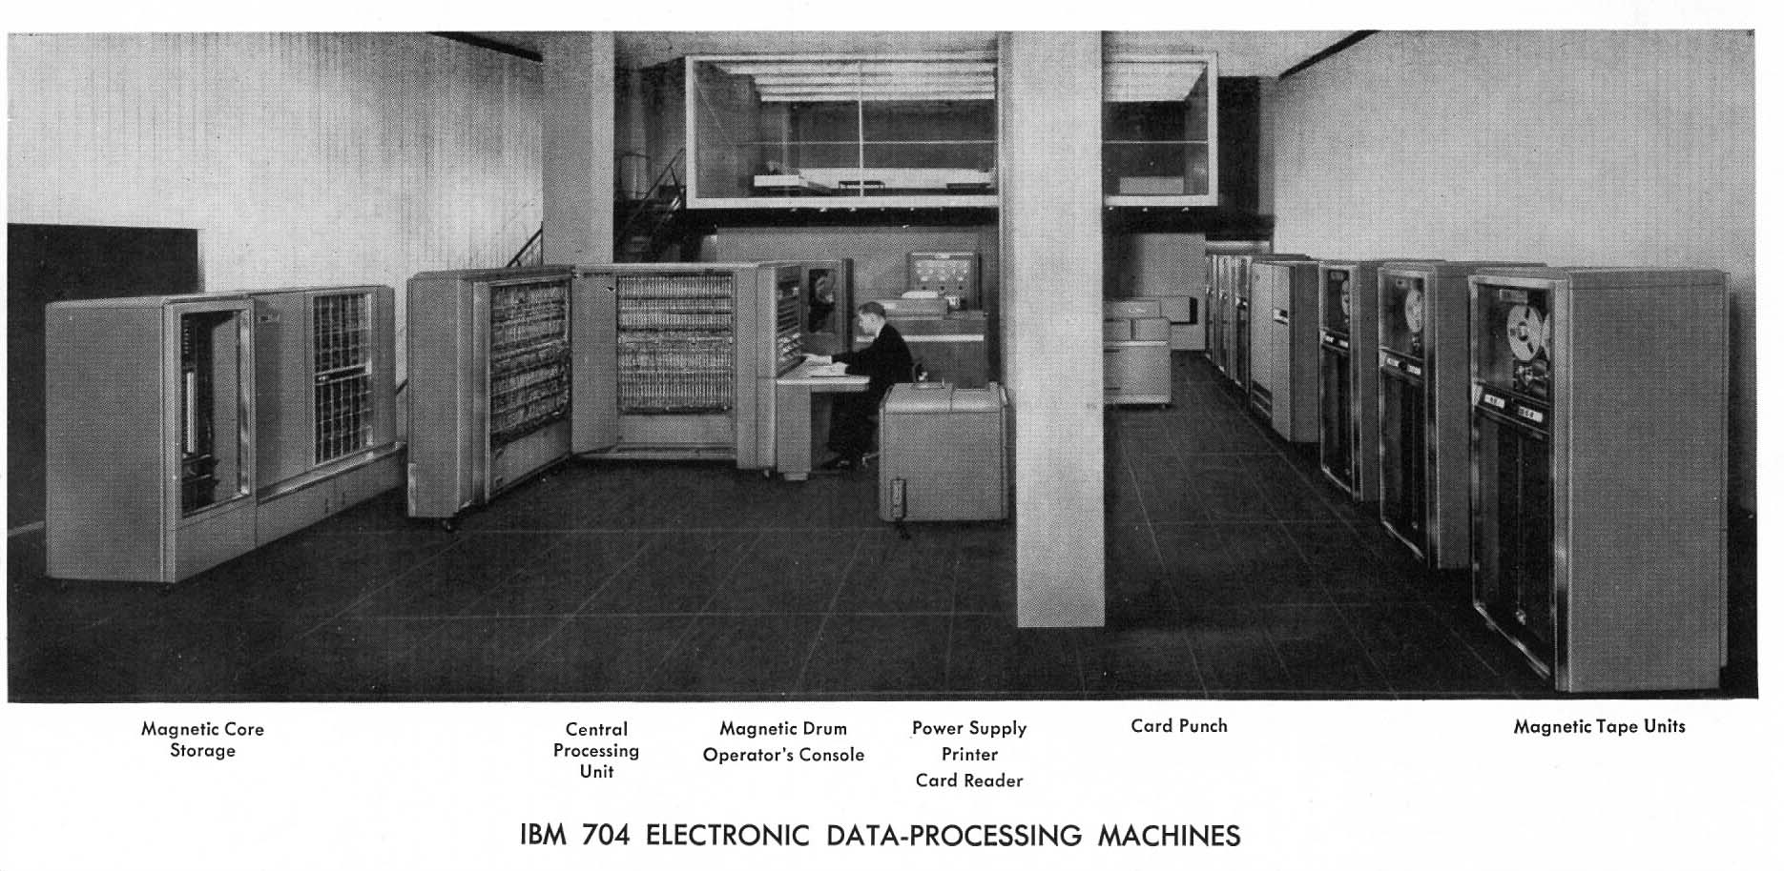
Summarization – Content Selection – Significant Words

Slide 16
Summarization – Content Selection
Unsupervised:
  tf-idf (term frequency-inverse document frequency):
    The fewer documents a significant term appears in the higher its idf weight
    Prefers words that appear a lot in a particular document but are rare in other documents

Slide 17
Summarization – Content Selection
Unsupervised:
  LLR (Log-Likehood-Ratio):
    It is the ratio between:
      The probability of observing a word in both the input and the background corpus assuming equal probabilities
      The probability of observing a word in both the input and the background corpus assuming different probabilities
      The score for a sentence would be:

Slide 18
Summarization – Content Selection
Supervised:
  Given:
    a labeled training set of good summaries for each document
  Align:
    the sentences in the document with sentences in the summary
  Extract features
    position (first sentence?)
    length of sentence
    word informativeness, cue phrases
    cohesion
  Train:
    a binary classifier (put sentence in summary? yes or no)
  Problems:
    hard to get labeled training data
    alignment difficult
    performance not better than unsupervised algorithms
  So in practice:
    Unsupervised content selection is more common

Slide 19
Summarization - Multi-document
Query based:

Slide 20
Multi-document - Content Selection
Use MMR (Maximal Marginal Relevance):
  Tries to avoid redundancy
  Method:
    Iteratively choose the best sentence to insert in the summary/answer so far:
      Relevant:
        Maximally relevant to the user’s query
        High cosine similarity to the query
      Novel:
        Minimally redundant with the summary/answer so far
        Low cosine similarity to the summary
    Stop when desired length

Slide 21
Multi-document - Content Selection – LLR + MMR
One of many ways to combine the intuitions of LLR and MMR:
  Score each sentence based on LLR (including query words)
  Include the sentence with highest score in the summary
  Iteratively add into the summary high-scoring sentences that are not redundant with summary so far

Slide 22
Summarization - Abstraction
Methods:
  Build a semantic representation for sentences in the text
  Create new semantic representations:
    Using selection, aggregation, and generalization.
    May need to create a discourse-level representation for the document
    A knowledge base containing background concepts may also be used.
  Render the new representations in natural language

Slide 23
Summarization - Abstraction
From templates:
  Attempt to extract predefined types of information, speciﬁed in the slots of a template, using information extraction methods.
  The slots in the template represent salient information to be instantiated from the text
  The background concepts thus include the slots of the template.
  The ﬁlled template is then rendered into natural language output
  Compression is provided automatically: the template only covers some aspect of the input

Slide 24
Summarization - Abstraction
Term rewriting:
  Each sentence is given a full semantic representation
  The propositions representing the meanings of sentences are expressed as logical expressions involving sets ofterms
  The sets of terms in the representation are, individually or collectively, selected, aggregated, or generalized in order to produce abstracts

Slide 25
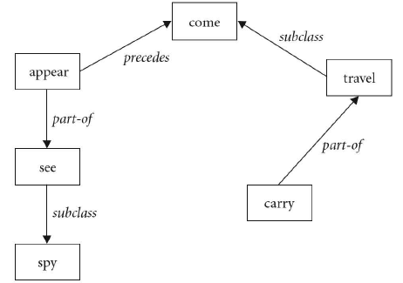
Summarization - Abstraction
Using event relations:
  When trying to summarize documents that include events (happenings) the semantic and temporal relations between events in a story need to be preserved for the story to be coherent.
  This preservation can be done via event connectivity graphs:

Slide 26
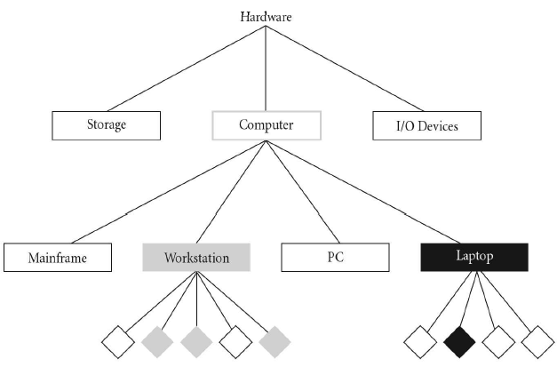
Summarization - Abstraction
Using a concept hierarchy:
  Uses Domain Knowledge representations concepts are used instead of words, so the idea is to identify salient concepts

Slide 27
Summarization - Abstraction
Using a concept hierarchy:
  To minimize the need for domain-specific knowledge, generic thesaurus dictionaries could be used to identify concepts.

Slide 28
Summarization- Evaluation - Extrinsic
Extrinsic:
  Task-based
  “Tries to determine the effect of the summarization on some other task”
Intrinsic:
  Task-independent: Test the system independent of any task
  “Test the system in of itself”

Slide 29
Summarization- Evaluation - Extrinsic
In a QA System: Does it answer the specific question asked?
Based on single-document summaries ask users to decide if the document is relevant to a particular query
Take a news event, give different subjects different types of documents: full documents, human summaries, automatically generated summaries. Then ask them particular questions about the event
How useful the summaries are in trying to find relevant documents in a collection
“If the summary is a presentation of some kind about an analysis of a crisis situation, the effectiveness of the argument can be determined based on reactions from decision makers or other experts who have been presented with the argument”

Slide 30
Evaluation – Intrinsic
Types:
  Agreement
  Quality
  Informativeness
  Component-level tests

Slide 31
Evaluation – Intrinsic - Agreement
Agreement (Kappa) [CARLETTA1997] [SIEGEL1998]:
    P(A) is the proportion of times judges agree
    P(E) is the proportion we expect judges to agree by chance
    K = 1 Complete agreement among judges
    K= 0 Complete disagreement
    K > .8 as good reliability, with .67 < K < .8 allowing tentative conclusions

Slide 32
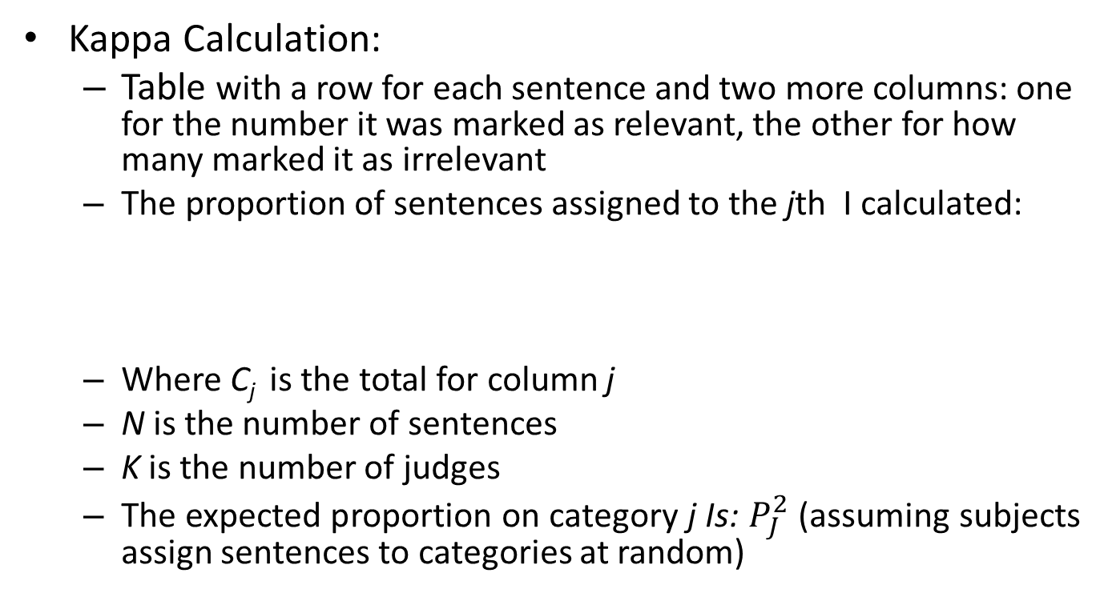
Evaluation – Intrinsic – Agreement
Kappa Calculation:
  Table with a row for each sentence and two more columns: one for the number it was marked as relevant, the other for how many marked it as irrelevant
  The proportion of sentences assigned to the jth I calculated:
  Where C_{j} is the total for column j
  N is the number of sentences
  K is the number of judges
  The expected proportion on category j Is: $P_{J}^{2}$ (assuming subjects assign sentences to categories at random)

Slide 33
Evaluation – Intrinsic - Quality
Characteristics of a high quality summary [ROWLEY82]:
  “… good spelling and grammar, clear indication of the topic of the source document, impersonal style, conciseness, readability and understandability, acronyms being presented with expansions, etc”
Readability:
  The FOG index:
    Sums the average sentence length with the percentage of words over 3 syllables, with a ‘grade’ level over 12 indicating difﬁculty for the average reader.
  The Kincaid index (for technical text):
    Computes a weighted sum of sentence length and word length. A lower score on these metrics means the text is less complex
  Issues with these two methods:
    “word and sentence length do not, in themselves, tell us very much about quality”
The main issue with methods based only on Quality evaluation:
  No relevance measure

Slide 34
Evaluation – Intrinsic - Informativeness
Comparison against reference output:
  Sentence Recall:
    Where n is the length of the reference summary, k the length of the machine summary, and p of the n sentences are in the machine summary:
      Precision p/k
      Recall p/n
    Main drawback: unable to distinguish between summaries that have same recall values
  Sentence Rank:
    Sentences are ranked according to “summary-worthiness”
    The ranks of the reference summary and the machine summary are then compared
  Utility-based:
    Fine-grained approach to judging summary-worthiness of sentences, instead of just boolean judgments:
      You can have levels of worthiness
    Disadvantage:
      Hard to assign values of worthiness (pas/fail vs 1 to 10)
      The worthiness scale must de bounded in reality, and that is not easy: how do you determine something is useful for a particular purpose

Slide 35
Evaluation – Intrinsic - Informativeness
  Content-based:
    Suited also for Abstract summaries
    Tries to compare the propositional content (statements) of two summaries
    However it is very difficult to evaluate summaries than contain different vocabulary from the input:
      Could use thesaurus lists
      Could use Latent Semantic Indexing (LSI) techniques:
        LSI Reduces the dimensionality of the vector space to try to find higher order regularities
    Disadvantages:
      Doesn’t consider syntactic or semantic information:
        “man bites dog” = “dog bites man”
        “The experiments provide evidence in favor of the hypothesis” =
        “The experiments don’t provide evidence in favor of the hypothesis” =
        “The experiments provide only weak evidence in favor of the hypothesis.”

Slide 36
Evaluation – Intrinsic – Component-level tests
Useful for multiple-document abstractive systems where components can be identified
Each component is intrinsically evaluated
Test suites of sample inputs and reference outputs for each component are compiled:
  Can include annotated corpora. Part or the corpora can be reserved for testing
“The performance of each component can be correlated with the performance of the summarizer as a whole in producing summaries”

Slide 37
Evaluation – Intrinsic – ROUGE
Recall Oriented Understudy for Gisting Evaluation
  Gist: “the main point or part” (Merriam-Webster)
Based on BLEU:
  Measures how well a machine translation overlaps with multiple human translations
  Computed by averaging the number of overlapping N-grams of different lengths between hypothesis and reference translations

Slide 38
Evaluation – Intrinsic – ROUGE
Given a document D, and an automatic summary X:
  Have N humans produce a set of reference summaries of D
  Run system, giving automatic summary X
  What percentage of the bigrams from the reference summaries appear in X?
Count_{match}(bigram) returns the maximum number of biagrams that co-occur in the candidate and the reference

Slide 39
Evaluation – Intrinsic – ROUGE – Example
What is water spinach?
  Human 1: Water spinach is a green leafy vegetable grown in the tropics.
  Human 2: Water spinach is a semi-aquatic tropical plant grown as a vegetable.
  H 3: Water spinach is a commonly eaten leaf vegetable of Asia.
  System answer: Water spinach is a leaf vegetable commonly eaten in tropical areas of Asia.
ROUGE-2 =
3 + 3 + 6
= 12/28 = .43
10 + 9 + 9

Slide 40
Evaluation – Intrinsic – ROUGE - Variations
ROUGE-L:
  Measures the longest common subsequence
ROUGE-S and ROUGE-SU:
  Measures the number of skip biagrams
    Skip biagrams are a pair of words that allows any other words to be in between

Slide 41
Summarizer - Example - CBSEAS
Clustering-Based Sentence Extractor for Automatic Summarization:
  Multi-document
  Produces Update Summaries:
    The user has read former documents about the topic
    Identify and summarize what is new to the user
    Redundancy detection is crucial

Slide 42
Example - CBSEAS
Other approaches:
  Remove sentences similar to the “source” documents
  Use MMR to remove redundancy:
    Increase the weight of dissimilarity
  Calculate the Novelty Factor of word:
    Based on its number of occurrences in the previous documents and its number of occurrences in the later documents

Slide 43
Example - CBSEAS
CBSEAS generic approach:
  Documents are made of groups of sentences (clusters) conveying the same information
  Try to identify the “central” (salient) sentence on each cluster and voilà! Redundancy is minimized
Sentences Clustering:
  Pre-processing
    Work with sentences (some approaches divide them in smaller units)
    POS tagging:
      To compute sentence similarity (syntactic)
    Name entity tagging:
      To compute sentence similarity

Slide 44
Example - CBSEAS
Sentences Clustering:
  Similarity Computation:
    Must take into account the types of documents and the user’s goal:
      Opinion pieces:
        Give more weight to adjectives, sentiment verbs, etc.
      Market analysis:
        Give more weight to currencies, amounts, company names

Slide 45
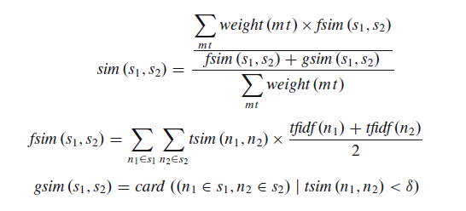
Example - CBSEAS
Sentences Clustering:
  Similarity Computation:
mt are the morphological types, s1 and s2 the sentences
tsim the similarity between two terms using WordNet and JCn similarity measure (corpus statistics and lexical taxonomy to calculate semantic similarity)
gsim similarity threshold calculation

Slide 46
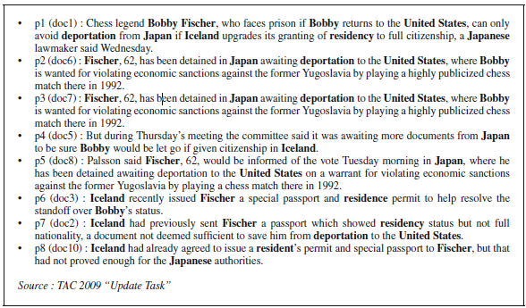
Example - CBSEAS
Sentences Clustering:
  Clustering algorithm:
    Using the similarity matrix use a Fast global k-means algorithm [LIKAS2001] to create the clusters

Slide 47
Example - CBSEAS
Sentence Selection:
  The final score of a sentence is computed with a weighted sum of three scores:
    Local Centrality:
      Relevance of a sentence to the content of its cluster.
      Information redundancy is correlated to information importance:
        The sentence which maximizes the sum of similarities to the other sentences is the most central sentence
    Global Centrality:
      If a user query exists:
        The summary must be relevant to that query
        Use the similarity to the request as global centrality score
      If not:
        The summary must be relevant to the overall content of all documents
        Use the Centroid [RADEV2002]:
          A centroid, is a pseudo-document which consists of words which have tf-idf scores above a predefined threshold in the documents that constitute the cluster.
    Sentence Length:
      Summaries are bound by a number of words, so penalize sentences that are too short or too long

Slide 48
Example - CBSEAS
Generating the actual Update Summary:
  Model the pieces of information that the user has already read
  Cluster the sentences already read
  Use the model to determine if a sentence from the new documents must be clustered with the sentences already read or on separate clusters (update clusters)
  Select sentences (using the methods described previously) from the update clusters to compose the update summary

Slide 49
Summarization - Conclusions
A very vast field (I covered probably 20% of concepts today)
Depending on the task at hand it can be seen as a sub-task
Extractive summarization is much simpler and cheaper, but abstractive summarization opens the door to other exiting fields such as multimedia summarization
A lot to do: particularly in the field of abstract summarization and summarization of other types of media (multimedia summarization)

Slide 50
Additional References
[MANI1999] Mani, I and Bloedorn, E. (1999) Summarizing similarities and differences among related documents. Information Retrieval, V1(1-2), 35-67.
[MANI2001] Mani, I. (2001) Automatic summarization. Vol. 3. John Benjamins Publishing, 2001.
[JURAFSKY2008] Jurafsky, D. and Martin, J. (2008) Speech and Language Processing. Prentice Hall, 2nd Ed.
[LUHN58] Luhn, H. (1958) The automatic creation of literature abstracts. IBM Journal of research and development, Vol. 2.2, 159-165.
[CARLETTA1997] Carletta, Jean, et al. (1997) The reliability of a dialogue structure coding scheme. Computational linguistics Vol. 23.1, 13-32.

Slide 51
Additional References
[SIEGEL1998] Siegel, S. & Castellan, N. J. (1988) Nonparametric Statistics for the Behavioural Sciences. New York: McGraw-Hill.
[POIBEAU2012] Poibeau, Thierry, et al. (2012)Multi-source, Multilingual Information Extraction and Summarization. Springer Science & Business Media.
[LIKAS2001] Likas, A., Vlassis, N., Verbeek, J. (2001) The global k-means clustering algorithm. Pattern Recognit. Vol. 36, 451–461
[RADEV2002] Radev, D., Winkel, A., Topper, M. (2002) Multi-document centroid-based text summarization. Proceedings of the ACL 2002 Demo Session, Philadelphia

