Slide 1
Sum-Product Networks
CS886 Topics in Natural Language Processing
Guest Lecture by Pascal Poupart
University of Waterloo
July 22, 2015

Slide 2
Outline
What is a Sum-Product Network?
Inference
Language modeling

Slide 3
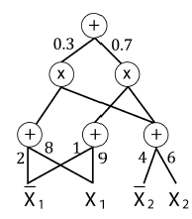
What is a Sum-Product Network?
Poon and Domingos, UAI 2011
Acyclic directed graph of sums and products
Leaves can be indicator variables or univariate distributions

Slide 4
Two Views
Deep architecture with clear semantics
Tractable probabilistic graphical model

Slide 5
Deep Architecture
Specific type of deep neural network
Activation function: product
Advantage:
Clear semantics and well understood theory

Slide 6
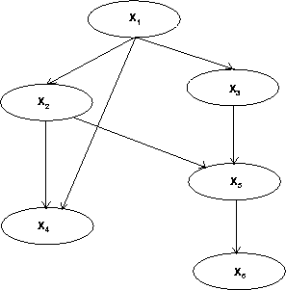
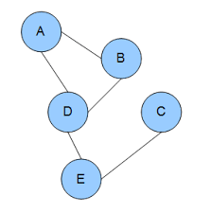
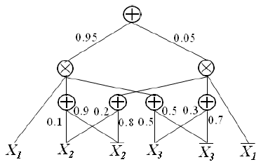
Probabilistic Graphical Models
Bayesian Network
Graphical view of direct dependencies
Inference
#P: intractable
Markov Network
Graphical view of correlations
Inference
#P: intractable
Sum-Product Network
Graphical view of computation
Inference
P: tractable

Slide 7
Probabilistic Inference
SPN represents a joint distribution over a set of random variables
Example: $Pr⁡(X_{1}=true,X_{2}=false)$

Slide 8

Marginal Inference
Example: $Pr⁡(X_{2}=false)$

Slide 9
Conditional Inference
Example:
$$Pr\left(X_{1}=true | X_{2}=false\right) \\ =\frac{\operatorname{Pr}\left(X_{1}=true,X_{2}=false\right)}{\operatorname{Pr}\left(X_{2}=false\right)} \\ =$$
Hence any inference query can be answered in two bottom passes of the network
Linear complexity!

Slide 10
Semantics
A valid SPN encodes a hierarchical mixture distribution
Sum nodes: hidden variables (mixture)
Product nodes: factorization (independence)

Slide 11
Definitions
The scope of a node is the set of variables that appear in the sub-SPN rooted at the node
An SPN is decomposable when each product node has children with disjoint scopes
An SPN is complete when each sum node has children with identical scopes
A decomposable and complete SPN is a valid SPN

Slide 12
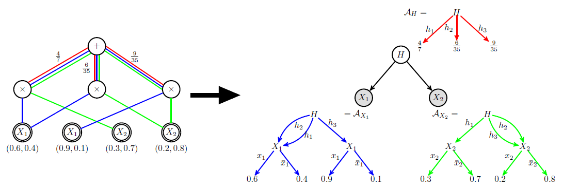
Relationship with Bayes Nets
Any SPN can be converted into a bipartite Bayesian network (Zhao, Melibari, Poupart, ICML 2015)

Slide 13
Parameter Learning
Parameter Learning: estimate the weights
Expectation-Maximization, Gradient descent
Instances
Data
?
?
Attributes
?
?
?
?
?
?

Slide 14
Structure Learning
Alternate between
Data Clustering: sum nodes
Variable partitioning: product nodes

Slide 15
Applications
Image completion (Poon, Domingos; 2011)
Activity recognition (Amer, Todorovic; 2012)
Language modeling (Cheng et al.; 2014)
Speech modeling (Perhaz et al.; 2014)

Slide 16
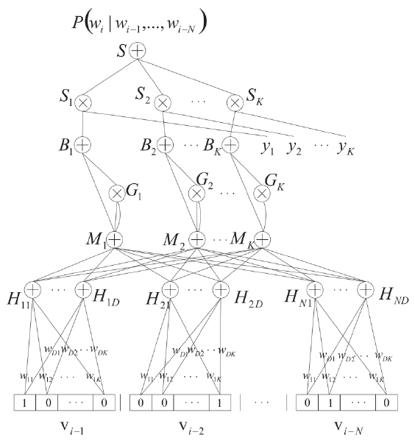
Language Model
An SPN-based n-gram model
Fixed structure
Discriminative weight learning by gradient descent

Slide 17
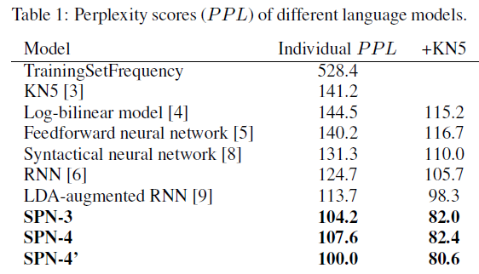
Results
From Cheng et al. 2014

Slide 18
Conclusion
Sum-Product Networks
Deep architecture with clear semantics
Tractable probabilistic graphical model
Work in progress at Waterloo
Improved structure learning: H. Zhao
Online parameter learning: H. Zhao, A. Rashwan
SPNs for sequence data: M. Melibari
Decision SPNs: M. Melibari
Open problem:
Thorough comparison of SPNs to other deep networks

