Slide 1
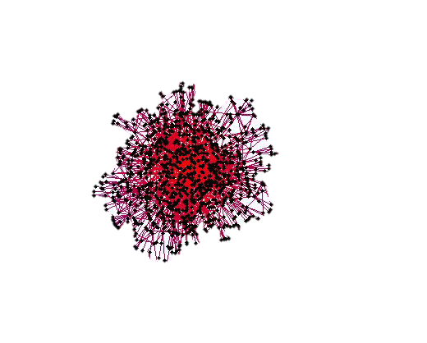
Going Beyond Simple Question Answering
Bahareh Sarrafzadeh
CS 886 – Spring 2015

Slide 2
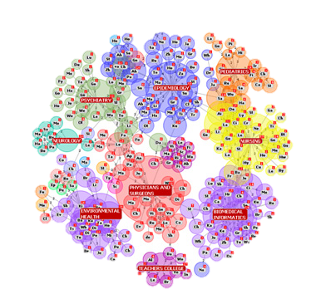
Current Challenges
Information Overload
Lack of Interaction
Lack of Overviews
Notes:
Information Overload is a well-known problem in today’s world.
The other two are the shortcomings of the current IR paradigm.

Slide 3
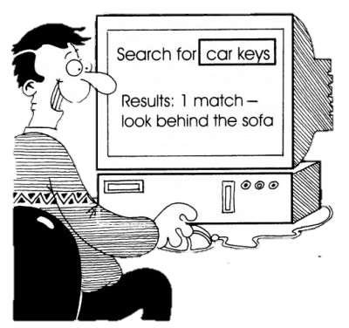
Current Efforts
Ranking Methods
Ordering retrieved documents
Novelty
Diversity
Going Beyond Documents
QA
Summarization
IE
Notes:
Ranking methods are a key part of IR systems and they help with fighting the Information Overload by ordering the retrieved docs such that the user doesn’t have to go through all.
There are interesting ranking criteria like “Novelty” and “Diversity” that help with identifying the docs that contain novel information and diversifying the SERP so the top ranked results cover different aspects related to the topic.
the ability of a machine to answer questions, simple or complex, posted in natural language, is perhaps the most exciting technology that we’ve asked for over a decade ago.
There are a different set of approaches that aim at retrieving a short, focused “answer” to the user’s query, so the user doesn’t need to read through many docs to find what he wants.
However, we argue that these approaches are usually applicable when the information need is not complex and it does not involve learning or investigation.

Slide 4
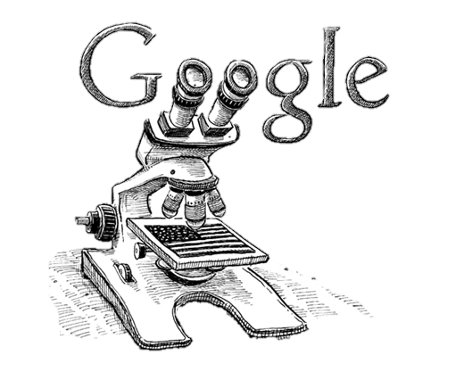
Motivation
Web Search and Increasing Expectations
Largest source of information
Satisfies different types of information needs
Search engines facilitated finding information
But … the expectations exceeds the capabilities
Notes:
However, the ease of Web Search, had led many people to turn into Web for any type of questions they may have.
People, perform many different types of search.

Slide 5
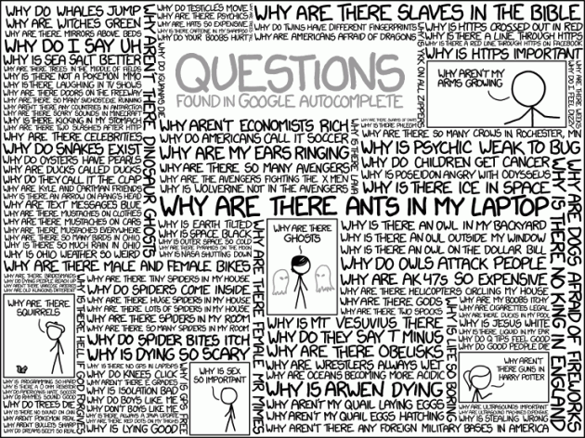

Slide 6
Motivation – Contd.
Search Engines do NOT fully support
Information need is not well defined;
The nature of Search is Complex;
It involves Learning;
…
Notes:
Exploratory searches have a serendipitous nature which simulates analogical thinking, which means users can relate their experience to other comparable situations. Hence, exploratory searches may be more concerned with recall than precision. Thus they are not well supported by today’s web search engines that are highly tuned toward precision in the first page of the results.

Slide 7
Simple v.s. Complex
People’s day-to-day search activities can vary greatly
motivations, objectives, and outcomes.
These search activities can be broadly classified into two groups: “Simple” and “Complex”.
Simple search tasks are similar to “known-item” search tasks
involve looking up some discrete, well-structured information object;
e.g., numbers, names and facts;
Complex search tasks, are seen to be more exploratory
involve investigating, learning and synthesis of information

Slide 8
Supporting Simple Questions
IR-based approaches
QUESTION PROCESSING
Detect question type, answer type, focus, relations
Formulate queries to send to a search engine
PASSAGE RETRIEVAL
Retrieve ranked documents
Break into suitable passages and re-rank
ANSWER PROCESSING
Extract candidate answers
Rank candidates
using evidence from the text and external sources
Knowledge-based and Hybrid approaches
Build a semantic representation of the query
Times, dates, locations, entities, numeric quantities
Map from this semantics to query structured data or resources
Geospatial databases
Ontologies (Wikipedia infoboxes, dbPedia, WordNet, Yago)

Slide 9
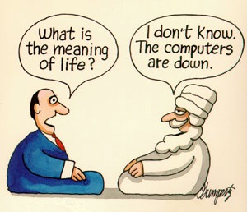
Supporting Complex Search
Finding relevant information
Making sense of the information
Offloading and Organizing the gathered information
Notes:
Since users do come up with complex questions these days, we need to develop frameworks that can support exploratory activities through different phases:
Finding …, Making sense of …., Offloading and Organizing.

Slide 10
How Complex Questions are Different?
Seek multiple different types of information simultaneously
One single answer will not suffice
General (rather than specific)
Open-ended
Target multiple items/documents
Involve Uncertainty
Motivated by ill-defined problems
Dynamic and evolve over time
Multi-faceted

Slide 11
Example
“How accurate are HIV tests?”
answer: a number or a range
“What are the causes of AIDS?”
wider focus;
less well-defined information need;
undefined informational goal;

Slide 12
Why Complex QA is more Challenging?
The Information Need is often Subjective and Ill-defined;
The answers do not necessarily fall into predictable semantic classes;
They may need some intellectual and cognitive development at the user side;
It’s not always possible to formulate a Query

Slide 13
Automatic Complex QA
Returning unstructured lists of candidate answers
e.g. “What effect does steroid use have on athletes’ performance?”
{“steroid helps boost athletic performance by improving muscle mass”, “steroids can cause many harmful effects”}
Returning paragraph-length answers
responsive;
relevant;
coherent;
e.g. “Describe steps taken and worldwide reaction prior to the introduction of Euro on January 1, 1999. Include predictions and expectations reported in the press.”
“Despite skepticism about the actual realization of a single European currency as scheduled on January 1, 1999, preparations for the design of the Euro note have already begun. Europe’s new currency, the euro, will rival the U.S. dollar as an international currency over the long term, Der Spiegel magazine reported Sunday.”
Notes:
Over the past years, complex questions have been the focus of much attention in both the automatic QA and Multi-doc Summarization
While most current complex QA evaluations require systems to return unstructured lists of candidate answers .. , recent MDS evaluations have tasked systems with returning paragraph-length …

Slide 14
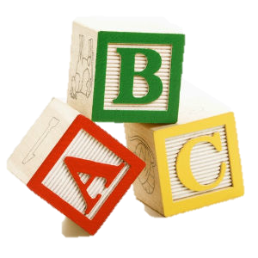
A Simple Paradigm
Question Decomposition
Factoid QA Techniques
Multi-Document Summarization (MSD)
Notes:
Based on Harabagiu et al. (2006)

Slide 15
Example
How have thefts impacted on the safety of Russia’s nuclear navy, and has the theft problem been increased or reduced over time?
Need of Domain Knowledge
To what degree do different thefts put nuclear or radioactive materials at risk?
Definition questions:
• What is meant by nuclear navy?
• What does ‘impact’ mean?
• How does one define the increase or decrease of a problem?
Factoid questions:
• What is the number of thefts that are likely to be reported?
• What sort of items have been stolen?
Alternative questions:
• What is meant by Russia? Only Russia, or also former Soviet facilities in non-Russian republics?
Question Decomposition

Slide 16
MDS and Complex QA
Sentence Retrieval
Translation Models
Highly Frequent Terms
Graph-based Random Walks
…
Sentence Ranking
Relevance
Informativeness / Interestingness
Novelty
Diversity
…
Sentence Ordering
Coherence
Cohesion
Sentence Similarity
Clustering
Textual Entailment
Sentence Alignment
Notes:
Concepts of coherence and cohesion enable us to capture the theme of the text. Coherence represents the overall structure of a multi-sentence text in terms of macro-level relations between clauses or sentences.
Cohesion, as defined by Halliday and Hasan (1976), is the property of holding text together as one single grammatical unit based on relations (i.e. ellipsis, conjunction, substitution, reference, and lexical cohesion) between various elements of the text. Lexical cohesion is defined as the cohesion that arises from the semantic relations (collocation, repetition, synonym, hypernym, hyponym, holonym, meronym, etc.) between the words in the text (Morris & Hirst, 1991).

Slide 17
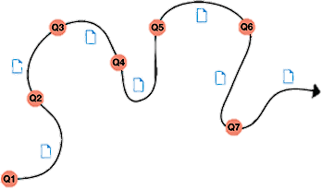
Is the Perfect QA System enough?
Rather than seeking an exact answer, a user might be interested in related information;
It may not be possible to formulate the information need as a question;
Information is gathered in bits and pieces;
The user has to assimilate this new Knowledge into his existing one;
“Intellectual Development”
It’s about the Journey; not the Destination!
Notes:
A type of information seeking and a type of sensemaking focused on the gathering and use of information to foster intellectual development [White, R. and Roth, A (2009)].

Slide 18
Supporting Complex Search
Finding relevant information
Making sense of the information
Offloading and Organizing the gathered information
Notes:
Since users do come up with complex questions these days, we need to develop frameworks that can support exploratory activities through different phases:
Finding …, Making sense of …., Offloading and Organizing.

Slide 19
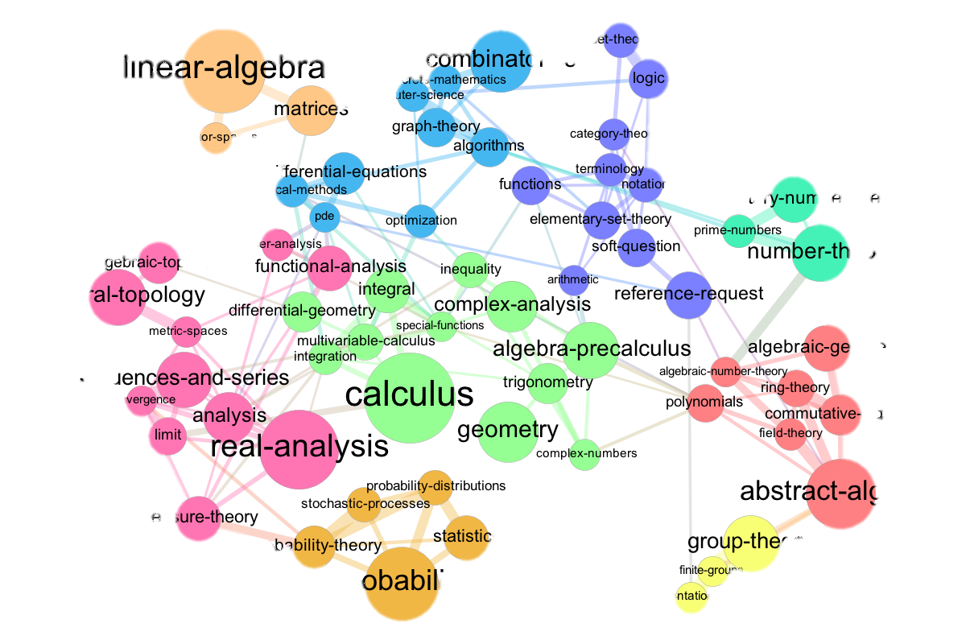
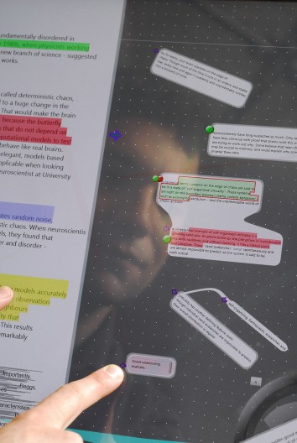
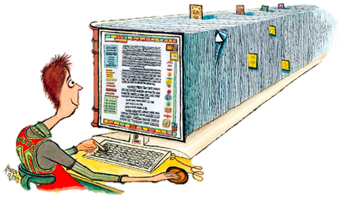
Supporting the Exploration

Slide 20
Notes:
a group of hyper-intelligent pan-dimensional beings demand to learn the Answer to the Ultimate Question of Life, The Universe, and Everything from the supercomputer, Deep Thought, specially built for this purpose. It takes Deep Thought 7½ million years to compute and check the answer, which turns out to be 42. Deep Thought points out that the answer seems meaningless because the beings who instructed it never actually knew what the Question was.

Slide 21
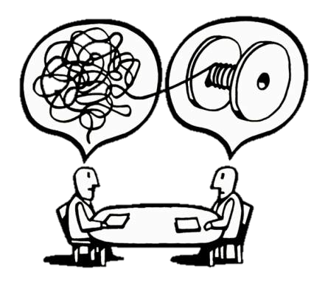
Thank You!

