Slide 1
Approximating Semantics
July 28, 2015, CS 886, Topics in Statistical NLP
Ming Li
University of Waterloo
Notes:
First given at AAAC’2011 – Taiwan, 2011, April. (Tsinghua University in Taiwan), then revised for Wilfred Laurier 100 yr conf in July, 2011, then revised for DS2011, Oct 4, 2011. Then revised Dec 2011 for Solomonoff conference. Then changed April 16, 2012 for UW colloquium. Then at SharcNet. What do frogs eat with their hamburgers – French flies. Why do gorillas have big nostrils? (because they have big fingers) What has 4 wheels and flies (pick up truck hauling manures) Then at Huawei Sept 5, 2013.

Slide 2
Semantics and semantic distance are not well defined, perhaps cannot be defined (just like the concept of “computation”).
In NLP applications, we usually have the answers. The key is to compute the “semantic distance” from a query to another query that has an answer.
We will propose a theory of approximating the “semantic distance” (whatever it is) such that our approximation is “better than” any other approximation.

Slide 3
New Theory
A well defined new theory
Better than
All of these
Traditional Distances
Undefined Semantic Distance
Any computable
version of semantic
distance

Slide 4
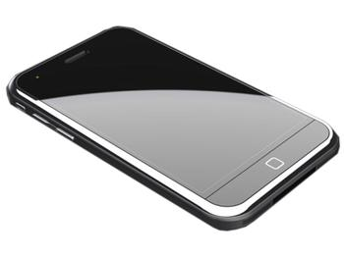
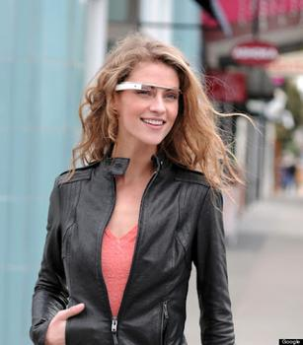


In the 20th century, we have invented hi-tech: Phones, TVs, Laptops
They will disappear in the 21 century
Replacing them: Natural User Interface

Slide 5
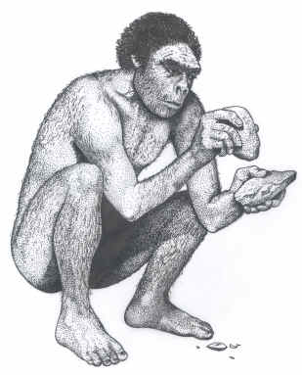

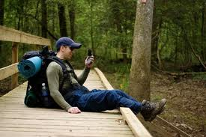
For 3 million years, our hands have been tied up by tools.
It is time to free them, again.

Slide 6
But the reality is not here yet
Let’s ask Siri
  What do fish eat?
  What does a cat eat?
What is the problem?

Slide 7
Problem 1: keywords vs templates
If you use keywords, like Siri, then you make mistakes like: “What do fish eat? → seafood”
If you use templates, like Evi, then you have trouble with even slight variations: “Who is da prime minister of Canada?”
We need to calculate the “distance” from a query to other queries with known answer.

Slide 8
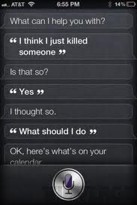
Problem 2: Domain classification
How can we prevent the mix up?
Ideally: we need to define a “distance”
It should satisfy triangle inequality etc
What do fish eat?
Phone
Weather
Restaurant
Music
GPS
Calendar
Time
General
search
Hotels
News
SMS
Email

Slide 9
Problem 3: What I said vs what it heard
In CACM, July 2013
How to improve speech recognition system in our QA domain?
Solution:
  Use 40 million user asked questions, set Q.
  Given voice recognition result {q₁,q₂,q₃}, we wish to find q, s.t.:
{q₁,q₂,q₃} ⬄ q ⬄ Q
is minimized.
How to define the distances?

Slide 10
Prob. 4: What it translates to vs what I meant
In CACM, July 2013
Translation systems are not ready for QA.
  蚂蚁几条腿? Google: Ants several legs.
  How do we improve it for special QA domain?
Solution:
  Use 40 million user asked questions, set Q.
  Given the translation result q₁, we find q, s.t.:
q₁ ⬄ q ⬄ Q
is minimized.
How do we define the distance?

Slide 11
Talk plan
Derive “Information Distance” to approximate the undefined semantic distance.
Apply it to solve problems 1-4.

Slide 12
Traditional approach:
We could apply one of the 21 statistical measures studied in [Tan et al: Selecting the right interestingness measure for association patterns, KDD’02]. Let’s analyze the following few:
Hirst and St-Onge proposes L(w,w’) in worldnet.
Leacock and Chodorow: -log L(w,w’)
Resnik propose to use: –log P(lso(w,w’)) (lowest super ordinate)
Lin: 2logP(lso(w,w’) / [logP(w)+logP(w’)
Jiang-Conrath: 2log P(lso(w,w’)) – [logP(w)+logP(w’)]
What makes most sense is “closeness in semantics” or call it “semantic distance”, but this cannot be mathematically defined.

Slide 13

What is a “distance”?
In physical space:
What is the distance between two information carrying entities: web-pages, genomes, abstract concepts, books, vertical domains, a question and an answer?
We want a theory:
  Derived from the first principles;
  Provably better than “all” other theories;
  Usable.

Slide 14


The classical approaches do not work
For all the distances we know: Euclidean distance, Hamming distance (sum of # of pixels that differ), nothing works. For example, they do not reflect our intuition on:
But from where shall we start?
We will start from first principles of physics and make no more assumptions. We wish to derive a general theory of information distance.
Austria
Byelorussia 1991-95

Slide 15
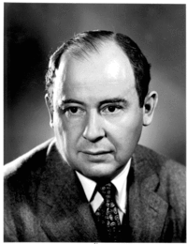
Thermodynamics of Computing
Heat Dissipation
Input
Compute
Output
Von Neumann, 1950
Physical Law: 1kT is needed to (irreversibly) process 1 bit.
Landauer

Slide 16
Reversible computation is free
A billiard ball computer.
Input
Output
A
A AND B
0
1
1
0
0
1
1
1
0
0
0
1
1
1
A
billiard
ball
computer
B AND NOT A
A AND NOT B
B
A AND B

Slide 17
Deriving the theory …
Cost of conversion between x and y is:
E(x,y) = smallest number of bits needed to
convert reversibly between x and y.
x
p
y
Fundamental Theorem:
E(x,y) = max{ K(x|y), K(y|x) }
Bennett, Gacs, Li, Vitanyi, Zurek, STOC’93. IEEE Trans-IT 1998

Slide 18
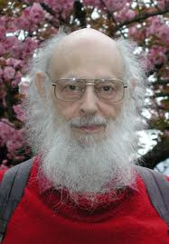
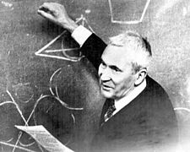

Kolmogorov complexity
Kolmogorov complexity was invented in the 1960’s by Solomonoff, Kolmogorov, and Chaitin.
Kolmogorov complexity of a string x condition on y, K(x|y), is the length of shortest program that given y prints x. K(x) = K(x|ε).
If K(x) ≥ |x|, then we say x is random.
Notes:
Similar talk was given in Taiwan AAAC, 2011, April.

Slide 19
Proving E(x,y) ≤ max{K(x|y),K(y|x)}.
Proof. Define graph G={XUY, E}, and let k₁=K(x|y), k₂=K(y|x), assuming k₁≤k₂
  where X={0,1}*x{0}
  and Y={0,1}*x{1}
E={{u,v}: u in X, v in Y, K(u|v)≤k₁, K(v|u)≤k₂}
X: ● ● ● ● ● ● …
Y: ○ ○ ○ ○ ○ ○ …
We can partition E into at most 2^{k₂+2} matchings.
  For each (u,v) in E, node u has most 2^{k₂+1} edges hence belonging to at most 2^{k₂+1} matchings, similarly node v belongs to at most 2^{k₁+1} matchings. Thus, edge (u,v) can be put in an unused matching.
Program P: has k₂,i, where M_{i} contains edge (x,y)
  Generate M_{i} (by enumeration)
  From M_{i},x ➔ y, from M_{i},y ➔ x. QED
degree≤2^{k₂+1}
M₁
M₂
degree≤2^{k₁+1}

Slide 20
Information distance:
D(x,y) = max{K(x|y),K(y|x)}
Theorem: For any other “reasonable” D’, there is a constant C, such that for all x, y,
D(x,y) ≤ D’(x,y) + C

Slide 21
Interpretations
Thus Information distance covers all computable distances like: edit distance, all 21 distances in Tan paper.
What we really want is “Semantic Distance”. But what is it? Like the concept of “computable”, Nobody knows.
  There are works, such as latent matching, trying to use it (in search context).
  But as long as it is a computable approach, it is dominated by information distance.

Slide 22
Let’s make a bold proposal:
Semantic distance ~ Information distance

Slide 23
Relationship
Information Distance
Dominates
Traditional Distances
Semantic Distance
Any computable
version of semantic
distance

Slide 24
Problem 1. Template variation
What is weather like in HK tomorrow?
What is weather in HK tomorrow?
Tomorrow what is weather like in Hong Kong?
In HK what will be weather like tomorrow?
How is weather in Hong Kong tomorrow?
I wish to know the weather in HK tomorrow?
They all mean the same –
and they have very small information distance to each other!

Slide 25
Encoding – Anything with small distance gets the same answer
Word level encoding
  WordNet – 0 bit for same Synset, k bits on path of length k.
  Yago2 – connecting Dbpedia entities to WorkNet
  DBpedia – recognizing Wikipedia entities in a sentence
Sentence text level encoding:
Sentence semantic level encoding. Big challenge:
  What is the population of China?
  How many people live in China?
In HK what will be weather like tomorrow?
Hi, what is weather like in Waterloo tomorrow?

Slide 26
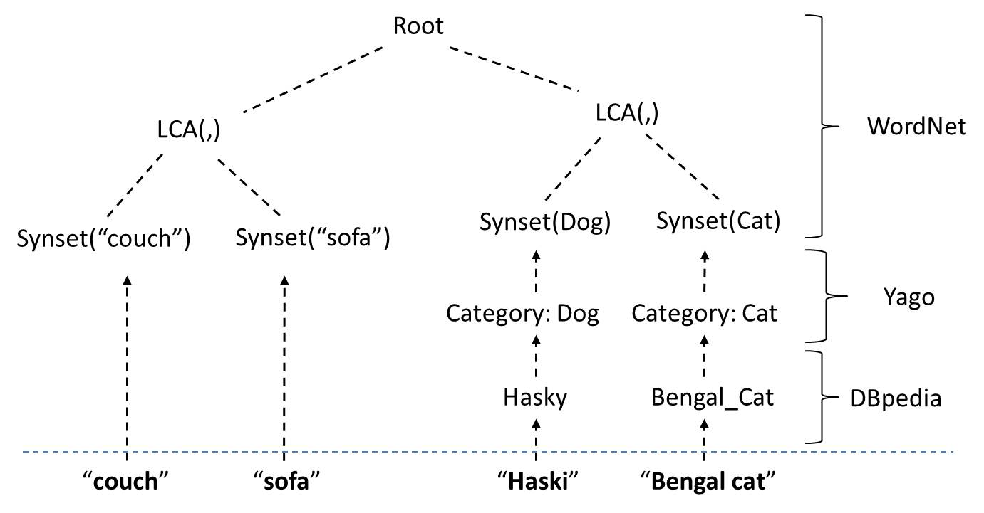
Word level encoding
Husky
Huski

Slide 27
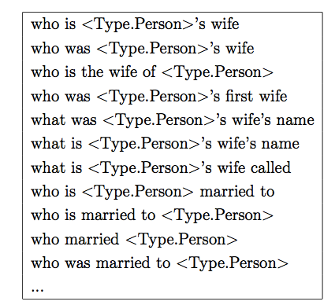
Semantic encoding
We have collected 40 million Question-Answer pairs.
Cluster questions “according” to answers
  Select DBpedia entries
  Clustering
  Compute eigenvalues

Slide 28
Problem 2. Domain Classification
Weather domain positive/negative samples:
  What should I wear today?
  May I wear a T-shirt today?
  What was the temperature 2 weeks ago?
  Shall I bring an umbrella today?
  Do I need suncream tomorrow?
  What is the temperature on the surface of the Sun?
  How hot is the sun
  Should I wear warm clothes today?
  What is the weather like last Christmas?

Slide 29
To build up a weather domain systematically
Clusters:
What is the weather like [location phrase] ?
What is the temp [time phrase] [location phrase] ?
We have obtained 40
million questions, Q
Keywords: weather, city, time,
rain, temperature, hot, cold,
wind, snow, umbrella, T-shirt,
API(Weather)
6000 questions extracted from Q:
What is the weather like?
What is the weather like today?
What is the weather like in Paris?
What is the temperature today?
What is the temperature in Paris?
There are ~3000 negative examples:
What is the temperature of the sun?
What is the temperature of the boiling water?

Slide 30

Comparison of RSVP, Siri, S-Voice on 100 typical weather “related” questions:
What weather is good for an apple tree?
What is the temperature on Jupiter?

Slide 31
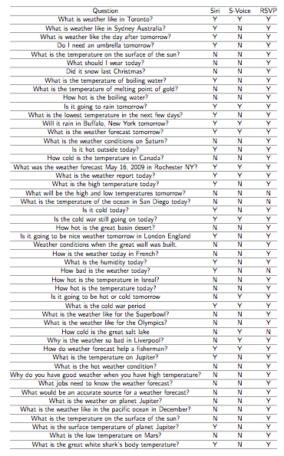

Slide 32
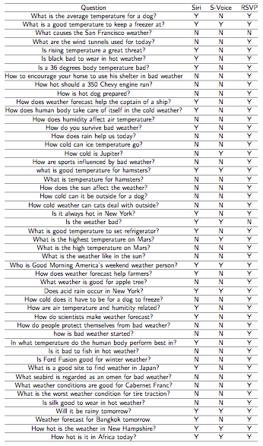

Slide 33
Problem 3. Speech improvement
Comm. ACM, July, 2013
Original question: Are there any known aliens?
Voice recognition result
  Are there any loans deviance
  Are there any loans aliens
  Are there any known deviance
RSVP outputs: “Are there any known aliens”，via minimizing the following:
{q₁,q₂,q₃} ⬄ q ⬄ Q

Slide 34
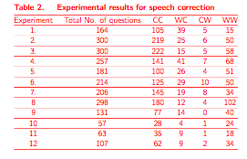
Experiments summary

Slide 35
Problem 4. Translation
Comm. of ACM, July, 2013, pp 70-77
Using information distance via semantic encoding, we can now also minimize:
q₁ ⬄ q ⬄ Q
从深圳到北京坐飞机多长时间？
  Google translation: Fly from Shenzhen to Beijing how long?
  Bing Translation: From Shenzhen to Beijing by plane to how long?
  RSVP translation: How long （does it take） to fly from Shenzhen to Beijing
恐龙是什么时候灭绝的？
  Google: Dinosaur extinction when?
  RSVP: When did the dinosaurs extinct?

Slide 36

Translation experiments:

Slide 37
Importance of Cross-language Search
Smartphone Trend: 2011 Q2, 2012 Q2 2013 Q2
US: 24M 24.2 M 32.9M
China: 24M 44.4 M 88.1M
Can we reach these people?

Slide 38
What does Information Distance give us:
Being a generative method, it gives direct solution to problems 3 and 4 as minimum encoding. Other distances require us to generate all candidates – which is impossible.
For problems 1 and 2, Information Distance unifies all methods coherently, providing a consensus method, as individually none of them being perfect:
  Many of these distances are not symmetric, not well defined
  None works in all cases, for example: cosine distance fails for “what fish eat” and “what eat fish”.

Slide 39
Conclusion
Semantics distance cannot be defined or computed
We proposed to approximate it with “information distance” that is provably the best approximation.
The new approximation although still not computable, but is at least “well defined”, and can be practically implemented via compression.
Open questions:
  What about “not”
  Boundaries of this approach.

Slide 40
Collaborators:
Information distance: C. Bennett, P. Gacs, P. Vitanyi, W. Zurek
RSVP system: K. Xiong, G.Y. Feng, A.Q. Cui, HC. Qin, B. Ma, J.B. Wang, Y. Tang, D. Wang, X.Y. Zhu, Y.H. Chen, A. Lin, Hang Li, Qiang Yang.
Financial support: Canada’s IDRC, PDA, Killam Prize, C4-POP, CFI, NSERC, Huawei Corp.

