Slide 1
Self Organizing Binary Search Trees
How can we update a binary search tree on an access to improve its performance?

Slide 2
Self Organizing Binary Search Trees
How can we update a binary search tree on an access to improve its performance?
Follow the ideas from linear search

Slide 3
Self Organizing Binary Search Trees
How can we update a binary search tree on an access to improve its performance?
Follow the ideas from linear search
Recall “transpose” on linear search
So on an access “swap with parent” in a BST
x
y
y
x

Slide 4
How Good is “Swap with Parent”?
Theorem: If all probabilities are equal (i.e. 1/n),then (asymptotically) “swap with parent” generates all binary trees with the same probability.
That’s good?

Slide 5
How Good is “Swap with Parent”?
Theorem: If all probabilities are equal (i.e. 1/n),the (asymptotically) “swap with parent” generates all binary trees with the same probability.
No, that’s bad!
But ???
If you insert elements in random order, you get rather good trees

Slide 6
Inserting Elements in Random Order
Cost of insertion = Cost of search for that element
Cost of inserting all n elements same as Quicksort
$$T\left(n\right)=( n−1)+( \sum_{i=1}^{ n}{T\left(i−1\right)+}\sum_{i=1}^{n}{{T\left(n−i\right) )/n}^{ }}$$
$=2{(\ln{2) n}\lg{n+O(n)}}$
$=$ 1.38…$n lg{n+O(n)}$

Slide 7
But Random Order isn’t Random Tree
Consider n=3
There are 5 trees
abc acb bac, or bca cab cba
Probability 1/6 except probability 1/3
The balanced one is more likely

Slide 8
But Random Order isn’t Random Tree
There are $\left(\begin{matrix}2n \\ n\end{matrix}\right)$/(n+1) binary trees (Catalan number)
≅ $4^{n}$/(${ n}^{3/2}$)
So about half have a root with only one child

Slide 9
But Random Order isn’t Random Tree
There are $\left(\begin{matrix}2n \\ n\end{matrix}\right)$/(n+1) binary trees (Catalan number)
≅ $4^{n}$/(${ n}^{3/2}$)
So about half have a root with only one child
Indeed
Theorem: The expected search cost for a random element in a random binary tree is Θ(√$n$)
Very different from tree created by random insertions
So swap with parent is a disaster

Slide 10
If it’s Bad to do it Once …
Do it as often as you can ???
Rotate to root

Slide 11
If it’s Bad to do it Once …
Do it as often as you can ???
Rotate to root
Theorem: Under a model in which each element has fixed and independent probability of access, rotate to root gives expected behaviour at most 2 (ln 2) H, and 2 (ln 2) lg n if all p_{i}=1/n.
So rotate to root looks good ???

Slide 12
Rotate to Root: What can Happen?
In rotating to root, all elements on that path can be moved down
This can lead to poor amortized behaviour
d
c
a
b

Slide 13
Splaying
Sleator and Tarjan:
Splaying is a move to root method that avoids moving a whole path down:
If element at root: leave it
If element is a child of root, swap with root (call this a zig step)
If lower down … avoid moving others down too much. Two cases … zig-zig and zig-zag

Slide 14
Splaying: Zig-Zig and Zig-Zag
Two cases: Outside and Inside grandchild
The outside grandchild (z): the zig-zig step
x
z
y
y

Slide 15
Splaying: More on (Not) Zig-Zig
Zig-zig is not a double rotation (as in AVL) and not 2 single rotations
2 Single rotations:
x
y
z
y

Slide 16
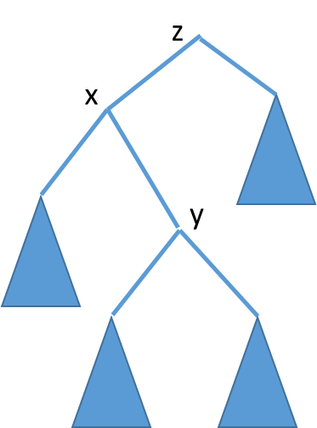
Splaying: Zig Zag
The inside grandchild:
This is a double rotation as per AVL trees
y
x
z

Slide 17
Splay Trees
Splay trees guarantee Θ(lg n) behaviour on an amortized basis

Slide 18
Splay Trees
Splay trees guarantee Θ(lg n) behaviour on an amortized basis
Paths may get long … so keeping track of the path could take Θ(n) extra space
use “pointer reversal trick” to avoid this

Slide 19
Splay Trees
Splay trees guarantee Θ(lg n) behaviour on an amortized basis
Paths may get long … so keeping track of the path could take Θ(n) extra space
use “pointer reversal trick” to avoid this
But if Θ(lg n) behaviour is all we care about … use AVL trees (etc)
and the constant factor is lower
Splay tree have other very useful properties for “efficient search”

Slide 20
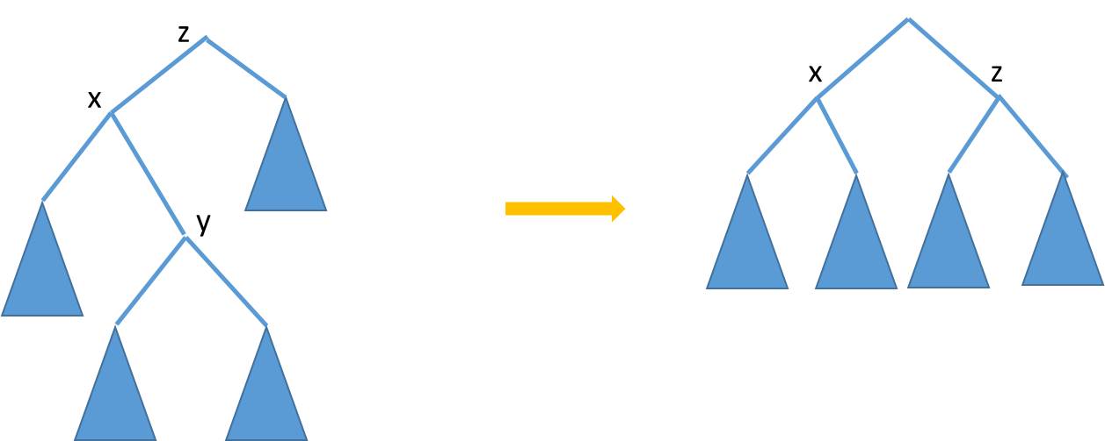
Splay Trees: Pulling Others Up
Splaying a node at depth d takes Θ(d) time and
roughly halves the depth of every node of the access path
E.g. Zig-Zag
Zig-Zig is similar
y

Slide 21
Splay Trees: Starting the Analysis
Analysis will be based on a potential function:
a = t + Φ − Φ’
amortized actual time old potential new potential
So for m operations
Σt_{j} = Σ(a_{j} + Φ_{j} − Φ_{j}’)= Σa_{j} + Φ₀ − Φ_{m}

Slide 22
Splay Trees: Starting the Analysis
Analysis will be based on a potential function:
a = t + Φ − Φ’
amortized actual time new potential old potential
So for m operations
Σt_{j} = Σa_{j} + Φ_{j-1} − Φ_{j}= Σa_{j} + Φ₀ − Φ_{m}
The potential function:
Each item has a positive (arbitrary but fixed) weight w(i)
Size of a node , s(x) is Σ weights in its subtree
Rank, r(x) is lg(s(x))
Potential = Σ ranks of all nodes

Slide 23
Splay Trees: The Access Lemma
Splay cost is # rotations done (unless none, in which case 1)
Access Lemma: The amortized time to splay a tree with root t at a node x is at most 3(r(t) – r(x)) + 1 = O(lg (s(t)/s(x))

Slide 24
Splay Trees: The Access Lemma
Splay cost is # rotations done (unless none, in which case 1)
Access Lemma: The amortized time to splay a tree with root t at a node x is at most 3(r(t) – r(x)) + 1 = O(lg (s(t)/s(x))
Proof (sketch):
No rotations bound immediate
Show amortized time is at most
3(r’(x)-r(x)) + 1 in case 1 (x is child of the root)
And
3(r’(x)-r(x)) in case 2 or 3 (x is grandchild of root, or farther down)

Slide 25
Splay Trees: More Analysis
y parent of x, z parent of y
Case 1 (1 rotation, a single zig)
Amortized time 1+r’(x)+r’(y)-r(x)-r(y)
≤1+r’(x)-r(x) as r(y)≥r’(y)
≤ 1+ 3(r’(x)-r(x)) as r’(x)-r(x) ≥ 0

Slide 26
Splay Trees: More Analysis
y parent of x, z parent of y
Case 1 (1 rotation, a single zig)
Amortized time 1+r’(x)+r’(y)-r(x)-r(y)
≤1+r’(x)-r(x) as r(y)>r’(y)
≤ 1+ 3(r’(x)-r(x)) as r’(x)-r(x)>0
Case 2 (2 rotations, a zig-zag or a zig-zig)
2 + r’(x)+r’(y) +r(z) -r(x)-r(y)- r(z) as only x, y, z can change rank
= 2 + r’(y) +r’(z) -r(x)-r(y) as r’(x)=r(z)
≤ 2 + r’(x) +r’(z)-2r(x) (manipulating) as r’(x)≥r’(y) and r(y)≥r(x)

Slide 27
More on the Access Lemma
Finally we claim 2 + r’(x) +r’(z)-2r(x) is at most 3(r’(x)-r(x))
(i.e. 2r’(x) - r(x) - r’(z) ≥ 2)
And with some manipulations relying on the convexity of the log function we get the claim.

Slide 28
Even More on the Access Lemma
Case 3- amortized time of the step is
2 + r’(x)+r’(y) +r’(z) -r(x)-r(y)- r(z)
And with similar manipulation we get this is at most 2(r’(x)-r(x))
The lemma follows by summing amortized times for all steps
The sum telescopes to an upper bound of
3(r’(x)-r(x))+1 = 3(r(t)-r(x)) + 1

Slide 29
Even More on the Access Lemma
Case 3- amortized time of the step is
2 + r’(x)+r’(y) +r(z) -r(x)-r(y)- r(z)
And with similar manipulation we get this is at most (2(r’(x)-r(x)
The lemma follows by summing amortized times for all steps
The sum telescopes to an upper bound of
3(r’(x)-r(x))+1 = 3(r(t)-r(x)) + 1
Note the lemma holds for any assignment of positive weights

Slide 30
Balance Theorem (if you care)
Balance Theorem: Total access time is O((m+n) lg (n+m))
Proof: Assign each node weight 1/n: total is 1
amortized cost is 3 lg n + 1
Drop of potential is at most n lg n

Slide 31
Static Optimality Theorem
Static Optimality Theorem: If every item is a accessed at least once, the total time is O(m+ Σ q(i) lg(m/q(i)) where q(i)= # times A[i] is accessed.

Slide 32
Static Optimality Theorem
Static Optimality Theorem: If every item is a accessed at least once, the total time is O(m+ Σ q(i) lg(m/q(i)) where q(i)= # times A[i] is accessed.
In the static optimal tree the average cost will be (about) “H”,
i.e. Σ (q(i)/m) lg(m/q(i)) ….
Multiplying by m we have the bound in the theorem …up to “O”

Slide 33
Static Optimality Theorem
Static Optimality Theorem: If every item is a accessed at least once, the total time is O(m+ Σ q(i) lg(m/q(i)) where q(i)= # times A[i] is accessed.
Proof: Assign the weight q(i)/m to element i. Then the sum of the weights is 1. The amortized access cost of A[i] is O(lg(m/q(i))) and the potential drop is small enough, so the theorem follows.

Slide 34
Static Finger Property
Static Finger Theorem: If f is any fixed item, the total access time is O(n lg n + m + Σ lg(|i_{j}-f|) +1)

Slide 35
Static Finger Property
Static Finger Theorem: If f is any fixed item, the total access time is O(n lg n + m + Σ lg(|i_{j}-f|) +1)
Proof: Assign the weight 1/(|i-f|+1)² to element i. Then the sum of the weights is O(1),and the theorem follows.

Slide 36
Two More Nice Results
For access j let t(j) be the number of different elements accessed element i_{j} was last accessed
Working Set Theorem: The total access time is O(n lg n + m + Σ lg(t(j) +1))

Slide 37
Two More Nice Results
For access j let t(j) be the number of different elements accessed element i_{j} was last accessed
Working Set Theorem: The total access time is O(n lg n + m + Σ lg(t(j) +1))
Scanning: in linear time

Slide 38
The “Big” Conjecture
Dynamic Optimality Conjecture: Consider any “long enough” sequence of accesses, a splay tree performs within a constant factor of the cost of the optimal offline algorithm for the these accesses.

