Slide 1
Observer Design Pattern
Also called implicit invocation
Observers are also often called listeners
Observable permits other objects to:
  Register and Unregister
  On one or more defined interfaces
Invokes all registered objects on the interface when relevant events occur

Slide 2
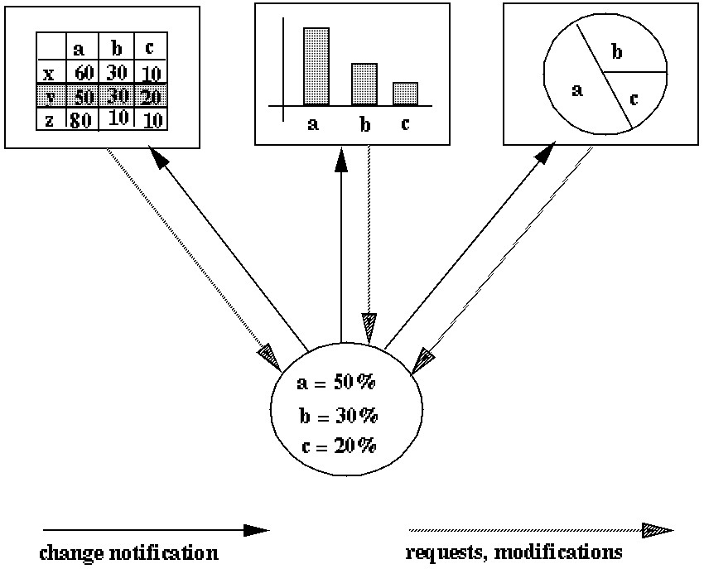
Example use of this pattern
Multiple views of the same data

Slide 3
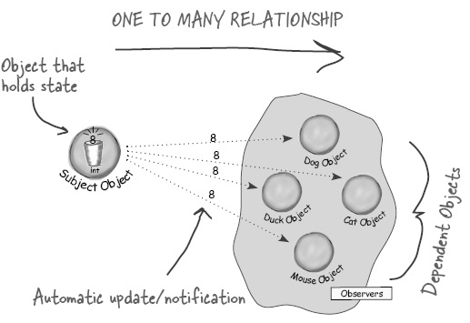
Listeners can query for and/or change subjects state
A listener might consequently be called recursively under itself

Slide 4
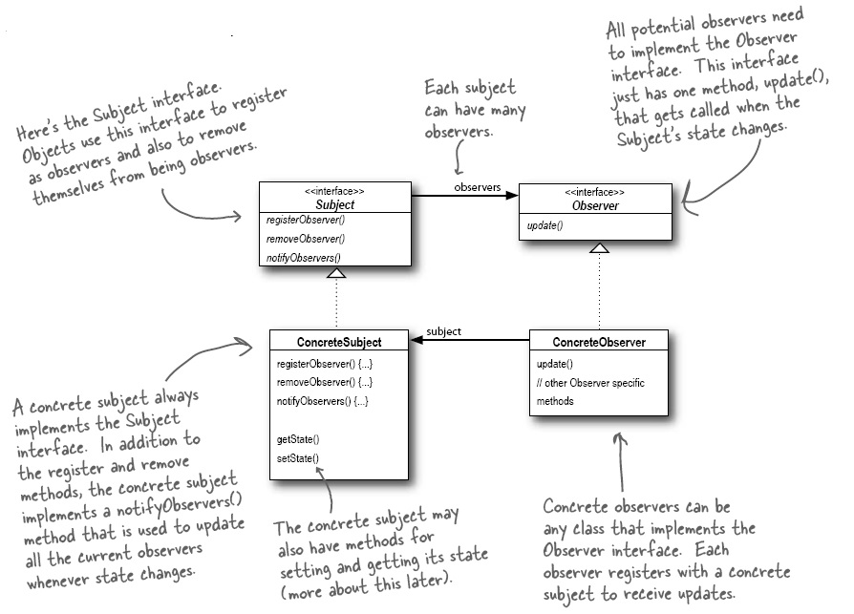

Slide 5
Advantages
Decouples observation of an action from consequences of an action
New consequences can be added without impacting the Observable code
Observable code not cluttered up with all the code concerning every consequence of an action
Code ends up where it rightly belongs
Complexity is replaced by simplicity

Slide 6
Observer Design Pattern Definition
Observer defines a one-to-many dependency between objects so that when one object changes state, all its dependents are notified and updated automatically.

Slide 7
Iterator Design Pattern
Problem: Might have many ways of iterating over a list of things
Principle: Encapsulate what varies
A class that supports:
  Get First
  Get Next
  Seen all
May be implemented by operator overloading
May also be implemented by language
  for (Object obj : collection) [Java 5]

Slide 8
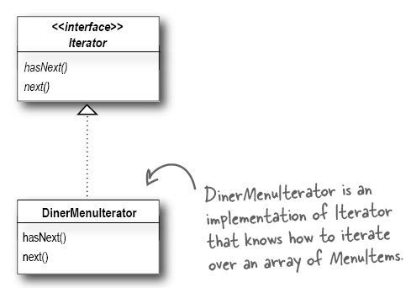
One problem: no two people can agree on the iterator interface ☺
Sometimes iterators overload the ++ operation
Sometimes they have a reset or a getFirst method
They might test hasNext() or return a special interator.atEnd() value

Slide 9
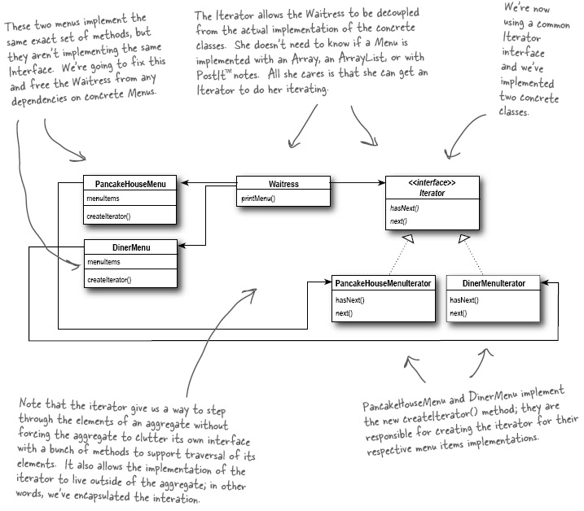

Slide 10
Problems
Adds a potentially needless layer of complexity
Has to carry where it is:
  Might break if used while structure being iterated
  over is changed
The user needs to “know” how to use the iterator
The reader might not understand what an iterator does or how to use it

Slide 11
Iterator Definition
The Iterator Pattern proves a way to access the elements of an aggregate object sequentially without exposing the aggregate object’s underlying representation
It also places the task of traversal on the iterator object, not the aggregate or the user of the aggregate, which conceptually simplifies the aggregate interface

Slide 12
Composite Iterators
Have to remember where we are:
  For a tree this requires also remembering what is above us
  Or having a means of getting to the node above us
Easy to directly traverse a composite tree structure
A little harder to write an iterator to do likewise

Slide 13
Mediator Design Pattern
A lot of things talking to a lot of things
Every time a new thing gets added it gets worse
  Loose track of where the logic is
  Explosion in the number of things interconnected
Put a mediator (bus) between all the things
Everything reports state change to mediator
Everything responds to request from mediator

Slide 14
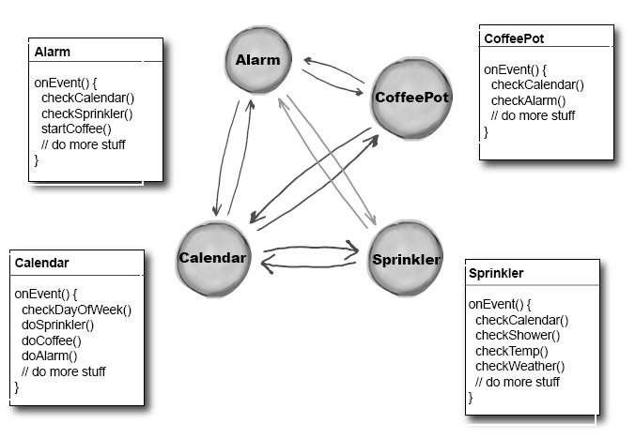

Slide 15
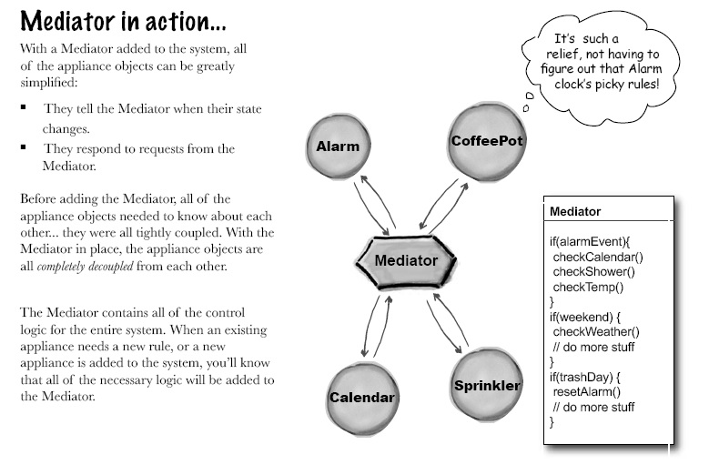

Slide 16
Advantages
All communication between objects is described in one central object
Objects do not need to know about all other objects they might communicate with
Reduces the exponential explosion in how things communicate
Easier to test
Easier to change

Slide 17
Memento Design Pattern
Backup state of a [composite] object
Save this state to a new memento object
To restore object / collection pass saved state to objects restoreState method

Slide 18
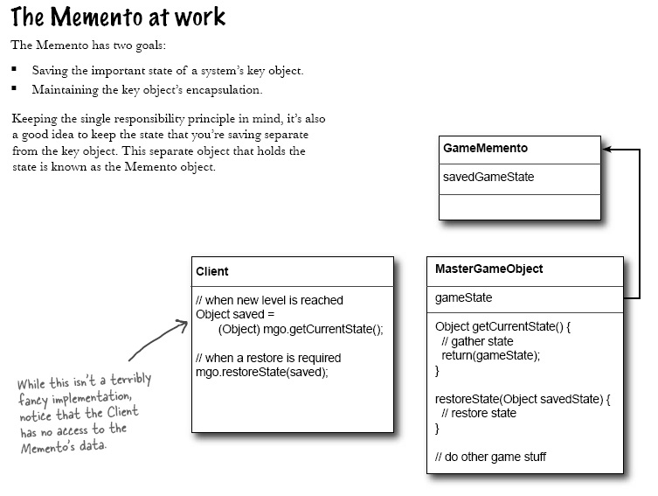

Slide 19
Advantages
Compartmentalizes backup / restore
Can be implemented using serialization
Can have many saved check points
Can restore to any state
Could make memento responsible for backup/restore
  But this would force memento to know about internals of object state it is capturing
  Visitor design pattern

Slide 20
