Slide 1
Behavioral Design Patterns

Slide 2
Template Design Pattern
Have a generic algorithm or task to perform
Want the code to be reusable
But the details differ
Create an abstract class that performs the task
Abstract functions code stuff that changes
Subclass behaviour of these things using polymorphism

Slide 3
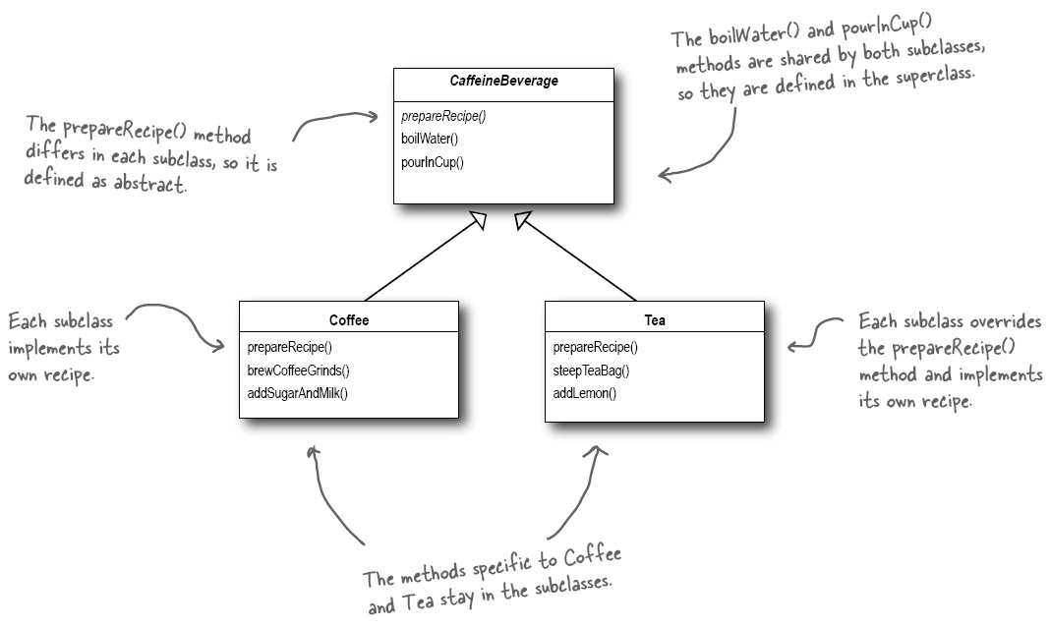

Slide 4
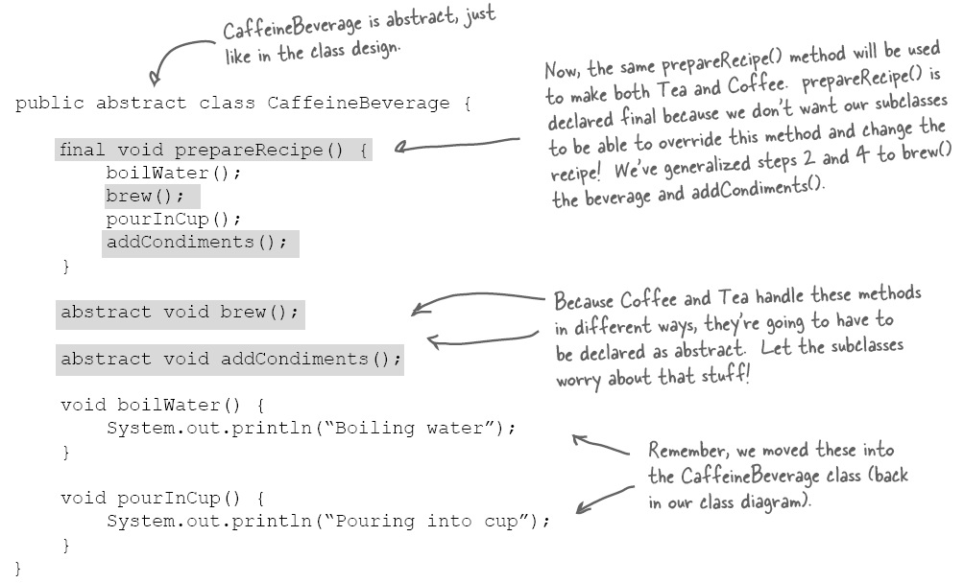
Or even more detailed templating

Slide 5
Template Pattern Advantages
Separates what changes from what does not
Bulk of unchanging code can be easily reused
Detailed differences are all that the subclasses worry about
Much that might change can also be a no-op
This pattern is being used every time in Java you extend a class
  public class MyFrame extends Jframe
  public class MyApplet extends Applet

Slide 6
Template Pattern Definition
The Template Method defines the skeleton of an operation either not specifying some steps to be performed, or giving them a generic default behaviour
The Template Method lets subclasses redefine these steps of the algorithm without otherwise changing the behaviour or intent of the generic algorithm

Slide 7
Strategy Design Pattern
In real life objects can have many behaviours
Need to be able to mix and match behaviours
  Across instances of the same class
  Across different subclasses of a class
  Across very different types of class
Behaviour might dynamically change
Hard to do with the template design pattern
Program to interface not an implementation

Slide 8
Bad approaches
Put behaviour is common superclass
  This forces behaviour on all subclasses
Then use polymorphism to alter behaviour
  Massive amount of code duplication
  Risk that fail to do this in all necessary cases
Use multiple inheritance
  Causes an explosion in the types of classes
  Need a class for all combinations of behaviour
Compile time solutions don’t permit change!!

Slide 9
Solution
Separate the behaviour from the object
  Define generic “do behaviour” as an interface
  Implement actual behaviours as subclasses of this
Logistically think object has-a behaviour
  not is-an object with consequently this behaviour
In original objects needing a behaviour
  Point at behaviour with behavioural interface
  In construction assign actual behaviour to object

Slide 10
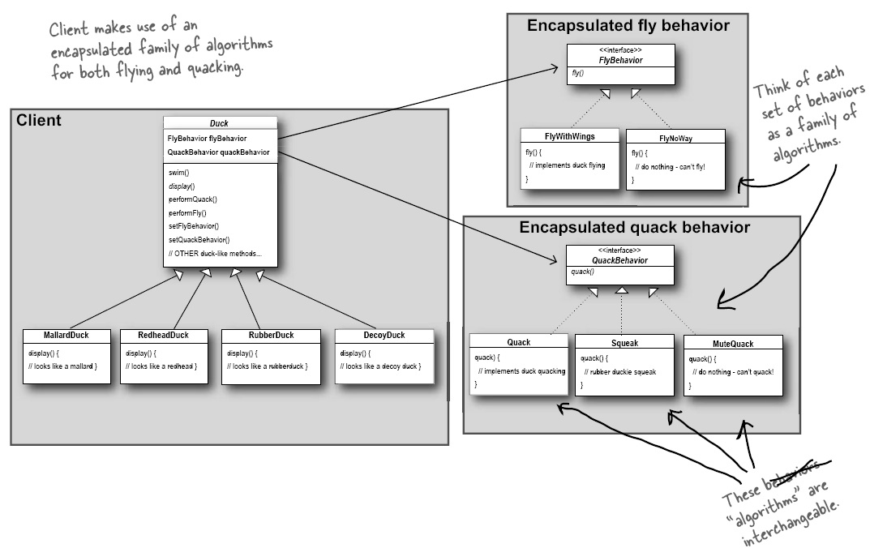

Slide 11
Avoids explosion in classes
Ducks have 8 types of quack and 8 styles of flying
Need 64 types of duck represent this
But need only
  1 type of Duck, 8 types of quack, 8 styles of flying
  Ie. 17 classes using the strategy design pattern
Easy to create new types of quack or flying
Easy to add further types of behaviour
Architecture grows linearly, not exponentially

Slide 12
Other Advantages
Assignment of behaviour now done at run time
Can easily increase types of behaviour with no new class definitions
Code needs to know how to invoke behaviour but not how actual behaviour is implemented
Behaviours can be shared and reused
Behaviour can be dynamically changed
Can modify object without touching behaviour
Can modify behaviour without impacting object

Slide 13
Formal Description
The Strategy Design Pattern defines a family of algorithms, encapsulates each one, and (by using a common interface) makes them interchangeable.
This lets the algorithm vary independently of the clients that use it.

Slide 14
The Command Design Pattern
We can view any behaviour as an action
We can unify different behaviour interfaces
  execute() and undo()
We can combine sequences of behaviour
  Arrays of pointer to successive actions
We can define a single behaviour from many
  Behaviour object that performs sequence of behaviours (these can be also nested)
We can easily implement do, undo, redo
  Simply save in a list the actions as performed

Slide 15
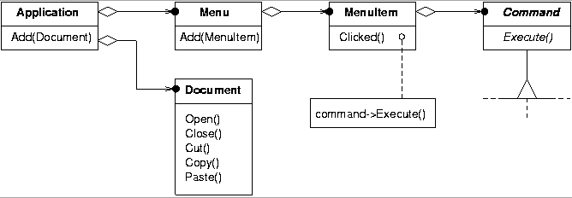
Typical use might be in a menu

Slide 16
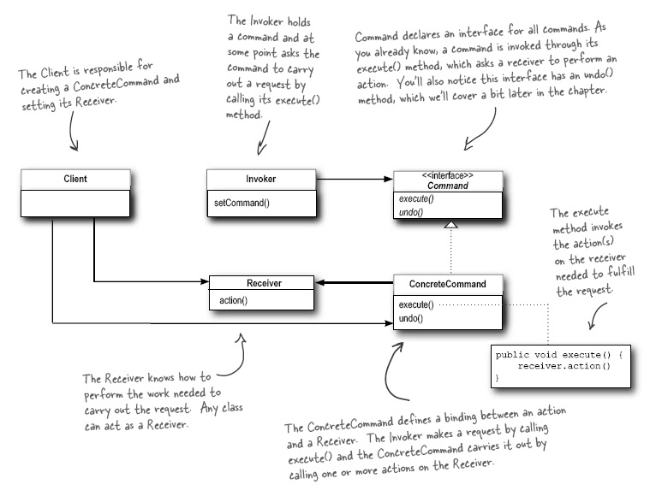
If it has one
Strategy
or does the work itself

Slide 17
More advantages
We can create no-op if no action required
Ducks can now quack when they fly
A concrete command may itself be targeted at different receivers
  Represent the receiver within the command object using the strategy design pattern
We can queue up future commands
  Using event driven message pump
We can cache commands to disk and repeat
  If want to be able to recover from backup

Slide 18
One disadvantage
Can’t easily parameterize an action
  Must add any parameterization to the command as part of its construction
But could have a common interface with an object passed containing parameters or actual parameters to execute if can agree on what these should always be

Slide 19
Command Pattern Definition
The Command Pattern encapsulates a request as an object (reification), letting you parameterize other objects with different requests, queue or log requests, and supports repeat and undoable operations.

Slide 20
State Design Pattern
A specialisation of the strategy pattern
Consider modelling problem as state changes
Define a complete list of actions interface
Represent each state by a class having interface
A class defines ∃ state ∀ actions
Current state is referenced using strategy pattern

Slide 21
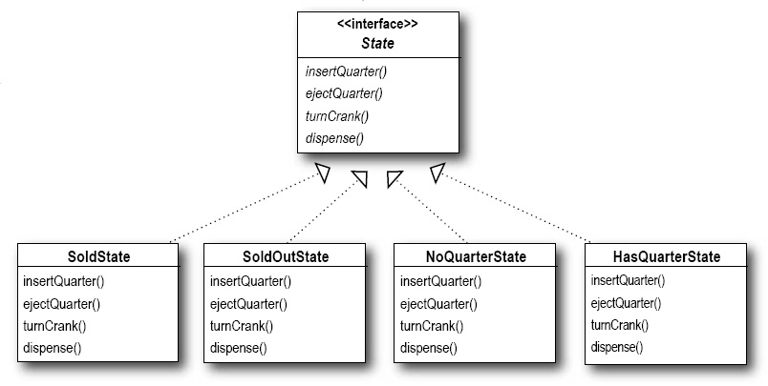

Slide 22
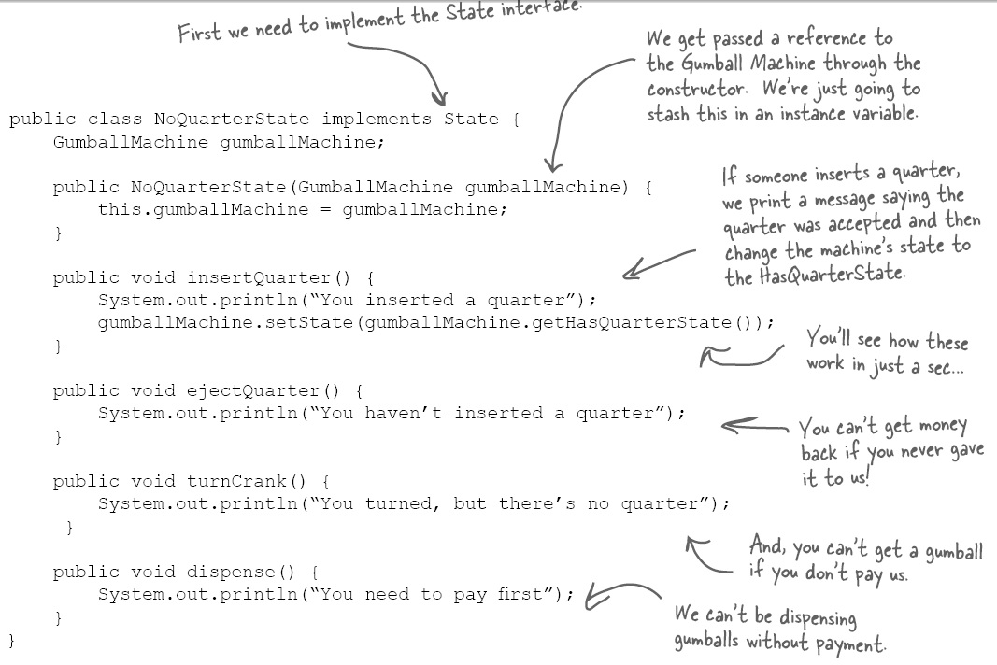

Slide 23
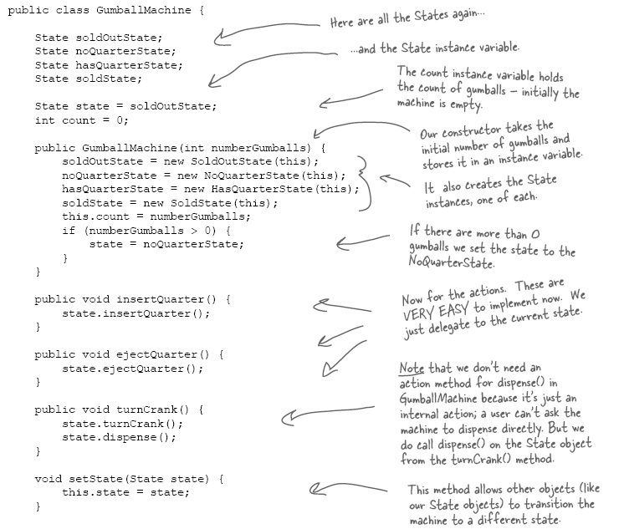
Object
pool
Strategy
Delegation
Change
state

Slide 24
Advantages
Implemented within a object the object appears to have behaviour predicated on state
But pointers to this object do not change
Behaviour in a given state encapsulated within a single class
Less risk of failing to handle an action when in an arbitrary state
Easy to change or extend the state diagram without having to consider the entire subsystem

Slide 25
State Pattern Definition
The State Pattern allows an object to alter its behaviour when its internal state changes
The object will appear to change its class
But the object is neither deleted or recreated
Internally the object can use singleton for each state, can create them using a virtual proxy or have an array of all possible states to facilitate state transition

Slide 26
Visitor Design Pattern
Use when a task involves “acting” on a lot of node types within a composite tree
Don’t want to add each task action to the nodes being visited
Might not be permitted to change class
Create a parallel abstract class
It is notified as each node type is “visited”
The actions to be performed are implemented by templating this parallel abstract class

Slide 27
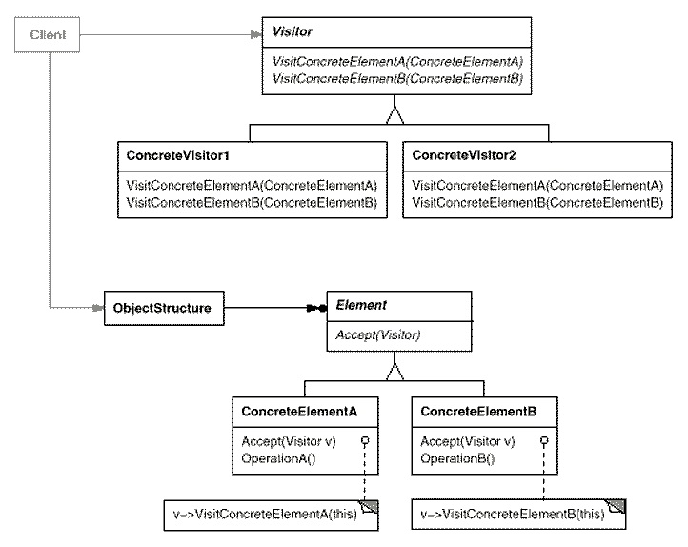
Passes each node seen to visitor
Actual visitor behaviour determined by templating
Walks through
structure

Slide 28
Visitor Pattern Advantages
  Separate what changes from what does not
    The parallel visitor class does this
  Classes open for extension; closed for modification
    The parallel visitor class achieves this
  Each class should have one responsibility
    Each visitor class is designed for one purpose
    The what to do code is centralised in the visitor class
      Not spread across all of the composite class members

Slide 29
Visitor Pattern Definition
Use the Visitor Design Pattern when you want to add capabilities to a composite of objects and encapsulation within these objects is not important, undesirable, or not possible.

Slide 30
Chain of Responsibility Design Pattern
Use the chain of responsibility design pattern when you want to give a sequence of objects in turn a chance to handle a request
Each object in chain delegates to next object in chain if it can’t handle request

Slide 31
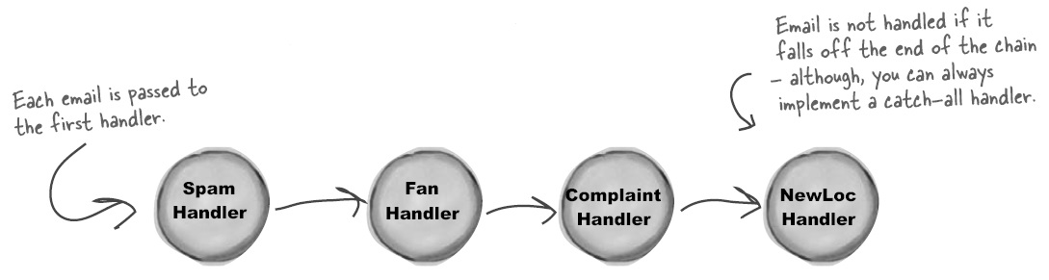
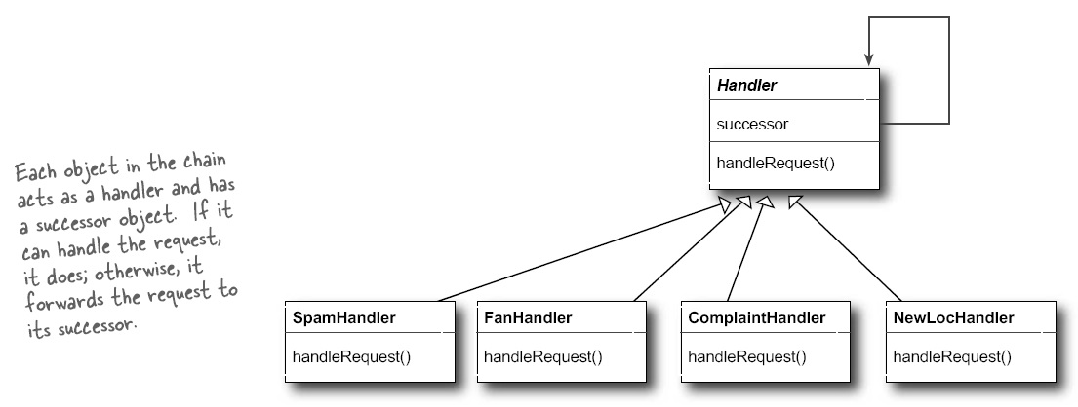

Slide 32
Advantages
Decouples a request from all of the things that might handle it
Allows the chain of things called to be changed at run time
Need a catch all if going to be certain a command is handled
But can be harder to debug

Slide 33
Interpreter Design Pattern
Convert a grammar into an Abstract Syntax Tree
Have the nodes in this tree be instances of classes
Have an interpret function in each node that computes the actions to be performed by the command
I.E. Construct and execute a plan

Slide 34
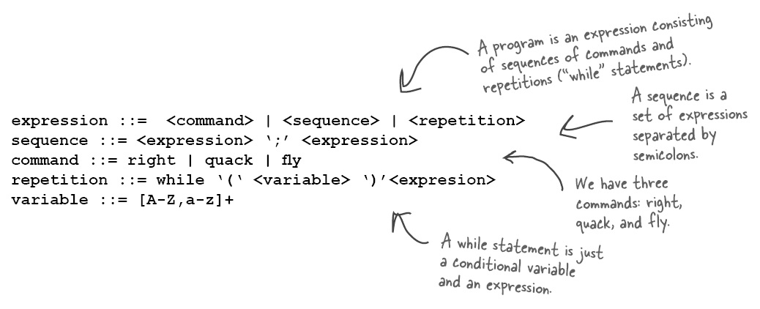

Slide 35
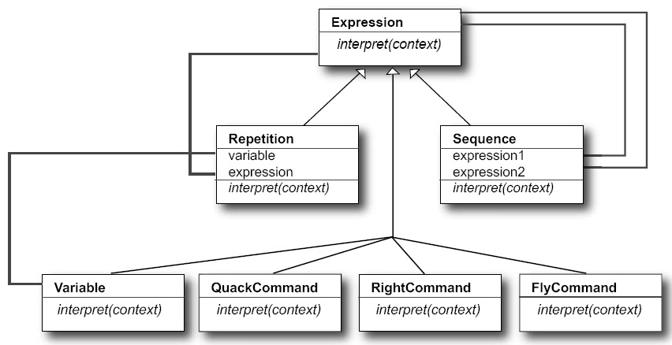

Slide 36
Interpreter Advantages
Easy to implement language from grammar
Can easily change/extend the language
Can extend plan using composite design pattern to do other things
  Eg. Dump plan

