Slide 1
Decorator Design Pattern
Objective: Want to add attributes to an object
Number of attribute to add is unspecified
One should be able to easily add newly defined attributes to code with minimal change
Don’t want a massive explosion in the number of subclasses employed

Slide 2
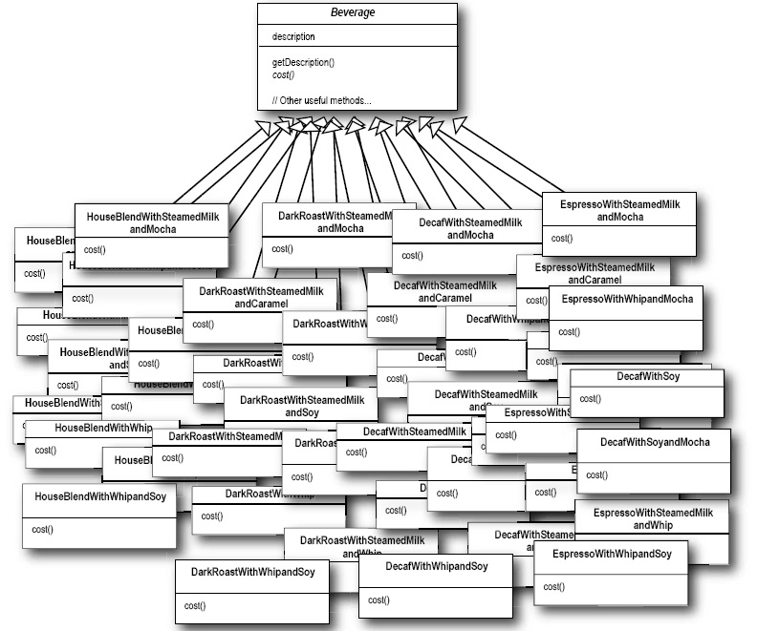
What a mess!!

Slide 3
Basic Idea
Reify (convert into or regard as a concrete thing) each attribute making it a fully fledged object
Treat the object and its attributes as a composite object using the composite design pattern
Extend the functionality for the object to operate on the tree instead of the node

Slide 4
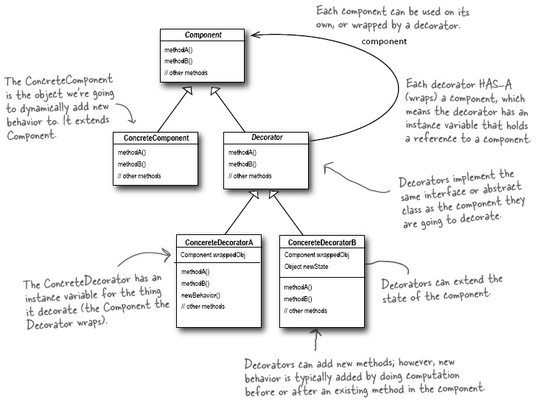

Slide 5
Advantages
Provides an alternative to sub classing
Decorators change behaviour of their component by adding functionality before, after or in place of method calls to their child/children.
A component can have any number of decorators
Decorators can add state to the thing decorated
Presence of decorators are typically transparent
Only have to change cost of cream cheese in the cream cheese decorator, no matter how used

Slide 6
Decorator Definition
A decorator attaches additional responsibilities to an object dynamically
A decorator provide a flexible alternative to sub classing for extending functionality
Caution: Decorators can result in many small objects in the design and overuse may be complicated and inefficient or somewhat limiting

Slide 7
Facade
Intent: “Provide a unified, higher-level, interface to a whole module making it easier to use.”
Motivation: Composing classes into subsystems reduces complexity. Using a Facade minimizes the communication dependencies between subsystems.
Applicability:
When you want a simple interface to a complex subsystem.
There are many dependencies between clients and a subsystem.
You want to layer your subsystems.

Slide 8
Facade Design Pattern
Provides a simplified interface to an otherwise difficult to use subsystem
Does not exclude direct access to the components of the subsystem
But makes life easier for the clients who have a canned set of actions they wish to always perform on the subsystem
Permits these clients to know nothing about the real subsystem

Slide 9
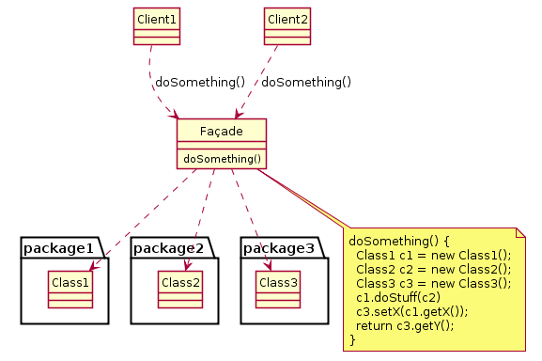
Facade
[en.wikipedia.org]

Slide 10
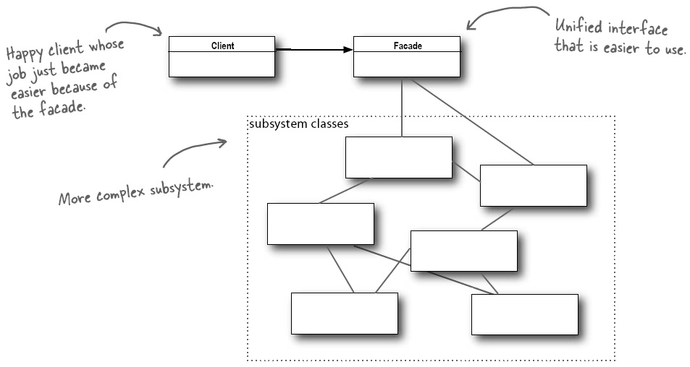
Components of the subsystem may remain open for direct usage
A subsystem may have many facades

Slide 11
Facade
Participants:
Facade
Subsystem classes
Collaborations:
Clients interact subsystem via Facade.
Consequences:
Shields clients from subsystem components.
Promotes weak coupling. (strong within subsystem, weak between them)
Does not prevent access to subsystem classes.

Slide 12
Adapter vs Facade
The main difference between two is their intent:
Adapter: Change an interface so it matches the one the client needs
Facade: Provide a client with a simplified interface to a subsystem

Slide 13
Flyweight Design Pattern
Have lots of the same objects but each with a small amount of differing state
Don’t want to have to allocate space for all these objects
Extract what changes from what does not
Client object contains the changing state
Invokes methods of flyweight providing state as parameter
Flyweight is stateless permitting sharing/reuse
State can be stored in array, on disk, in database

Slide 14
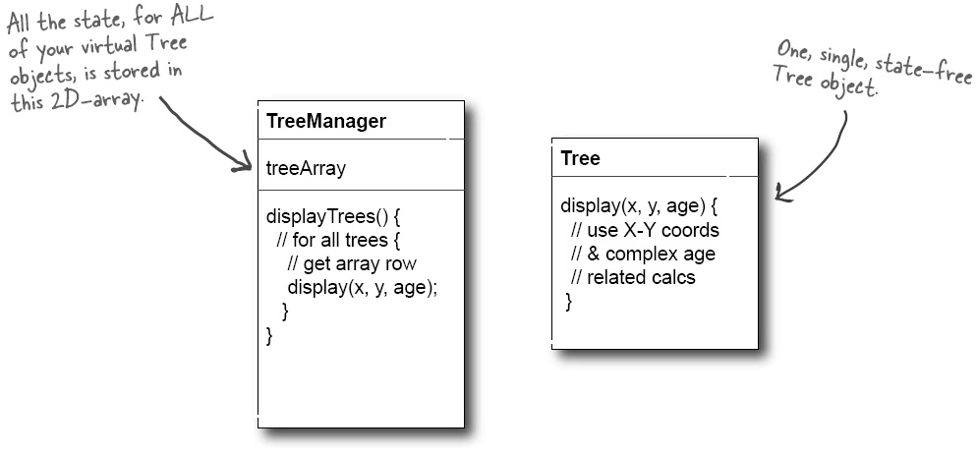

Slide 15
Front Controller Design Pattern
Route code through a common front end controller which handles task that must be performed on absolutely every access.
Eg. Security
Unmarshalling of web parameters
Deciding which script to be invoked
Logging of requests received
Load balancing ..

Slide 16
Advantages
Avoids having to repeat code in many places
But could alternatively put this code in procedures
Centralises routing and so isolates low level logic from the “what do I can next” question
A component should do one thing
Simplifies navigation issues
Reconfiguring order of page presentation easier
Can spawn thread for bulk of work
Can preserve Javascript state on client

Slide 17
Proxy Design Pattern
Provides a surrogate or placeholder for another object to control access to it.
Uses
Remote: transparent communication with object
Virtual: creates real object only when needed
Side effects while loading might include wait warning
Protection: refuses access unless permitted
Stub generation in RPC etc.

Slide 18
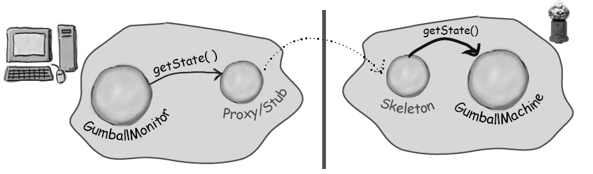
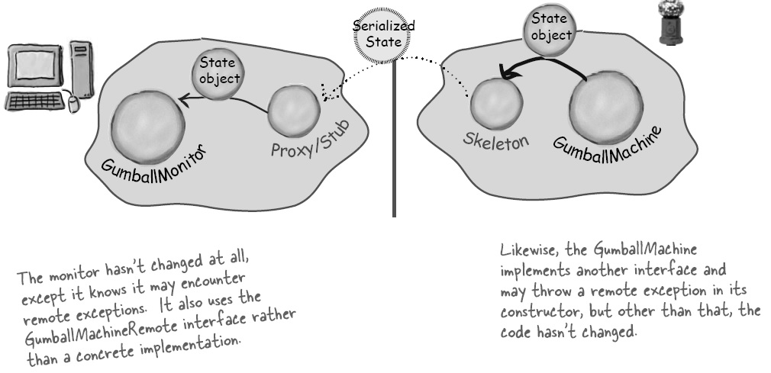

Slide 19
