Slide 1
Design Patterns
Spring 2017

Slide 2
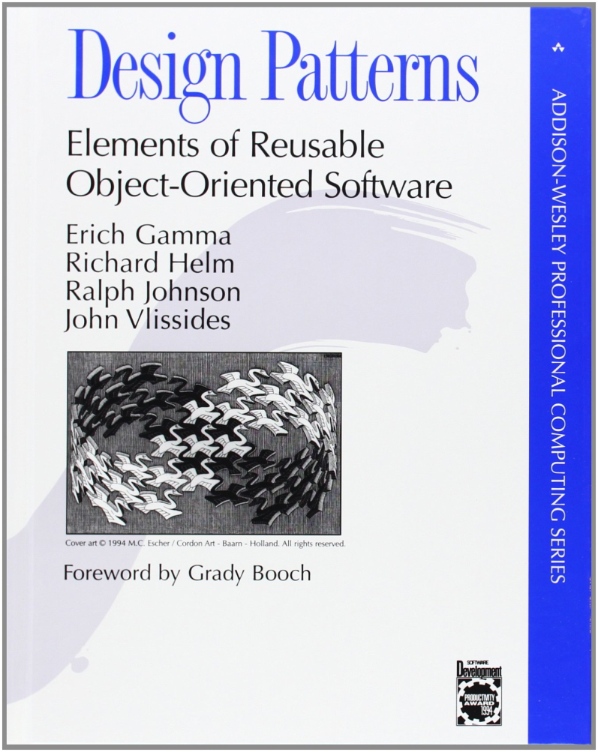
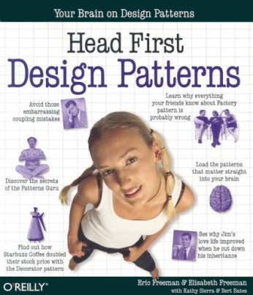
Useful books
The “Gang of Four” book
1994
Head First Design Patterns Book
2004

Slide 3
What you can do
A design pattern is a general solution to a common problem in a context.
What you want
What you have

Slide 4
Design Pattern Index
Creational | Structural | Behavioural
Factory Method | Adapter | Template
Abstract Factory | Bridge | Strategy
Builder | Composite | Command
Singleton | Decorator | State
Multiton | Facade | Visitor
Object pool | Flyweight | Chain of Responsibility
Prototype | Front controller | Interpreter
 | Proxy | Observer
 |  | Iterator
 |  | Mediator
 |  | Memento

Slide 5
Motivation
A cook knows a lot of recipes
They look up the ones they forget
Design patterns are recipes for programmers
How can you choice a good strategy
If you don’t know the range of available strategies
How can you talk about the choices
If they don’t have well understood names
Angel cake
Instruction: Fold don’t stir..
I used a food blender because it was there
My angel cake was afterwards remembered as a pancake

Slide 6
WARNING:
Overuse of design patterns can lead to code that is downright over-engineered.
Always go with the simplest solution that does the job and introduce patterns only where the need emerges.
[Head First Design Patterns]

Slide 7
Good design principles
Program to interfaces not to an implementation
Separate what changes from what does not
Encapsulate what varies behind an interface
Favor composition over inheritance
Loosely couple objects that interact
Classes should be open for extension, but closed for modification
Each class should have one responsibility
Depend on abstractions, not concrete classes

Slide 8
Good use of Design Pattern Principles
Let design patterns emerge from your design, don’t use them just because you should
Always choose the simplest solution that meets your need
Always use the pattern if it simplifies the solution
Know all the design patterns out there
Talk a pattern when that simplifies conversation

Slide 9
Creational Design Patterns

Slide 10
Factory Design Pattern Goals
Separate what changes from what does not
Encapsulate what varies behind an interface
Depend on abstractions, not concrete classes
Loosely couple objects that interact
Design should be open for extension but closed to modification

Slide 11
Problems with using new
So myClass = new MyClass(….) is bad..
It might be invoked from many places
It might be replaced by new MyBetterClass(…)
Many different subclasses might exist
Want to be able to decide the subclass at runtime
Want to create the correct subclass not old superclass
Without ugly code present everywhere
Want perhaps to pass around a tool to create whatever the tool is designed to create
May not know what to create until run time
May wish to identify classes by GUID’s, and register them

Slide 12
Factory Solution
Wrap code that creates objects inside a method
Interface = createMyClass(parameters)
We can change the class created now in one place
Parameter can identify what to create
Might make createMyClass static
Ie. static MyClass::createMyClass(…)
But this reassociates the creation with the class
If we want to pass method around put it in a factory object (clearer than pointer to method)

Slide 13
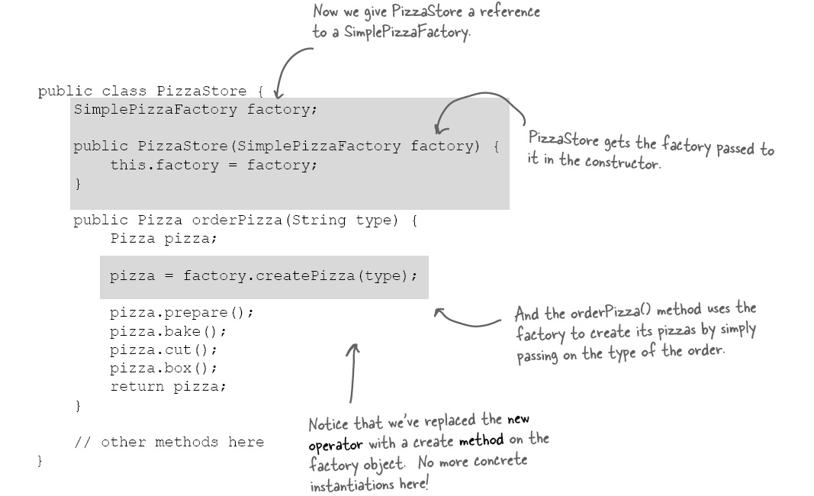

Slide 14
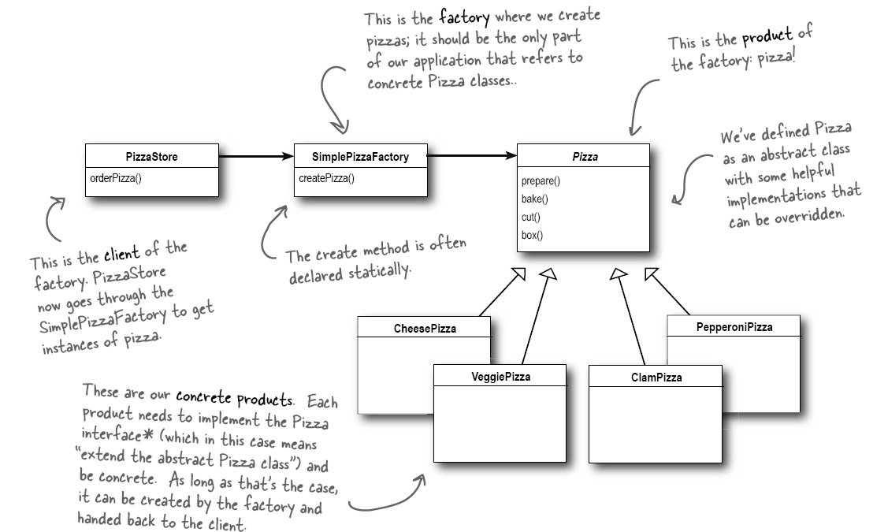

Slide 15
Advantages
Protects higher level code from ugly lower level detail such as which class should be created
Any change to the class created is made just once
We can make the objects to create dynamic
Simply pass a pointer to a factory object to the things that need to create the objects
Then the factory object becomes conceptually the instruction regarding what to create
We can override createMyClass in subclasses or use it in any other way we wish
(ie. Use with template design pattern described later)

Slide 16
Factory Pattern Definition
The Factory Method Pattern defines an interface for creating an object, but lets subclasses decide which class to instantiate.
Question: How should we delete objects created using a factory.
Should we have a matching deleteMyClass()
Should it make the pointer to the object null
Or should we use reference counting??

Slide 17
Abstract Factory Pattern
Suppose we have a factory that can be told what objects to create from a choice of all within a framework
Then we can create a new factory with the same “abstract” interfaces to create the same objects but from a very different framework
Deciding which framework to use then becomes deciding which concrete instantiation of an abstract factory class to use

Slide 18
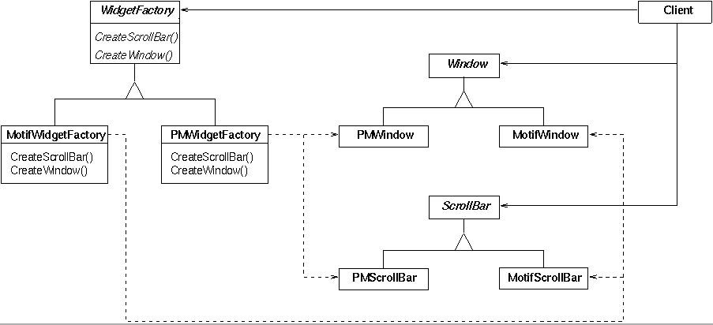

Slide 19
Advantages
Protects us from creating components from many frameworks that can’t talk to each other
Makes it easy to decide at run time which framework we want to use
The framework chosen is transparent to all higher level code
Makes it easier to add new frameworks if we have need to do so

Slide 20
Example
Domino’s pizza’s are flat
Pizza Hut’s pizza’s are deep dish pizza’s
Both offer a variety of subclasses of pizzas
If we create an abstract factory
Subclass a Domino’s pizza factory
Subclass a Pizza Hut’s pizza factory
We won’t need to create a pizza store for each
Just give each pizza store a different factory
Adding support for New York Pizza
Piece of cake (pizza)

Slide 21
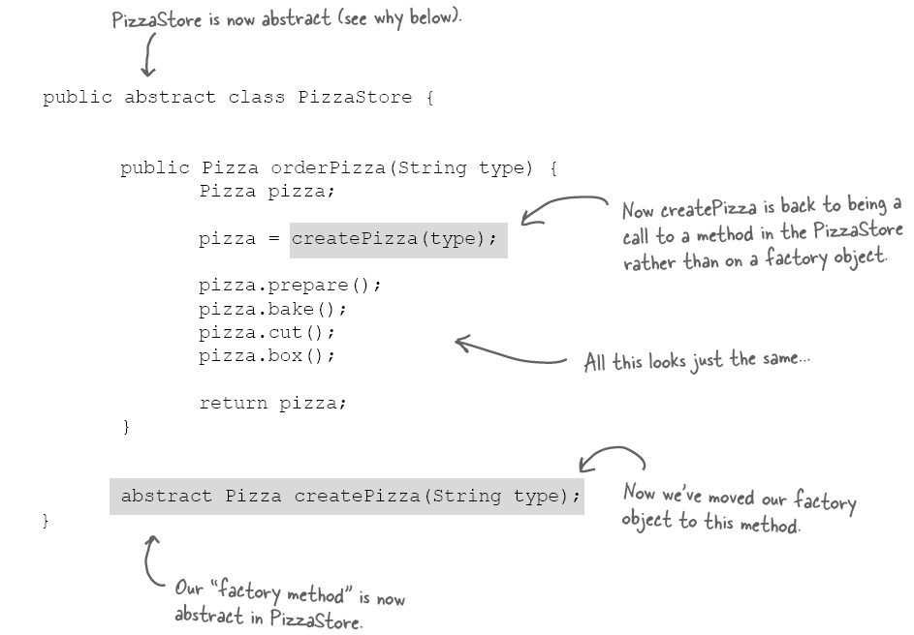
This is employing the template design pattern (described later)

Slide 22
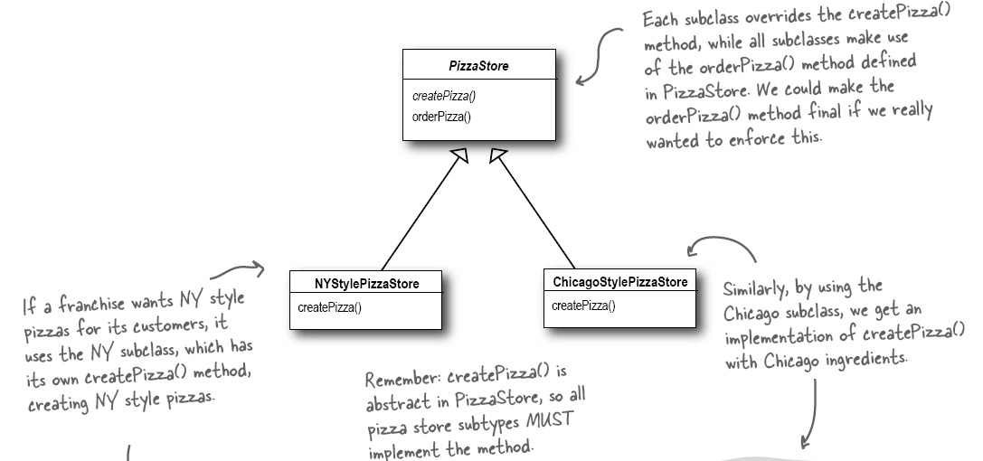
This is the template approach
Can also pass factory to pizzastore
Save it internally
This is the strategy design pattern

Slide 23
Abstract Factory Definition
The Abstract Factory Pattern provides an interface for creating families of related or dependent objects without specifying their concrete classes

Slide 24
Builder Design Pattern
Want to construct a complex object built from many component objects
Want to say what must be constructed
But don’t want to expose the details of how the object is composed from its components
Use a builder object that keeps track of the object being built and allows construction to be performed via method calls in the builder

Slide 25
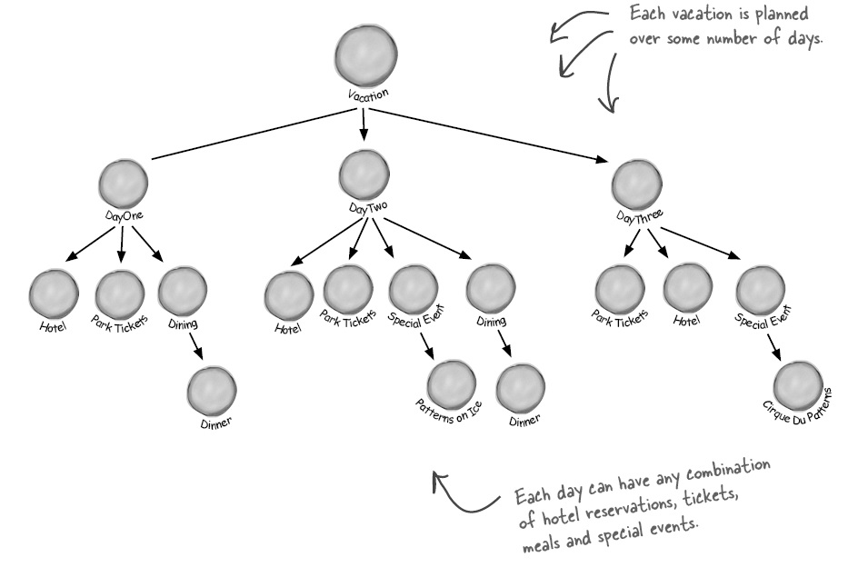

Slide 26
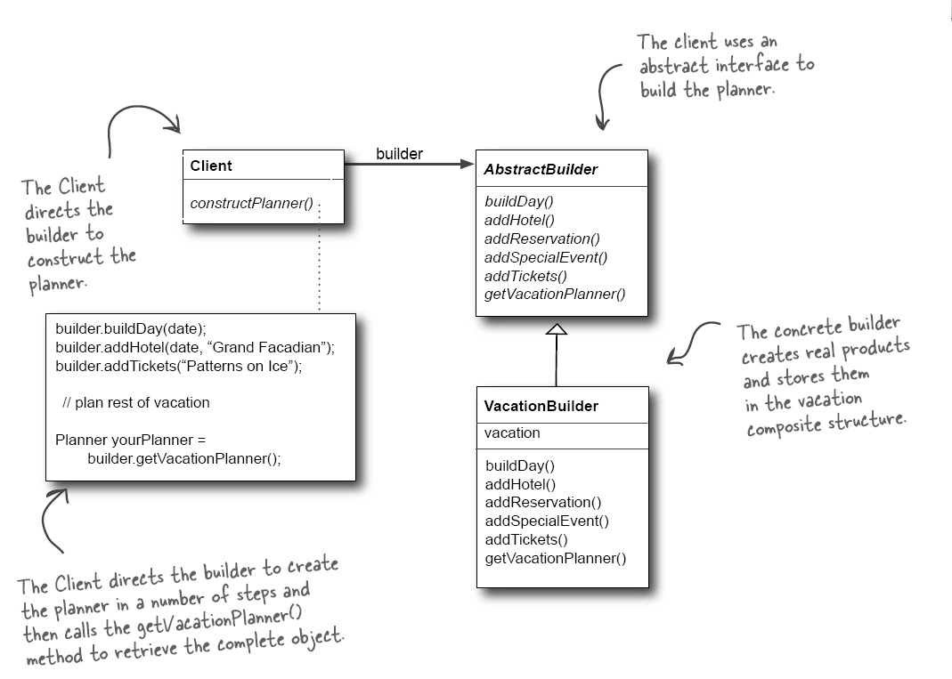

Slide 27
Advantage
Programming to an interface
Objects built according to actions, not code
The composite objects are be constructed differently within the builder transparently
Additional useful structures such as indices, hashing etc. can be implemented as needed inside the builder
But extra layer of indirection

Slide 28
Builder Definition
The Builder Pattern encapsulates the construction of a product and allows it to be constructed as a sequence of steps.

Slide 29
Singleton Design Pattern
Ensure there is only one instance of an object
Ensures that global objects are not misused
Use a factory to construct it
Have the factory return it if already constructed
Make the constructor(s) private to the class
Put the factory method in the class
Be careful to ensure logic is thread safe

Slide 30
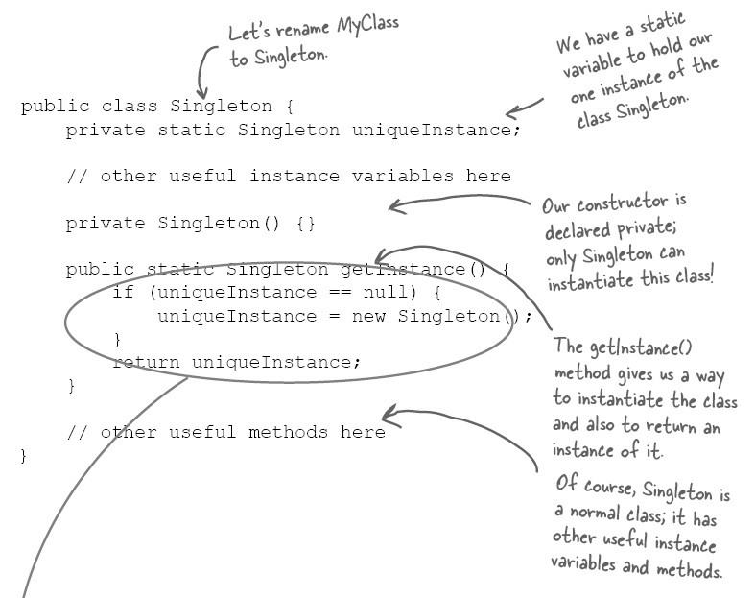
= null;

Slide 31
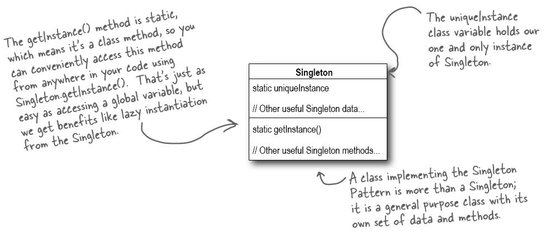
The constructor is private so it can’t be invoked directly from outside of the class

Slide 32
Singleton Definition
The Singleton Pattern ensures that a class has only one instance, and provides a global point of access to it
Need to ensure that the assignment of the single instance to a static variable (as well as other operations) are thread safe if might be using singleton in multiple threads
Question: how might a singleton object be deleted

Slide 33
Multiton Pattern
Generalisation of the Singleton Design Pattern
Creates a singleton object associated with a given key
Enforces a one-to-one mapping between keys and the object (if present) associated with that key

Slide 34
Object Pool Design Pattern
Consider implementing if you have a lot of objects of the same type being constantly created and deleted
Factory maintains a list of constructed but now release objects
Creation involves returning an object from the pool if it exists else creating a new object
Deletion involves adding deleted object to the pool for later reuse

Slide 35
Advantages
Malloc/new are expensive operations
Dramatically reducing the need to create memory can produce significant performance improvement
Can return elements of a large array instead of creating each element independently
Can also manage the maximum number of objects of a type created more easily and potentially transparently
Can potentially control number of threads created

Slide 36
Prototype
A collection of proto-typical instantiations of a class exist
To create a new instance of one of these classes the class is cloned from its prototype
Or if the class has no state it can simply be reused in many places (see: flyweight pattern)

Slide 37
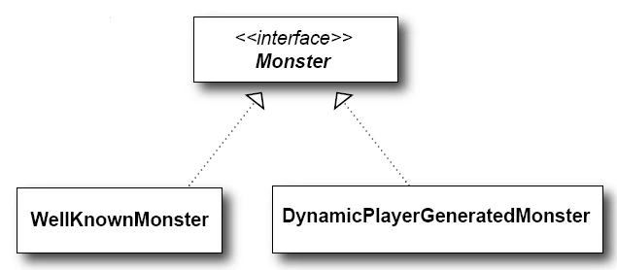
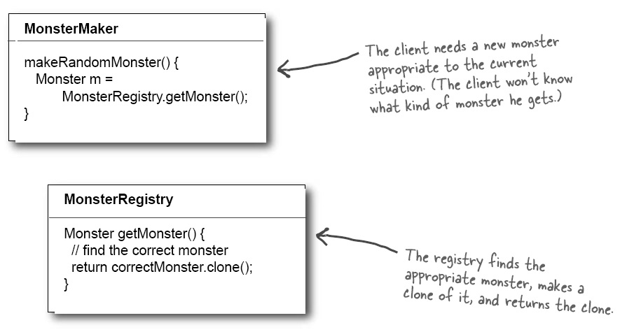

Slide 38
Advantages
How an instance of a class is to be created is fully determined by referring to an example
This might simplify the construction of a very complex object
New prototypes can be added to the list
Afterwards easy to create copies of these
Users may choose the prototype they want
Can visually show the choices easily
But copying an object can also be complicated

Slide 39
Structural Design Patterns

Slide 40

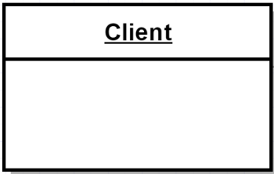
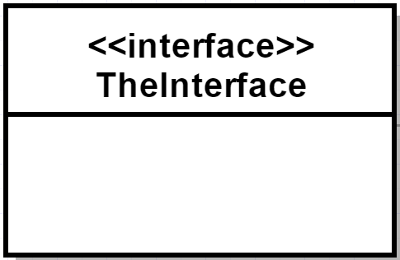
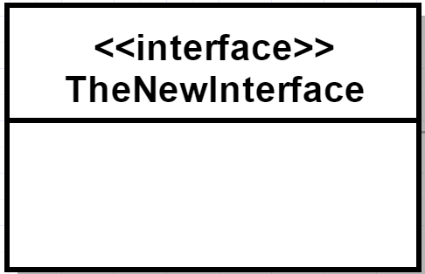

Adapter
uses
uses wants to use

Slide 41
Adapter
Intent: “Convert the interface of one class to make it compatible with another class.”
Motivation: Components often have incompatible interfaces that cannot be used by a client but also cannot be modified.
Applicability:
When an intermediate representation between one component and another is required
When you want to isolate a client from changes in an external component’s interface

Slide 42
Adapter
Two kinds of adapters:
Object adapters (use composition)
Class adapters (use multiple inheritance)

Slide 43
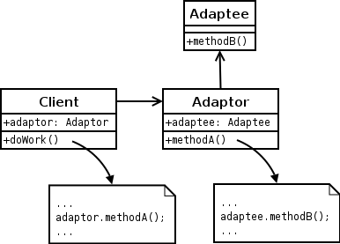
Object Adapter
[en.wikipedia.org]

Slide 44
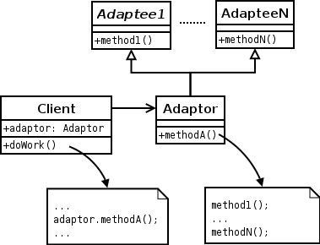
Class Adapter
[en.wikipedia.org]

Slide 45
Adapter
Participants:
Client: Calls the adapter; is completely isolated from the adaptee.
Adapter: Forwards calls between client and adapter. The adapter may have to interact with multiple classes.
Adaptee: A component being adapted.

Slide 46
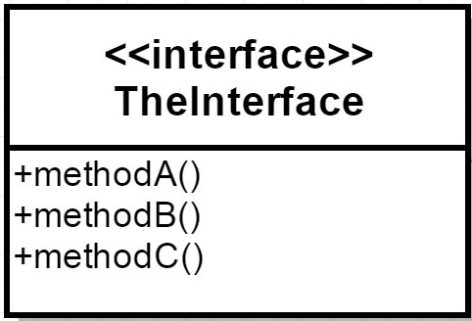
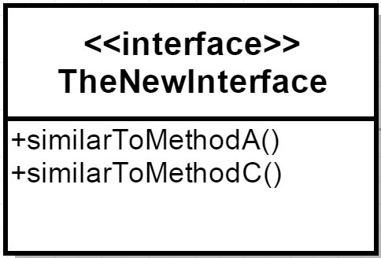
Adapter
There might be no exact match between old and new interfaces:
Clients have to watch for potential exceptions

Slide 47
Bridge Design Pattern
Separates abstraction from its implementation
The abstraction can be very different from the implementation
The abstraction uses code to “bridge” the differences
Replaces is-a inheritance / implementation relationship with has-as composition relationship
Essentially a wrapper hiding implementation
Useful when the implementation might be selectable or switchable at run time

Slide 48
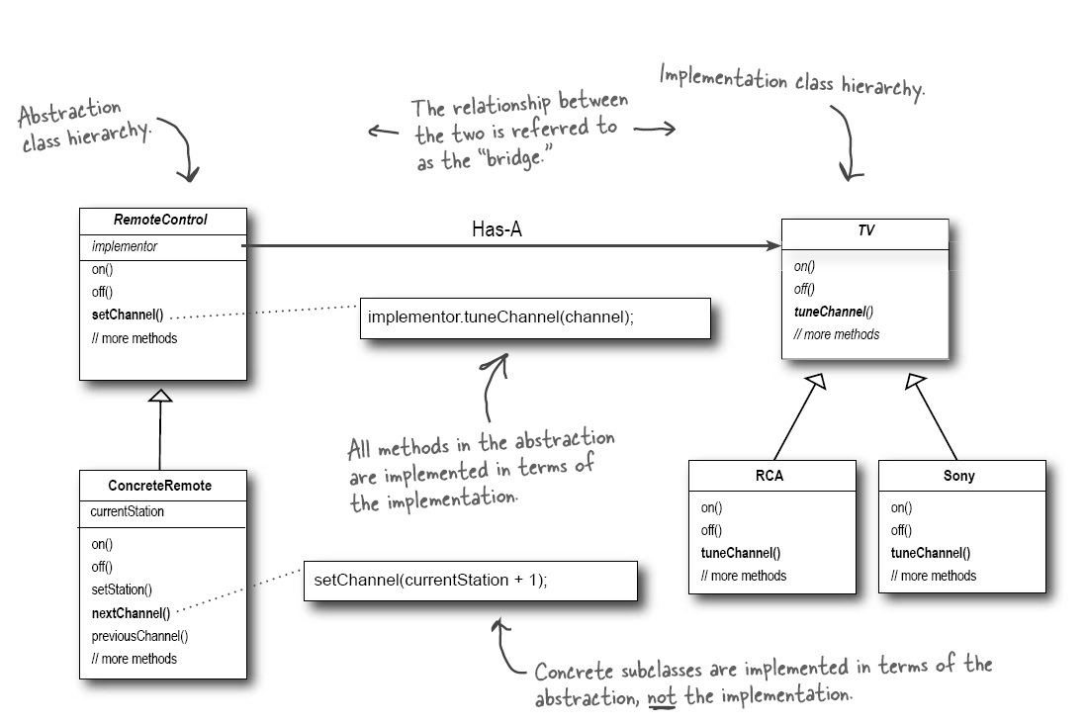
One usage of strategy design pattern

Slide 49
Composite Design Pattern
Given a hierarchy implement the same interface on every member of this hierarchy even if members differ
Subclass from this common functionality
Do not distinguish between actions on a leaf and actions on a subtree
Eg . Move location of leaf / subtree
Traverse all nodes in/under node
Print tree

Slide 50
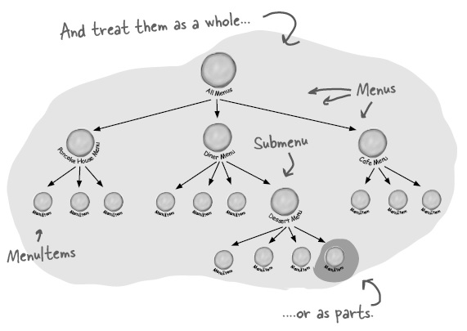
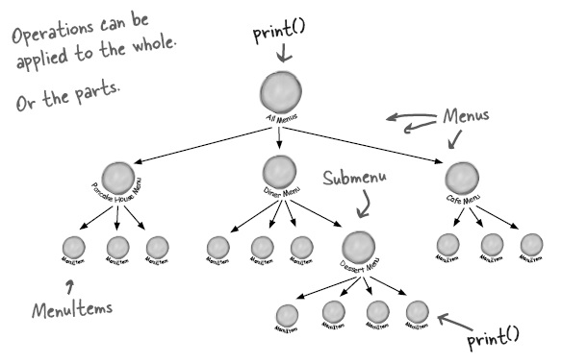

Slide 51
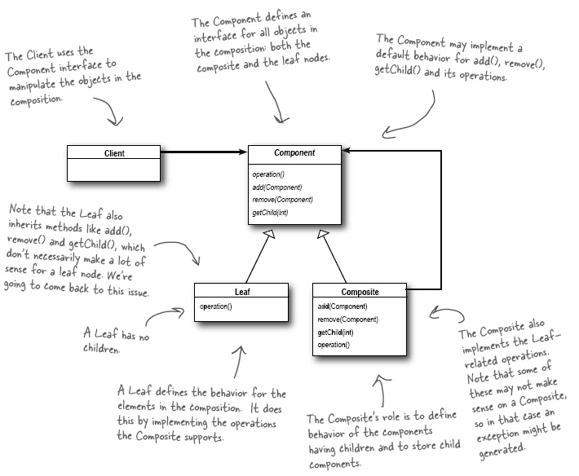

Slide 52
Composite Definition
The Composite Pattern allows you to compose objects into tree structures to represent part-whole hierarchies.
Composite lets client treat individual objects and composition of objects uniformly, irrespective of how the objects within the hierarchy differ.

