Slide 1
SW-Store: a vertically partitioned DBMS for Semantic Web data Management
Daniel J. Abadi, Adam Marcus, Samuel R. Madden, and Kate Hollenbach. 2009. The VLDB Journal.
Presented By:
Sanam Narula

Slide 2
Agenda
Introduction
Current State Of Art
A simple Alternative
SW Store Design
Benchmarks and Results

Slide 3
Introduction
SW-Store is a new DBMS based on the approach of column oriented DBMS.
SW-Store is able to achieve high performance in RDF data management.
It is an extension of column based DBMS.

Slide 4
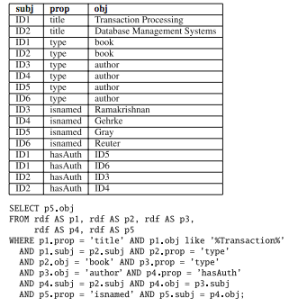
Current State Of Art
Efficient storage mechanism for RDF triples
Find all authors of books whose
title has the word “Transaction”.
5 way self join.
Query will also be very slow
to execute as the size will increase

Slide 5
Current State of Art
Two Approaches to implement property Tables:
1. A data clustering approach:
Denormalize RDF tables by storing them in a wider, flattened
representation.
2. Property Class Table:
It exploits the type property of subjects to cluster similar sets of subjects together in same table.

Slide 6
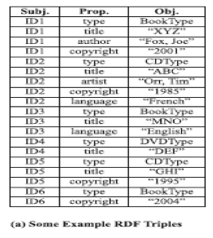
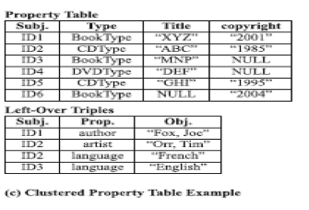
Data Clustering Approach

Slide 7
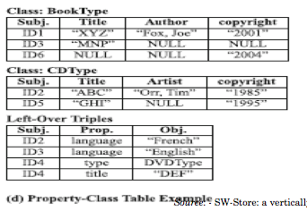
Property Class table
It exploits Type property of subjects
to cluster tables.

Slide 8
Advantages & Disadvantages
Advantages :
It improves performance by reducing number of self joins.
Opens up possibility of attribute typing.
Less Number of Null values
Disadvantages:
Increase the complexity by requiring property clustering.
Multi-valued Attributes
Although less but still Null values are present.

Slide 9
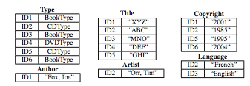
A Simple Alternative
Approach :
A fully Decomposed Storage Model
The triples table is rewritten into n two column tables.
Each table is sorted by subject so that fast merge join
can take place.

Slide 10
Analysis of this approach
Effective handling of multivalued attributes
Support for heterogeneous records.
Only property tables required by a query needs to be read
No clustering algorithms
Fewer unions
Increased number of joins.
Slow Inserts

Slide 11
Extending a column Oriented DBMS
The Ideas is to store tables as collections of columns rather than collection of rows.
Projection occurs for free – only those columns relevant to a query need to be read in memory.
Record header is stored in separate columns thus reducing the tuple width and letting us choose different compression techniques for each column.

Slide 12
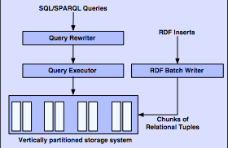
SW-Store Design
Input : RDF data in the form of triples <subject, property, object>
Output : Efficient storage system for RDF data.
Objective : Improve the query performance for complex real world queries.

Slide 13
Components
SW-Store basically consists of four major components :
A vertically partitioned storage system
A relational Query Engine.
A Query Rewriter that converts the queries.
A Batch Writer

Slide 14
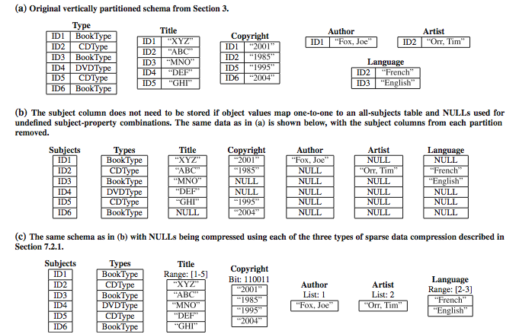
Data Representation
Objective : Improve the query performance for complex real world queries.

Slide 15
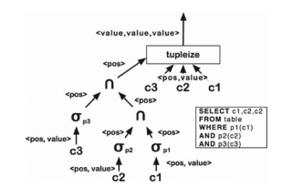
Query Engine and Query Translation
Each column scanned to produce tuples that satisfies all three predicates
Tupleize operator becomes merge join over two column vertical partitions

Slide 16
Overflow Table
A mechanism to support inserts in a batch.
Additional table in the standard triples schema
Not indexed or read optimized
Properties that appear very small number of times in overflow table are not merged due to cost of merging.
Horizontal “chunks” to improve the efficiency of merging
Queries must go to both overflow table and vertical partitions
Merge operation is still needed.

Slide 17
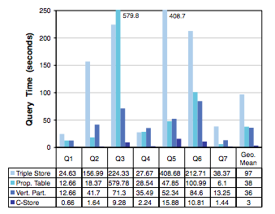
Benchmark and Results

Slide 18
Benchmark and Results
Property table and vertical partitioning outperforms triple store by a factor of 2-3.
C-Store adds another factor of 10 performance improvement
For Property table, careful selection of column names are required.
Vertical partitioning represents the best case and worst case scenario.
Linear scaling for all tested queries

Slide 19
References
http://www-users.cs.umn.edu/~smithal/
spatial databases CSCI 8715

Slide 20
Thanks

