Slide 1
“success Will come and go, but integrity is forever”
Amanda McKenzie
http://www.forbes.com/sites/amyanderson/2012/11/28/success-will-come-and-go-but-integrity-is-forever/#239f34ac6141

Slide 2
Integrity Defined
“The quality of being honest and having strong moral principles”
(Cambridge Dictionaries: http://dictionary.cambridge.org/dictionary/american-english/integrity)

Slide 3
Acting with integrity means:
  Being HONEST
  Having and giving RESPECT
  Taking RESPONSIBILITY for your actions
  Being FAIR
  Building TRUST

Slide 4


Slide 5


Slide 6
Integrity Matters everywhere
Academics
Athletics
Research Assistant, TA’s
Post-graduation employment

Slide 7
Get to Know the Rules Here
Policy 71
Sets out expectations
Lists various offences
Explains the disciplinary process
Describes potential penalties

Slide 8
What you need to Know
Do not plagiarize
Do not work together without permission from your instructor
Do not cheat
Do not make up data
Do not alter documents, grades, images etc.

Slide 9

Plagiarism
Pretending that someone else’s work, ideas, or words are your own.
When researching for an assignment,
make sure to cite the source
of any research that you use.
That means giving credit to
the original thinker!
Source: Mark Airs/iStockphoto

Slide 10
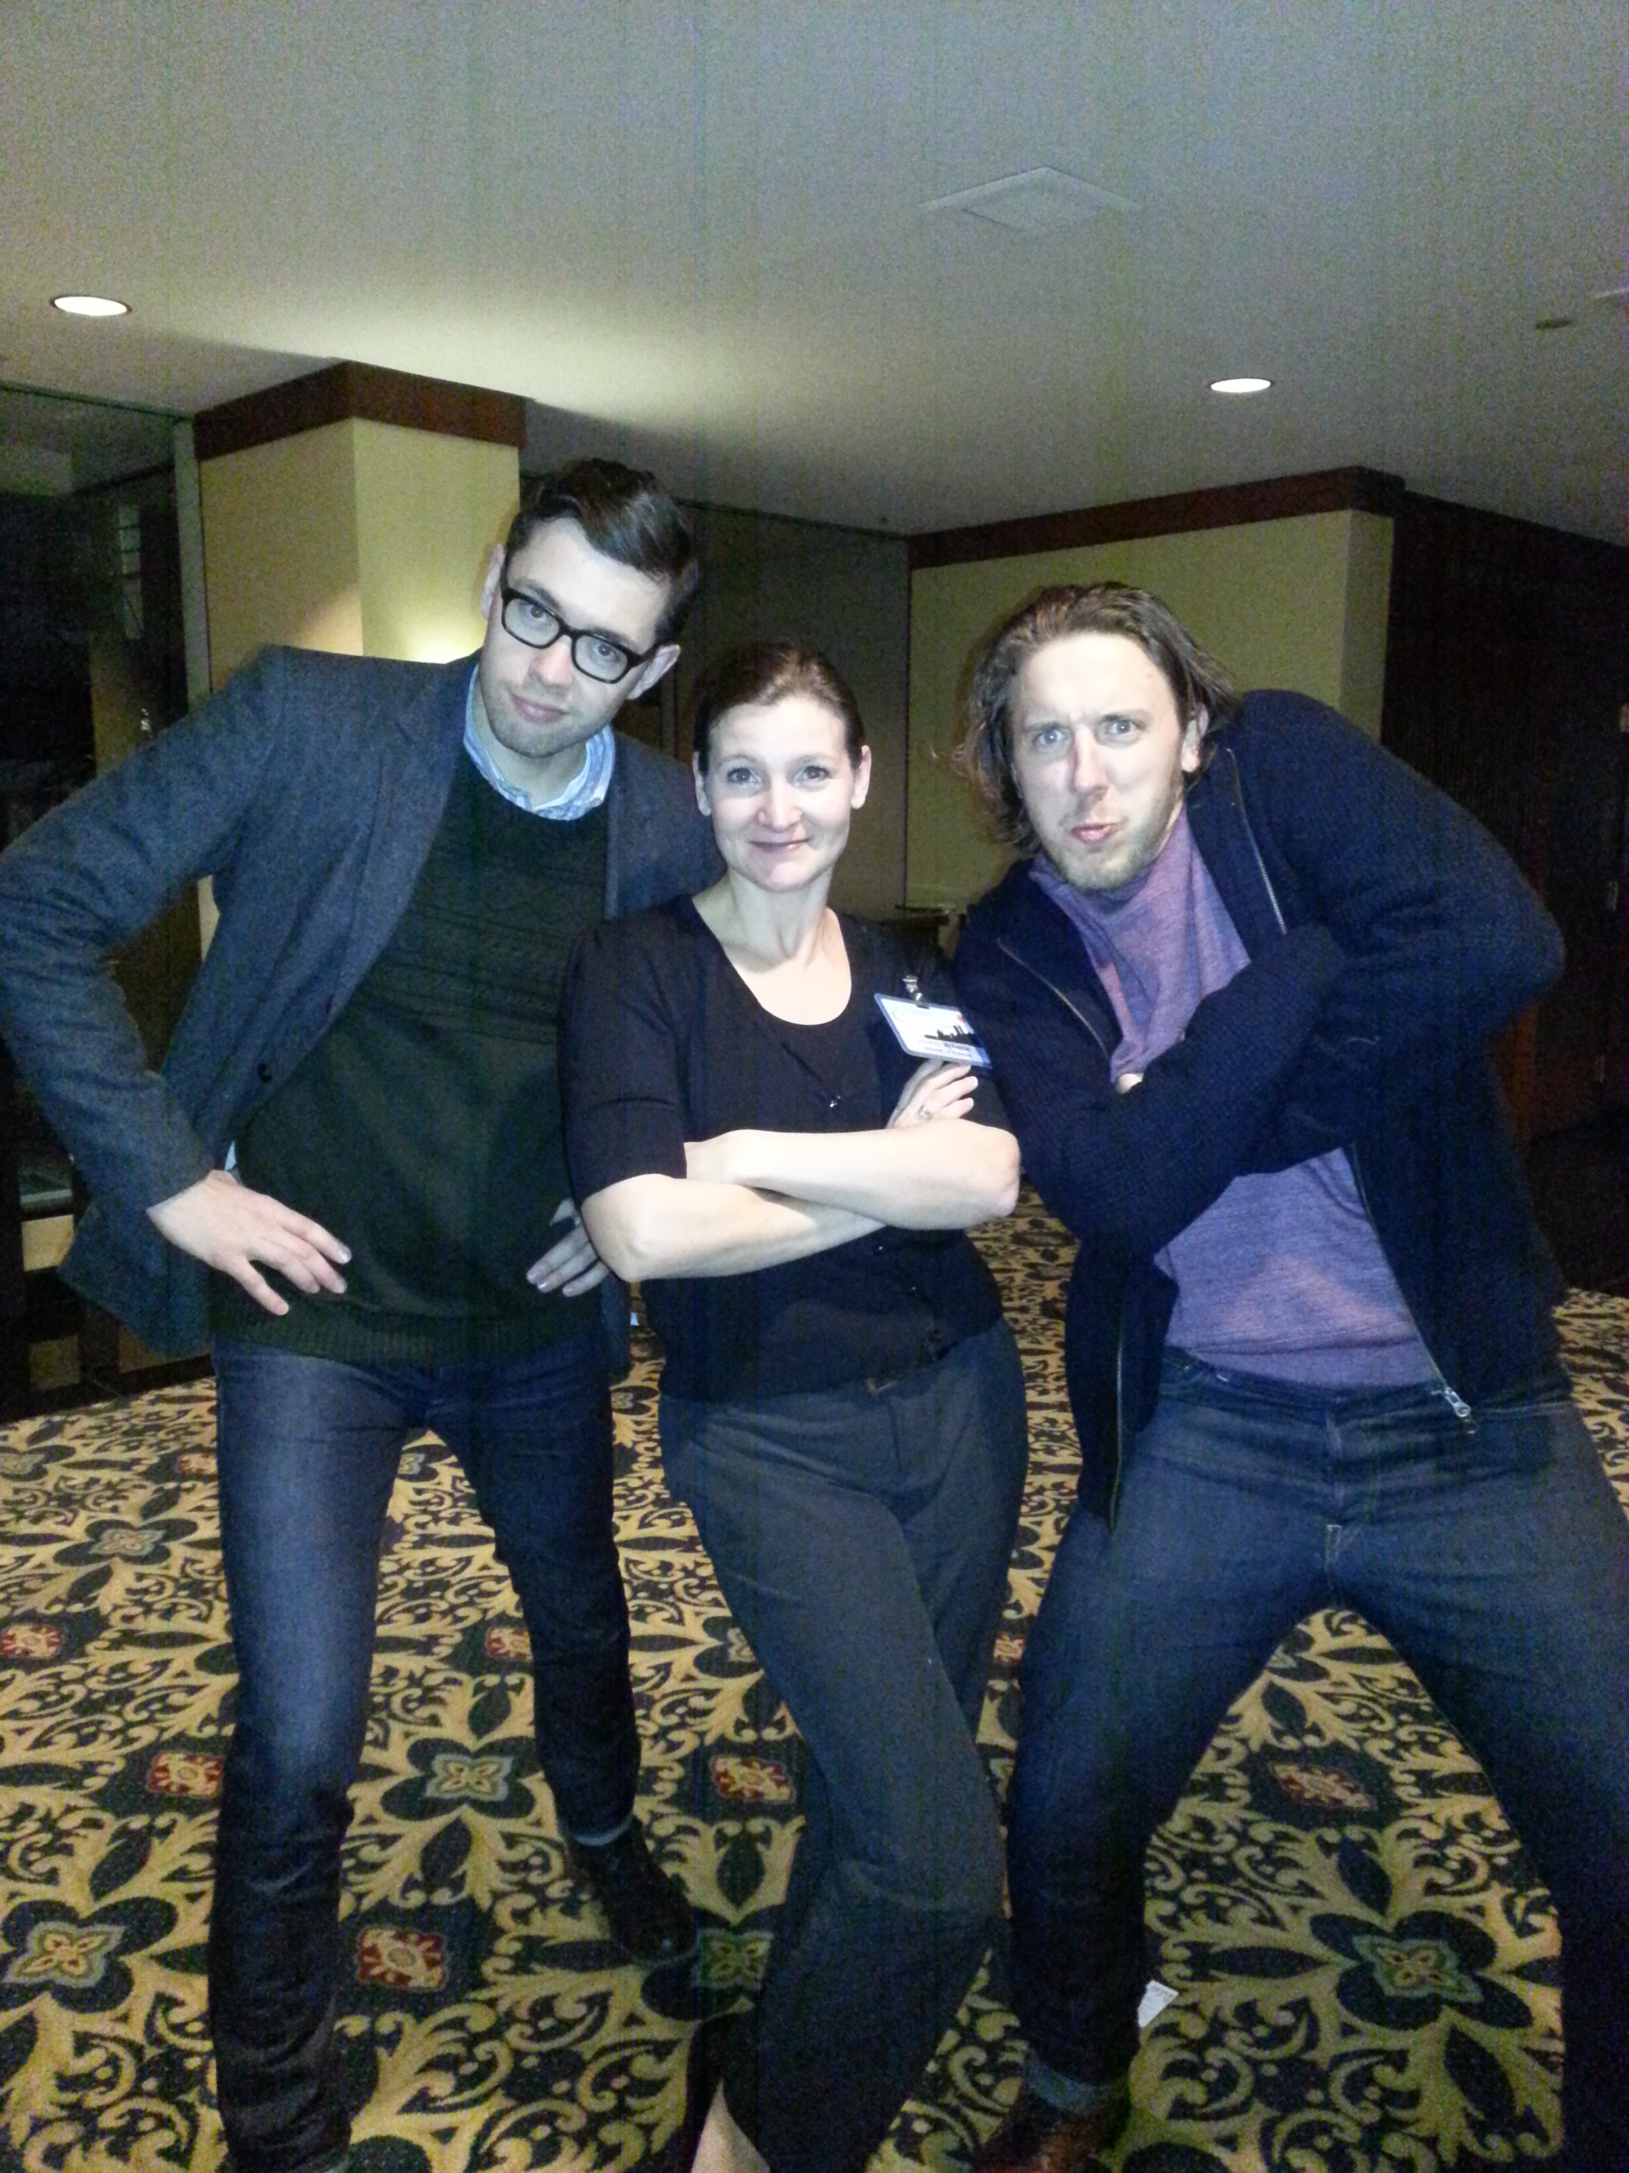

Slide 11
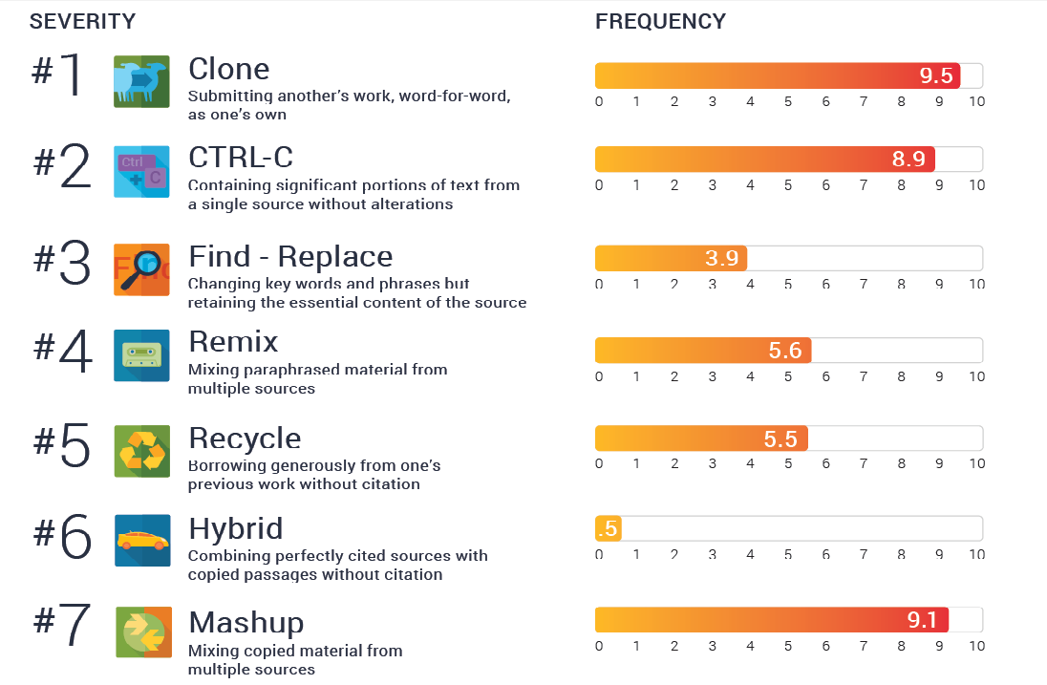

Slide 12
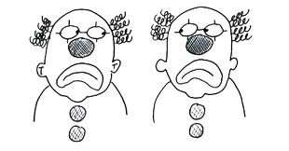
#1 CLONE

Slide 13
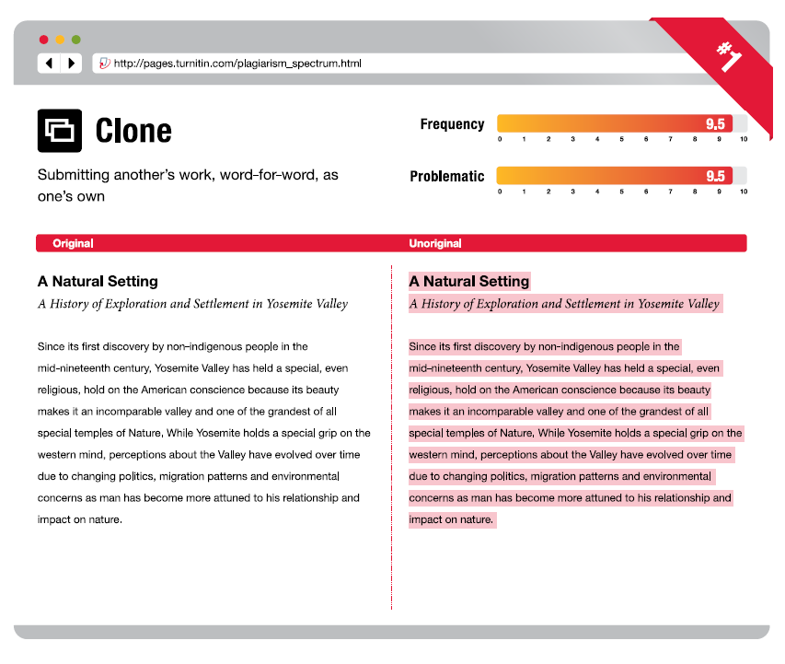

Slide 14
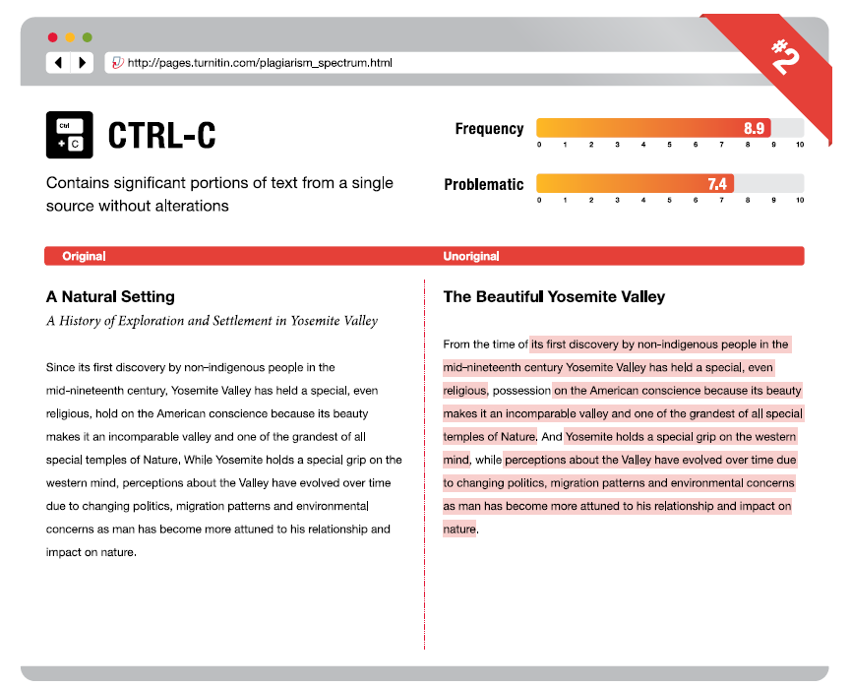
#2 CTRL-C

Slide 15
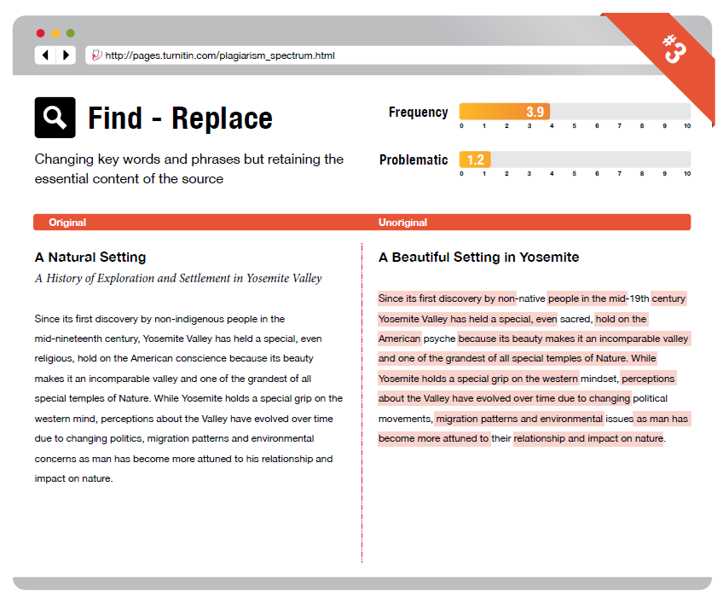
#3 Find - Replace

Slide 16
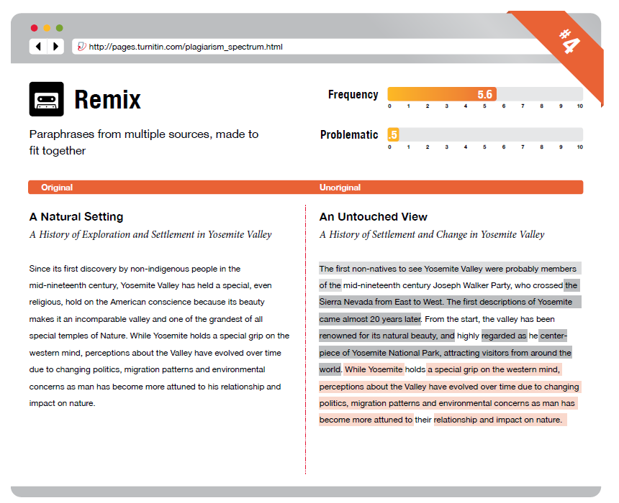
#4 Remix

Slide 17
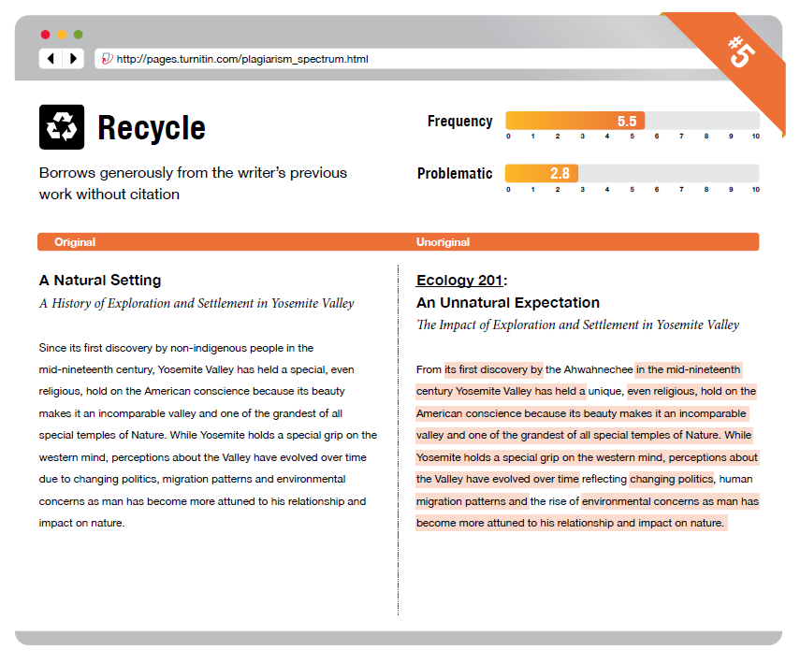
#5 recycle

Slide 18
Avoid plagiarizing
  Cite where you found ideas, words, images, code, etc.
  If you summarize an idea, you still have to cite it!
  Take detailed notes when you do research
  Take workshops, ask questions, and use Waterloo’s resources!

Slide 19

Working together without Permission is
Sharing work with other students when the instructor said to work alone
Getting too much help
from tutors or editors
If you don’t know the
Content – don’t hand it in!
Source: wesleyowns, zazzle.ca

Slide 20
How to avoid troubles with Group work
Always work alone ,unless your instructor specifically asks for group work
Don’t use a tutor’s answers - a tutor should only help you with concepts
Editors or friends should not rewrite your work & don’t write work for anyone else

Slide 21

Cheating
Doing anything that gives you an unfair advantage over others.
A student is most likely to cheat if he/she is feeling stressed.
Getting good marks isn’t
as important as working
hard and making the
right decisions!
Source: http://witzzer.com/jun30-1/
Source: www.isleyunruh.com

Slide 22
Avoid Being tempted to cheat by:
  Talking to your instructor if you are overwhelmed - Don’t wait until the deadline or exam date!
Stay healthy, and leave plenty of time to complete your assignments
Carefully follow instructions on assignments and tests, and ask questions!

Slide 23
Making Stuff Up
Making up research or altering results to make sure it fits your assignment is WRONG!
It can be frustrating if you can’t find the right research, or your results are different than expected.
But don’t make up research or cite something that doesn’t exist!

Slide 24
Don’t Be tempted to make stuff up:
Talk to your instructor if you need help. Never edit images, numbers or text without permission
Don’t try to create “the perfect result”
If you are having trouble finding research material, ask your instructor or a Liaison Librarian for assistance

Slide 25
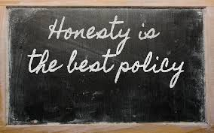
Don’t Alter reality
Official documents (e.g. transcripts, degrees, Verification of Illness form)
When doing assignments or taking tests
When applying or interviewing for a job
Source: www.fergusonvalues.com

Slide 26
Avoid ISSUES by:
Being truthful!
Do not complete assignments or take tests for someone else
Do not make up marks, skills, experiences, or other information
Leave plenty of time to get the right information (e.g. transcripts, reference letters etc.)

Slide 27
Remember to …
Plan ahead – give yourself enough time
Take good notes, be thorough and don’t rush
Give credit to others when using their work
Show your instructors what you know
Do your own work
Don’t copy or share answers or exams
You only get out what you put in!

Slide 28
Unsure??? It’s okay to ask!
Your instructor is the best place to start.
You can also speak to your:
Supervisor
Liaison librarian
or The Writing Centre
Notes:
To add a photo to this slide, click the Picture icon in the content area (first column of icons, second row). Navigate to the photo you would like to insert. PowerPoint will auto-resize the photo to fit the area. If you are unhappy with the results, you can either:
Manually resize your photo to 6.4” high x 10” wide using an image editor. Then, insert it via Home>Insert>Picture.
Insert your picture as-is via Home>Insert>Picture. Then, select your photo and choose Format. Resize and crop your photo using the editing tools in PowerPoint.

Slide 29


